Slide 1
King County Metro: Value Driven, Data Informed, and Customer Focused
April 2021

Slide 2
Please note:
All data in this presentation is for example only.
Most charts you will see contain replica data and do not represent the actual King County Metro metrics or measures.

Slide 3
PERFORMANCE METRICS Tiers
Tier V
King County
Department of Public Health
Metro Transit Department
Department of Executive Services
Etc
Tier IV
Metro Department
Ridership
Labor Hours
Capital Budget
Etc
Tier III
Divisions
Bus Operations
Vehicle Maintenance
Transit Facilities
Marine, Rail, Etc.

Slide 4
MTD Power BI structure
Public
Metro Rider Dashboard
Strategic Plan Dashboard
Tier IV
MTD Dept
Tier IV Board
Dept MBR Board
COVID-19
Focus Boards
Tier III
Metro Pulse
(MBR 3.0 Internal)
Equity
Category Board
Safety
Category Board
Sustainability
Category Board
Performance
Category Board
People
Category Board
Financials
Category Board
Division Boards
Bus Ops
TFD
VM
Rail
Marine
Mobility
Capital
F&A
Emp Services
Safety & Security

Slide 5
Public Facing DASHBOARDS

Slide 6
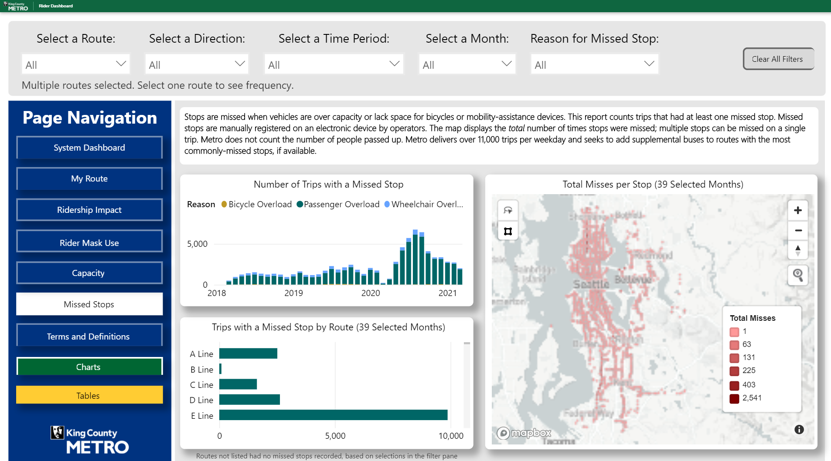
The DASH – Public Facing RIDER DASHBOARD
https://www.kingcounty.gov/thedash

Slide 7
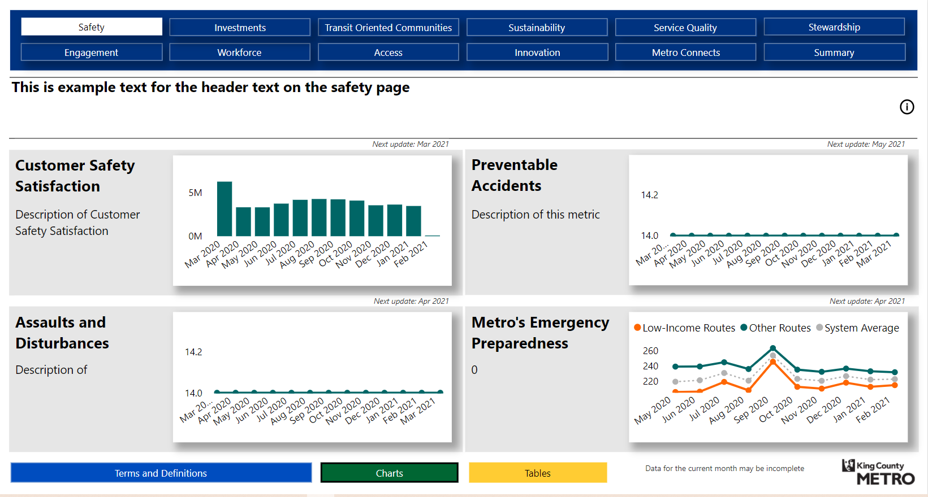
In Development – Strategic Plan DASHBOARD

Slide 8
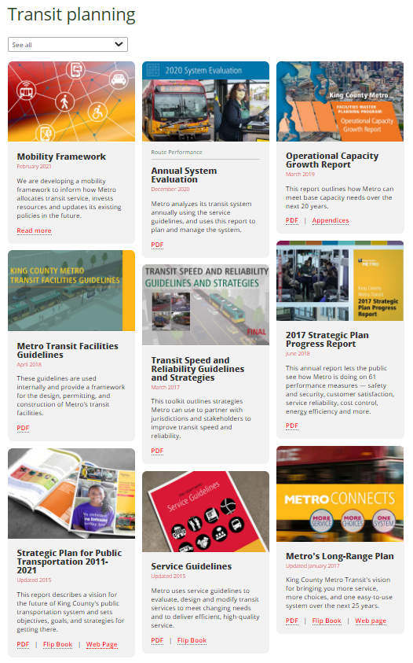
METRO POLICES
Strategic Plan
Metro Connects
SERVICE GUIDELINES
https://kingcounty.gov/depts/transportation/metro/about/planning.aspx

Slide 9
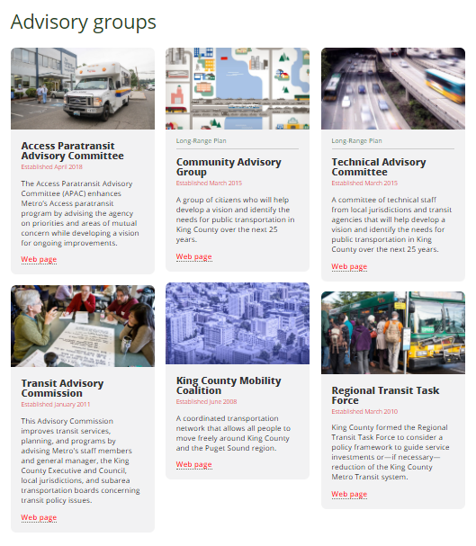
Policy Input
Regional Transit Committee
https://www.kingcounty.gov/council/committees/regional_transit.aspx The Regional Transit Committee reviews and makes recommendations to the King County Council on countywide policies and plans for public transportation services operated by the County. The committee’s responsibilities include the Strategic Plan for Public Transportation, which sets objectives, goals and strategies for King County Metro; the King County Metro Service Guidelines, the blueprint for allocation of transit service and measuring performance; and the METRO CONNECTS long-range plan.
Equity Cabinet
https://kingcountymetro.blog/2019/11/01/metro-takes-action-to-address-racial-disparities-and-the-climate-crisis-with-bold-direction-from-community/
COMMUNITY ADVISORY GROUPS
https://kingcounty.gov/depts/transportation/metro/about/planning.aspx

Slide 10
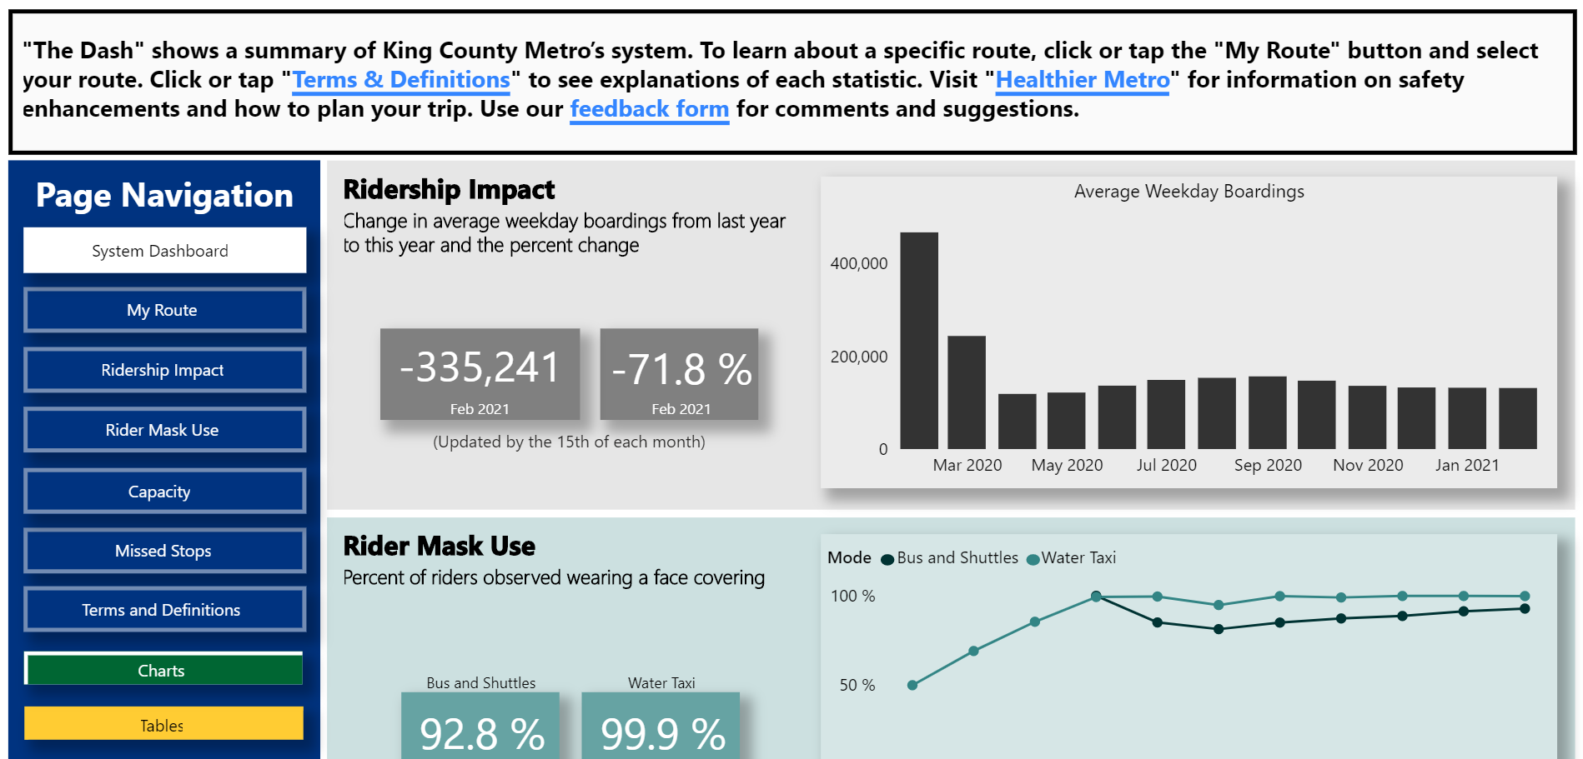
PFD REVIEW
Public Facing Dashboards go through:
Internal Stakeholder Review
External Focus Groups
Translations – 10 languages

Slide 11
INTERNAL TIER IV

Slide 12
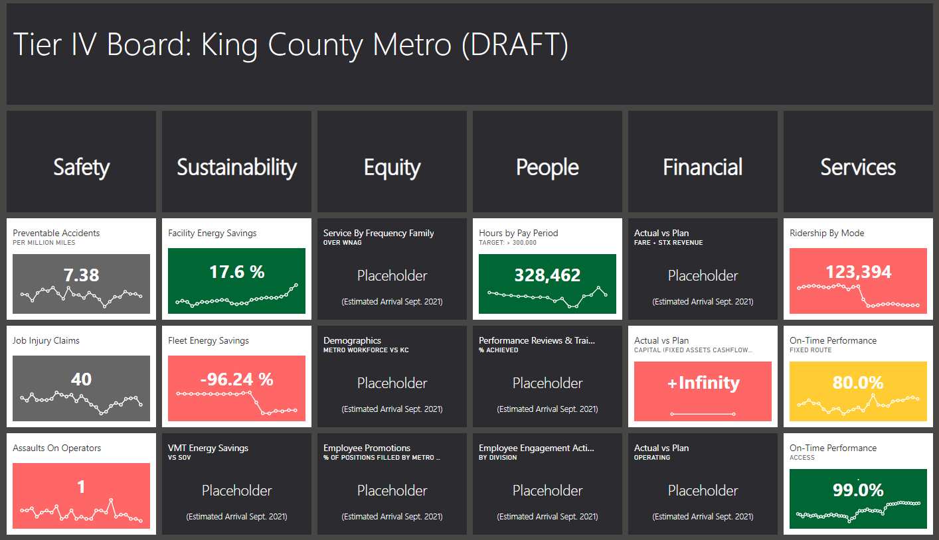
IN DEVELOPMENT – TIER IV BOARD

Slide 13
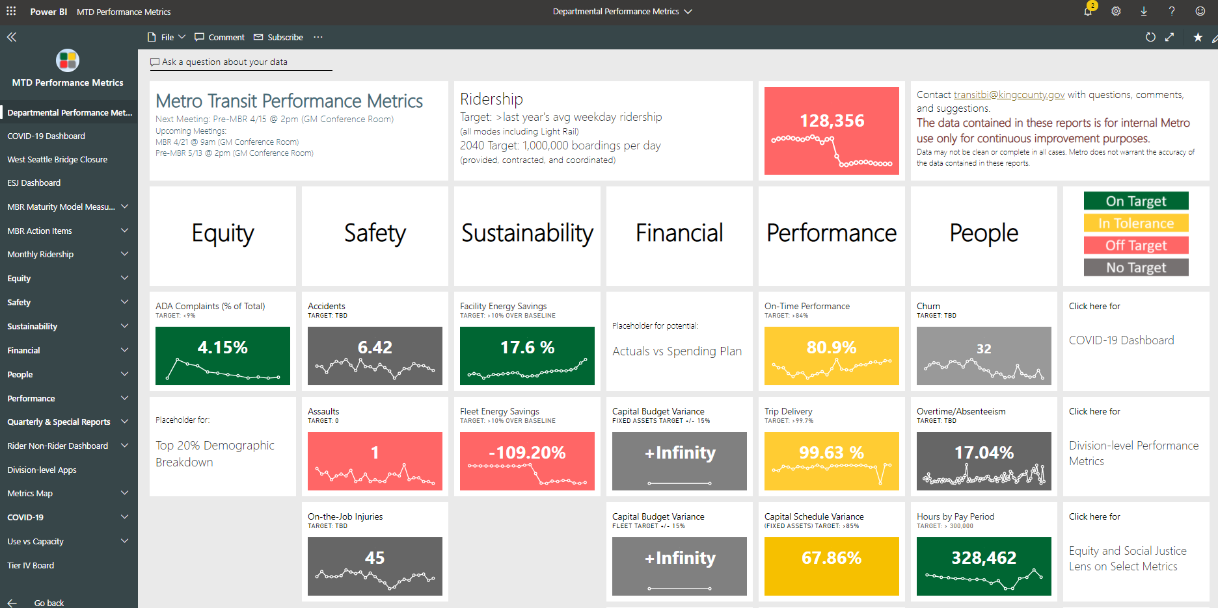
Department MBR BOARD

Slide 14
INTERNAL TIER III

Slide 16
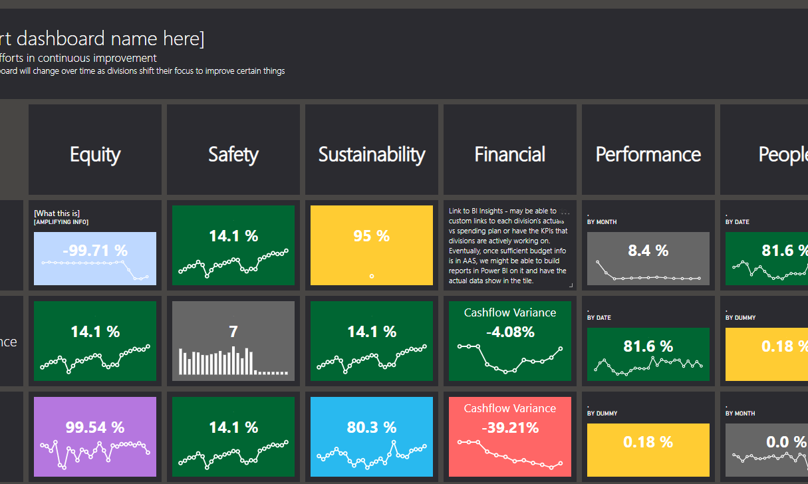
METRO PULSE (under Construction) 6 Categories X 10 Divisions
Radical Transparency:
Meaningful/relevant KPIs
Identifying the challenges where we are putting our efforts
Highlight the areas we are actively working to improve
Proud of our trends and focus our energies where we have gaps

Slide 17
MBR (Monthly Business Review)

Slide 18
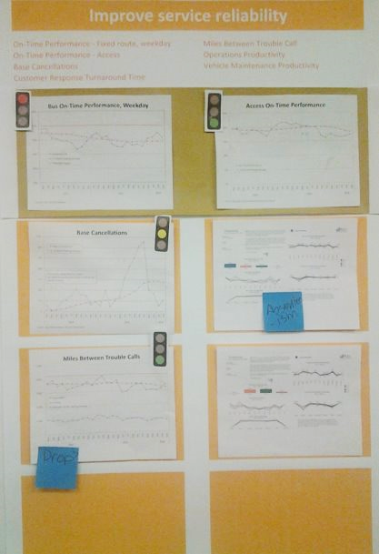
MBR HISTORY
Monthly Business Review 0.0
Tier IV - Visual Management Boards
2016 – 2017
Reviewed weekly during EMG meeting​
Metrics aligned to agency strategy​
Utilized simple visual management
Tier IV Visual Management Boards

Slide 19
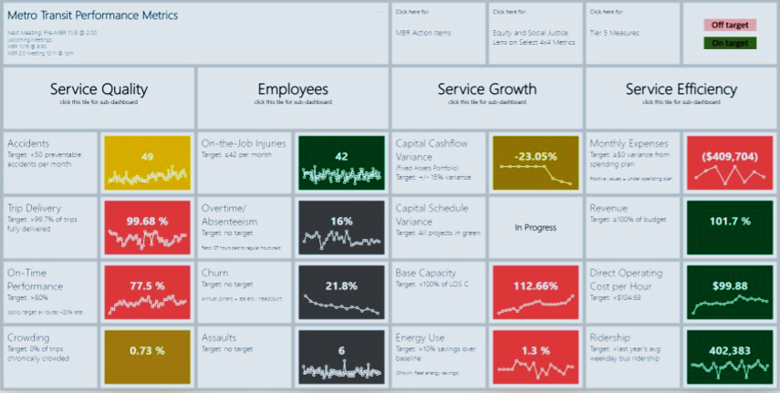
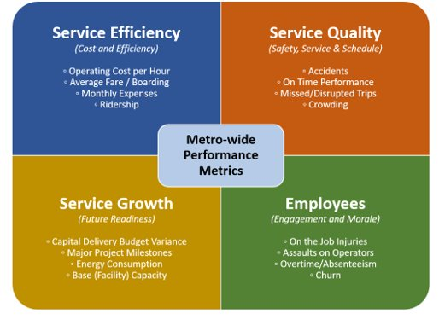
MBR HISTORY
Monthly Business Review 1.0
Department Level
Started in January 2017
Available to everyone with a transit email address via SharePoint​
Included action items and accountability​
Data available in many different views​
Stand alone meetings to focus on the metrics
MBR 1.0

Slide 20
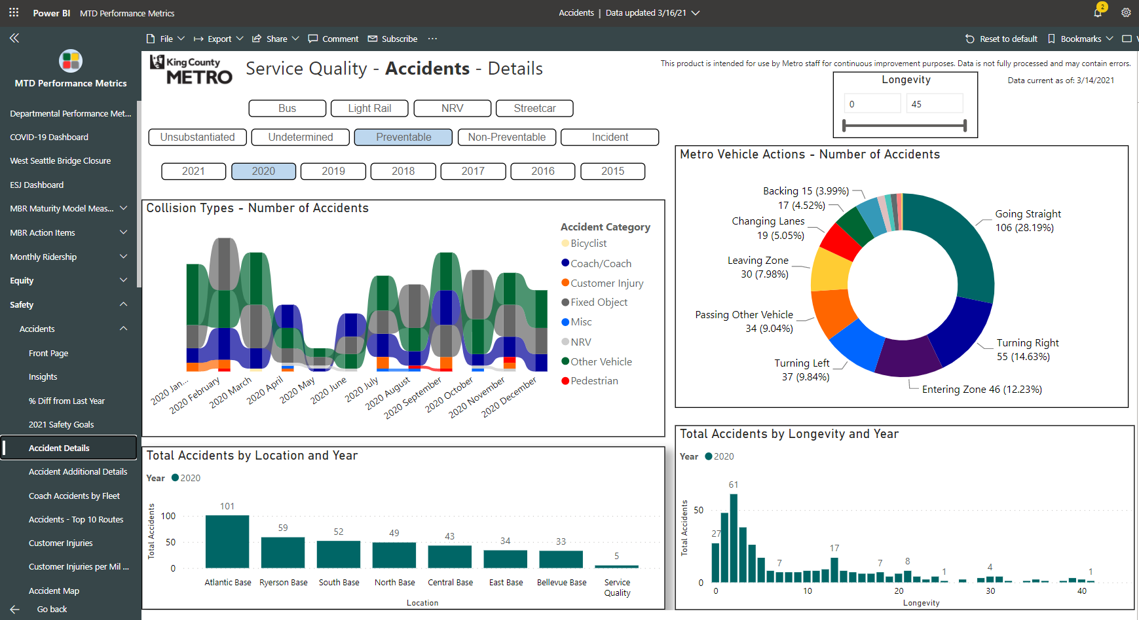

Slide 21
WHY?

Slide 22
MBR GOALS
VALUE DRIVEN
DATA INFORMED
CUSTOMER FOCUSED

Slide 23
In the WORDS OF TERRY WHITE, MTD GENERAL MANAGER
Our prior life at Metro […] we were more focused on the experts. We’re going to put this package together. We’re going to give it to you, and this is the best thing going. And trust us because we went to school and we know what we’re doing.
And it did not necessarily engage as much as it should. We have to get out of that mindset. We’re serving the people. We’re serving the regions, we’re serving jurisdictions. All of those have a voice needs to come to that table. We need to do better at listening before we make a move. And I say, especially because of my upbringing, that there are folks that we haven’t figured out necessarily how to hear from. We have to do that better.
https://www.theurbanist.org/2021/01/25/terry-white-has-deep-roots-and-big-plans-as-metro-general-manager/

Slide 24
Lifecycle of a Metric
Start with a baseline set of data – could be super ugly!
If you have the courage to measure, you are ahead in the game!
Identify mitigation strategies – how could this data be improved?
Implement a change and document it
Collect a second set of data
Compare and analyze – did the change work?

Slide 25
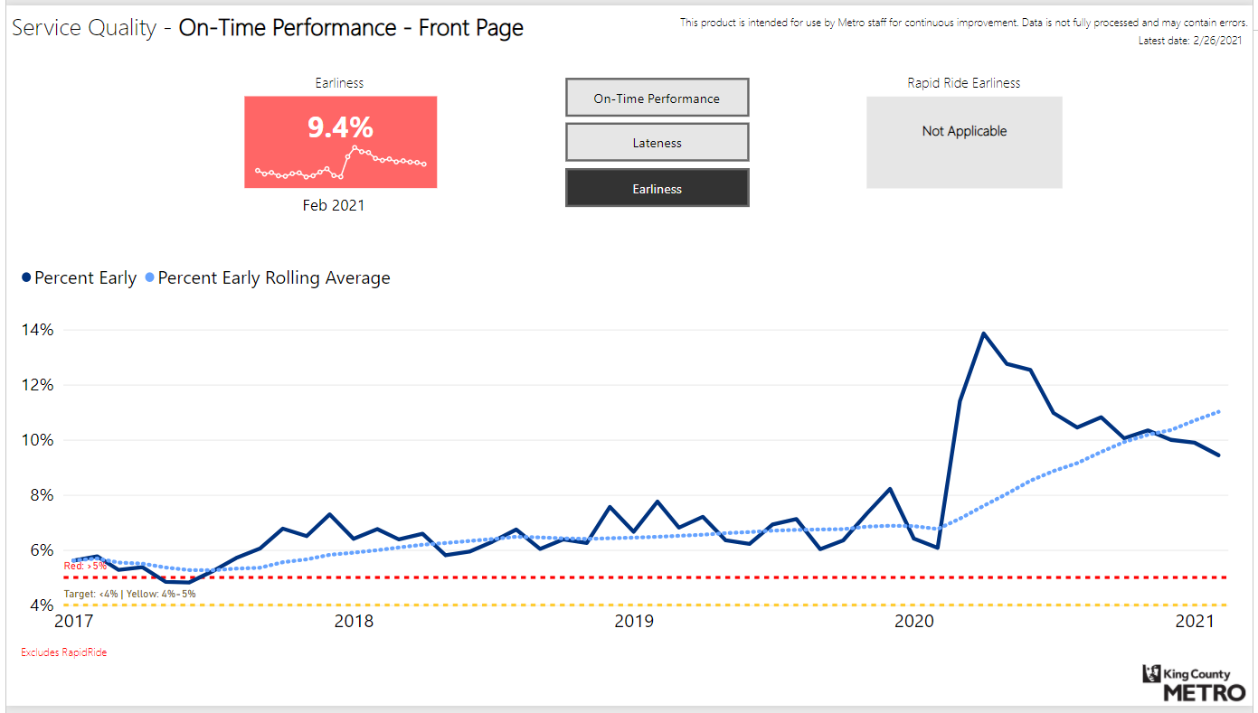
MITIGATION STRATEGIES

Slide 26
MBR STRATEGIES

Slide 27
MBR Roles
Data SME
Leads
BI Team
Coordinates Metro BI work
Guides and assists the development of division- and section-level metrics, reports, and dashboards
Helps leads establish routine, data-driven conversations
Gathers, processes, analyzes, and presents division- or section-level data and information
Develops division- or section- level metrics that cascade from/to agency-wide metrics
Assists their lead at routine meetings about the metrics
Directs division-level efforts to generate division-level metrics and dashboards
Establishes data and analysis requirements
Drives accountability
Leads should have decision making authority within the division
Notes:
Outline the concept of the three parts
xBI Team –
Leads

Slide 28
STRATEGIES
MBR 3.0 Focus Group
Meetings bi-weekly
Category Support Team
Support Divisions in choosing relevant data sets
Establish best practices
Work from source systems when available
Align with existing reports
Public Facing Dashboards, NTD data, etc
MBR Maturity Model
Currently being rolled out across all Divisions

Slide 29
Aligning to Six Categories
Equity
Safety
Sustainability
Performance
People
Financials

Slide 30
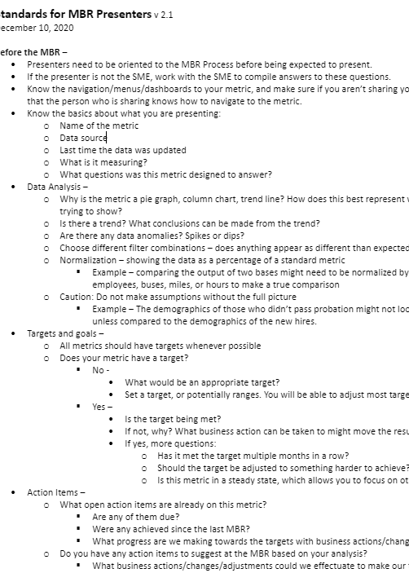
Best practices

Slide 31
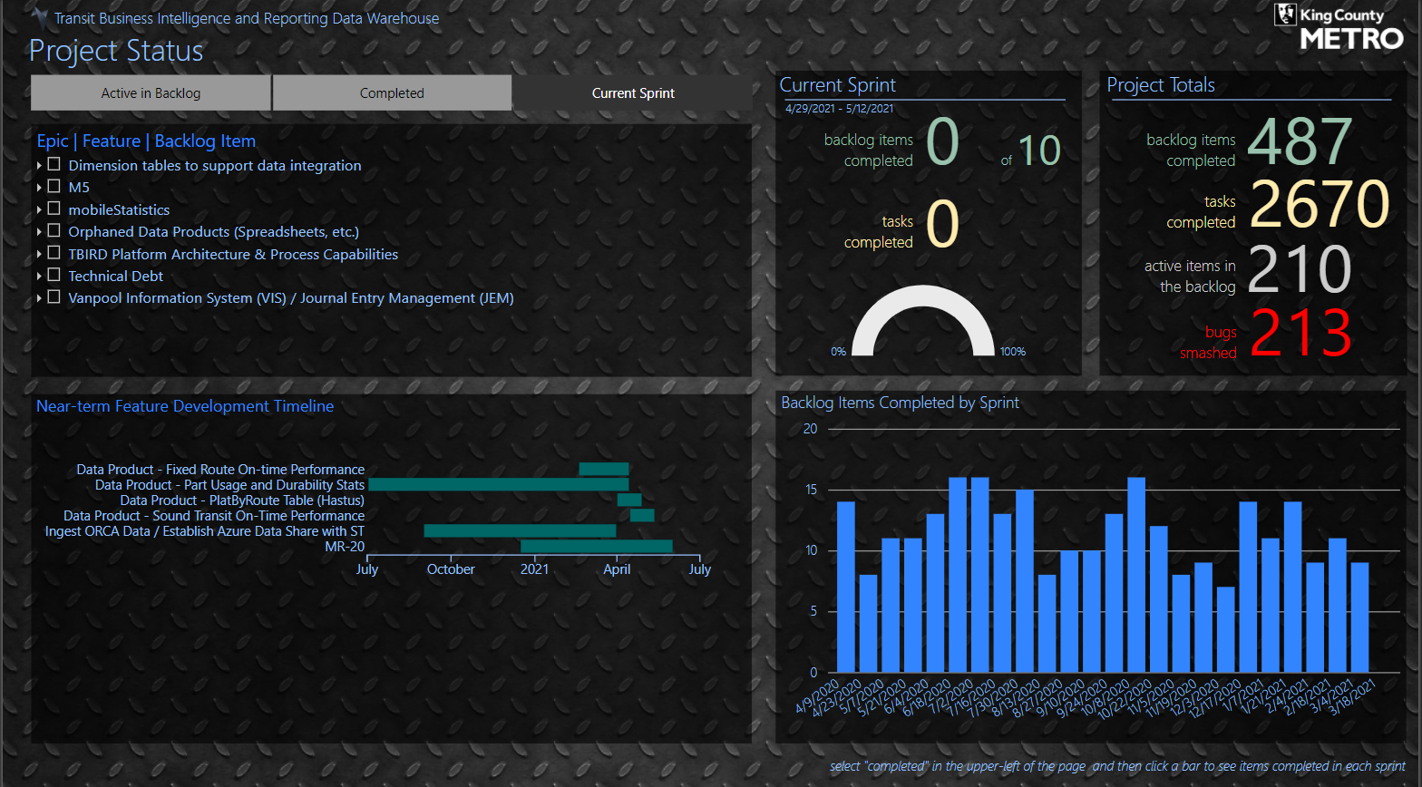
T-BIRD Transit Business Intelligence and Reporting Data WAREHOUSE

Slide 32
RIDER/Non-RIDER SURVEY Qualitative Data
https://kingcounty.gov/~/media/depts/metro/accountability/reports/2019/2019-rider-non-rider-survey-final.pdf

Slide 33
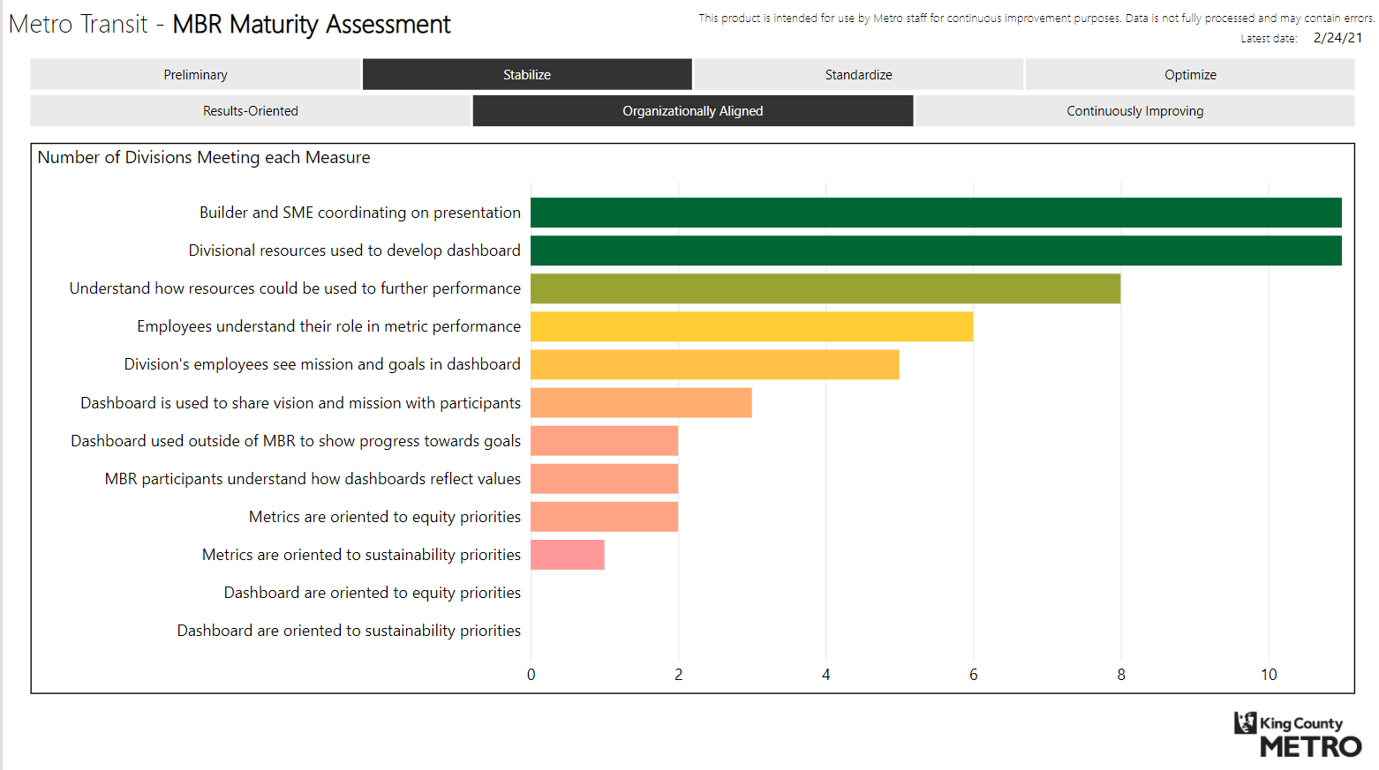
MBR MATURITY MODEL

Slide 34
OUTCOMES
Divisions take ownership and lean into process
1
KPIs from each division in each category
2
Metro efforts are focused where most needed
3

Slide 35
Thank you!

