Slide 1
Cascade Natural Gas Corporation Revised Hedging Program UG-180825 Gelber & Associates Corp. December 14, 2018

Slide 2
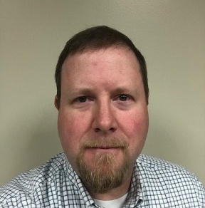
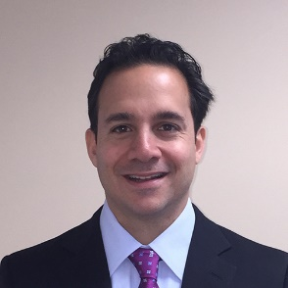
Cascade’s Hedging Project Leadership Team
Chris Robbins,
Manager of Gas Control & Supply for the Western Region
Arthur Gelber,
Consultant
Mark Sellers-Vaughn, Manager of Supply Resource Planning
Kent Bayazitoglu, Consultant
Eric Wood, Supervisor of Gas Supply
Notes:
The Cascade Hedging Project team is led by Chris Robbins (Manager of Gas Control and Supply Western Region) with additional key leadership from Mark Sellers-Vaughn, Eric Wood and their respective staff members. I have been helped by Kent Bayazitoglu, who is here today (Kent shows himself) and another of my staff members named Daniel Myers. Daniel is not present today but is dialed in.

Slide 3
Gelber & Associates
Based in Houston, TX
Natural gas specialist since 1990
Working with utilities since 2000
We’ve worked in 35 states nationwide
Design, implement and manage the natural gas hedging programs for utilities and large gas consumers
First worked with Cascade on a portion of their IRP in 2014
Recognized as utility hedging “Best in Class” by the Colorado PUC in 2017

Slide 4
Importance of the Winter
Like most utilities Cascade, customers’ usage of natural gas is appreciably higher in the winter months
Accordingly, a high percentage of market exposure is related to the winter cost of gas
The winter costs of gas is often related to how cold the winter is…but other macro forces are also pertinent
Notes:
Transitioning now away from program features to talk for a short bit on the topic of utility hedging. Most utility hedging performance occurs in the winter months because usage is so much higher. If you can manage the winter right, that’s 80% of the ball game.

Slide 5
Winter Drives Load Profile

Slide 6
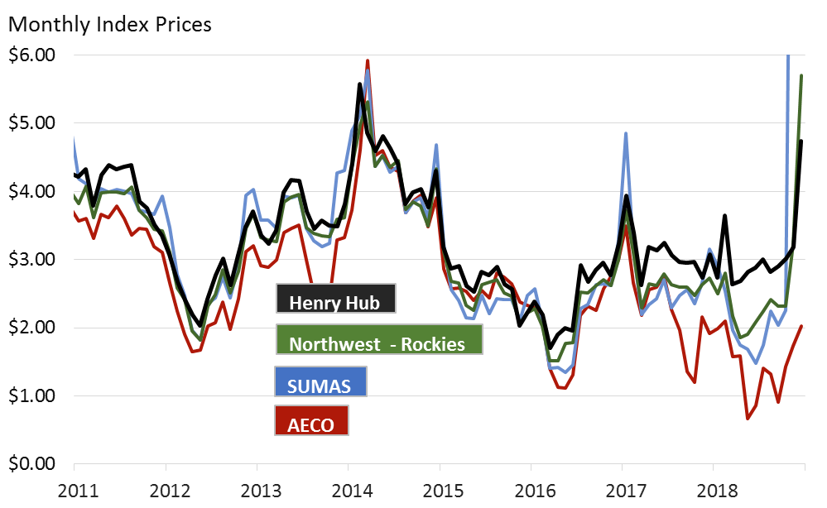
Location Matters as Northwest prices break from NYMEX (Henry Hub, Louisiana)
At this time hedging only with Henry Hub NYMEX may not give adequate price protection
Correlations have potentially distorted since the AECO supply glut and Enbridge outage
NW Rockies has good historical correlation with NYMEX
*Latest two Sumas prices are above the range of chart.

Slide 7
Current Cascade Hedging Plan
Buy forward up to 80%, but hedge price up to 40%
Physical supply design based on a three year ladder
Year 3 – 20% maximum
Year 2 – 25% maximum
Year 1 – 40% maximum
Fixed priced physicals are primary tool
GSOC oversight

Slide 8
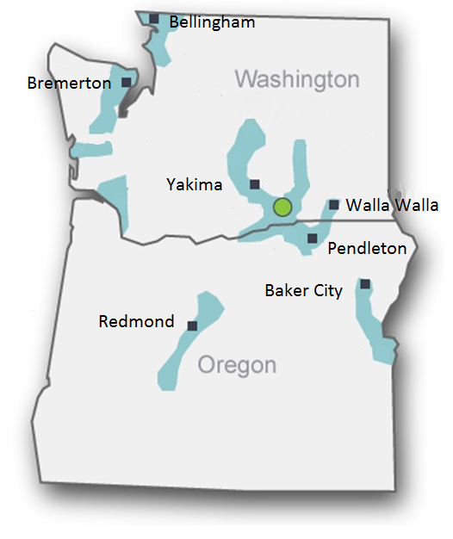
The Cascade Utility Hedging Project
Driven by UG-132019 Policy Statement
Designed to be risk responsive
Designed with constructed baseline quantitative metrics
Risk responsive features
Variable annual hedging volume between 15% minimum and 60% maximum
Flexibility between call options, fixed price swaps, or fixed price physicals
Ability to delay or accelerate purchase volumes within the structural design to take advantage of price lows and avoid price highs
VaR_{up} and VaR_{down} calculations to measure risk exposure

Slide 9
Hedging the last 20 years
Hedge Savings
Strictly Programmatic Hedging lowers volatility*
Hedging produces savings from 1998 to 2008 (hedge gains)
Hedging creates losses from 2008 to 2018
Hedge Losses
*Hedging 100% of purchases, ratably daily from 2 to 3 years away reduces monthly change volatility appreciably when compared to unhedged position

Slide 10
Balancing Upward and Downward Price Risk
Price Goes Up – Unhedged gas costs imperil customers
Prices Goes Down – Hedged gas purchases are higher than market
VaR (Value at Risk) is a statistical way to measure price risk exposure – gives a dollar figure for what could be lost for a given probability
VaR_{up} and a VaR_{down} can be measured and managed
This Photo by Unknown Author is licensed under CC BY-NC-ND

Slide 11
Plan Uses a Three Year Ladder
Hedging is designed for three year forward ladder
Hedge volume NOT rigid, flexibility is an element of risk responsiveness
Annual Hedge Execution Plan (HEP) meeting with GSOC to set volume guidelines

Slide 12
Risk Responsive Tools
Structural
Annual Hedging Execution Plan (HEP)
Monthly Guidance
Approved exceptions
Flexible hedge volumes with boundaries
Analytical
CNGC Book Models – calculates hedged and unhedged volumes, mark to market, VaR_{up} and VaR_{down} Gelber Storage Model – residuals show over/under supplied market
Production models
Stochastic tools
This Photo by Unknown Author is licensed under CC BY-NC-ND

Slide 13
Why Effective
Allows the utility to use their institutional knowledge of the natural gas market
Allows professionals closest to the market to advise with key decisions
Creates a structured framework to drive expectation and constrain activities
Senior management has to authorize annual hedge percentage & strategy
Flexible hedge volumes to balance upward and downward price risk
Tactics are handled by the front-line personnel and the structure of the hedging program
Proven effective over 20 years of developing use

Slide 14
Reporting
Retrospective reporting is performed yearly at the end of the winter period
Meeting with GSOC oversight committee to review the hedging program
Benchmarks for measurement include current hedge valuation
Narrative addressing the execution of the prior year hedging plan
Hedging plan appropriateness discussion
Prospective reporting is performed yearly before the beginning of the upcoming hedging period
Identification of changes in market conditions
Targets established for hedge percentages years 1, 2, and 3
Changes to the hedging program, if necessary

Slide 15
Prudence and Paper Trail
All risk responsive hedging will occur within the structure of the designed hedging program
Risk responsive activities will be communicated to oversight and management on a monthly basis in advance of hedging activity
Any exception to the Monthly Guidance will be memorialized in an Exception Document to management and file

Slide 16
Operations, Oversight and Guidance
GSOC serves as oversight committee and authority
Gas Supply team operates as front and mid-office for transactions
Accounting operates as the back office for settlement
Resource Planning operates as research, surveillance, and compliance

Slide 17
Project Milestones
Project team meets
Location Basin Study Completed
Final Corporate Hedging Plan Signoff
VaR Risk Model Roll-out
Hedge Plan Written
Create 2019 HEP (Hedging Execution Plan)
Draft Process Flow Diagrams
GSOC Approves 2019 HEP
Done
2018
NOW
Implement 2019 HEP
Next Steps
2019

Slide 18
Summary
Revised Hedge Program avoids “set it and forget it” to be more risk responsive
The Program uses the actual Cascade procurement sheet to drive the initial quantitative metric framework
Program features and employed-resources are expected to become more sophisticated over time
Hedging Program complies with policy statement UG-132019

Slide 19
Questions and Discussion

