Slide 1
Recessed Open Meeting
2022 NWN Gas IRP
Docket UG-210094
Feb 27, 2023

Slide 2
Agenda
9:30 Call to Order
9:35 Overview of Agenda and Instructions for Participation
9:40 Commission Staff Presentation
9:50 Integrated Resource Plan Presentation by Company
10:40 Public Comments
11:30 Adjourn

Slide 3
Participant Instructions
Please mute your computer microphone or phone (Press *6 to mute/unmute)
Wait to be called on for comment and do not interrupt other speakers
Only use video during the time you are directly addressing the commission (video is not required for participants)
Language Access: www.utc.wa.gov/translate
Contact information for technical difficulties (2 options)
Use the chat feature
The “Chat” feature should only be used to report technical difficulties
Call Ryan Smith at (360) 915-3646

Slide 4
Commission Staff Presentation

Slide 5
Integrated Resource Plan Presentation by NW Natural

Slide 6
NW Natural 2022 Integrated Resource Plan
Washington Utilities and Transportation Commission
February 27, 2023

Slide 7
Today’s Agenda
Key Changes in 2022 IRP
The Planning Environment
Defining Resource Needs
Resource Options
Results
Action Plan
Prepared for IRP Working Group- Not to be used for investment purposes.

Slide 8
Key Process Changes for 2022 IRP
Development of Community and Equity Advisory Group (CEAG)
Recording of Technical Working Group (TWG) Stakeholder Workshops and posting on NW Natural website
Posting TWG presentations on NW Natural website
Established online workpaper depository for stakeholder review and held workpaper tour workshop
Post-filing office hours to field stakeholder questions
Prepared for IRP Working Group- Not to be used for investment purposes.

Slide 9
Key Analytical Changes in 2022 IRP
Switching to the PLEXOS software for system planning optimization
State specific emissions compliance planning
Utilization of stochastic risk analysis as the primary tool for developing the Action Plan
More detailed assumptions about low-GHG emitting resources
Change in how load forecasting models are deployed
Including transportation schedule loads in our optimization modeling
Inclusion of implementation workbook for low carbon gas evaluation methodology
Inclusion of customer bill impacts in addition to system costs
Results presented in comparison to a “reference case”
Prepared for IRP Working Group- Not to be used for investment purposes.

Slide 10
IRP Analysis Process
Prepared for IRP Working Group- Not to be used for investment purposes.

Slide 11
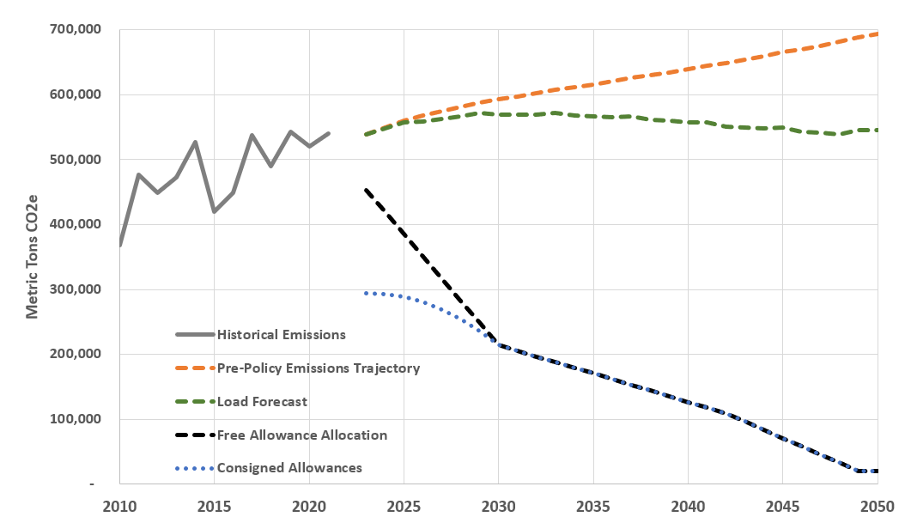
Climate Commitment Act (CCA) Compliance Position
Prepared for IRP Working Group- Not to be used for investment purposes.

Slide 12
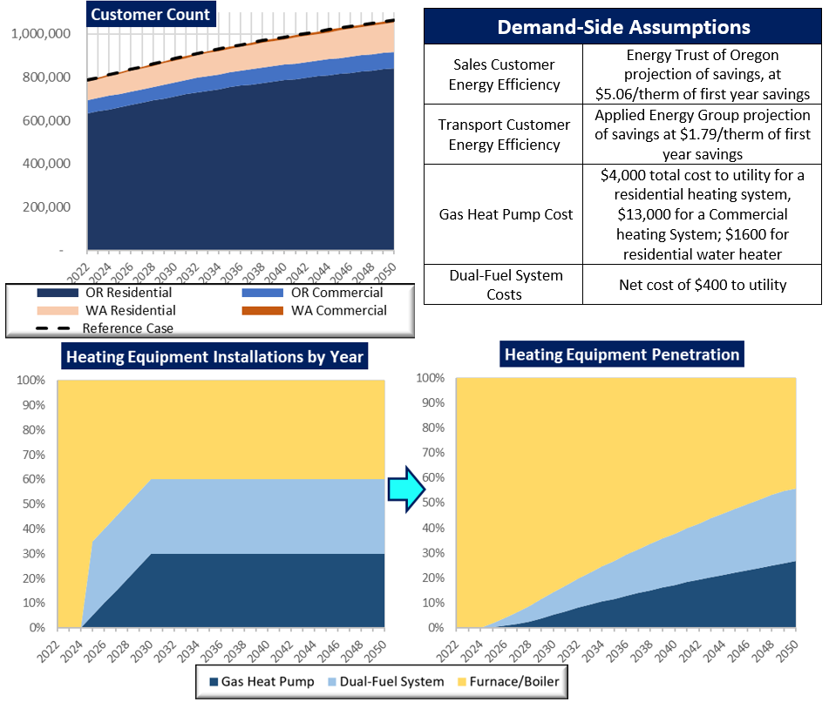
Analysis Example- Scenario 1
Prepared for IRP Working Group- Not to be used for investment purposes.

Slide 13
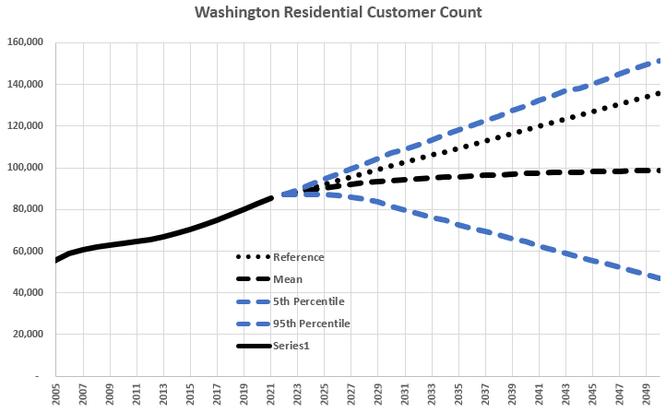
Risk Analysis- Residential Customer Count Example

Slide 14
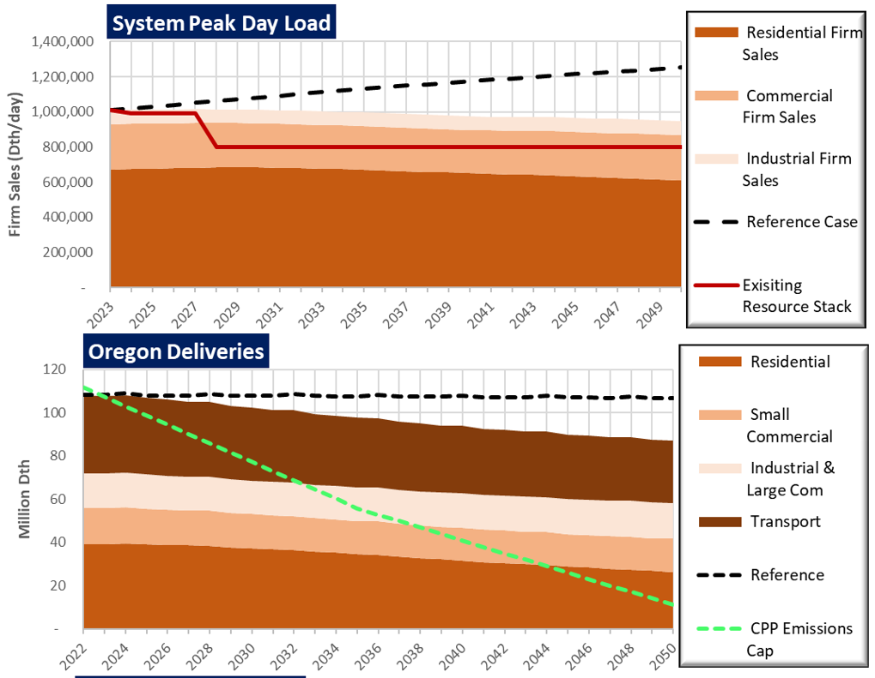
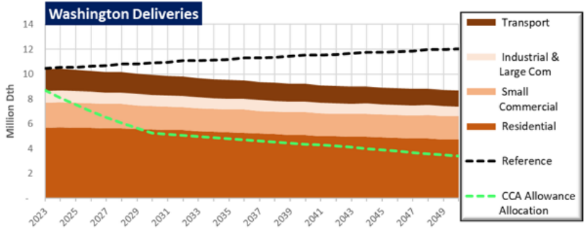
Analysis Example- Scenario 1
Prepared for IRP Working Group- Not to be used for investment purposes.

Slide 15
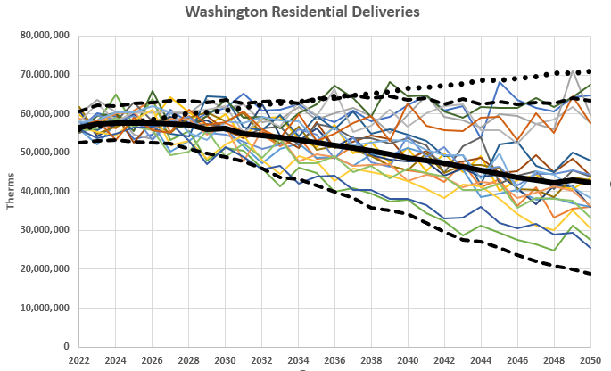
Risk Analysis- Residential Load Example
Prepared for IRP Working Group- Not to be used for investment purposes.

Slide 16
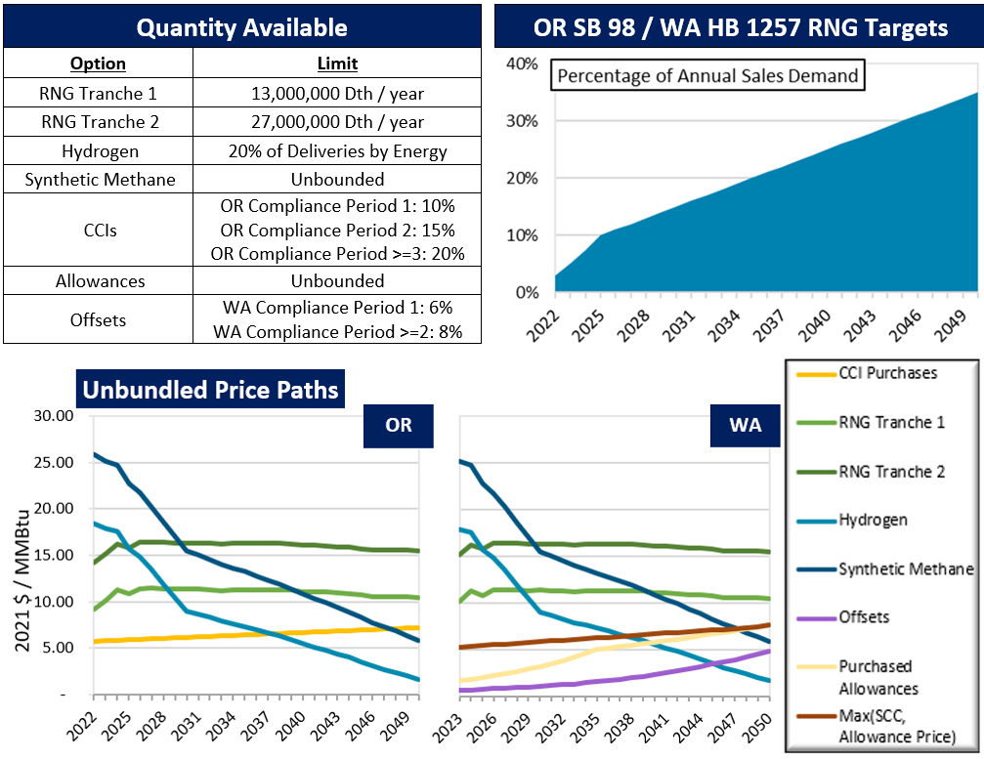
Analysis Example - Scenario 1
Prepared for IRP Working Group- Not to be used for investment purposes.

Slide 17
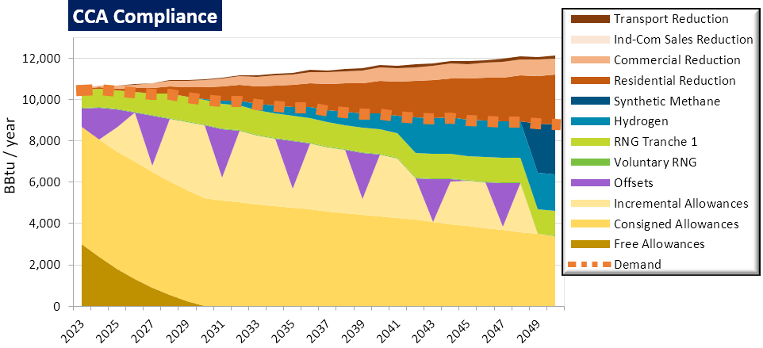
Compliance Example-Scenario 1
Prepared for IRP Working Group- Not to be used for investment purposes.

Slide 18
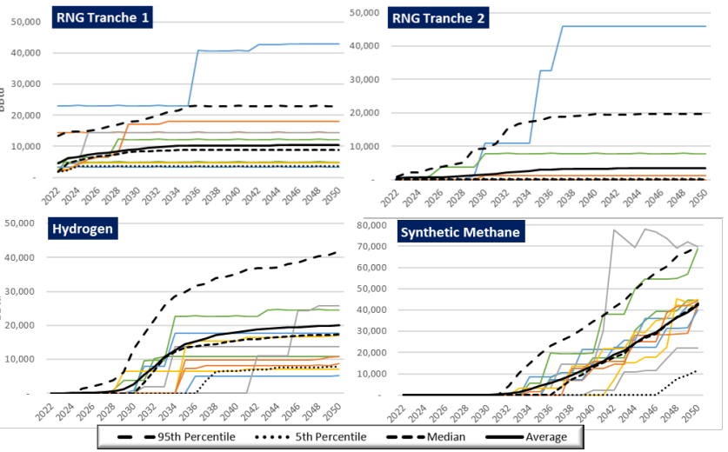
Risk Analysis Low Emissions Gas Results
Prepared for IRP Working Group- Not to be used for investment purposes.

Slide 19
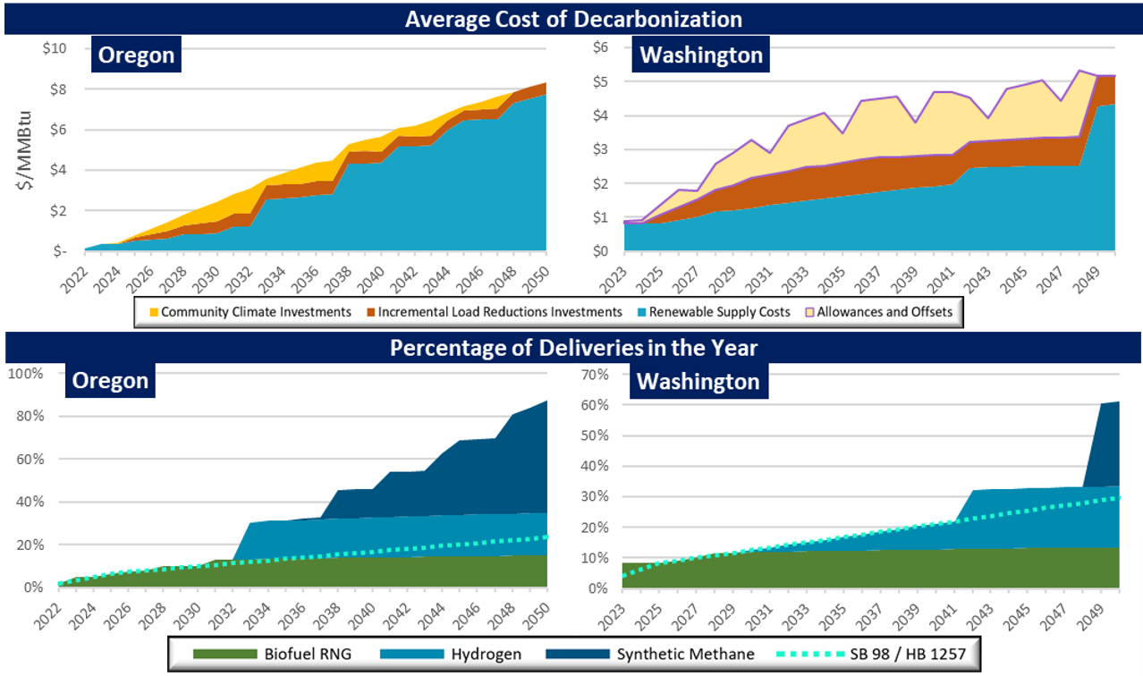
Analysis Example- Scenario 1
Prepared for IRP Working Group- Not to be used for investment purposes.

Slide 20
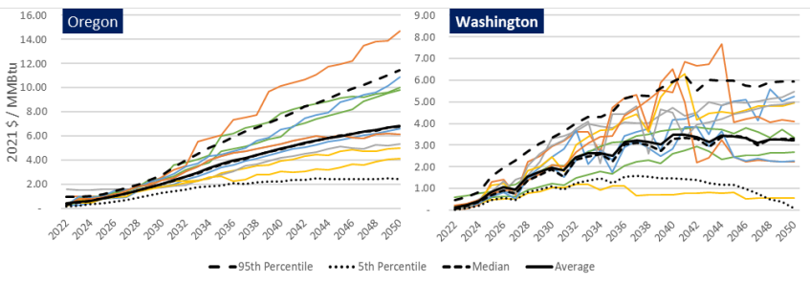
Cost of Environmental Compliance
Washington results shown do not include options where consigned allowance revenue sales are not deployed in least cost method from total utility cost perspective.
Prepared for IRP Working Group- Not to be used for investment purposes.

Slide 21
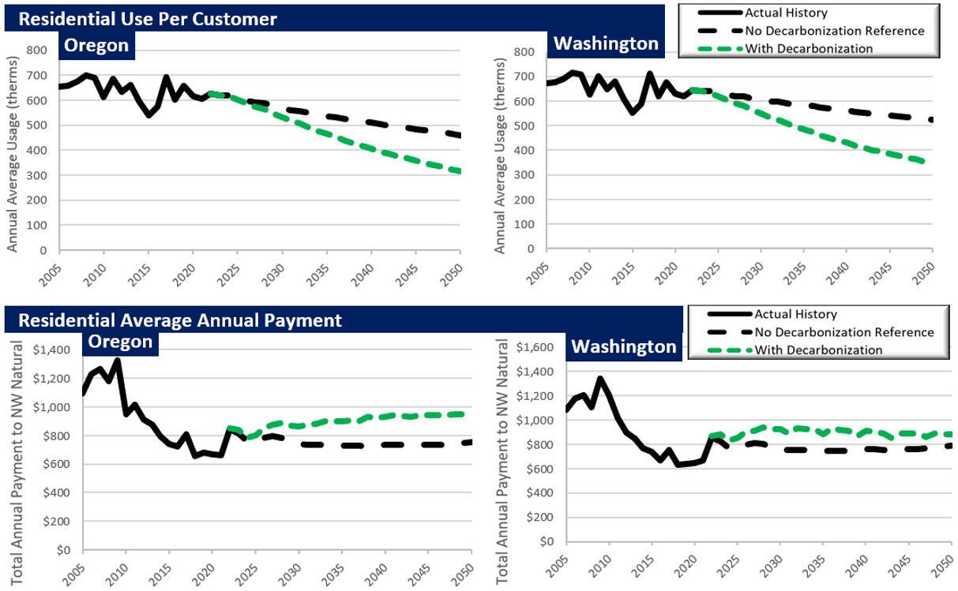
Analysis Example – Scenario 1
Prepared for IRP Working Group- Not to be used for investment purposes.

Slide 22
Action Plan
The Action Plan turns the results of the IRP analysis into discrete near-term activities that represent the best combination of least cost and least risk over the IRP planning horizon. The action items in this Action Plan are robust to a wide range of potential future outcomes and therefore all represent low regret ways to move forward in the current environment.
The focus of the Action Plan in Washington are actions to comply with the Climate Commitment Act’s Cap-and-Invest program.
Prepared for IRP Working Group- Not to be used for investment purposes.

Slide 23
Action Plan
Washington Emissions Compliance Action Items:
9. Acquire carbon offsets compliant with the Climate Commitment Act’s Cap-and Invest program for 5% of expected weather emissions in year 2023 and 2024. Seek to acquire additional offsets representing 3% of expected weather emissions allowed for CCA compliance on tribal lands, and if they can be acquired for a lower price than the program allowance price floor for years 2023 and 2024, acquire these offsets.
10. Seek to acquire 600,000 Dths of renewable natural gas (RNG) in 2024 and 800,000 Dths of RNG in 2025, representing 6% and 8% of normal weather compliance gas in 2024 and 2025.
11. Purchase emissions allowances equal to emissions at an estimate of the 95th percentile of need for annual compliance net of voluntary RNG, carbon offsets, and freely allocated but not consigned allowances.
12. Working through Energy Trust of Oregon, acquire 275,000-370,000 therms of first year savings in 2023 and 276,000-310,000 therms of first year savings in 2024, or the amount approved through WUTC Biennial Energy Efficiency Plan.
13. Work with Energy Trust of Oregon, the Alliance of Western Energy Consumers and other stakeholders to develop energy efficiency programs for transportation and industrial sales schedule customers by 2024.
Prepared for IRP Working Group- Not to be used for investment purposes.

Slide 24
Action Plan
Capacity Resource Action Items:
1. Acquire 20,000 Dth/day of deliverability from either recalling Mist, a city gate deal, or a combination of both for the 2023-24 gas year. Based upon updated load forecast in upcoming IRP updates recall Mist capacity as required for the 2024-25 and 2025-26 gas years.
2. Replace the Cold Box at the Portland liquified natural gas (LNG) facility for a targeted in-service date of 2026 at an estimated cost of $7.5 to $15 million.
3. Scope a residential and small commercial demand response program to supplement our large commercial and industrial programs and file by 2024.
Prepared for IRP Working Group- Not to be used for investment purposes.

Slide 25
Public Comments

Slide 26
The meeting has concluded

