Slide 1
Western Energy Imbalance Market update
Mark Rothleder
Vice President
Market Quality & Renewable Integration
Body of State Regulators
San Diego, CA
October 31, 2016

Slide 2
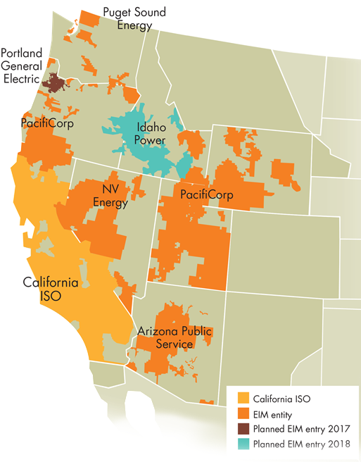
EIM update
Arizona and Puget
Went live October 1st
Portland General
Fall 2017
Idaho Power
Spring 2018
Entities exploring future entry
CENACE, Baja CA
Balancing Authority of Northern California (BANC)
Los Angeles Department of Water & Power (LADWP)
Seattle City Light (SCL)

Slide 3
Gross economic benefits since start of EIM = $114.36M
BAA | 4th Qtr 2014 | 1st Qtr 2015 | 2nd Qtr 2015 | 3rd Qtr 2015 | 4th Qtr 2015 | 1st Qtr 2016 | 2nd Qtr 2016 | 3rd Qtr 2016 | Total
CAISO | 1.24 | 1.44 | 2.46 | 3.48 | 5.28 | 6.35 | 7.89 | 5.44 | 33.58
NVE | - | - | - | - | 0.84 | 1.70 | 5.20 | 5.60 | 13.34
PAC | 4.73 | 3.82 | 7.72 | 8.52 | 6.17 | 10.85 | 10.51 | 15.12 | 67.44
Total | 5.97 | 5.26 | 10.18 | 12.00 | 12.29 | 18.90 | 23.60 | 26.16 | 114.36
BAA | July | August | September | Q3 – 2016 Total
CAISO | 2.24 | 1.38 | 1.82 | 5.44
NVE | 1.88 | 2.16 | 1.55 | 5.60
PAC | 6.09 | 4.92 | 4.12 | 15.12
Total | 10.21 | 8.46 | 7.49 | 26.16
Avoided curtailment of 335,930Mwh of renewables, displacing an estimated 143,695 metric tons of CO2.
Reduced Renewable Curtailment | 1st Qtr 2015 | 2nd Qtr 2015 | 3rd Qtr 2015 | 4th Qtr 2015 | 1st Qtr 2016 | 2nd Qtr 2016 | 3rd Qtr 2016 | Total To-Date
Mwh curtailment avoided | 8,860 | 3,629 | 828 | 17,765 | 112,948 | 158,806 | 33,094 | 335,930
Estimated metric tons of CO2 displaced | 3,792 | 1,553 | 354 | 7,521 | 48,342 | 67,969 | 14,164 | 143,695
Notes:
EIM benefit to continue to accrue with Q3 benefits $26 million. Benefits reflect
More efficient dispatch, both inter- and intra-regional
Reduced renewable energy curtailment
Reduced flexibility reserves needed in PacifiCorp BAAs
Q3 avoided renewable curtailement of 33,000MWh is down from Q3 reflects seasonal changes. With higher loads the amount of avoided curtailment reduces.

Slide 4
APS and PSE demonstrating good performance, through October 16
Balancing test pass rate
APS: 96.6%
PSE: 97.9%
Feasible solution in 15-minute market
APS: 99.61%
PSE: 99.94%
Feasible solution in 5-minute market
APS: 99.81%
PSE: 99.57%
Notes:
The balancing test is one of the tests that is required to ensure EIM entity balancing area is resource sufficient and avoids leaning on other balancing areas coming into the hour. Both APS and PSE have a hgh rate of demonstrating sufficiency. If test is not passed the EIM entity area transfers are frozen to avoid leaning on others.
With the high rate of sufficiency, we are observing very high rate of feasible solutions in both the 15 minute and 5 minute market. Both APS and PSE are feasible, meaning there are sufficient volume of bid in erergy to meet the imbalances well over 99% of the time. Based on past experience we observe market is working well when there are infeasibile solutions less than 1% of time.

Slide 5
Daily average prices in EIM areas
* Prices still under price validation and subject to change.
Notes:
Prices are generally stable and prices are reflect of system conditions. The Red line is the prices for 15-minute market, the blue line is the prices for the 5-minute market and the dotted line reflects the proxy daily index price the respective EIM entity used prior to implementing EIM. When prices deviate from index, the prices are better reflecting the system conditions.

Slide 6
Transfer capability increases as EIM entities join

Slide 7
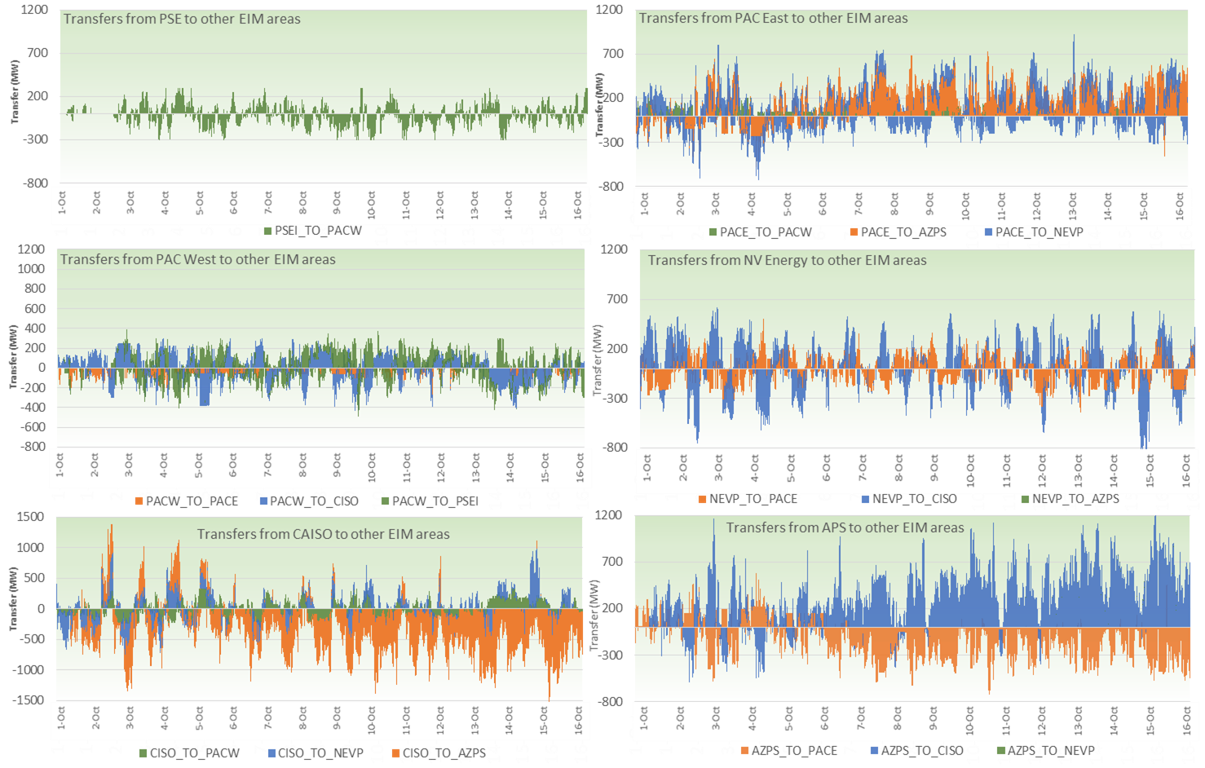
Transfer capabilities have been gradually released
Notes:
For the first two days the transfer for the new APS and PSE areas were increased. We observe bi-directional transfers that reflect the economic opportunities.

