Slide 1
Cascade Natural Gas Corporation Integrated Resource Plan Technical Advisory Group Meeting #2
Tuesday, August 23, 2016
Cascade HQ – Kennewick, WA

Slide 2
Agenda
Introductions

Slide 4
Demand Side Management
August 23rd 2016, TAG 3, Integrated Resource Planning

Slide 5
Purpose [of re-Running TEA-Pot]
Cascade Natural Gas uses Nexant Inc.’s in house developed Microsoft Excel-based modeling tool – TEA-POT (Technical/Economic/Achievable Potential) to run multiple scenarios to establish our market potential savings based on variable inputs within our Washington Service territory.
TEA-POT was rerun with updated inputs for the Demand Side Management Chapter of Cascade’s 2016 Integrated Resource Plan. For the first time, it was run at the climate zone level of granularity, with separate unique inputs for each of the three geographic service territories.
This run represents proposed revisions to the Conservation Incentive Program tariffs discussed with our Conservation Advisory Group which will be submitted to the WUTC in September.
Notes:
The DSM Chapter will be an Executive Summary in accordance with the commitment made to transition towards a separate Conservation Plan provided each December where the majority of the energy-efficiency planning process will take place
The majority of the Low Income program elements have been pulled out of the IRP to be addressed in the annual Conservation Plan per the July Conservation Advisory Group meeting
The DSM Chapter will discuss the Company’s motivation (through policy, commission directive, etc.), what has been accomplished, and how the Company is going to move forward including what the Company will do differently to accomplish our goals in the near future
Contains information pertaining to the Company’s study needs, Company’s regional collaborative efforts and the long-term benefits to its service territory in relation to those efforts

Slide 6
Key Inputs
Long term discount rate updated to 3.52% from 4.17%, derived from the average U.S. 30 year mortgage.
Inflation rate – decreased from 2% to 1%.
Updated transmission loss rate of 0.1348%.
Revised Administrative Budget forecast -Residential $550k based on transition to in-house rebate processing. Commercial/Industrial expected total investment increased to $900k for additional outreach efforts.
New proportional measure category cost distribution.
Updated Load Profile
New Demand Forecast & Avoided Costs* by Climate Zone.
New
TAG 3 Review
Updated
Changes
Rerun TEA-POT
TAG 4
*NOTE – Avoided Costs differ from July and may be updated one last time in September.
Notes:
Updated all of the inputs listed. Note, Admin costs increased while Avoided Costs decreased. This movement has contributed to lower expected conservation therm savings potential, however, the inputs will be finalized after this TAG 3 meeting and DSM’s forecasting will be rerun and finalized before TAG 4.

Slide 7
New Scenarios

Slide 8
Scenarios
Residential
Commercial & Industrial
Uses measures offered under the new proposed tariff
A mix of 30 and 50 percent of incremental costs for the incentive level, dependent upon the measure’s cost-effectiveness – as per consultation with the CAG.
Includes ALL measures from the Nexant Potential Study to reflect both Custom and Prescriptive program offerings
A mix of 30 & 50 percent incentive levels based on each measure’s cost-effectiveness
Notes:
Across the board, all customer class DSM forecasts used a cost effective mix of 30 and 50 percent of incremental costs for the incentive levels.
The difference between Residential and Commercial is that the Residential scenarios looked at the current measure offerings while Commercial and Industrial included all reviewed measures from the Nexant potential study in order to cover the full breadth of available conservation therm savings potential across our territory from both custom and prescriptive options.

Slide 9
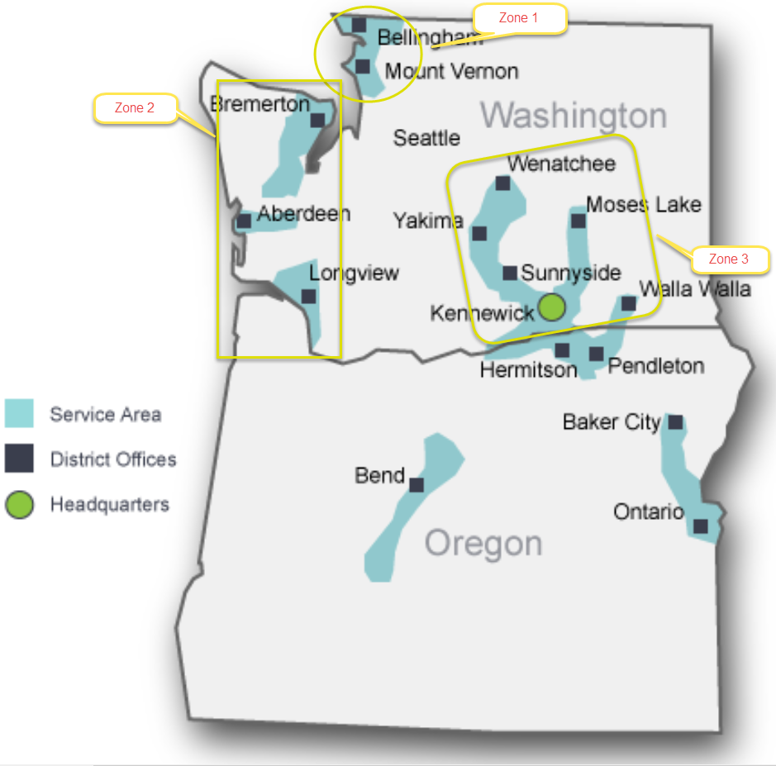
Climate Zone Map
Notes:
Smoother assimilation into the other IRP chapters will be reflected by moving from statewide conservation forecasts to a climate zone granularity. Focus will also be placed on how the Company incorporates the goals into its resource allocations and how the Company has the pieces in place to make sure its achievement potential is reached, including insights into items needing to be accomplished in the future10 year range to meet its goals

Slide 10
Full Portfolio by Climate Zone
Notes:
Zone 2 has historically performed lower than the others, a reflection of lower demand and customers.

Slide 11
Full Portfolio by Customer Class

Slide 12
Regional Awareness

Slide 13
Areas of interest
Clean Air Rule
NEEA Regional Market Transformation Collaboration
Building Stock Studies
GUEP & other community involvement

Slide 14
Additional Slides

Slide 15
Noteworthy Changes
The DSM Chapter will be an Executive Summary in accordance with the commitment made to transition towards a separate Conservation Plan provided each December where the majority of the energy-efficiency planning process will take place
The majority of the Low Income program elements have been pulled out of the IRP to be addressed in the annual Conservation Plan per the July Conservation Advisory Group meeting
Smoother assimilation into the other IRP chapters will be reflected by moving from statewide conservation forecasts to a climate zone granularity. Focus will also be placed on how the Company incorporates the goals into its resource allocations and how the Company has the pieces in place to make sure its achievement potential is reached, including insights into items needing to be accomplished in the future10 year range to meet its goals
The DSM Chapter will discuss the Company’s motivation (through policy, commission directive, etc.), what has been accomplished, and how the Company is going to move forward including what the Company will do differently to accomplish our goals in the near future
Contains information pertaining to the Company’s study needs, Company’s regional collaborative efforts and the long-term benefits to its service territory in relation to those efforts

Slide 16
Residential Scenarios
Uses measures offered under the new proposed tariff
A mix of 30 and 50 percent of incremental costs for the incentive level, dependent upon the measure’s cost-effectiveness – as per consultation with the CAG.

Slide 17
Residential Measures’ Incentive Levels
30% of Incremental Costs
50% of Incremental Costs
Tankless Hot Water Heater
All Non Equipment Measures:
Insulation
Air Sealing
Built Green®
ENERGY STAR®
Entry Door
ESKs
Water Heater 0.67 EF
Combination Hydronic Space & Water Heat
Furnace, 95 percent AFUE
Hearths

Slide 18
Commercial & Industrial Scenario
Includes ALL measures from the Nexant Potential Study to reflect both Custom and Prescriptive program offerings
A mix of 30 & 50 percent incentive levels based on each measure’s cost-effectiveness

Slide 19
Commercial: Equipment Measures
30% Incentive Level
50% Incentive Level
Combination Boiler and Hot Water Heater
Combination Oven
Conveyor Oven
Direct Fired Radiant Heater
High Efficiency Condensing Boiler
High Efficiency Condensing Unit Heater 92% AFUE
High Efficiency Non-Condensing Unit Heater
High Efficiency Tank Condensing Water Heater
High Efficiency Tankless Water Heater
High Efficiency Water Heater
Solar Hot Water Heater
Heat Pump Water Heater
Natural Gas Heat Pump
ENERGY STAR
Convection Oven
ENERGY STAR Fryer
ENERGY STAR Griddle
High Efficiency Condensing Furnace
High efficiency steam cooker

Slide 20
Commercial: NON-Equipment Measures
30% Incentive Level
50% Incentive Level
Boiler Power Burner
Boiler Repair/Maintenance
Boiler Stack Economizer
Boiler Steam Trap
Boiler vent damper
Boiler Waste Water Heat Exchanger
Duct Sealing and Insulation
Faucet Aerator
Floor Insulation
Heat Recovery
Hot Water Temperature Reset
HVAC Controls
HVAC System Commissioning
Low Flow Showerhead
Low-flow Pre-Rinse Spray Valve
Low-temp Door-Type ENERGY STAR Dishwasher
Ozone injection laundry systems
Pool Cover
Pool Spa Solar Heat
Refrigeration system superheat recovery DHW
Roof insulation (retrofit only)R-45
Solar Wall
Steam System Efficiency Improvements
Variable Volume Air System
Wall insulation - Tier 2: Min R-19
Windows - Non-Tinted AL Code to Class 36
Windows - Non-Tinted AL Code to Class 45
Windows - Tinted AL Code to Class 36
Windows - Tinted AL Code to Class 45
Ventilation Hood / Makeup Air
Boiler Pipe Insulation
Demand Controlled Ventilation
Drainwater Heat Recovery
High Efficiency Commercial Gas Clothes Washer
Hot Water Pipe Insulation
Hot Water Temperature Setback
Motion Faucet Controls
Multi-tank Conveyor ENERGY STAR Dishwasher
Recirculation Controls
Roof insulation (retrofit only) R-30
Wall insulation (Retrofit Only) R-11
Windows - Add Argon to Vinyl Lowe
Windows - Add Low E and Argon to Vinyl Tint
Windows - Add Low E to Vinyl Tint
Windows - Non-Tinted AL Code to Class 40

Slide 21
Industrial Measures
30% Incentive Level
Condensing Boiler
Condensing Unit Heater 92% AFUE
Non-Condensing Unit Heater
Process Heating: HE Furnace
HE Condensing Furnace
Boiler Power Burner
Boiler Repair/Maintenance
Boiler Stack Economizer
Boiler Steam Trap
Boiler vent damper
Duct Sealing and Insulation
HVAC Controls
HVAC System Commissioning
Refrigeration system superheat recovery
Roof insulation (retrofit only) R-30
Roof insulation (retrofit only) R-45
Space Heating O&M
Steam System Eff. Improvements
Wall insulation (retrofit only)R-11
Wall insulation (retrofit only)R-19
Waste Water Heat Exchanger
Windows - Non-Tinted AL Code to Class 36
Windows - Non-Tinted AL Code to Class 40
Windows - Non-Tinted AL Code to Class 45
Windows -Tinted AL Code to Class 36
Windows -Tinted AL Code to Class 45
50% Incentive Level
Direct Fired Radiant Heater
Demand Controlled Ventilation
Improved Process Heating Controls
Optimized Furnace Operations/Improved O&M
Windows - Add Argon to Vinyl Lowe
Windows - Add Low E and Argon to Vinyl Tint
Windows - Add Low E to Vinyl Tint

Slide 22
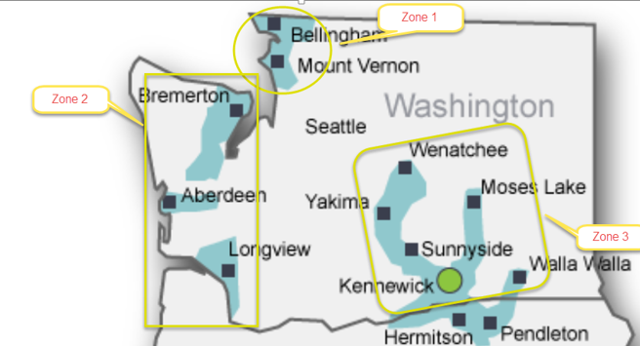
Residential Conservation Forecast Potential

Slide 23
Commercial Conservation Forecast Potential

Slide 24
Industrial Conservation Forecast Potential

Slide 25
Commercial/Industrial combined Savings Potential Forecast

Slide 26
Climate Zone 1: Bellingham & Mt Vernon

Slide 27
Climate Zone 2: Bremerton, Aberdeen & Longview

Slide 28
Climate Zone 3: Kennewick, Walla Walla, Wenatchee, & Yakima

Slide 29
Monica Cowlishaw MGR, Energy Efficiency & Community Outreach Monica.Cowlishaw@cngc.com Amanda Sargent Conservation Analyst II Amanda.Sargent@cngc.com
Questions?

Slide 30
IRP Carbon Assumptions
Mark Sellers-Vaughn
Bruce Folsom
August 23, 2016

Slide 31
Topics to Cover Today
Purpose
Laying the Foundation
The National Focus
The Regional Focus
Washington
Oregon
Types of CO2 Adder Analyses
Fugitive Methane Emissions
Washington and Oregon Commission-Jurisdictional Planning Treatment
Sensitivities and Impacts on Prices
Proposed Direction
Next Steps and Conclusion

Slide 32
Purpose
To support policies that cost-effectively achieve state and federal carbon emission reduction policies and regulations
To determine carbon methodology and assumptions for calculating inputs towards a 20 year avoided cost of natural gas, with associated two-year action items

Slide 33
Laying the Foundation
Carbon dioxide is the primary source of greenhouse gas emissions (GHG)
The US Environmental Protection Agency (EPA) released its final Clean Power Plan (August 2015) rule with required CO2 reductions by state, primarily directed towards electric generation
Electricity production fueled by natural gas produces significantly less CO2 emissions than coal plants; fugitive methane emissions from natural gas production wells, pipelines, storage, and distribution is a contributor to GHG but involves considerable uncertainty
CO2 cost-adders are to be applied to avoided costs to address the above
(NOTE: Numbers shown in this presentation are “draft” as this remains a work-in-process)

Slide 34
The National Focus
Clean Air Act, Section 111(d) gave the US EPA authority to promulgate state Clean Power Plan rules
Reduce greenhouse gas emissions from covered power plants by 32% from 2005 levels by 2030
US Supreme Court stayed implementation (February 2015)
Oral arguments heard June 2016 (DC Circuit Court of Appeals)
States may comply in two ways:
Rate-based – Reducing the average CO2 emissions rate (pounds of CO2/kilowatt-hour) from electric generating plants
Mass-based – Limiting the total emissions (tons of CO2 per year)

Slide 35
The Regional Focus
The Northwest Power Planning and Conservation Council (NPPC or Council) recently published its 7th Power Plan
Released May 2016
Significant discussion, analysis, and scenarios regarding CO2 contained in Chapters 3 and 15
Considerable prior regional collaboration regarding GHG
Such as the proposed cap and trade program of the Western Climate Initiative

Slide 36
Washington
Draft Clean Air Rule published by the Department of Ecology (January 2016), with new draft in June
If adopted, would require LDCs to reduce CO2 emissions by 5% from a rolling baseline
Reductions to come from efficiency, investment in Washington facilities, and/or purchased allowances and offsets
Initiative 732 (I-732) – Clean Energy Future
Charges a carbon tax of $25 per ton of carbon
Lowers the sales tax by 1%
Grants tax rebate of up to $1,500 annually to 400,000 low income families
Eliminates the business and occupation (B&O) tax on manufacturing

Slide 37
Washington (continued)
Potential other initiative in-progress
Significant other state policies with CO2 impacts
Energy Independence Act (“I-937”)
Electric Vehicle Action Plan
And others

Slide 38
Oregon
“Coal to Clean” law adopted in 2016 (SB 1547)
Effectively eliminates coal power by 2030
50% renewable electric generation by 2040
Several other legislative proposals considered without adoption in 2016:
Replace GHG emission goal with cap and trade program (SB 1574)
Repeal GHG emission goal; requires Environmental Quality Commission to adopt goals and limits (HB 4068)
Additional proposals expected in the 2017 legislative session
Monitoring Northwest Natural Gas’ carbon program

Slide 39
Types of CO2 Adder Analyses
The Northwest Power and Planning Council summarizes applicable approaches. While directed to the electric industry, these are provided as illustrations of the potential scope of methodologies and recently-performed analyses
Eight approaches were applied by the Council:
Social Cost of Carbon (Mid-Range and High) – two approaches
Carbon Cost Risk (e.g., $0 - $110/ton) – one approach
Regional Renewable Portfolio Standards at 35% – one approach
Maximum Carbon Reduction (Existing Technology, Coal Retirement, Coal Retirement with the Social Cost of Carbon, Coal Retirement with the Social Cost of Carbon and No New Gas) – four approaches

Slide 40
Types of CO2 Adder Analyses (continued)
Four additional scenarios included:
Planned Loss of a Major Non-GHG Emitting Resource (i.e., 1,000 aMW of hydro)
Unplanned Loss of a Major Non- GHG Emitting Resource
Faster Conservation Deployment
Slower Conservation Deployment
Four sensitivity analyses were performed:
No Demand Response
Low Natural Gas and Wholesale Electricity Prices
Increased Market Reliance
Lower Conservation

Slide 41
Fugitive Methane Emissions
Fugitive methane (a major component of natural gas) occurs during production, transportation and distribution
Ranges of methane emissions vary, with new production facilities now coming in around 1%
Council’s 7th Power Plan
“…there is considerable uncertainty around such issues as whether its impacts compared to carbon dioxide are over or under-stated…and whether accounting for the methane emissions from coal production would also raise that fuel’s full life-cycle climate impacts…”
“…will likely draw on gas production new wells which have lower fugitive emissions…”
“…unless new pipeline capacity is needed, fugitive emissions from pipeline leaks remain relatively constant…”
Summary: Electric generation fueled by natural gas has significantly less CO2 emissions than electric generation from coal. Including fugitive methane emissions, natural gas remains with lower CO2 emissions

Slide 42
Washington and Oregon Commission-Jurisdictional Planning Treatment of CO2 Emissions
Local Distribution Companies:
(note all based on NPPC forecast using the carbon cost risk approach)
PSE
In its 2015 IRP, modeled three CO2 prices: No Federal CO2 price ($0/ton); Mid CO2 price ($13/ton in 2016 to $54/ton in 2035); High CO2 price ($35/ton in 2020 to $120/ton in 2035)
Northwest Natural Gas
In its “2016 IRP Draft for Public Comment,” for Oregon, begins in 2021 at $7/ton with $28/ton in 2035 and for Washington, starts at $7/ton in 2017 with $32/ton in 2035)
Avista
In it draft 2016 slides, adder begins in 2018 ($10/ton), escalating to $20/ton (2035)

Slide 43
Current Efforts by Cascade re GHG Reduction
Cascade is addressing CO2 in the following manner
Energy efficiency programs
Encouragement of the direct use of natural gas
Methane recapturing and leak prevention

Slide 44
Proposed Direction
Apply CO2 adders from 7th Plan
Apply Carbon Cost Risk approach
Near time price of $10/ton escalating to $35 per
ton in 2035
Include:
Ranges
Sensitivity analyses
Determine impact on prices

Slide 45
Next Steps and Conclusion
Incorporate carbon planning assumptions into modeling
Will provide a brief update of the modeling impacts at TAG 4
Conclusion…
Regarding expectations, lesser impact on customers as compared to the electric utility industry
Impact of ranges and sensitivity analyses will be presented to the TAG when modeling is performed

Slide 46
Questions…
…and thank you

Slide 47
Market Outlook and Long Range Price Forecast

Slide 48
Long range market outlook
Rockies production slight decline; but with other supplies serving the Midwest, the west coast is ripe for expansion.
Once LNG flows from BC in early 2020s we should see AECO prices begin to rise relative to Rockies.
Station 2 should become more liquid
A number of experts say US production is expected to over 90 bcfd in 2020 and over 110 bcfd in 2030
Even more low-cost gas in the Marcellus.
Production growth in Western Canada now, but low prices will ultimately reduce any long-term production expectations.
US demand is expected to exceed 90 bcfd in 2020 and 115 bcfd by 2030, about 7-10% higher than expected in our 2012 IRP
Low long-term prices will likely encourage new gas-intensive industrial projects
Power-sector consumption strengthens as coal displacement continues.
US and Canadian LNG exports likely to ramp up by 2020
Several projects utilizing Canadian resources continue to emerge in the US Pacific NW and British Columbia
Mexico's power sector is expected to continue to grow as new gas-fired power plants are built and existing fuel-oil plants are converted to burn gas.

Slide 49
Long Range Price Forecast
Cascade’s long term planning price forecast is based on a blend of current market pricing along with long term fundamental price forecasts.
The fundamental forecasts include Wood Mackenzie, the Energy Information Administration (EIA), the Northwest Power Planning Council, Bentek and the Financial Forecast Center’s long term price forecasts.
Market, particularly in near term is heavily influenced by Henry Hub prices
While not a guarantee of where the market will ultimately finish, Henry Hub NYMEX is the most current information that provides some direction as to future market prices

Slide 50
Long Range Price Forecast
Wood Mackenzie's long-term forecast is at a monthly level by basin. We use this to help shape the forecast’s monthly basis pricing.
We also rely on EIA’s forecast; however, it has its limitations since it is not always as current as the most recent market activity. Further, the EIA forecast provides monthly breakdowns in the short term, but longer term forecasts are only by year.
We assign a weight to each source to develop the monthly Henry Hub price forecast for the 20 year planning horizon.
Although it is impossible to accurately estimate the future, for trading purposes the most recent period has been the best indicator of the direction of the market. However, Cascade also considers other factors (historical constraints) which can lead to minor adjustments to the final long range forecast.

Slide 51
Long Range Price Forecast
Considerations in weight assignments
Typically, highest weight is given to NYMEX for the near term (approximately 3-5 years) then the others take on increasing weight over the horizon
Wood Mackenzie (monthly, covers all basins)
EIA (industry barometer, annual long term
NPPC (regional perspective, but recognize it is also a blend)
Bentek (3-5 years out years)
Financial Forecast Center (typically only a few years)

Slide 52
Base Weights in Draft 2015 Price Forecast

Slide 53
Price Elasticity—Context and Import to the IRP Process
Price elasticity is an economic concept which recognizes that customer consumption changes as prices rise or fall. The amount of this change (or “elasticity”) is a function of other available products (i.e., substitutes) or the ability for customers to go without or use less, with no meaningful impact on their personal life or in commerce.2,3 “Price signals” is a term used to describe how customers see or expect future pricing to affect them.
Price elasticity is expressed mathematically as a coefficient describing the amount of change in consumption per change in price. By way of example, a price elasticity factor of negative 0.10 means a consumer will reduce usage by one percent if the price increases by 10%. Conversely, a positive 0.10 coefficient factor for a 10% price decrease would predict customers would increase consumption by 1.0%. For products with high substitutability, the coefficient factors are high (e.g., greater than 0.50) and vice versa.
Price elasticity can be highly temporal. Consumers may not be able to make changes to short-term price increases or decreases. Yet, several years out, that same customer may replace equipment or make behavioral changes to use significantly less or more of a product depending on whether, over the long term, the product is more or less expensive, respectively.

Slide 54
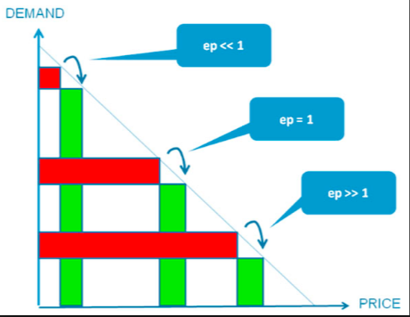
Price Elasticity—Context and Import to the IRP Process
The import of price elasticity to natural gas integrated resource planning lies in the twenty year period over which the demand forecasts are estimated. This forecast (or range of forecasts under scenario planning) is a key determinant of the avoided cost. Low price elasticity in a rising natural gas price environment, would suggest forecasted higher load would not change and more natural gas would need to be acquired, with corresponding delivery infrastructure. However, if usage materially decreases with higher prices, then less purchases and capital investment by a local distribution company (LDC) would be necessary. Thus price elasticity effects the avoided cost.
Because avoided costs are integral to conservation planning, among other components, the impact of price elasticity on consumer consumption is particularly scrutinized by stakeholders.
The previous discussion is a relatively academic explanation. Application of price elasticity to natural gas resource planning presents several confounding issues. These are described in the following section.

Slide 55
Several attributes of the regulated utility environment cause price elasticity calculations to be difficult to calculate with precision. These include:
Within customer classes, the type of customer usage varies:
Residential—heating and non-heating
Commercial—heating and processing

Slide 56
…leading to a general inability to make short-term changes in usage other than some behavioral modifications.
Regulatory protocols reduce direct price signals:
Annual purchased gas adjustments can be increases or decreases of unknown magnitude
General rate cases and price changes are assumed by customers to occur annually or biannually
…leading to customer uncertainty of future pricing other than a preconception that prices will rise.
Billing plans reduce direct price signals:
Average, or levelized, billing which results in twelve equal monthly payments adjusted annually, is a service to customers but does not send direct price signals. For customers not on a level payment plan, seasonal temperature changes appear as increases in monthly bills during cold months and decreases during warmer months
…leading to a misunderstanding by customers of future pricing.
isn’t clear that customers may not return (or rebound) to historic usage after a higher or lower price excursions.

Slide 57
Several items reduce load growth over time, regardless of price elasticity and price signals:
Economic conditions
Conservation
Building codes and appliance standards (which are already built into forecasts)
Technology
…leading to historical data that includes reductions in usage irrespective of pricing.
To the above can be added subjective items such as customers’ general propensity to use less of many products. Additionally, electricity and natural gas pricing now move in tandem.5
This causes difficulty for customers to receive meaningful price signals and difficulty for utilities to isolate primary factors for long term price elasticity calculations (other than inflation). Regardless, it

Slide 58
Several price elasticity inquiries are traditionally referenced in regional price elasticity discussions. These include:
The American Gas Association (AGA) released a study in 2007 identifying the short-run price elasticity coefficients for the Pacific and Mountain regions to each be -0.07 with a low and high range of -.03 and -0.13 respectively. The long-run estimates were -0.12 (Pacific) and -0.10 (Mountain), with the range being between -0.01 and -0.29.
Regional differences in price elasticity for demand of energy were examined, with the conclusion that the geographic area of a utility’s service territory results in the statistical significance of price becoming more uncertain. This suggests that for Cascade—with its customers spread over two states in smaller sections—relatively precise price elasticity coefficient factors would either not be available or would be costly to determine with lesser benefits of doing so.

Slide 59
Use per customer has been decreasing over the past thirty years prompted by multiple factors, including systemic items such as conservation, building codes and appliance standards and behavioral influences such as the 2008 recession.

Slide 60
Options for Price Elasticity Treatment
Options exist for treatment of price elasticity in IRPs. One option is to incorporate coefficient factors into linear modeling. For example, in its draft 2016 IRP, Avista uses a short-run coefficient factor of -0.12 and long-run of -0.14 for Washington. In Oregon, Avista uses a short-run coefficient factor of -0.08 and long-run of -0.13.
Alternatively, modeling of future pricing effects can be pursued through exacting calculations that iterate a series of cost environments based on primary variables. This is part of evolving forecast methodologies.8
Other regions are experiencing similar examinations of appropriate coefficient factors and/or more exhaustive and iterative modeling methods.
A short-run coefficient factor of -0.10 and a long-run factor of -0.12 would be justifiable for Cascade’s current IRP process, given the temperature differentials of its service territory, east and west of the Cascade Mountains. Low and high ranges would be justifiable at plus or minus 0.07.

Slide 61
Price Elasticity - Conclusion
Integrated Resource Planning (IRP) includes demand forecasting over a twenty-year horizon. Load growth needs to take into account several factors over this period due to aspects effecting customer usage. Price elasticity (or changes in consumption based on changes in price) is one such factor.
A review of price elasticity leads to the following findings relevant to Cascade Natural Gas Corporation’s (Cascade or Company) current IRP process.
Price elasticity exists, yet determining specific coefficient factors for linear modeling is inexact.
A range of coefficient factors should be used to test sensitivities of the factors and impacts to the forecasts.
Given Cascade’s diverse geographical territory, statistical significance of price elasticity coefficients is uncertain.

Slide 62
Price Elasticity - Conclusion
Several complicating factors call into question the accuracy and application of price elasticities. These include:
Regulatory mechanisms (e.g., purchased gas adjustments—PGAs—and general rate cases) which dampen price signals, or information to customers about future pricing.
Historical data (embedded with effects of conservation, technology, and economic conditions) renders reliance on this data imperfect for precise price elasticity determination.
The retail price of most “substitutable” fuel—electricity—moves with the cost of natural gas, thereby lessening the economic value of alternative fuels to customers.
Evolution of modeling suggests that future IRP modeling should incorporate iterative quantitative equations to allow built-in price elasticity effects.
Regardless of the above, price elasticity must be taken into account. For Cascade’s current IRP cycle, a short-run coefficient factor of -0.10 and a long-run factor of -0.12 with ranges of plus or minus 0.07 is justifiable, given regional studies and other utilities’ modeling efforts.

Slide 63
SENDOUT Scenarios and Inputs

Slide 64
SENDOUT model
Cascade utilizes SENDOUT™ for resource optimization
This model permits the Company to develop and analyze a variety of resource portfolios to help determine the type, size, and timing of resources best matched to forecast requirements.
SENDOUT™ is very powerful and complex. It operates by combining a series of existing and potential demand side and supply side resources and optimizes their utilization at the lowest net present cost over the entire planning period for a given demand forecast.

Slide 65
SENDOUT model
SENDOUT™ utilizes a linear programming approach
The model knows the exact load and price for every day of the planning period based on the analyst’s input and can therefore minimize costs in a way that would not be possible in the real world.
Therefore, it is important to acknowledge that linear programming analysis provides helpful but not perfect information to guide decisions.

Slide 66
SENSITIVITIES ANALYSES
Scenario Name | Key Assumptions
High Growth | Strong Economic Growth result in High Load growth, Average Weather, Medium Gas Prices
Low Growth | Economic Conditions result in Low Load growth, Average Weather, Medium Gas Prices
Environmental Externalities Carbon 1 | Medium Load Growth, Average Weather, Assumes Carbon Adder Implemented in 2017 for CO2 emissions at $7/ton with adder increasing annually by 3% plus CPI (Consumer Price Index)
Environmental Externalities Carbon 2 | Medium Load Growth, Average Weather, Assumes Carbon Adder Implemented in 2017 for CO2 emissions at $10/ton with adder increasing annually by 3% plus CPI (Consumer Price Index)
Environmental Externalities Carbon 3 | Medium Load Growth, Average Weather, Assumes Carbon Adder Implemented in 2017 for CO2 emissions at $15/ton with adder increasing annually by 3% plus CPI (Consumer Price Index)

Slide 67
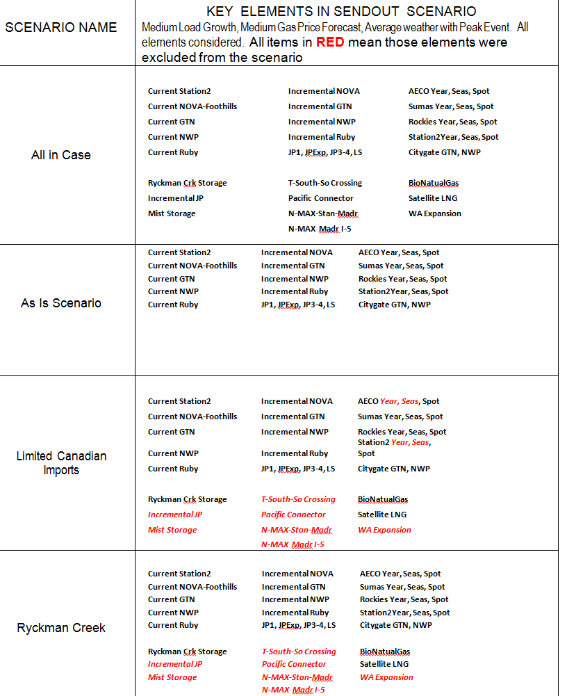

Slide 68
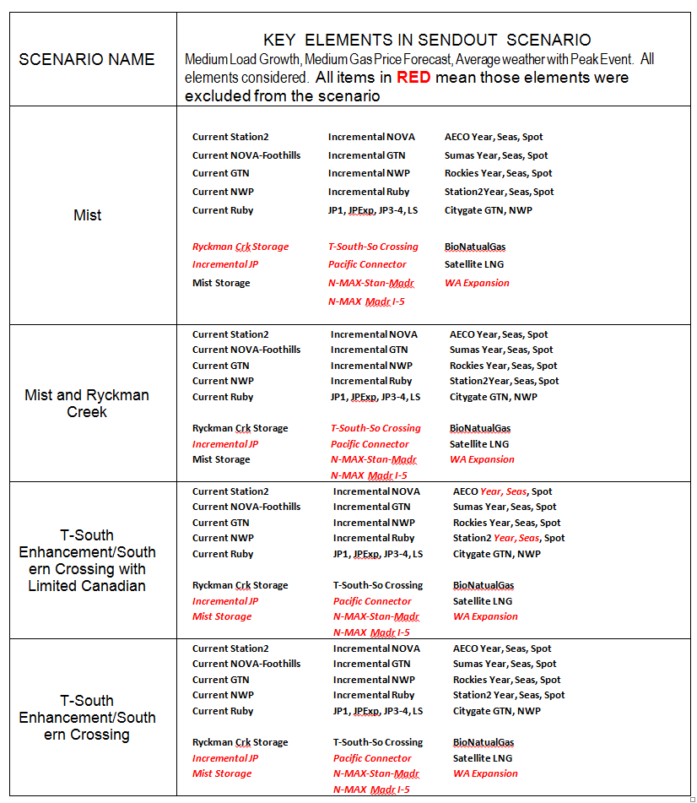

Slide 69
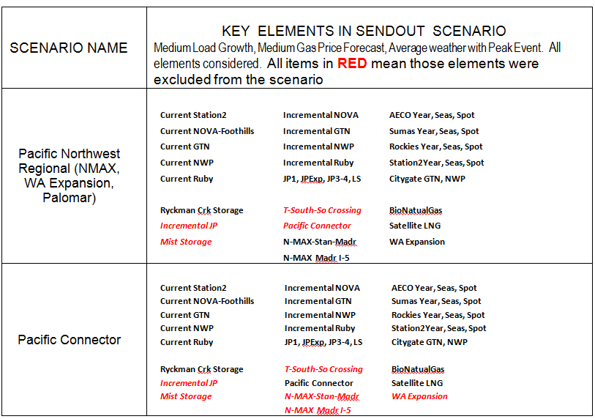

Slide 70
Supply Resource Scenario Stochastic Risk Analysis

Slide 71
Risk Analysis – Cascade’s goasl (re-order)
•Scenario optimization is based upon assumptions that are going to be wrong to some degree or another
–Load Forecast
•Customer counts
•Usage
•DSM/EE savings
–Natural Gas Price Forecast
–Carbon Policy Cost of Compliance (not included in risk analysis since all therms under assumption all therms have same carbon intensity)
–Resource option costs
–Weather
•Risk analysis tests the sensitivity of the results to changes in these assumptions to determine the robustness of the choice to acquire resources
•Risk analysis in the 2016 IRP is not as critical to resource decisions for this Action Plan since Mist Recall carries little risk. Resource choices that carry a significant amount of risk are expected to be made in future IRPs.

Slide 84
It is expected that if NW Natural needed to make a decision to subscribe to a new regional interstate pipeline project starting in 2021-22 or forego the opportunity indefinitely it would be lower cost than not subscribing. However, at the 95th percent confidence bound it would be cheaper not to subscribe to the pipeline project

Slide 85
Risk Analysis Key Findings
NW Natural’s stochastic supply resource risk analysis utilizes Monte Carlo simulation and is new to this IRP
•The goal of stochastic risk analysis is to test the sensitivity of expected resource decisions to assumptions about prices, weather, resource costs, and customer growth that are known to be uncertain
•NW Natural’s current resources play a muting role in the difference in PVRR across portfolios in different futures of the simulation as they will make up the majority of the resource stack over the planning horizon even when considering load growth
•Since LDCs are in the business of distributing natural gas, variation in costs in different future environments tends to move in concert across resource portfolios as fuel switching is not possible
–Only supply basin/trading hub and seasonal price switching is possible

Slide 86
Risk Analysis Key Findings
All 4 base case load Scenarios (1-4 and 7-9) have identical resource portfolios through 2020-21 and Scenarios 1-4 have identical resources through 2026-27 and are only significantly different in the last years of the planning horizon
–Most variation in costs across portfolios takes place at highly discounted values
•There is little chance Mist Recall will turn out to be more expensive than the other long term resource options considered available (though short term city-gate delivery deals or recall agreements could be competitive)- supports Resource Investment Action Item 1
•Load growth uncertainty is not a considerable risk to resource choice in the short term since Mist Recall is flexible and the amount recalled can be determined one year in advance of need
•Resource choices that carry considerable customer risk will be decided in future IRPs
•Feedback on the stochastic risk analysis methodology is important so the tool is ready to go in case a decision with a reasonable degree of risk needs to be made

Slide 87
Other thoughts, questions, concerns…
Are there other ideas or concerns that you feel need to be addressed?
Are there other alternatives we should consider?

Slide 88
Overview
As part of the IRP process, Cascade calculates a 20‐year forecast and 45 years of avoided costs.
The avoided cost is an estimated cost to serve the next unit of demand with a supply side resource option at a point in time. This incremental cost to serve represents the cost that could be avoided through energy conservation.
The avoided cost forecast can be used as a guideline for comparing energy conservation with the cost of acquiring and transporting natural gas to meet demand.
Cascade evaluates the impact that a range of environmental externalities, including CO2 emission prices, would have on the avoided costs in terms of cost adders and supply costs.
We produce an expected avoided cost case based on the medium forecast (base case) peak day.

Slide 89
Costs included in the avoided cost calculation
The long term gas price forecast compiled from a consultant’s gas price forecast (which is the majority of the cost);
A price for carbon included in the gas price forecast, which has been embedded by price forecast consultant
Gas storage variable and fixed costs
Upstream variable and fixed transmission costs;
Peak related on‐system transmission costs; and
A 10 percent adder for unidentified environmental benefits, as recommended by the Northwest Power and Conservation Council (“NWPCC”).

Slide 90
METHODOLOGY
The SENDOUT® resource planning model is used to generate the avoided costs.
SENDOUT® contains a marginal cost report which lists the daily incremental cost to serve the next unit of demand for each demand region.
The model determines the lowest cost method for serving the next unit of demand and computes a marginal cost.
ALTERNATIVE RESOURCES CONSIDERED
With regards to alternative resources considered in the optimization of the portfolio, there is a level of uncertainty as to when certain alternative supply side resources will materialize and yet a base case needs to be created to calculate the avoided cost.
Using the base case demand parameters as inputs, including the design weather pattern, and base case customer and gas price forecasts, in addition to existing supply side resources, the Company’s resource portfolio for purposes of the avoided cost calculation include:
Ryckman Creek storage
Incremental NGTL, Foothills, GTN and NWP transport (all of which are allocated between Oregon and Washington).
Also, a small level of satellite LNG and biogas is also included in the base case—however; these two alternative resources are assigned directly to Washington.
NOTE: The optimal portfolio will be available until TAG 5. Some of the assumptions above are subject to change.

Slide 91
2016 IRP Timeline

Slide 92
Questions?
Next Steps?

Slide 93
Cascade Natural Gas Corporation Integrated Resource Plan Technical Advisory Group Meeting #3
Tuesday, August 23, 2016
Cascade HQ – Kennewick, WA

