Slide 1
Palouse Falls
Public Safety Fence
OVER HEAD DIAGRAM
Proposed Fencing Project

Slide 2
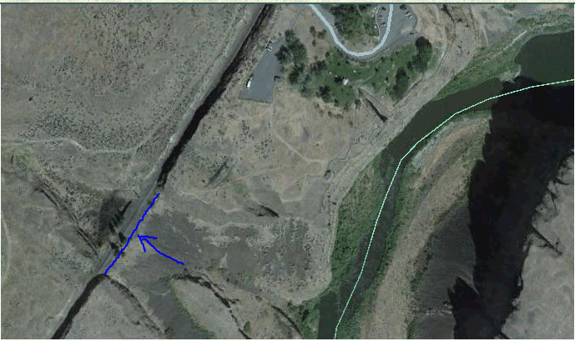
Public fencing project will create a barrier from Palouse Falls State Park to the North where the trail system leads to our right of way. The Proposed North fence will tie in with Natural Basalt Rock Barriers and will eliminate access to the Union Pacific Right of way.
Proposed South Fence

Slide 3
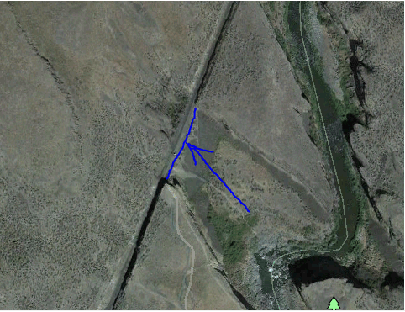
The North Fence will also tie in with natural Basalt rock Barriers and eliminate the public from using the trail system to access the Union Pacific right of way.
Proposed North Fence

