Slide 1
WECC Dialogue and Resource Adequacy Work
Jordan White
Vice President of Strategic Engagement & Deputy General Counsel
Victoria Ravenscroft
Sr. Policy and External Affairs Manager

Slide 3
Western Assessment of Resource Adequacy

Slide 4
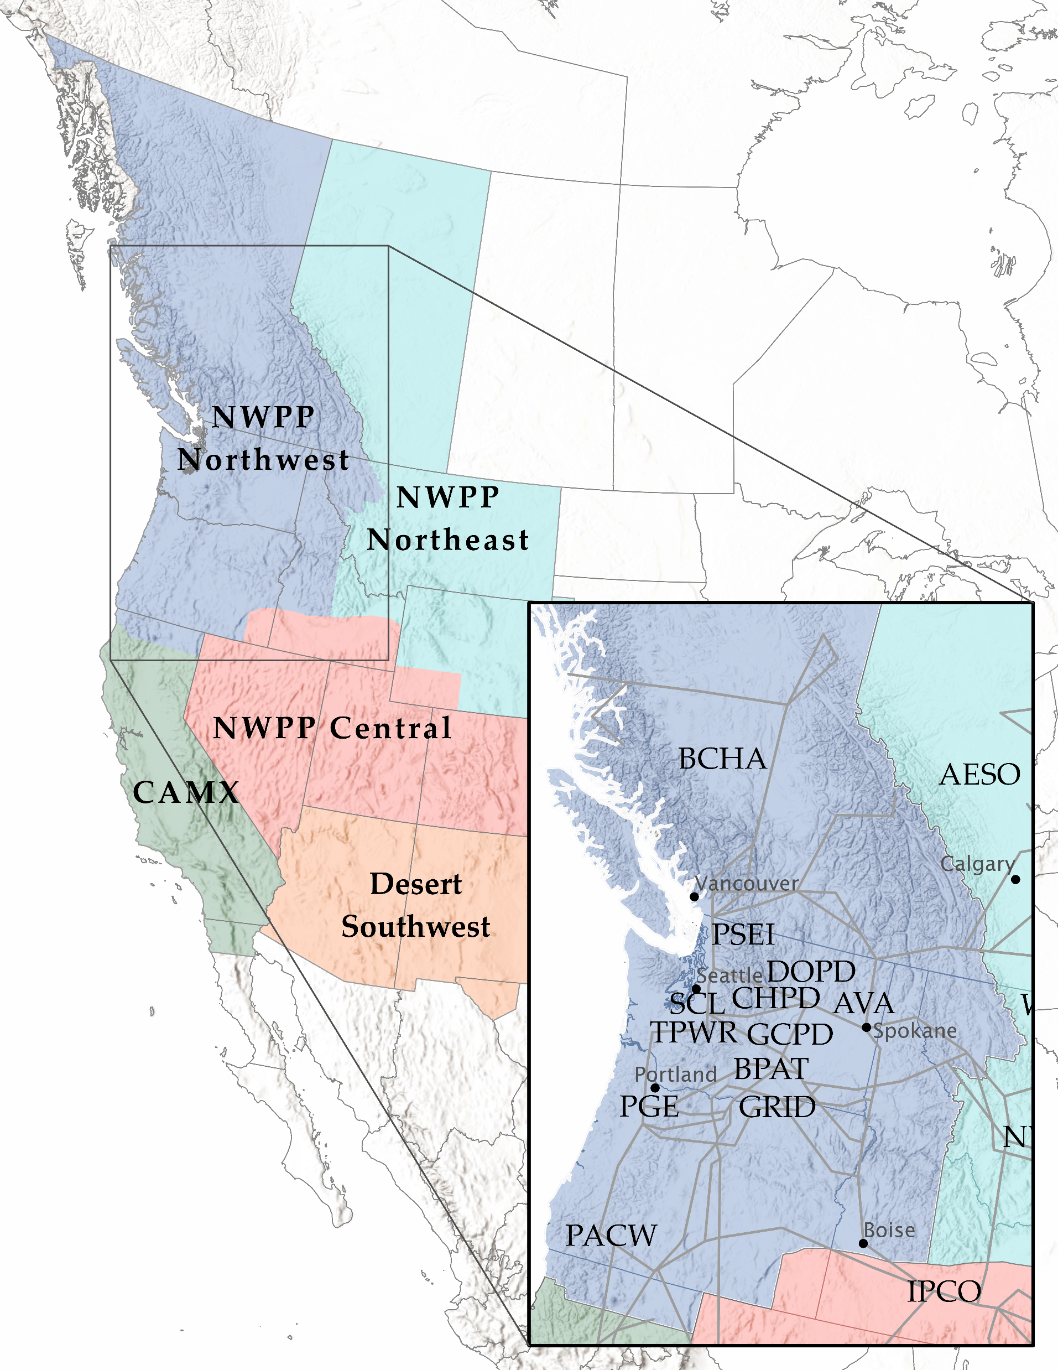
Assessment Regions
NWPP Northwest (NWPP-NW)
NWPP Northeast (NWPP-NE)
NWPP Central (NWPP-C)
California-Mexico (CAMX)
Desert Southwest (DSW)

Slide 5
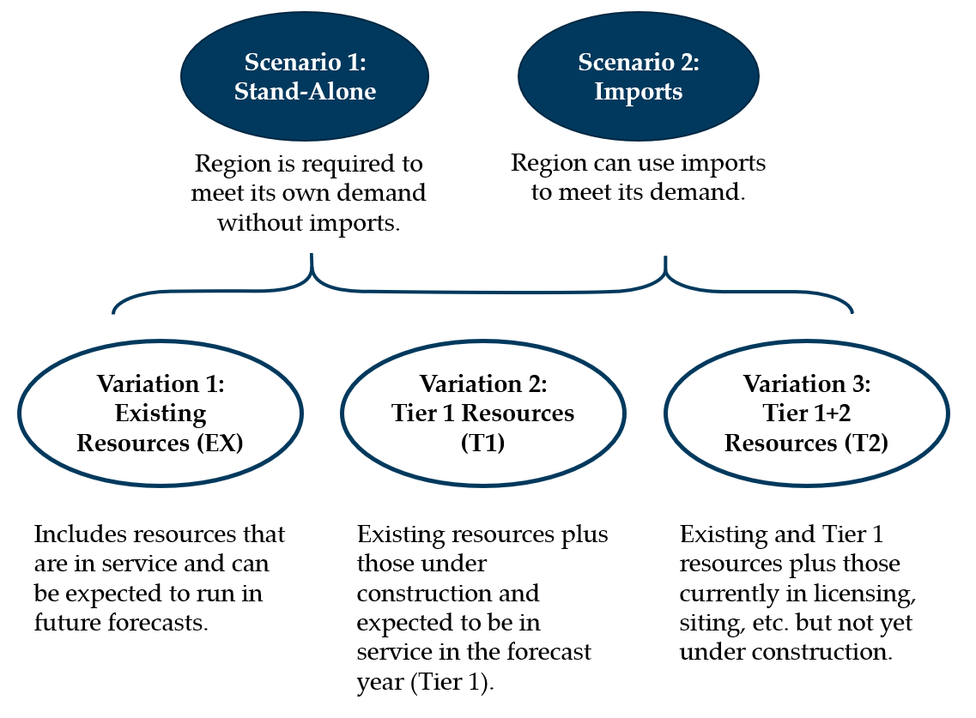
Western Assessment of Resource Adequacy
Scenarios
Risk Tolerance Threshold
“One day in ten years”
1 Day / 3650 Days = 0.027%
Risk Tolerance Threshold = 99.97%

Slide 6
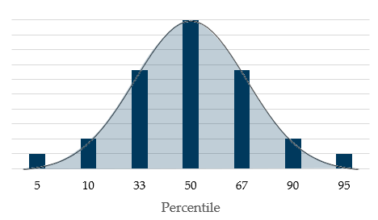
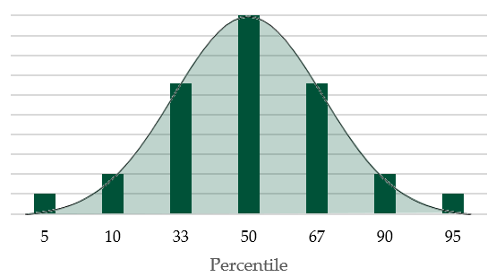
Develop Probability Functions
Demand Forecast
Resource Availability

Slide 7
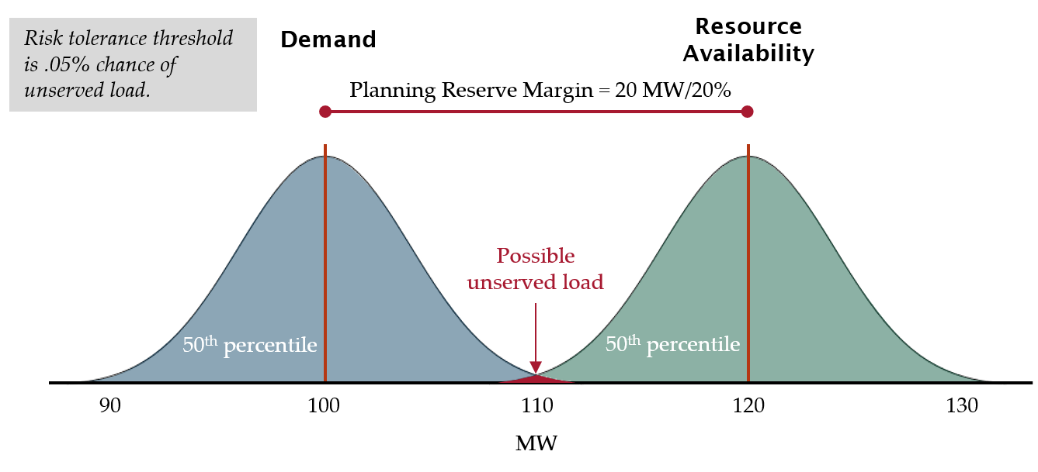
Loss of Load Probability

Slide 8
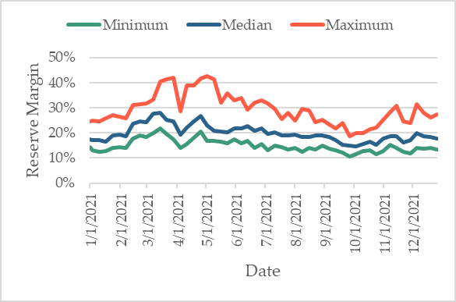
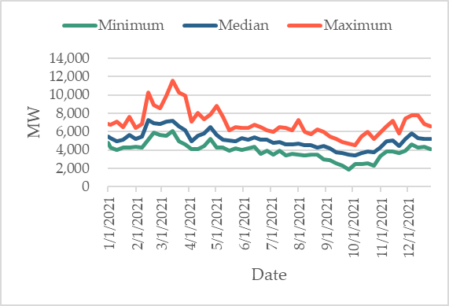
Reserve Margins
Planning Reserve Margin Plot - Percent
Planning Reserve Margin Plot - MW

Slide 9
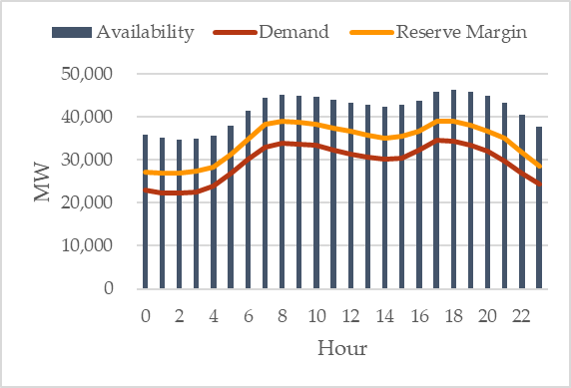
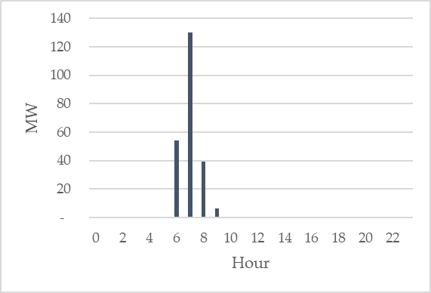
2021 Peak Day Results for NWPP-NW Subregion
Peak Day Condition Expectations - 2021
2021 Peak Day Potential Demand at Risk
U.S. Area

Slide 10
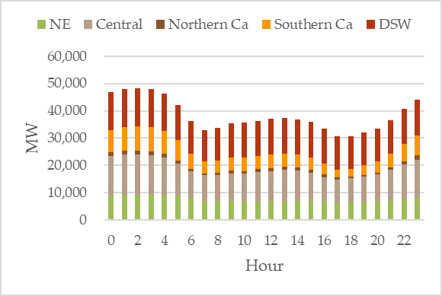
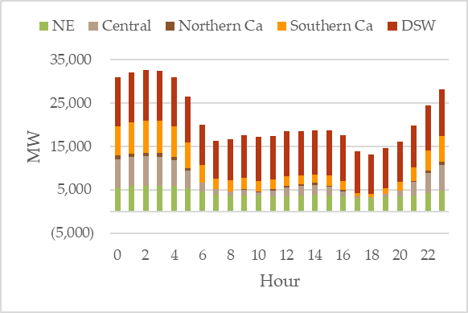
2021 Peak Day Low Import Availability Scenario
Peak Day Expected Import Availability - 2021
Peak Day Low Import Availability - 2021

Slide 11
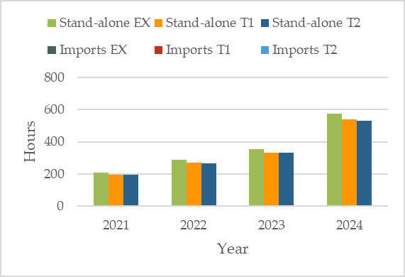
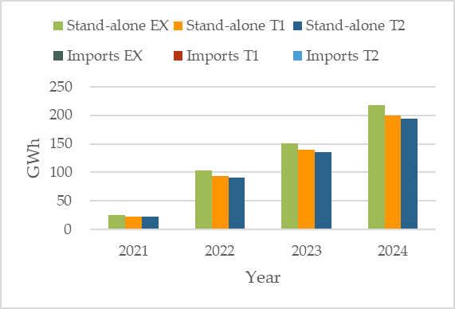
Potential Demand at Risk
Potential Demand at Risk – Hours
Potential Demand at Risk – GWh

Slide 12
NWPP-NW Conclusions
Under expected conditions, with no imports, the subregion could be resource inadequate as early as 2021
Imports greatly reduce the probability of being resource inadequate
Growing supply and demand variability across the interconnection increases the risk that imports may not be available when needed

Slide 13
Western Interconnection Key Findings
Finding 1: Under Scenario 1, which requires each subregion to meet its own demand without imports, all subregions show some risk of unserved demand, regardless of the addition of Tier 1 and Tier 2 resources
Finding 2: When subregions can import energy (Scenario 2), most hours of potential unserved demand can be resolved
Finding 3: Increasing levels of variable resources drive the resource adequacy issues seen in this analysis
Finding 4: Historical approaches to resource planning, if unchanged, will result in a significant degradation of resource adequacy

Slide 14
Western Interconnection Recommendations
Recommendation 1:
Consider moving away from a fixed planning reserve margin
Recommendation 2:
Consider not only how much additional capacity is needed to mitigate variability, but also the expected availability of the resource
Recommendation 3:
Planning entities should coordinate their resource planning efforts on an interconnection-wide basis each year to help ensure they are not all relying on the same imports

Slide 15
Jordan White
jwhite@wecc.org
Victoria Ravenscroft
vravenscroft@wecc.org

