Slide 1
Energy Delivery System Planning Process
UTC Rulemaking for Integrated Resource Planning Transmission and Distribution Workshop
March 10, 2017

Slide 2
Planning considerations differ between gas and electric
Considerations | Natural Gas | Electric
Service obligations | Feasibly serve; Upon service - obligation to serve | Obligation to serve
Design demand | Typically planning for winter peak hour | Winter and summer peak depending on customer equipment
Outages | Outages pose safety risk and are avoided; typically design for colder temperatures than electric | Outages can occur and result in reliability concerns
System configuration | High pressure backbone; networked/2-way flow, where practical Intermediate/low pressure pipelines; highly networked/2-way flow | Transmission networked; 2-way flow Distribution feeders maybe networked: 1-way flow Distribution laterals typically radial
Focused and monitored regulation | Operations and Maintenance including design is heavily prescribed at all levels and audited by UTC routinely | Bulk Electric System is heavily regulated by FERC/NERC and audited every 2-3 years by WECC – focused prescribed planning Other codes – bit more flexibility, little monitoring
Source supply | Interstate pipelines - Williams Northwest Pipeline | Self supply with PSE owned generation or from other providers such as Bonneville Power Authority
Regional planning responsibility | Interstate pipeline operators | Columbia Grid
Source augmentation | Mobile or permanent liquefied natural gas or compressed natural gas injected on site from core supply, biogas | Battery storage, distributed generation
* “Transmission” defined by how much stress pipeline is operating at (>20% SYMS)
*Note - This is not meant to be a comprehensive list

Slide 3
Detailed process used to determine infrastructure needs and investments
Natural gas and electric infrastructure planning uses the same core process

Slide 4
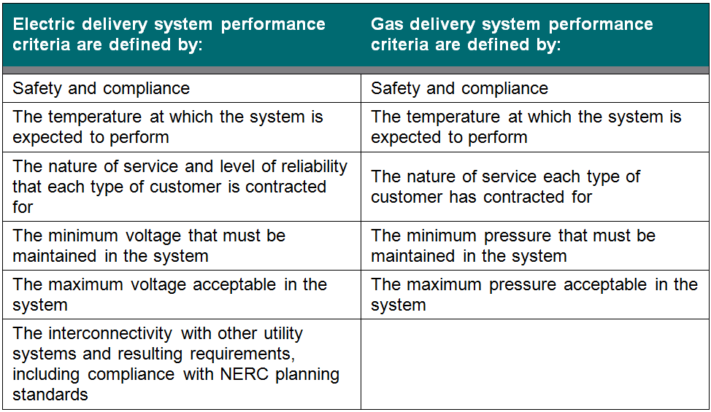
There are multiple drivers for evaluating need
Drivers/criteria
Customer request
Load growth
Reliability
Compliance
External commitment
Aging Infrastructure
Integration of resources

Slide 5
Analysis tools are robust and comprehensive
TOOL | USE | INPUTS | OUTPUTS
SynerGi® | Network modeling | Gas and electric distribution infrastructure and load characteristics | Predicted system performance
Power World Simulator – Power Flow | Network modeling | Electric transmission infrastructure and load/generation characteristics | Predicted system performance
PSS/E Power Flow & Stability | Network modeling | Electric transmission infrastructure and load/generation characteristics | Predicted system performance
PSLF Power Flow & Stability | Network modeling | Electric transmission infrastructure and load/generation characteristics | Predicted system performance
Electric Predictive Spreadsheet | Predictive analysis | Electric outage history | Predicted outage savings
Gas Outage Spreadsheet | Predictive analysis | Gas network model output for future capacity | Predicted outage savings
Estimated Unserved Energy (EUE) Spreadsheet | Electric financial analysis | Electric project costs; hourly load data; load growth scenarios | Net Present Value; income statement; load growth vs. capacity comparisons; EUE
Investment Decision Optimization Tool (iDOT) | Project data storage & portfolio optimization | Gas and electric project scope, budget, justification, alternatives and benefits; resources/financial constraints | Optimized project portfolio; benefit cost ratio for each project; project scoping document
*Note - This is not meant to be a comprehensive list

Slide 6
Alternatives are evaluated for meeting the determined need
Electric
Add energy source
Substation
Strengthen feed to local area
New conductor
Replace conductor
Improve existing facility
Substation modification
Expanded right-of-way
Uprate system
Rebalance load
Modify automatic switching scheme
Load reduction
Fuel switching
Distributed energy resource
Natural gas conversion
Conservation / Demand response
Load control equipment
Possible new tariffs
Do nothing
Gas
Add energy source
City-gate station
District regulator
Strengthen feed to local area
New high pressure main
New intermediate pressure main
Replace main
Improve existing facility
Regulation equipment modification
Uprate system
Load reduction
Fuel switching
Conservation
Load control equipment
Possible new tariffs
Do nothing

Slide 7
Alternatives are evaluated and recommendations compared
Benefit analysis performed across multiple types of projects and risks – Both gas and electric projects are analyzed using this common platform
Maximize value
to PSE, customers,
employees,
and shareholders
Regulatory
compliance
Treated as constraint
PSE financial
success
Health
safety & the
environment
Customer
satisfaction
Stakeholder
Concerns
/perceptions
Platform
for
success
Project Cost
Public
Outages
Key constituents
Citizens
WECC/NERC
WUTC
IPP’s
State & fed agencies
NGO’s
Other utilities
Property owners
Strategic
infrastructure
Cost Savings
in Other Areas
Workers
Unmet
Energy needs
Flexibility
Impacts on
Revenue
Natural
environment
Service
quality
New technology,
learning
Advance other
components of
strategy

Slide 8
PSE welcomes transparency through several forums and processes
Growth Management Act Comprehensive Plans
Community engagements
Permitting processes
Project information and schedules on PSE website
Specific project community engagements
Regulatory avenues
Commission Policy on Accelerated Replacement of Pipeline Facilities with Elevated Risk
Reports such as Smart Grid Report and Electric Service and Reliability Quality Reports

