Slide 1
IP Networks: Legal and Policy Issues
Washington Utilities and Transportation Commission
Workshop
November 12, 2013
Dave Conn
Vice President -- State Regulatory
T-Mobile US
Dave.Conn@T-Mobile.com

Slide 2
T-Mobile Overview
Completed combination with MetroPCS on May 1, 2013; trades on NYSE as “TMUS”
Combined company:
c. 45 million customers
$3.4B capital expenditures (2012)
$24.8B revenues (2012)
“UnCarrier” Initiatives
1.0 Simple Choice plans rolled out in March 2013
2.0 JUMP!™ Phone Upgrade Program
3.0 Part I – Expanded Data and Texting in 100 Simple Global countries for most Simple Choice customers
3.0 Part II – Tablets Un-Leashed

Slide 3
IP Transition
An orderly industry transition to IP networks holds potential for enormous benefits, including greater efficiencies for carriers and new and better competitive services for consumers.
However, IP networks should not replicate the architecture of the legacy TDM network which reflects outdated and inefficient network design.

Slide 4
The Importance of IP Interconnection
Network evolution
GSM → EDGE → UMTS → HSPA → HSPA+ → LTE
CDMA → CDMA2000 → EVDO Rev. 0 / A / B → LTE
LTE rapidly evolving to Voice over LTE (VoLTE)
VoLTE is a packetized voice technology
Bottom Line
Voice services provided by wireless carriers will transition over the next few years to a packet-based technology.
Conversion of traffic to circuit-switched technology for interconnection is inefficient.

Slide 5
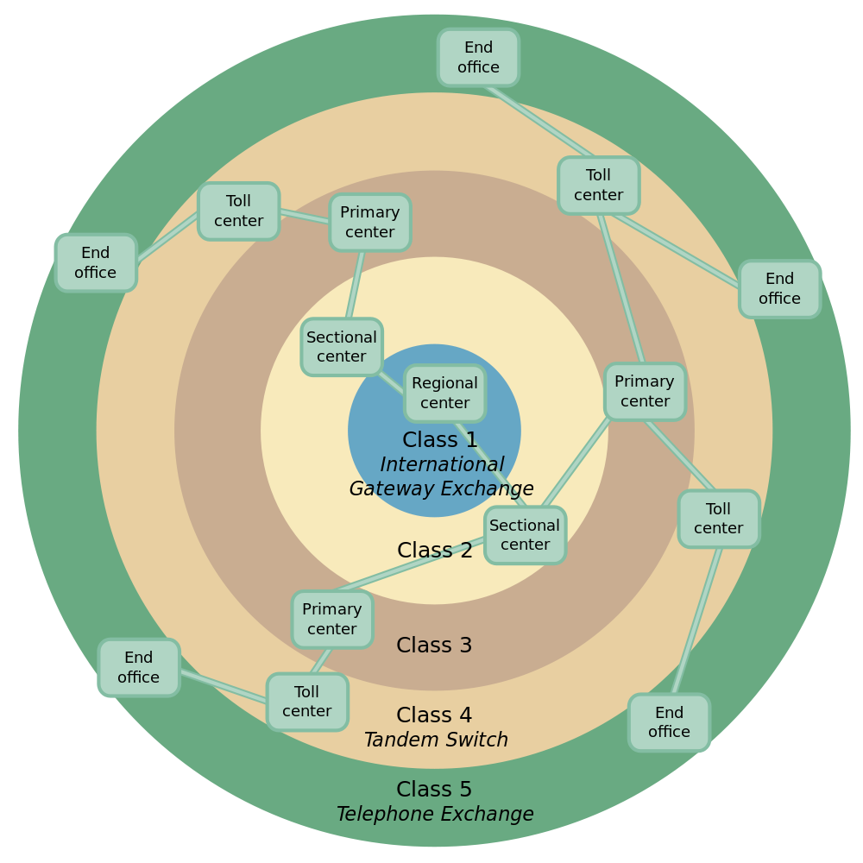
Network Architecture of the Past
Hierarchical
Generally: links up and down, but not “sideways”
Common ownership (except for “independent” class 5 offices and some tandems)

Slide 6
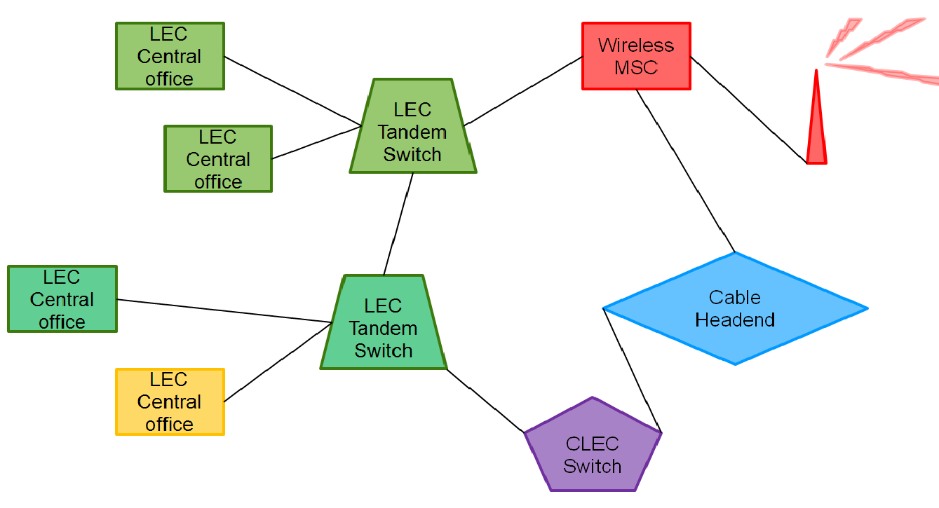
Network Architecture of the Present
Flatter
Multiple connections (both direct and indirect interconnections)
Diverse ownership, but key points under RBOC control

Slide 7
Network Architecture of the Future
Flat
Route diversity with regional exchange points
Diverse ownership without RBOC concentration
Carrier
Carrier
Carrier
Regional Packet Traffic Exchange Point
Carrier
Carrier
Carrier
Carrier
Carrier

Slide 8
Advantages of Future Network Architecture
Each carrier controls, and is responsible for, its own traffic (that is, traffic which originates on its network, or which terminates on its network).
Two-way traffic flows allow transport facilities efficiency.
Neutral interconnection points dilute large carrier control, and allow possibility to leverage existing internet exchange points.
Improved network reliability.

Slide 9
Key Considerations
IP voice exchange points should be “carrier-neutral”: they should not be under the exclusive control of any carrier.
Incumbent carriers with existing voice interconnection points on their premises have an incentive to maintain their control.
Fewer points of interconnection (“POIs”) required.
“Bill and Keep” for all traffic.

Slide 10
Key Considerations (continued)
Section 251 of the Act will continue to apply to ILECs during and after the transition to IP networks.
Voluntary negotiations preferred, but a regulatory backstop is required for the negotiation process to work (jurisdiction under 47 U.S.C. §§ 201, 251).
Either existing state arbitration processes under Section 252 or a standard FCC process (such as a complaint process) could be used.

Slide 11
IP Trials
T-Mobile supports a regional trial of VoIP interconnection, covering a number of states, to ensure a robust set of urban and rural areas that may be served by different ILECs. (i.e. Pacific Northwest region, Southeast region)
Carriers should interconnect at a single location in the region, such as an Internet exchange point.
Exchange of all voice traffic in IP format.
Interconnection rates and terms must be reasonable with a regulatory backstop.

Slide 12
Questions?
Email: Dave.Conn@T-Mobile.com

