Slide 1
Procedural rules requirements
Filing documents with the commission via electronic submission
WAC 480-07

Slide 2
Contacting the commission
PHONE
360-664-1160
EMAIL
records@utc.wa.gov
MAIL
1300 S Evergreen Drive SW
|or|
PO Box 47250
Olympia, WA 98504-7250

Slide 3
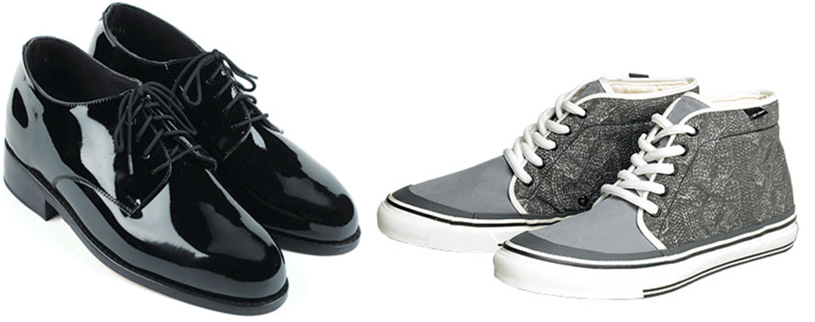
Types of submissions
Formal submissions
Informal submissions
Written submissions that seek or respond to a formal commission action
Required by statute or commission rule
Information filed in a docketed proceeding
Do not seek or respond to a formal commission action
Not required by statute or commission rule
General exchange of information

Slide 4
Formal Submissions
The commission will not accept a document for formal filing unless it is received in electronic form by using one of the following methods:
E-filing portal
Mailed or hand-carried media storage device/disc
Emailing the Record’s Center (only if the web portal is unavailable)

Slide 5
Types of formal documents
Motions
Briefs
Testimony
Answers and Replies
Comments solicited by UTC

Slide 6
Formal submission requirements
Addressed to the commission secretary
Cover letter (required unless the entire submission fits on one page)
Identification of sender
Identification of proceeding, permit, license or certificate
Identification of documents
Proper document format
Named appropriately
Staff direct testimony of John Q. Staff direct testimony of John Q. Witness with information designated as confidential:
179999-Staff-Exh-JQW-1CT-3-1-17 (C)
Correct data capacity
Web Portal - 50 MB per submission
Email – 10MB
Confidential designation (if applicable)

Slide 7
Commission secretary
Steven v. King
1300 S Evergreen park drive SW
|or|
PO Box 47250
Olympia, wa 98504-7250

Slide 8
Cover Letter
A cover letter is required unless the sole document submitted is a letter, or the document is one page in length and includes all formal submission requirements. The cover letter must include:
Identification of sender
Identification of proceeding, permit, license or certificate
Description of document(s)
Confidential filing designation (if applicable)

Slide 9
Identification of sender
Full name
Mailing address
Telephone number
Email address
Title/position with company
Name of entity on whose behalf they are representing
Please note: The entity must be identified by using the exact name on file with the commission

Slide 10
Identification of proceeding, permit, license or certificate
Each filing type shall include the following information:
Adjudicative Proceedings
Name of proceeding
Docket number
Pleading type
Certificate of service
Docket Filings
Name of proceeding
Docket number
Transportation Filings
Permit, license or certificate number as issued by the commission

Slide 11
Proper document format
Named in accordance with the file naming conventions example listed on the commission website at www.utc.wa.gov
Filed in searchable .pdf format, except spreadsheets (.xls, .xlsx, .xlsm) which should be submitted in native form
Appropriate file size based upon submission method
E-Filing Portal – 50 MB (large submissions may need to be broken up into multiple postings)
Email – 10 MB (incoming mail attachments have size restrictions due to the commission firewall)
Confidential designation (if applicable)

Slide 12
Confidential filings
DOCUMENTS CONTAINING INFORMATION DESIGNATED AS CONFIDENTIAL OR HIGHLY CONFIDENTIAL MUST BE MARKED ACCORDINGLY, AND SUBMITTED WITH A REDACTED COPY

Slide 13
Confidential & Highly Confidential Information Requirements
Confidential information
Highly confidential information
Protected under RCW 42.56
Information protected under the terms of a protective order in an adjudicative proceeding
Valuable commercial information, including trade secrets, marketing, financial information or customer-specific usage and network configuration
Must meet all confidential criteria and meets the requirements in RCW 80.04.095 or 81.77.210
Commission may authorize protection only pursuant to a protective order

Slide 14
Confidential designation
The confidential designation must be present in the cover letter and on the first page, and every subsequent page that contains confidential information. Each copy of the confidential version should be marked as follows:
Dockets with protective orders
Dockets without protective orders
“Designated information is confidential per protective order in Docket (fill in docket number)”
|or|
“Designated information is highly confidential per protective order in Docket (fill in docket number)”
“Designated information is confidential per WAC 480-07-160”
|or|
“Designated information is highly confidential per WAC 480-07-160”
All confidential information shall be highlighted with no more than 20% grey shading to indicate withheld information

Slide 15
Filing confidential documents
Formatting Requirements
2 Separate documents
Proper confidential designation
Must be present in the cover letter and on the first page and every subsequent page that contains confidential information
20% or less gray shading over sensitive information
Searchable .pdf format
Filed separately from redacted document(s)
Redacted copy
Highly confidential copy

Slide 16
Filing highly confidential documents
Formatting Requirements
2 Separate documents
Proper confidential designation
Must be present on the first page and every subsequent page that contains confidential information
20% or less gray shading over sensitive information
A clear distinction between confidential and highly confidential material must be present
Searchable .pdf format
Filed separately from redacted document(s)
Redacted copy
Highly confidential copy

Slide 17
Filings with both confidential and highly confidential documents
Formatting Requirements
3 separate documents
Proper confidential designation
Must be present on the first page and every subsequent page that contains confidential information
20% or less gray shading over sensitive information
A clear distinction between confidential and highly confidential material must be present
Searchable .pdf format
Filed separately from redacted document(s)
Redacted copy
Confidential copy
Highly confidential copy

Slide 18
Submitting Informal documents
The commission prefers that all submissions come through the Records Center portal, however, they can be submitted to the commission using any of the following methods:
Comment form on UTC website
Telephone
Letter
Email
Courtesy window (in person)

Slide 19
informal submissions include
Consumer complaints
Public comments on an item at an open meeting
Oral or written comments from a non-party in an adjudication
Information letters from regulated companies
General correspondence not related to a docketed item

