Slide 1
Insights on Resource Adequacy from Advanced Analytical Techniques
Elaine Hart, Moment Energy Insights
Ana Mileva, Blue Marble Analytics
UTC Resource Adequacy Meeting
July 24th, 2023

Slide 2
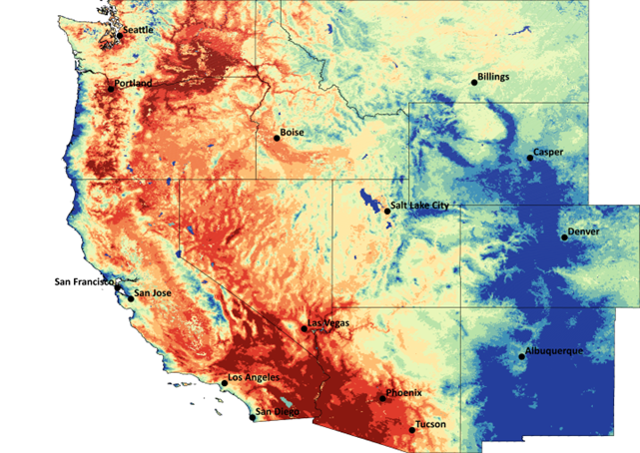
Why Conduct West-wide RA analysis?
Decarbonization in a manner that maintains reliability and affordability will require regional coordination
Evaluating clean technologies and regional coordination requires new capabilities in our RA analyses
Several efforts are underway to enhance regional coordination through expansion of markets and development of regional programs (e.g. the Western Resource Adequacy Program, or WRAP)
The system is already highly interdependent even without an organized market, and efforts to account for this in RA analysis are often fraught
Max Daily Temperature, June 21, 2021

Slide 3
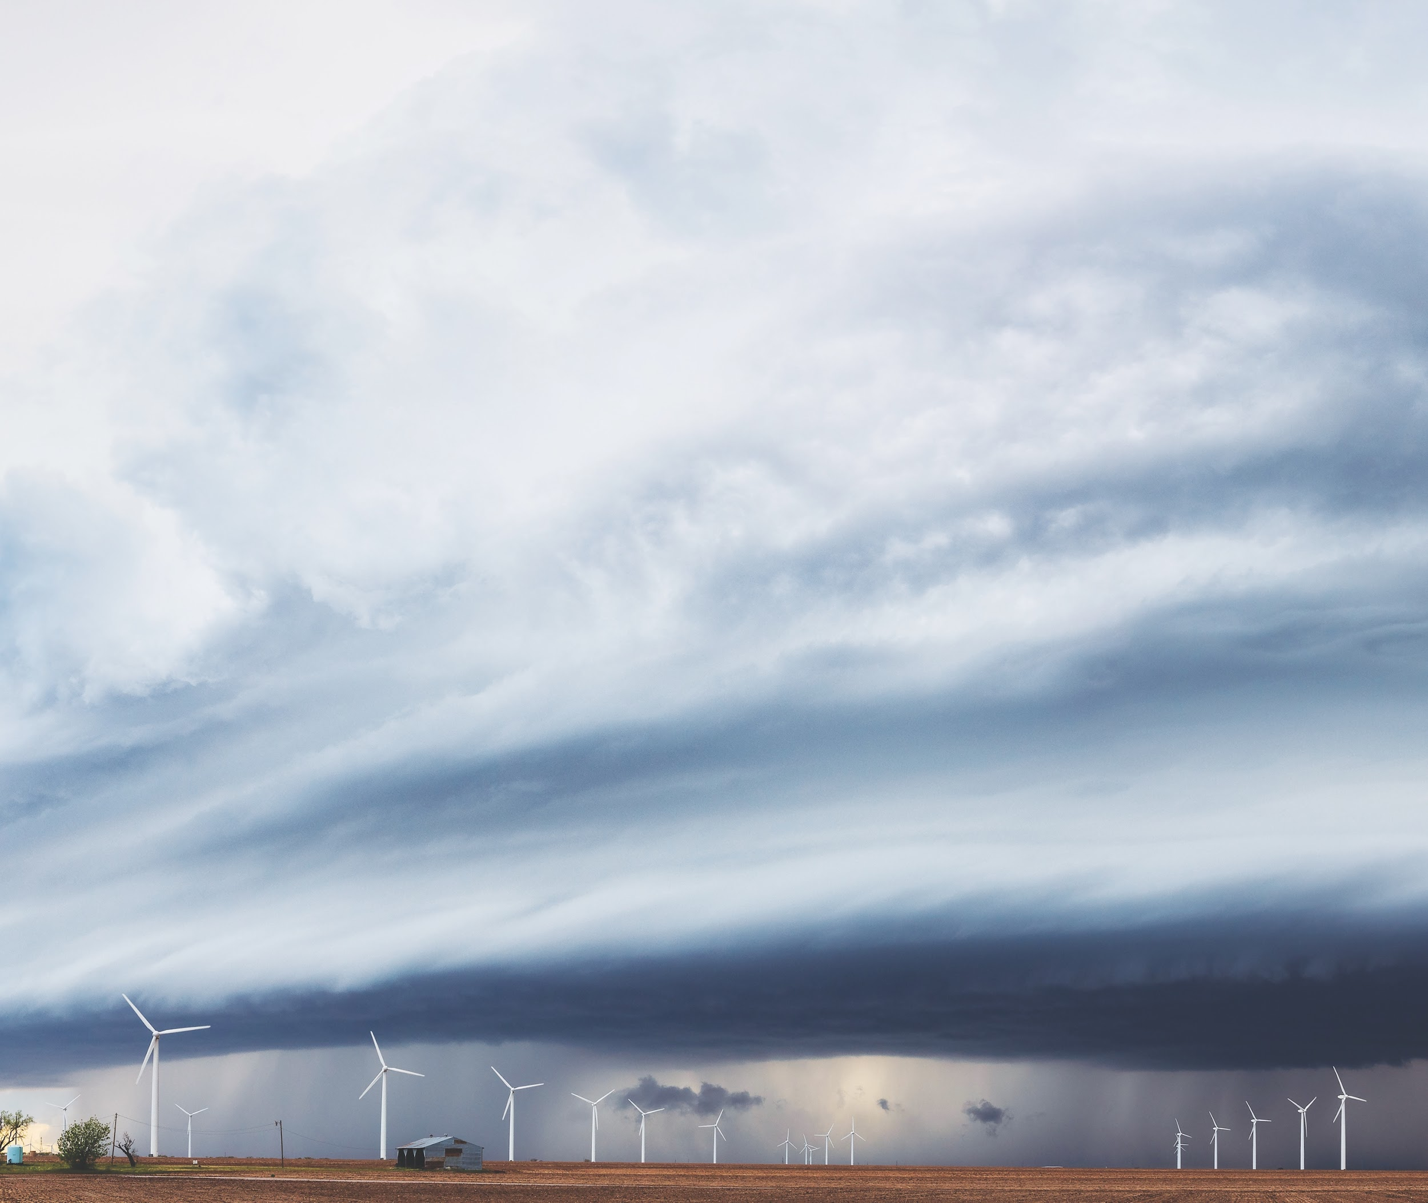
GridPath RA Toolkit What is needed to fully evaluate clean technologies and regional coordination within RA analysis?
Weather correlations
Must account for complex weather correlations between load and resource availability over very large geographical areas.
Energy-limited resources
Must account for the dynamic cabilities and limitations of energy-limited resources, like hydropower, energy storage, and hybrid resources.
Transmission
Must account for the benefits and limitations of the transmission system to realize geographical diversity.

Slide 4
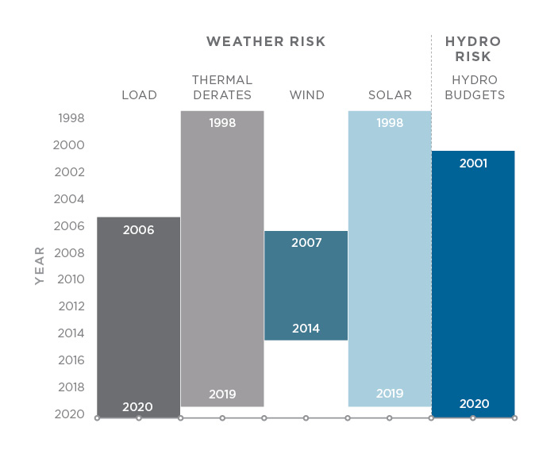
Weather-based analysis
Weather-based datasets with adequate granularity and coverage for West-wide analysis are limited
RA analysis focuses on the likelihood of very rare events, so the findings can be highly sensitive to which years of weather data are available
Historical data may not reflect future weather
Every RA study grapples with this problem. More and better data is needed.
Coverage of publicly available datasets
(FERC Form 714, NSRDB, Wind Toolkit, EIA Form 923)

Slide 5
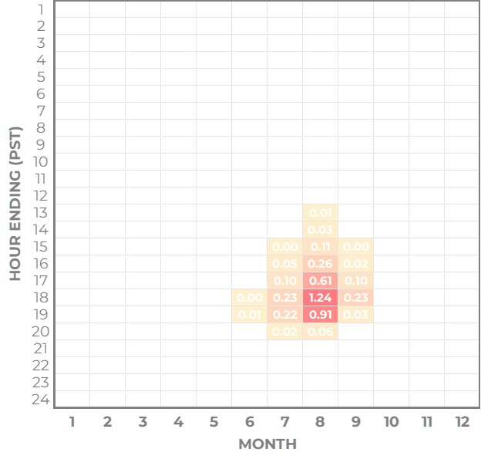
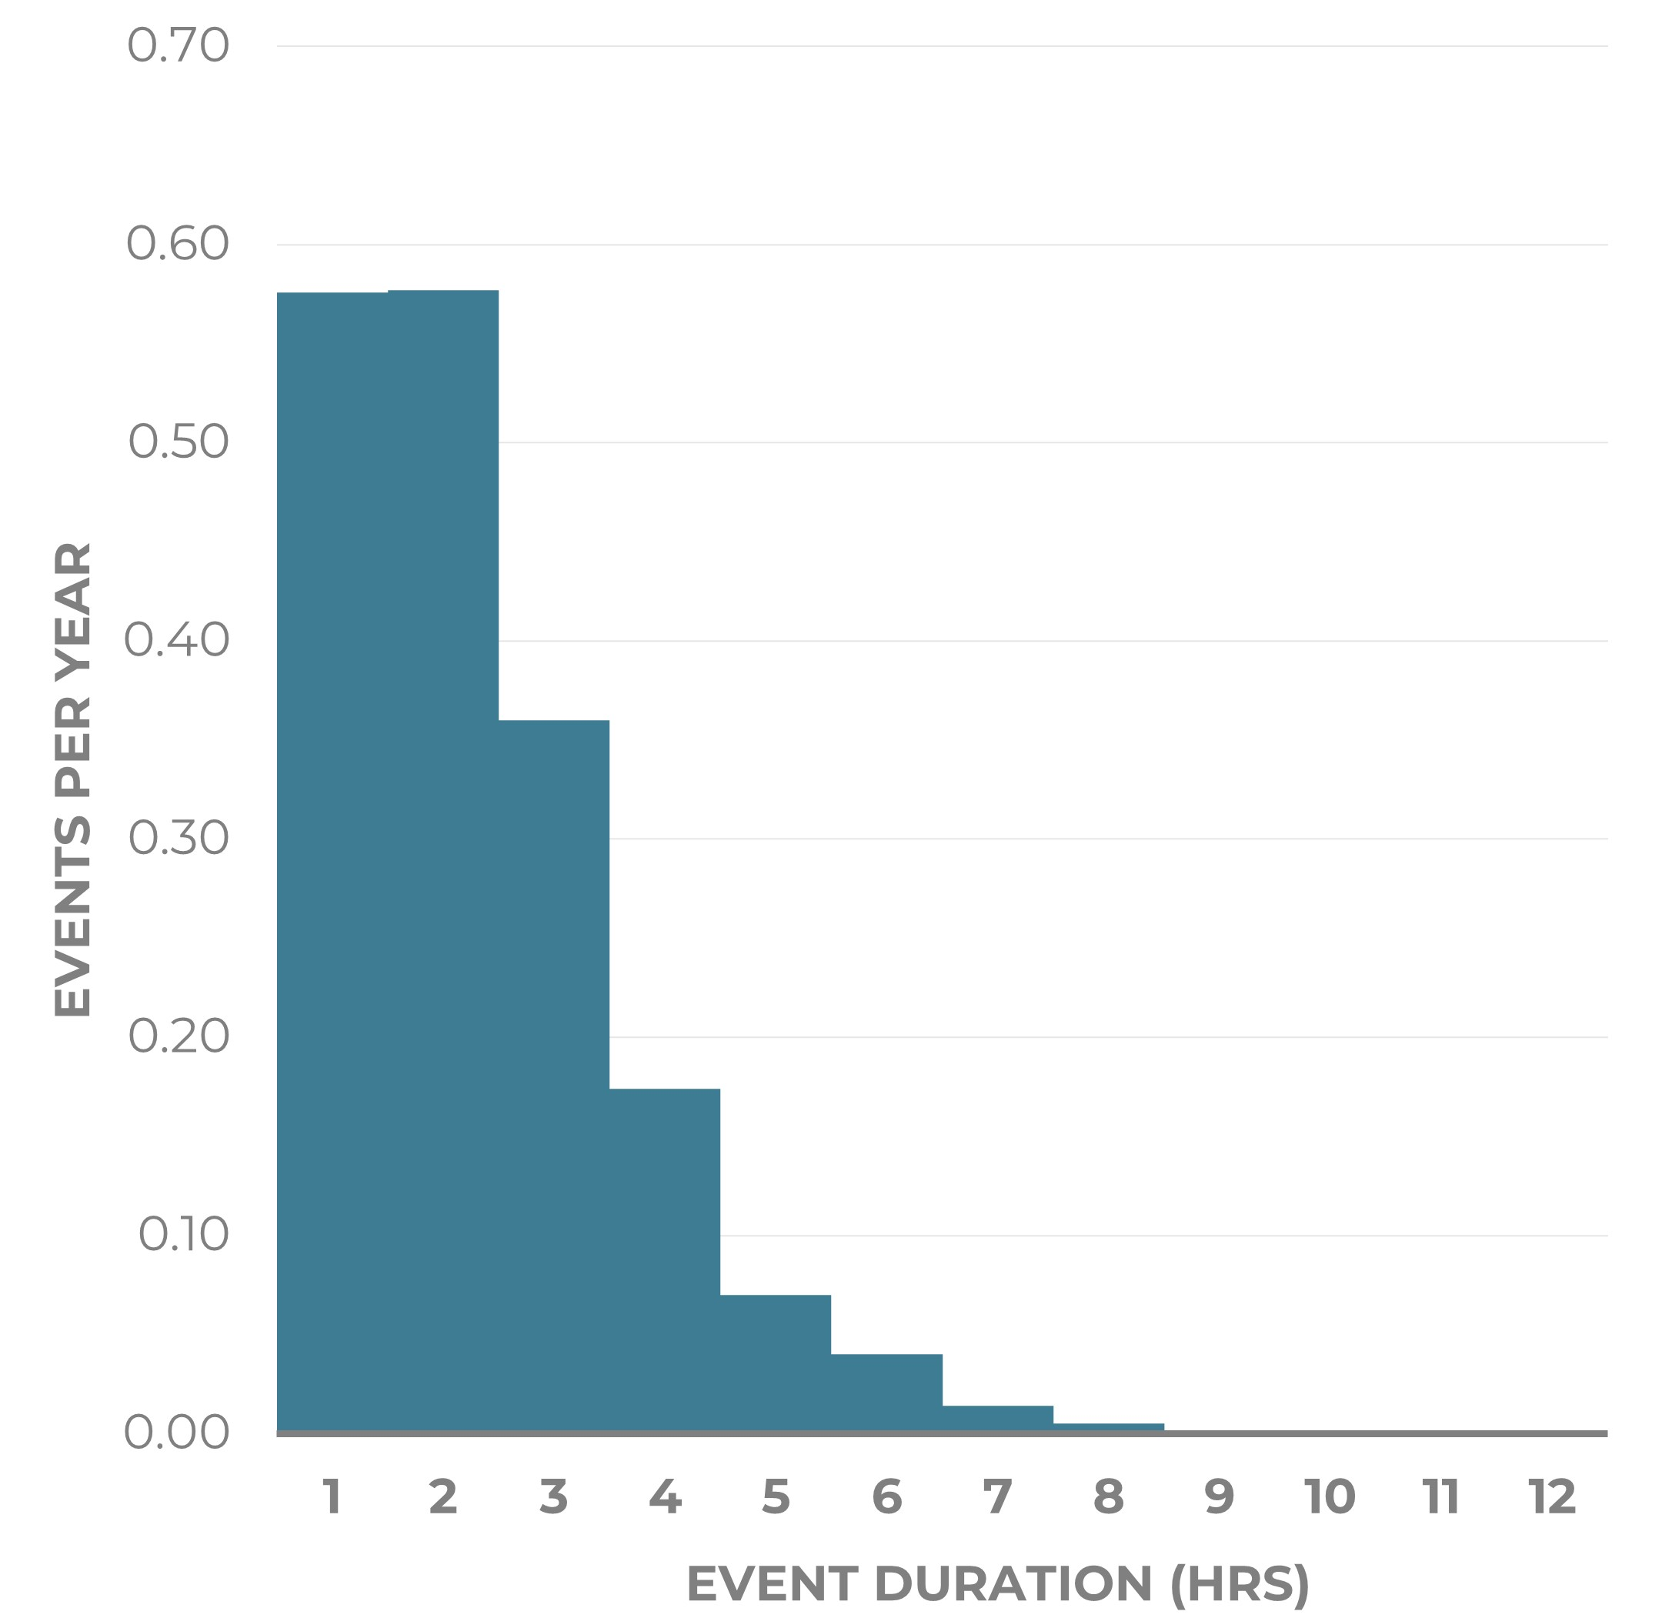
2026 RA Metrics No Additions scenario examines the system without planned additions through 2026
Metric | Value
LOLP_{year} | 69%
LOLE (days/10yrs) | 18.2
LOLH (hrs/yr) | 4.23
EUE (MWh/yr) | 13,797
EUE_{norm} (ppm) | 19.4
Average Event Duration (hrs) | 2.33
Loss of load hours per year
Event duration distribution
Near-term RA risk is concentrated in the evening on hot summer days and is short in duration

Slide 6
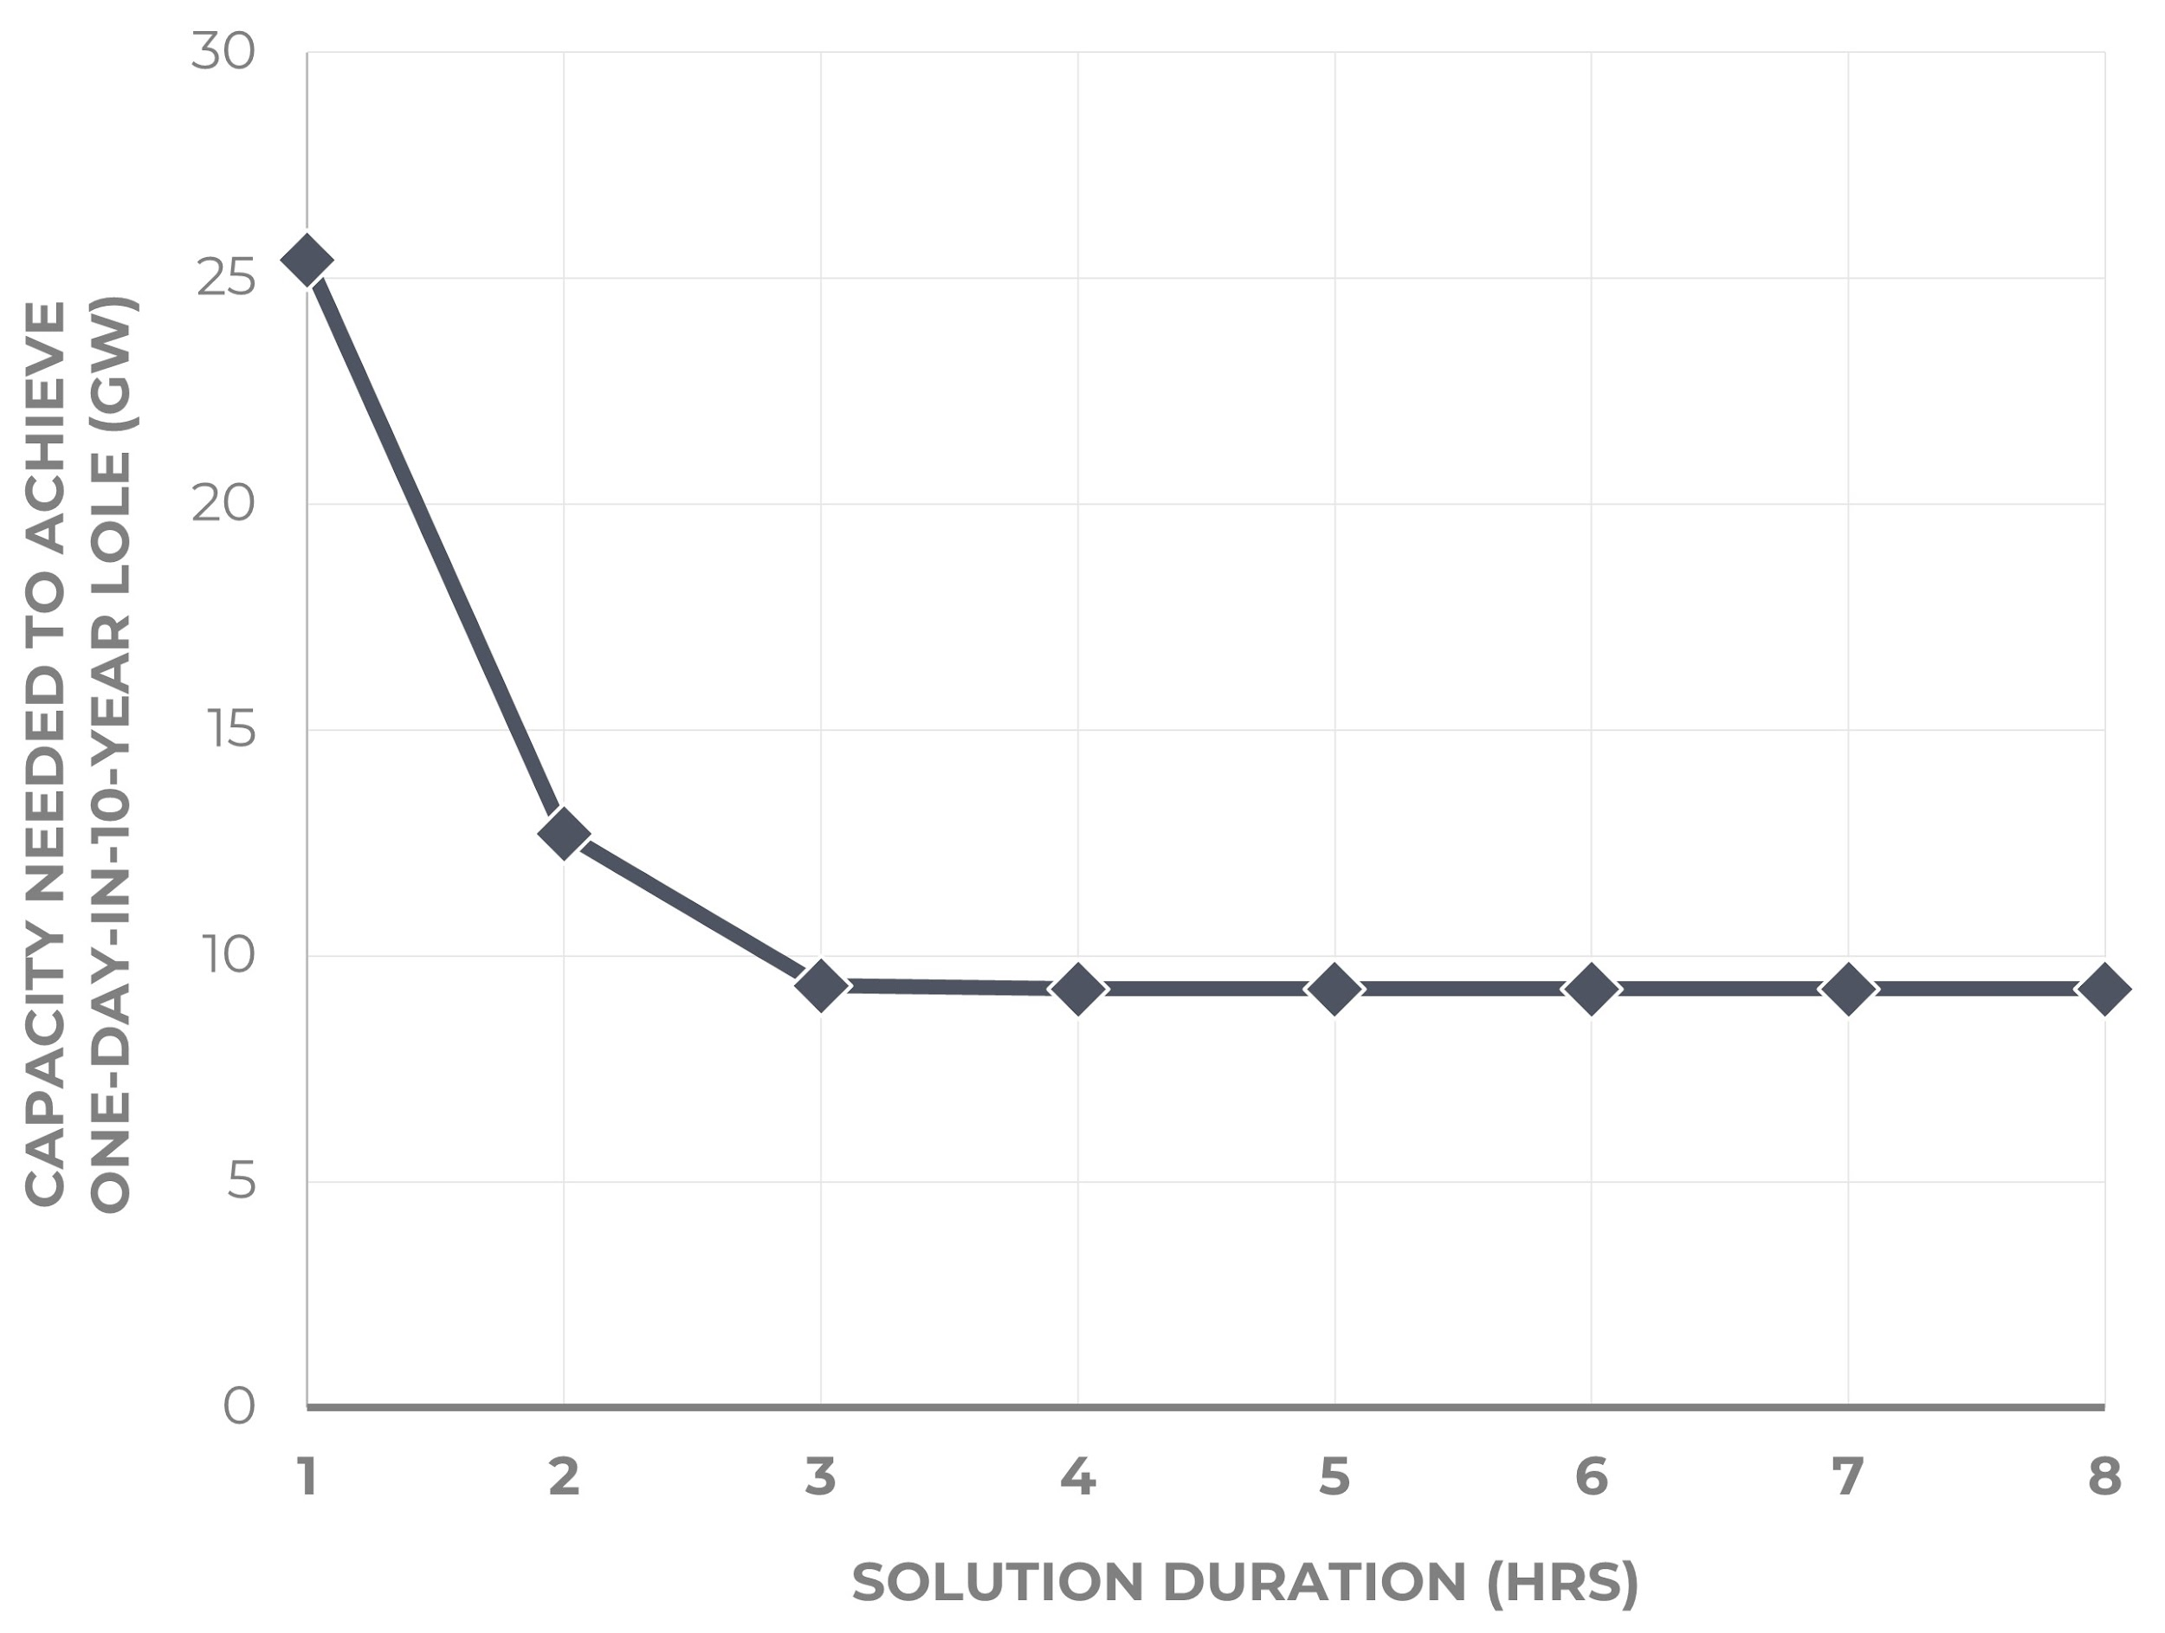
Targeting solutions Short-duration solutions appear to be least cost for meeting near term RA challenges
Capacity and duration efficient frontier
2-hr Capacity Need
12.7 GW
4-hr Capacity Need
9.3 GW
Perfect Capacity Need
9.3 GW

Slide 7
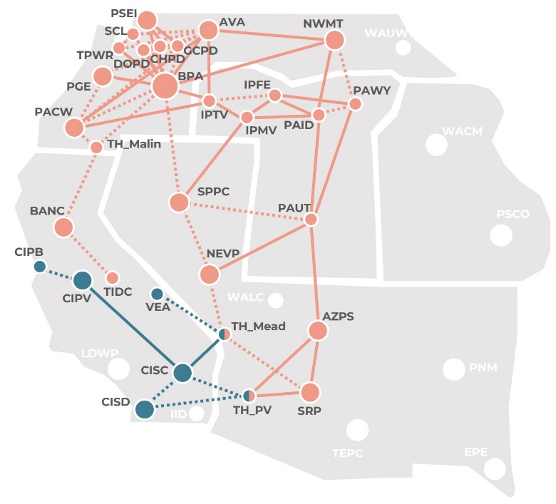
Subregional analysis approach
Subarea | WECC BAAs/Zones
CAISO | CIPB, CIPV, CISC, CISD, VEA, TH_Mead (partial), TH_PV (partial)
WRAP | AVA, AZPS, BANC, BPAT, CHPD, DOPD, GCPD, IPFE, IPMV, IPTV, NEVP, NWMT, PACW, PAID, PAUT, PAWY, PGE, PSEI, SCL, SPPC, SRP, TIDC, TPWR, TH_Malin, TH_Mead (partial), TH_PV (partial)
Excluded | EPE, IID, LDWP, PNM, PSCO, TEPC, WACM, WALC, WAUW
Weather-coherent and transmission- constrained imports:
When imports are allowed, unserved energy for a given subarea (CAISO or WRAP) is only recorded to the extent that it was observed in the islanded simulation AND in the West-wide simulation under the same weather conditions

Slide 8
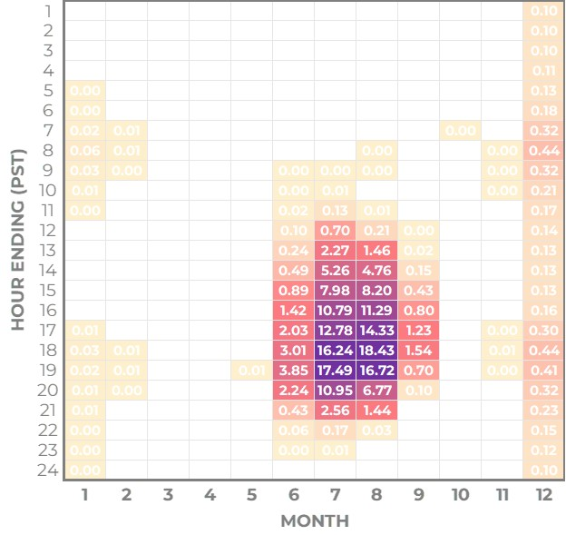
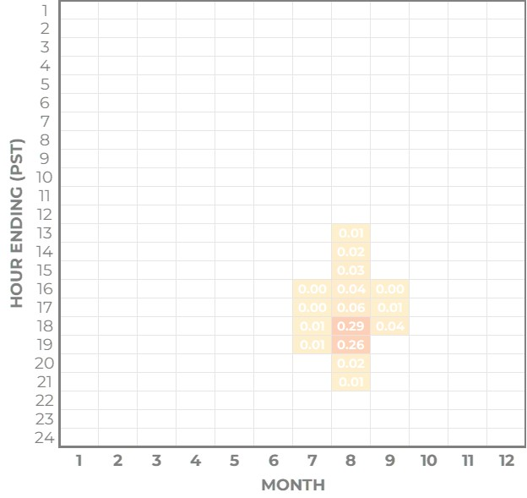
Impacts of coordination Less Coal Scenario begins with No Additions scenario and retires all coal in WRAP footprint
Metric | WRAP as an Island | WRAP w/ Imports
LOLP_{year} | 100% | 29%
LOLE (days/10yrs) | 451 | 4.13
LOLH (hrs/yr) | 196 | 0.80
EUE (MWh/yr) | 275,929 | 2,118
EUE_{norm} (ppm) | 808 | 6.2
Average Event Duration (hrs) | 4.34 | 1.94
Perfect Capacity Need (GW) One-day-in-10-year std | 10.1 | 3.8
WRAP – Islanded
Loss of load hours per year
WRAP w/ Imports
Loss of load hours per year
Accounting for WRAP ↔ CAISO coordination alleviates most RA risk and narrows the nature of the RA challenge
Note: This study uses a physical approximation of the WRAP footprint, which includes loads and resources in the following WECC BAs: AVA, AZPS, BANC, BPAT, CHPD, DOPD, GCPD, IPFE, IPMV, IPTV, NEVP, NWMT, PACW, PAID, PAUT, PAWY, PGE, PSEI, SCL, SPPC, SRP, TIDC, TPWR

Slide 9
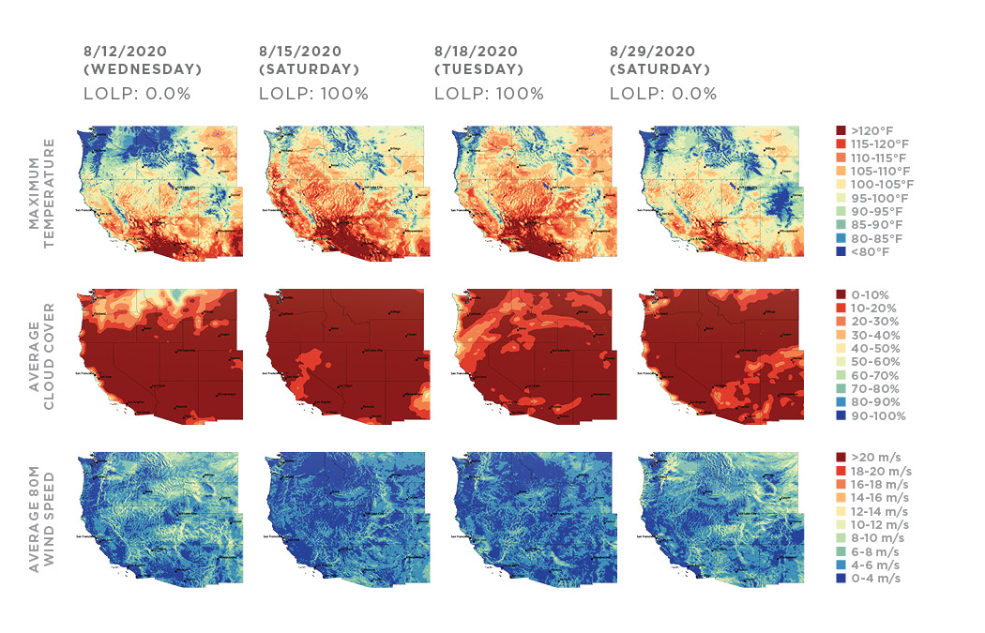
Weather insights
RA risk is highest when challenging weather systems are large relative to the size of the power system
[Data source: NOAA High-Resolution Rapid Refresh (HRRR) Data Archive: AWS Open Data Program (https://mesowest.utah.edu/html/hrrr/)]

Slide 10
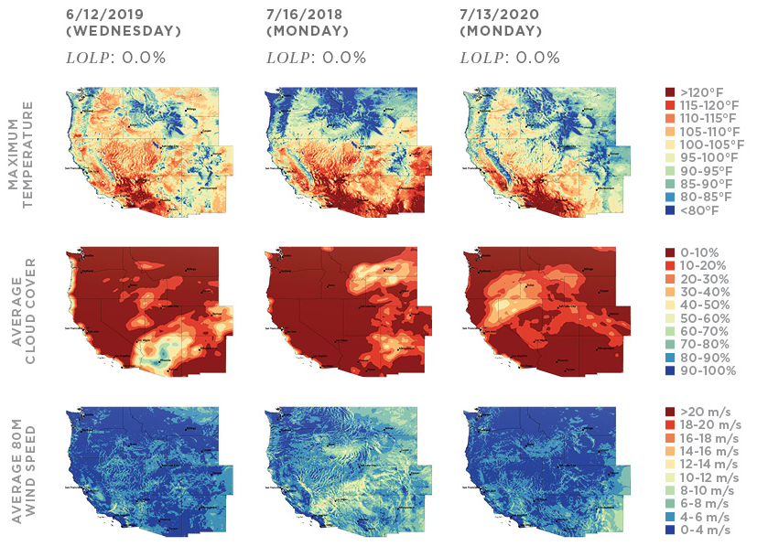
Weather insights
June 12, 2019
Seattle: 95°F
Portland: 98°F
Sacramento: 103°F
Phoenix: 112°F
Los Angeles: 72°F
San Diego: 74°F
July 16, 2018
Seattle: 92°F
Portland: 98°F
Phoenix: 105°F
San Francisco: 69°F
LA & San Diego: 79°F
July 13, 2020
Seattle: 76°F
Portland: 80°F
Phoenix: 114°F
RA risk may appear larger than it is in local utility analyses under localized extreme weather conditions
[Data source: NOAA High-Resolution Rapid Refresh (HRRR) Data Archive: AWS Open Data Program (https://mesowest.utah.edu/html/hrrr/)]

Slide 11
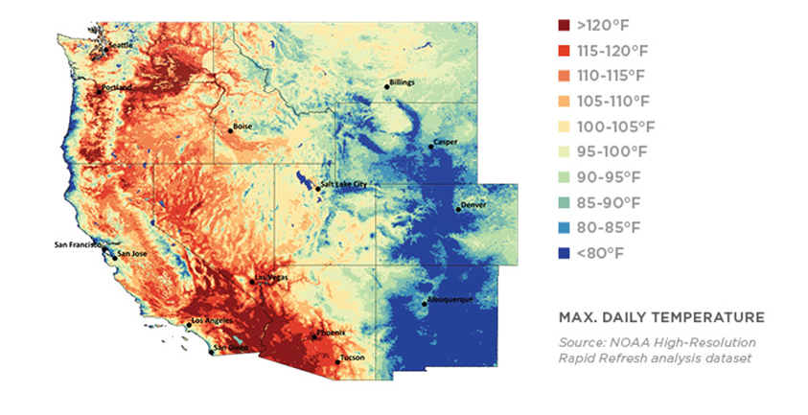
Estimating RA risk based on weather
Statistical models can be developed to estimate risk during regional events
June 2021 heat dome event
June 28, 2021
Seattle: 108°F
Portland: 116°F
Estimated LOLP: 1.2%
Despite the historic heat dome in the Pacific Northwest, milder conditions in the rest of the West mitigate RA risk
[Data source: NOAA High-Resolution Rapid Refresh (HRRR) Data Archive: AWS Open Data Program (https://mesowest.utah.edu/html/hrrr/)]

Slide 12
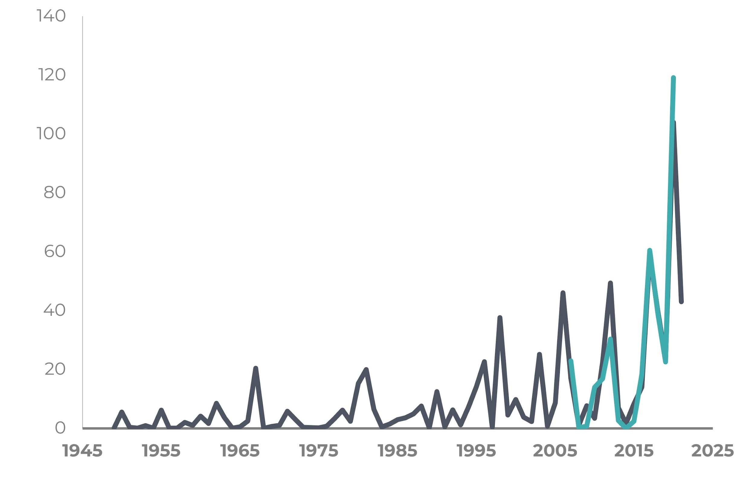
Examining impacts of weather trends
Recent years have seen more frequent weather events with high RA risk
LOLE (DAYS EVERY 10 YEARS)
Longer term historical weather record may not be indicative of the near future
The selection of which weather years to consider and how to account for future changes in weather are important policy decisions

Slide 13
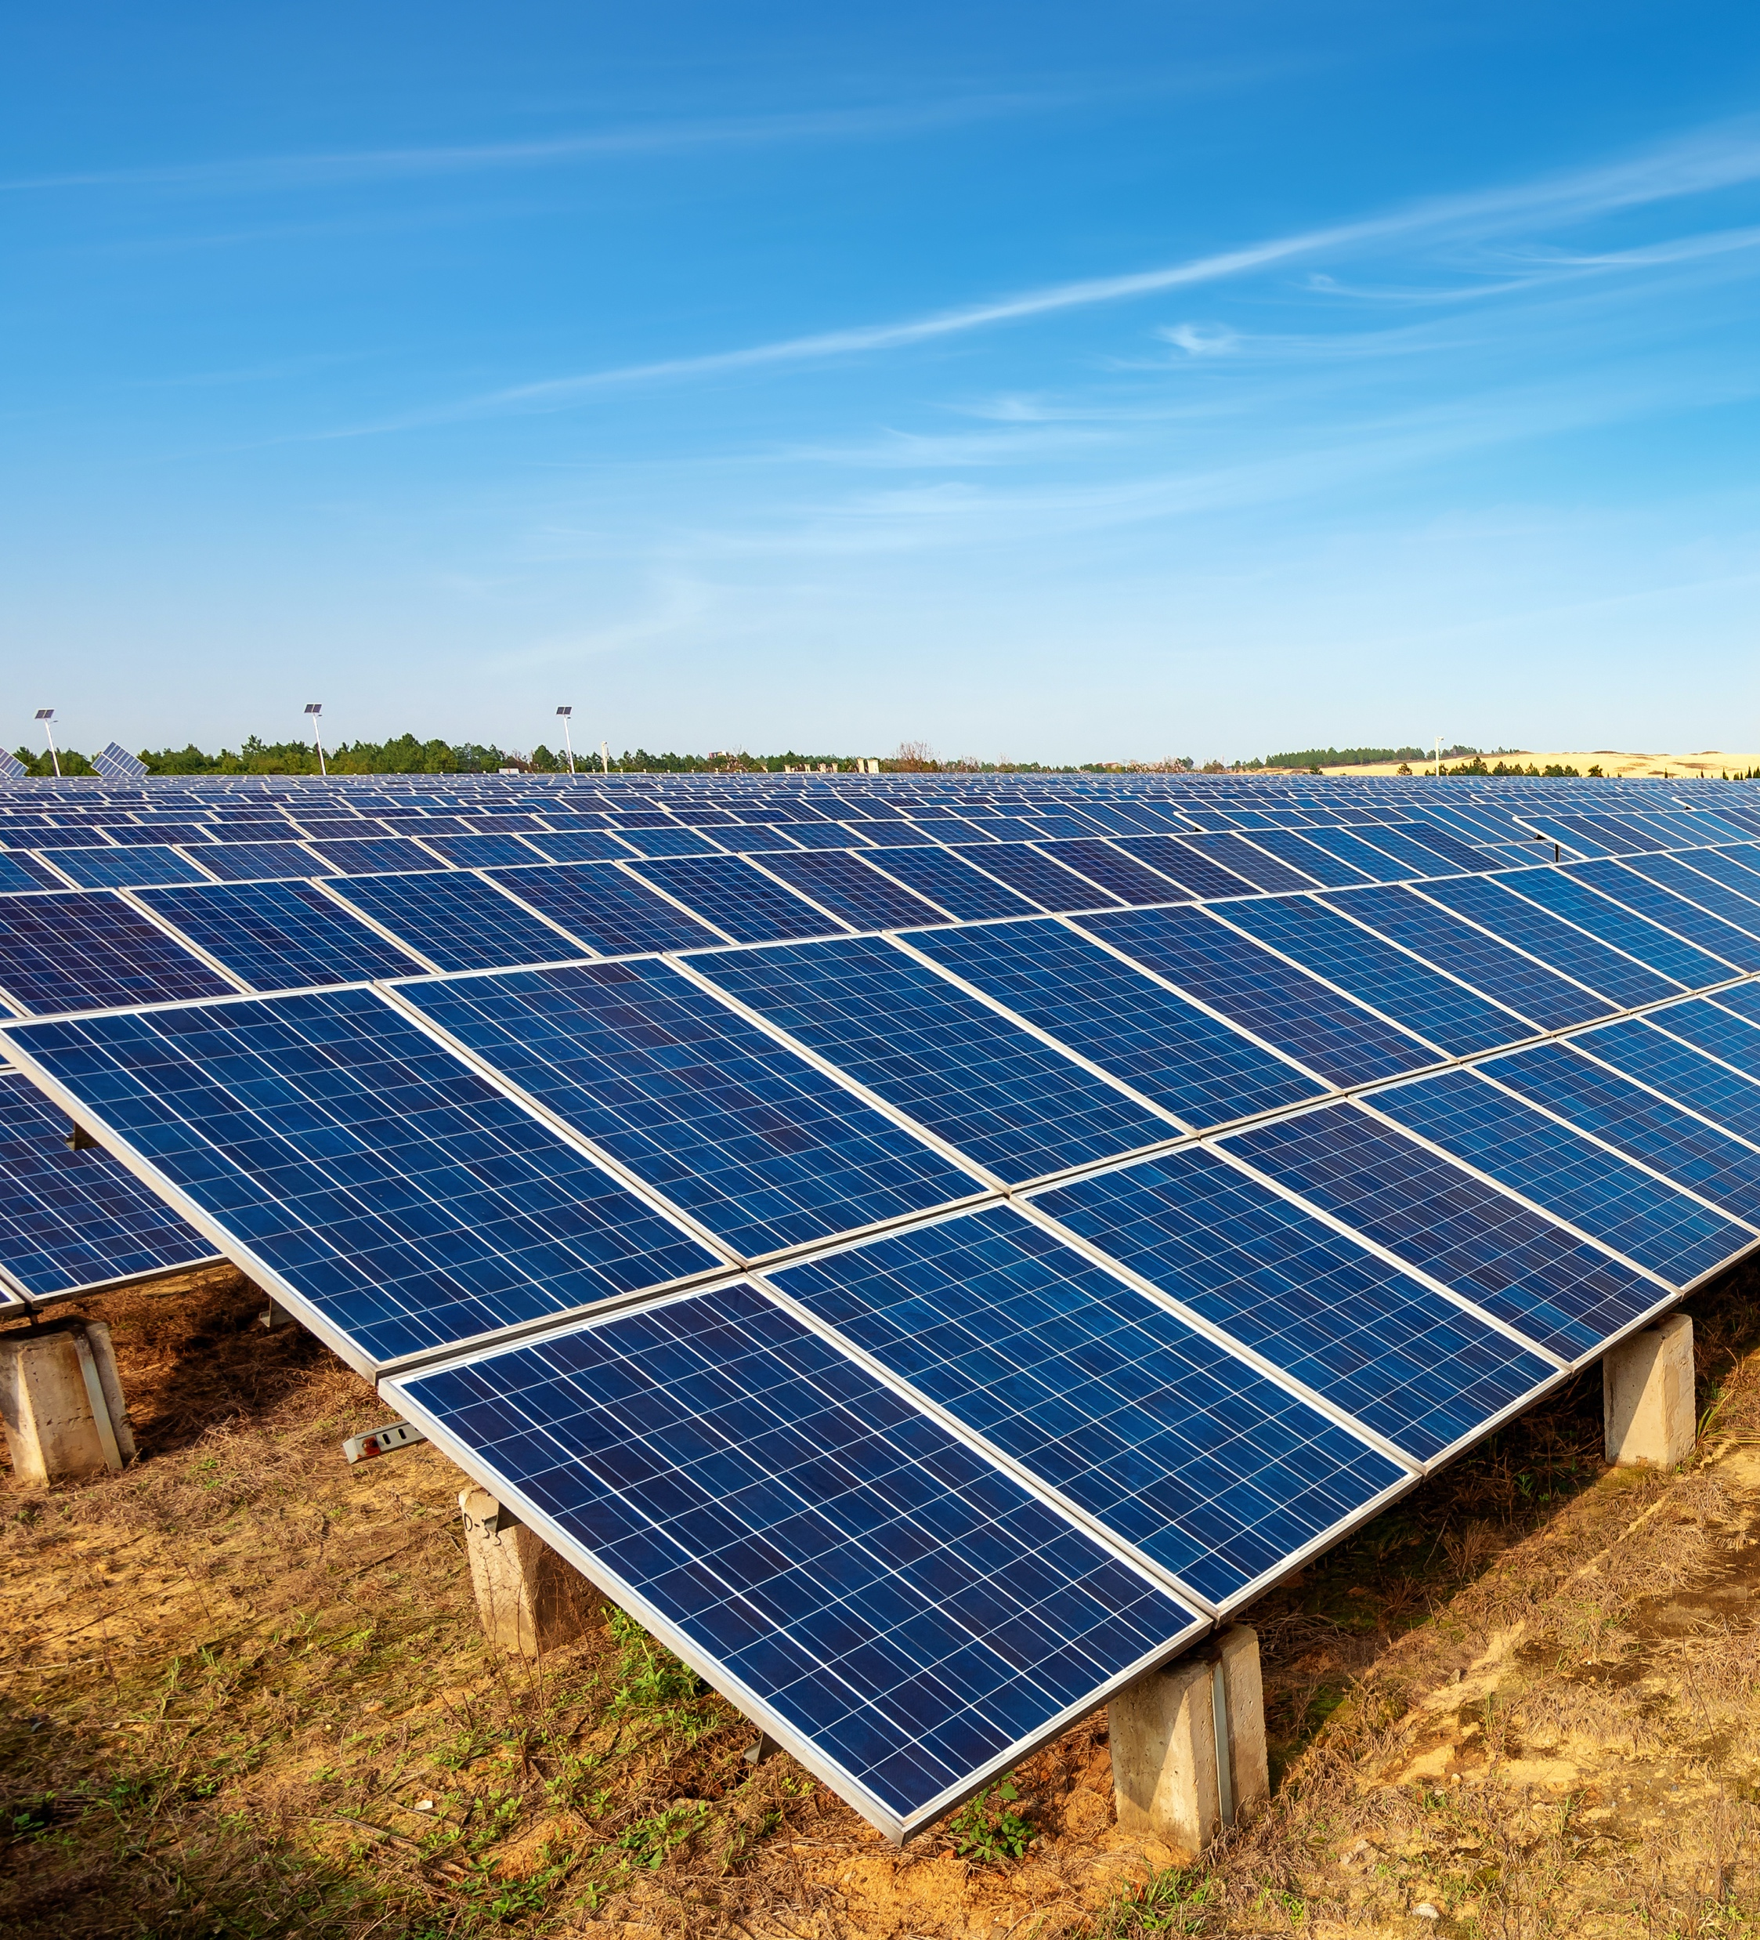
Key Takeaways
Near-term resource adequacy risk in the West appears to be primarily driven by very large-scale heat events
The expansion of public, high resolution, West-wide weather-based datasets is critical for understanding RA risks
RA analysis findings are highly sensitive to import assumptions, which are difficult to define with confidence without formal coordination
More work is needed to address fuel supply risks, transmission risks, and weather-driven forced outage risk

Slide 14
Questions?
Final report and data is available at: www.gridlab.org/GridPathRAToolkit
For more information about GridPath or this project, please reach out to us:
Ana Mileva
ana@bluemarble.run
Elaine Hart
elaine@momentenergyinsights.com

