Slide 1
Recessed Open Meeting
2023 Cascade Natural Gas IRP
Docket UG-220131
June 1st, 2023

Slide 2
Agenda
9:30 Call to Order
9:35 Overview of Agenda and Instructions for Participation
9:40 Commission Staff Presentation
9:50 Integrated Resource Plan Presentation by Company
10:40 Public Comments
11:30 Adjourn

Slide 3
Participant Instructions
Ground Rules – please remember to follow these ground rules to help us conduct a smooth and productive meeting:
Mute your microphone when not speaking
We are recording and streaming, by participating you consent to be recorded
Use the “raise hand” tool to ask a question or indicate you’d like to comment on a particular item
Don’t put your phone on hold
The chat is for technical assistance only
One person speaks at a time

Slide 4
Participant Instructions
Closed captioning is available.
To view them in Zoom, scroll down to the controls bar at the bottom of your screen. This is where you can find your Mute, Video, Chat, and Reactions button to raise your hand. Select Closed Caption and turn it on.

Slide 5
Participant Instruction
We will provide an opportunity to comment on Cascade’s Integrated Resource Plan. If you would like to provide a public comment today, please remember to:
Raise your virtual hand if you’re participating virtually – if you’re joining us on the phone, dial *9 to raise your hand
Stay muted until called on
Wait your turn and do not interrupt other speakers
Use the chat feature in Zoom if you need technical assistance

Slide 6
Commission Staff Presentation
Notes:
Cascade IRP Recessed Open meeting script
Good morning, Welcome everyone – we are going to be hearing from Cascade Natural Gas momentarily about their 2023 Integrated Resource Plan.
My name is Byron Harmon, staff lead on this docket.
I will try to keep my overview brief:
Cascade filed their work plan in February of 2022
The company held six work groups from March of 2022 through February of 2023 and completed their draft in December.
Cascade filed their final IRP in February of 2023.
The 2023 IRP brings many changes from the previous IRP.
These include climate change modeling, RNG resources for the voluntary RNG program, a new optimization software, PLEXOS, analysis regarding the CCA, and hydrogen fuel blending.
Staff’s extensive comments prompted further conversations between Staff and Cascade that has resulted in pledges for increased direct and routine communication for future IRP processes.
Next, I will Invite Cascade staff to introduce themselves and hand the reins over to Cascade for their presentation

Slide 7
Integrated Resource Plan Presentation by Cascade Natural Gas

Slide 8
Integrated Resource Plan Open Meeting Presentation
June 2, 2023
Microsoft Teams/Teleconference

Slide 9
Agenda
Introductions
Safety Moment
Demand Side Management
Environmental Policy
Final Results
Demand Forecast
Next Steps
Avoided Cost

Slide 10
Safety Moment

Slide 11
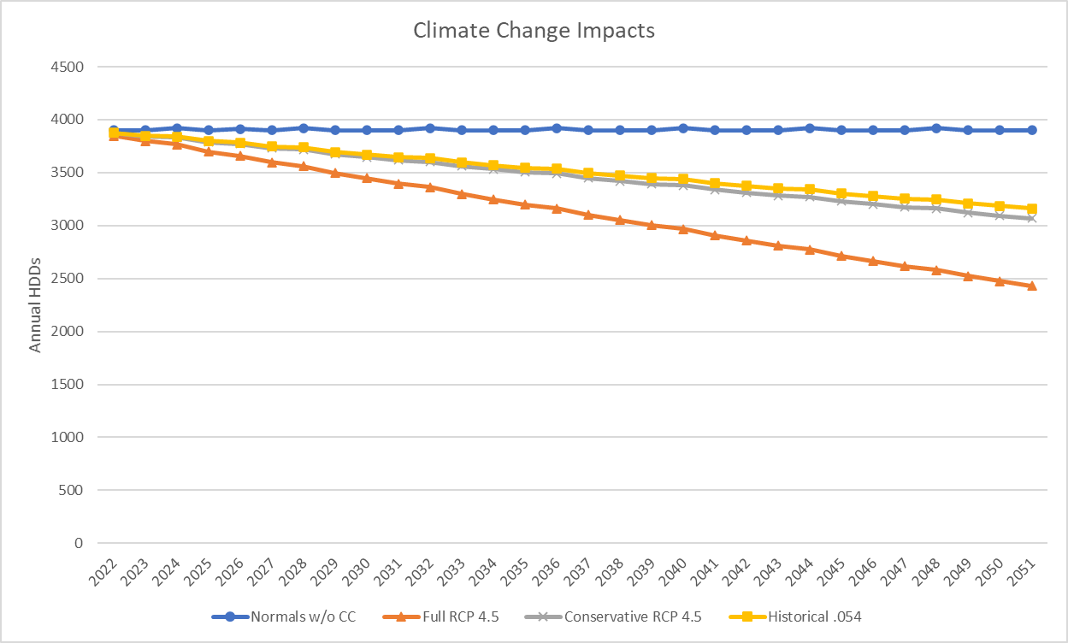
Climate Change Impacts
Cascade utilized Climate Change data from the Intergovernmental Panel on Climate Change.¹
Cascade used the Coupled Model Intercomparison Project Phase 4 (CMIP5) with the RCP 4.5 scenario which included 36 different models.
Cascade chose this scenario as it best represents the Western North America emission goals and was labeled as the most probable baseline scenario.²
Cascade also modeled using the 18 most conservative models as well as the Environmental Protection Agency’s noted historical temperature change (.54°F per decade since 1979).³

Slide 12
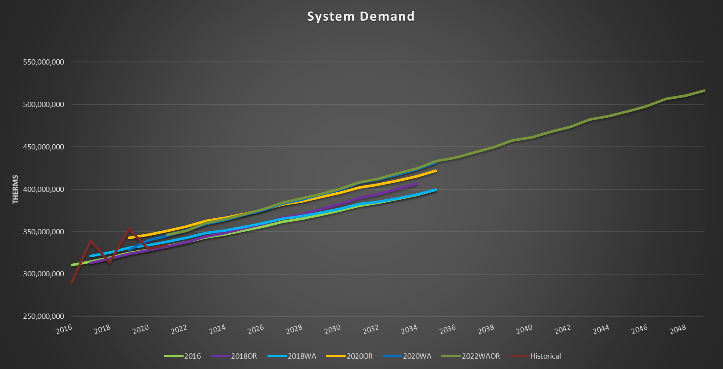
Total System Demand

Slide 13
Snapshots
Potential Code-Driven Real Time Program Changes
Clear Indications From Code Officials Across The Service Territory Will Be Needed
WSEC 2021 Impact On Program Forecasts
Enhanced Focus on Growing Low Income Programs
Continued Focus on Trade Ally Network
ENERGY EFFICIENCY NEAR TERM GOALS
 | 2021 | 2022 | 2023
C&I | 578,483 | 419,461 | 537,858
RES | 471,164 | 429,213 | 507,695
LI | 12,180 | 17,859 | 19,665

Slide 14
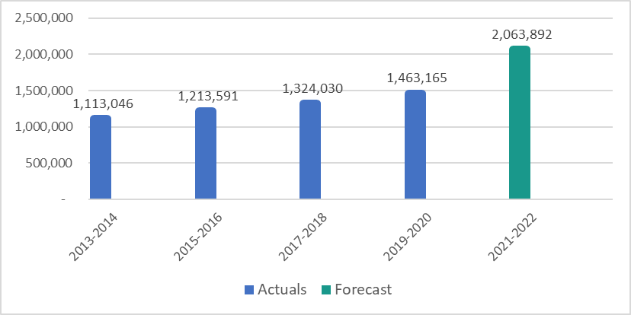
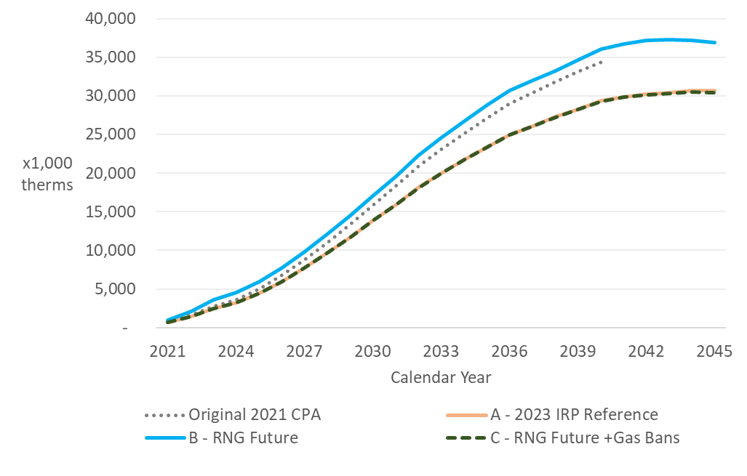
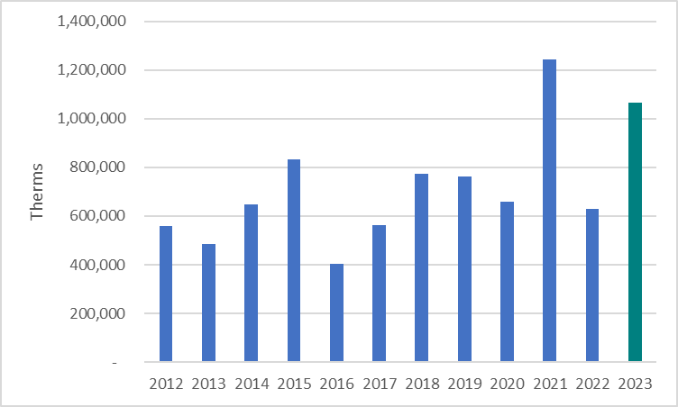
BIENNIUM PERFORMANCE
CUMMULATIVE POTENTIAL DSM FORECAST
ANNUAL PERFORMANCE
Savings Through 2045:
48 Million
therms

Slide 15
Energy Efficiency Deliverable Milestones
Date | Milestone
6/1/2023 | Conservation Potential Assessment (CPA) Filing
6/15/2023 | 2022 Annual Report Filing
7/1/2023 | Consult CAG – Begin Identifying Achievable Conservation Potential for 2024-2033
7/12/2023 | Presentation of CPA at CAG Meeting
7/15/2023 | Address 2022 Annual Report Comments
July 2023 | 3rd Party Measure Level EM&V Final Report
8/9/2023 | Mid-Biennial Conservation Plan (BCP) CAG Meeting
8/15/23 | First Draft: BCP 10-year conservation potential and 2-year target
9/15/23 | First Draft: BCP Program Details & Budget
10/15/2023 | 2024-2025 BCP Draft with Program Tariff & Exhibits Submitted to CAG
11/15/2023 | 2024-2025 BCP Filed with WUTC
5/1/2024 | Biennial Program EM&V Draft Report to CAG
6/1/2024 | Biennial Program EM&V Final Report to CAG
6/15/2024 | Biennial Report Filing

Slide 16
Climate Commitment Act
Program establishing a declining cap on GHG emissions from covered entities consistent with the limits established in RCW 70A.45.020, and a program to track, verify, and enforce compliance with the cap through the use of compliance instruments.
Anthropogenic GHG Emissions Reductions:
Achieve 1990 levels (90.5 million metric tons)​ by 2020
45% below 1990 levels (50 million MT)​ by 2030
​70% below 1990 levels (27 million metric tons) by 2040
95% below 1990 levels (5 million metric tons)​ by 2050
Covered Entities:
Fuel suppliers, natural gas distribution, electric utilities, and large facilities.
Landfills and certain emissions intensive and trade exposed (EITE) entities are added in during 2nd and 3rd compliance periods.
Notes:
Abbie Weigh in

Slide 17
Climate Commitment Act
Cascade’s regulated emissions:
Customer Emissions – about 2,000,000 metric tons CO2e in 2023
All core customers
Non-core customers that are not covered entities under the CCA (=/>25,000), and excludes customers that may "opt-in" to program individually or that may petition to be emissions-intensive and trade exposed (EITE).
Operations Emissions – about 24,000 to 25,000 metric tons CO2e
Methane leakage
Fuel combustion from >5 mmbtu sources (e.g. compressor stations)
Notes:
Abbie Weigh in

Slide 18
Climate Commitment Act
Baseline
2015-2019 average
No Cost Allowances for Natural Gas Suppliers
See chart
Allocation of No Cost Allowances
2023 – proposed allocation by September 1, 2023
2024 and thereafter, allocations made in October of prior year
93% of baseline for 2023
7% incremental reduction from baseline each year, 2024 to 2030
2.6% incremental reduction from baseline each year, 2043 to 2049.
1.8% incremental reduction from baseline each year, 2031 to 2042
Notes:
As a comparison with the overall program targets, if we reduce emissions commensurate with the decline in our no cost allowance allocations, this equates to a 98.4% reduction from the baseline.

Slide 19
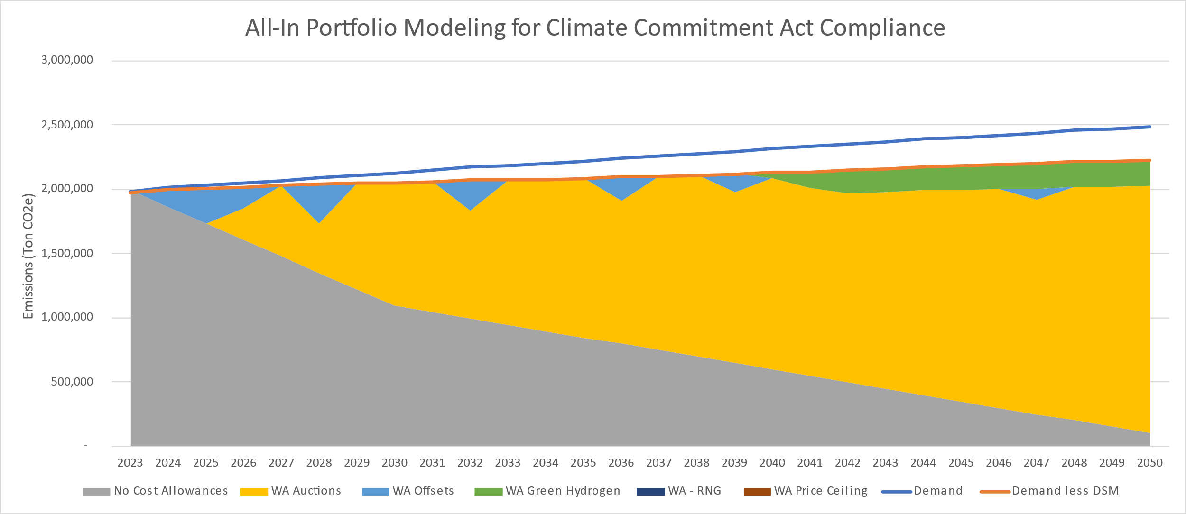
Top Ranked Candidate Portfolio Components
All Cost-Effective DSM
Incremental RNG – Utilized mostly in Oregon, 154,210 Dth starting in 2023, up to 15,635,780 Dth by 2050
Incremental Hydrogen – 90,970 Dth starting in 2029, up to 524,700 Dth by 2050
Compliance Instruments – Utilized as needed, exact number discussed under confidential treatment in IRP

Slide 20
Integrated Resource Plan Open Meeting Presentation
June 2, 2023
Microsoft Teams/Teleconference

Slide 21
Public Comments

Slide 22
The meeting has concluded

