Slide 1
Autonomous Commercial Vehicles (ACV) Testing and Deployment 2018 (Target Date for Submission and Passage of Legislation) Professor William Covington Technology Law and Public Policy Clinic Simone A. Montez, M.Ed. Masters of Jurisprudence Candidate, ‘17 Drew Wilder Masters of Jurisprudence Candidate, ‘17
Share some definitions.
Talk about the development of standards and guidelines.
Discuss who should be allowed to apply to test and operate ACV’s on Washington State’s roads and highways.
Share some safety statistics; and
Provide an example of how our legislative proposal would work.
Notes:
Slide One: Good morning, I would like to thank the Utility and Transportation Commission Commissioners and staff for allow us the time to speak.
I am Simone Montez and I am very excited about Autonomous Commercial Vehicle Technology and a legislative proposal we plan to submit to the Legislature in the 2018 session.
Mr. Drew Wilder and I plan to do five things today:
Share some definitions
Talk about the development of standards and guidelines
Discuss who should be allowed to apply to test and operate ACV’s on Washington State’s roads and highways.
Share some safely statistics; and
Provide an example of how our legislative proposal would work.

Slide 2
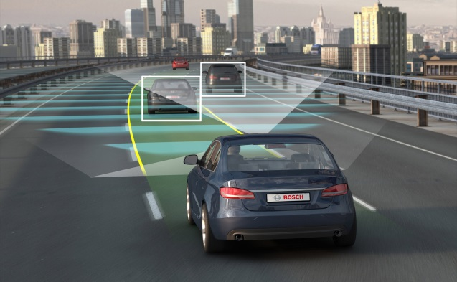
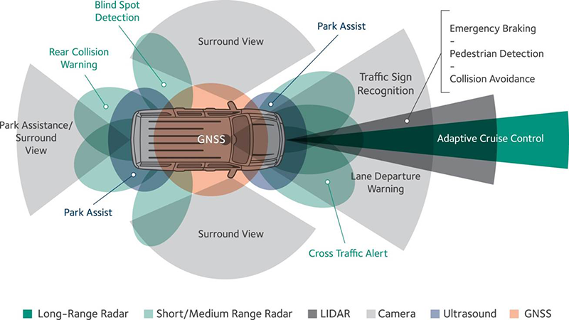
Autonomous Commercial Vehicle
Testing and Deployment in Washington State (Definitions, Eligibility)
What is an autonomous vehicles?
A driverless vehicle that is capable of sensing its environment and navigating without human input.
Notes:
Slide Two: What is an autonomous vehicle?
An autonomous commercial vehicle whether it’s a passenger car, a bus or a commercial truck uses a combination of technologies to see and react to the world around it.
Lasers,
Lidar: a combination of radar and laser technology
Sensors; and Mapping programs allow a vehicle to see and react to the world around it.
Autonomous technology is rapidly evolving and even today there are some vehicles which can drive themselves for prolonged periods of time without human intervention. We need to determine how we can promote this technology while ensuring people and property are safe.

Slide 3
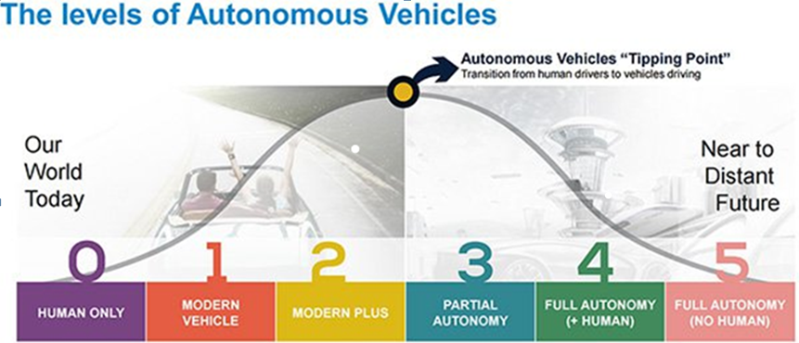
ACV Automation Levels as Applied to Testing
Level 0: The full-time performance by the human driver of all aspects of the dynamic driving task, even when enhanced by warning or intervention systems.
Level 1: The driving mode-specific execution by a driver assistance system of either steering or acceleration/deceleration using information about the driving environment and with the expectation that the human driver perform all remaining aspects of the dynamic driving task.
Level 2: The driving mode-specific execution by one or more driver assistance systems of both steering and acceleration/ deceleration using information about the driving environment and with the expectation that the human driver perform all remaining aspects of the dynamic driving task.
Level 3: The driving mode-specific performance by an automated driving system of all aspects of the dynamic driving task with the expectation that the human driver will respond appropriately to a request to intervene.
Level 4: The driving mode-specific performance by an automated driving system of all aspects of the dynamic driving task, even if a human driver does not respond appropriately to a request to intervene.
Level 5: The full-time performance by an automated driving system of all aspects of the dynamic driving task under all roadway and environmental conditions that can be managed by a human driver.
Notes:
SLIDE THREE:
The Society of American Engineers has six levels of automation
No automation
Driver Assistance
Partial Automation
Conditional Automation
High Automation; and
Full Automation

Slide 4
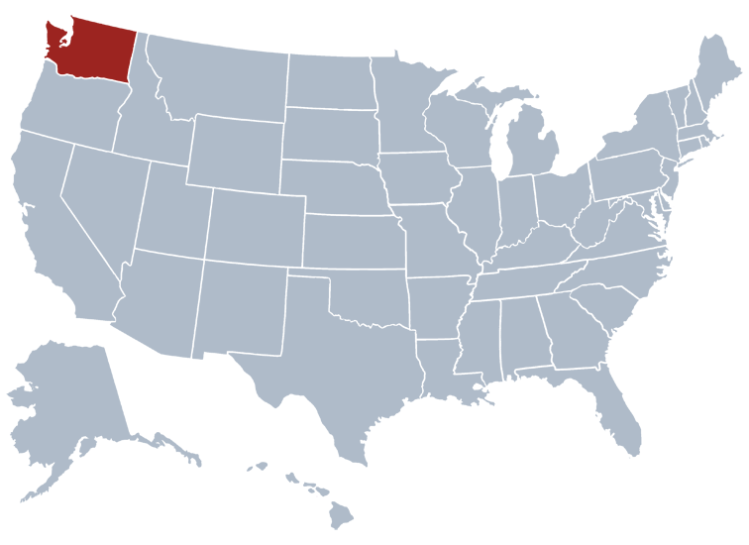
What are the ACV Automation Levels as Applied to Testing and Deployment in Washington?
Level 3: The driving mode-specific performance by an automated driving system of all aspects of the dynamic driving task with the expectation that the human driver will respond appropriately to a request to intervene.
Level 4: The driving mode-specific performance by an automated driving system of all aspects of the dynamic driving task, even if a human driver does not respond appropriately to a request to intervene.
Level 5: The full-time performance by an automated driving system of all aspects of the dynamic driving task under all roadway and environmental conditions that can be managed by a human driver.
Notes:
SLIDE FOUR:
Level 3 Conditional Automation and Level 4 High Automation are already here or shall be here very quickly. Level 5 vehicles are a bit further away but we should not forget the speed with which technology evolves.”
Because there are corporations and manufacturers who have some of these technologies and wish to use them it is time to develop a testing mechanism and we need to use the lessons we learn from testing for developing deployment guidelines and standards.

Slide 5
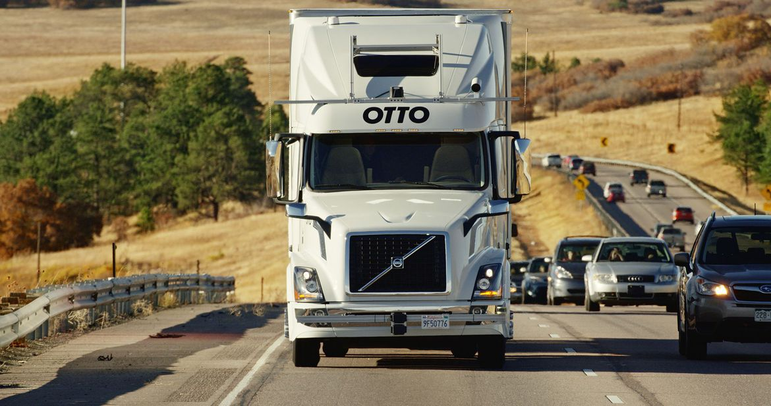
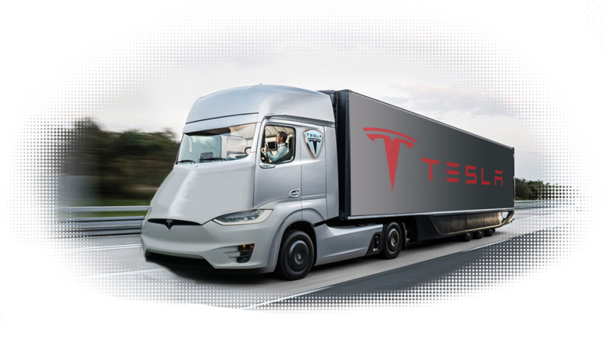
When will ACV’s be available?
Uber-owned Otto to offer freight hauling services using autonomous trucks in September 2016. According to comments from Otto co-founder Lior Ron, who told Reuters that Otto will enter the long-haul freight business in 2017.
Silicon Valley startup Peloton Technology will deliver its V2V system package late this year to a small number of truck fleets. “We will purposely slow down our initial rollout to make sure it’s going well.” Peloton CEO Joshua Switkes told Automotive News. January 4, 2017
Elon Musk revealed a teaser image during a TED Talk on May 2, 2017, and followed up by announcing a September reveal for an autonomous truck in September 2017.
Notes:
SLIDE FIVE: WHEN WILL ACV’S BE AVAILABLE?
As we can see from these headlines taken from news stories, autonomous commercial vehicles shall be in operation sooner than expected.

Slide 6
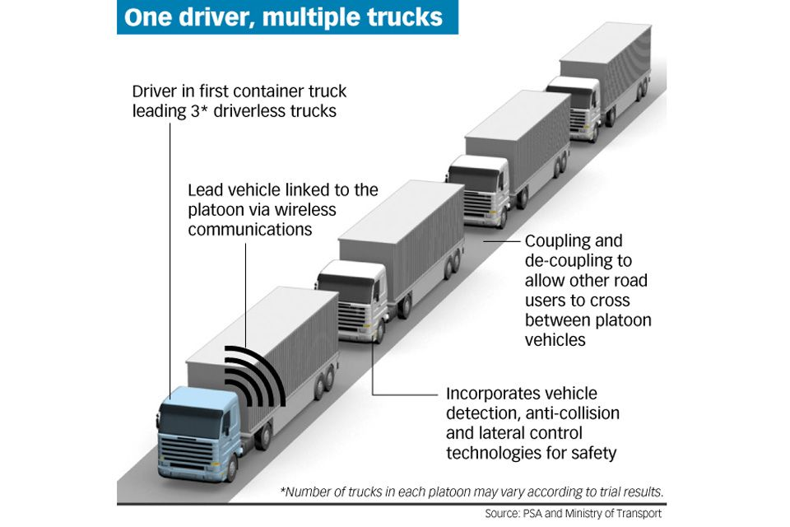
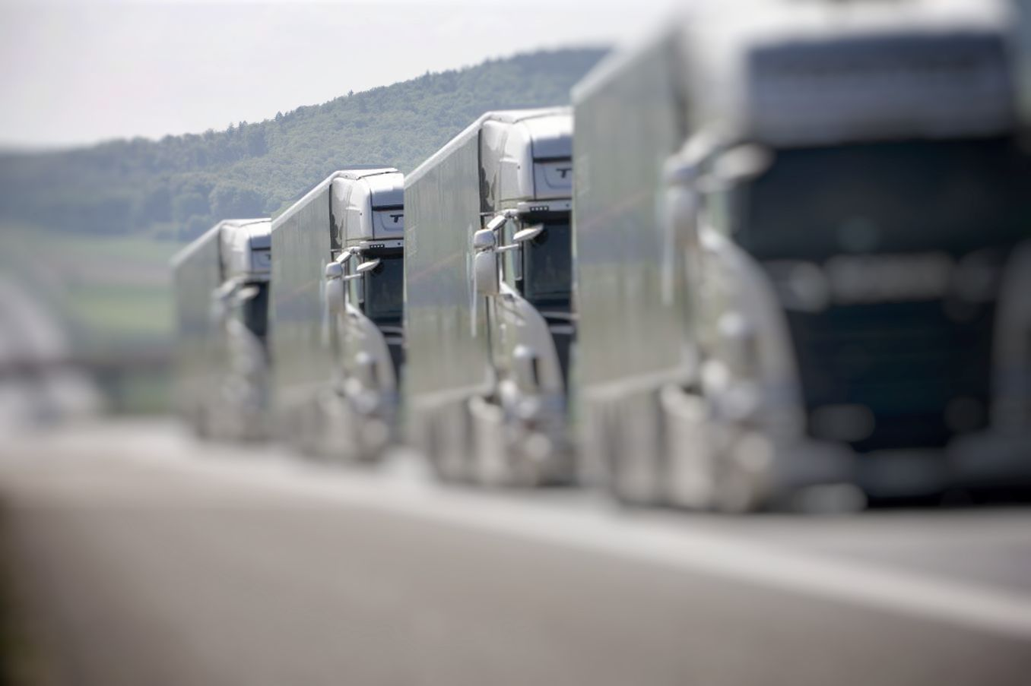
Platooning
Platoon (or road train) is a collection of vehicles where a manually driven heavy lead vehicle is followed by several automatically controlled trucks and/or passenger cars. The V2V communication system enables forwarding of messages between vehicles to share data such as vehicle speed. Traveling in close formation reduces drag and saves on fuel, while increasing safety.

Slide 7
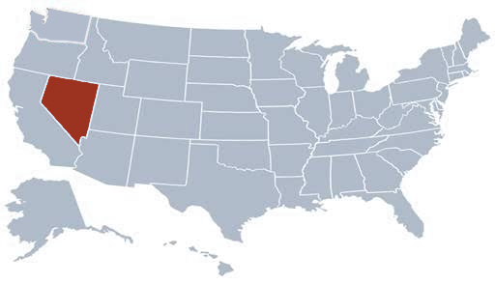
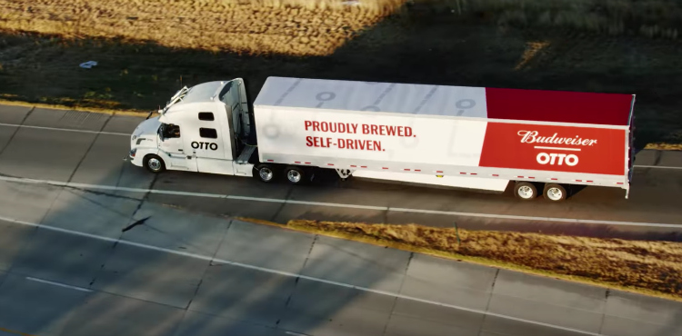
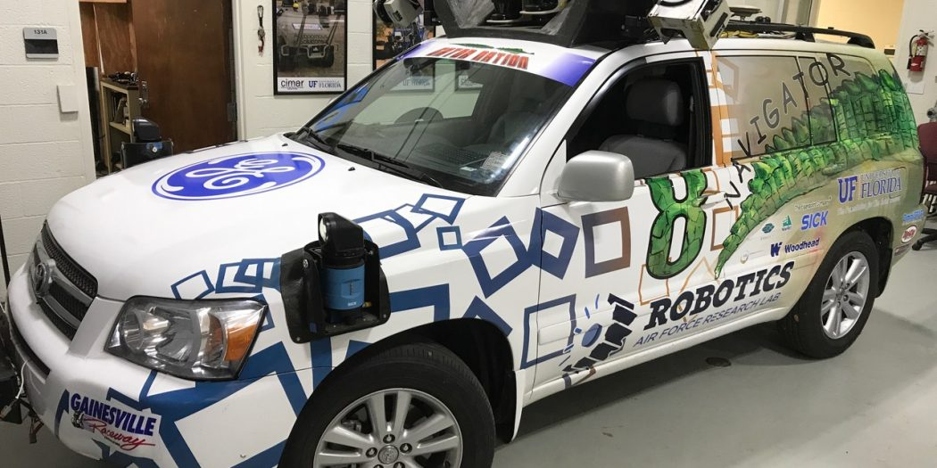
Autonomous Commercial Vehicle Testing and Deployment Legislation
Arizona: In late August 2015, an executive order directing various agencies to “undertake any necessary steps to support the testing and operation of self-driving vehicles on public roads within Arizona.”
Colorado: “Uber's Otto hauls Budweiser across Colorado in self-driving truck.” The Executive Director of Colorado’s Department of Transportation commented that there was one instance where a car had slowed down to about 35 mph and the truck slowed down to the appropriate distance, “so to me that was striking how well the truck performed.” November 2016
Florida: “Truck Platooning Coming This Summer One Year After Autonomous Vehicle Legislation,…and this summer, you may see automated trucks hitting Florida roads as a result of a bill passed by the Florida legislature.” The University of Florida and its Transportation Institute, the Florida Department of Transportation, and the City of Gainesville are gearing up to create a “smart testbed” on the UF campus and surrounding highway network. April 2017

Slide 8
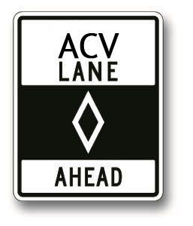
How Do We Make It Happen?
Who are the key actors in developing ACV Testing and Deployment Policy?
The key to our proposal is making use of the Utilities and Transportation Commission’s (UTC) regulatory experience. UTC to be tasked with forming an ACV Testing and Deployment Policy Committee (ACV-TDPC) whose members shall include but not be limited to:
The Washington State Patrol
The Washington State Department of Licensing
The Washington Trucking Association
Transportation Industry Professionals; and
Other persons and organizations the UTC feels are necessary.
The ACV-TDPC will be urged to consult with federal agencies such as the Department of Transportation, the National Highway Traffic Safety Administration, and the Federal Motor Carrier Safety Administration.

Slide 9
How do we make it happen?
Who Can Apply for Testing and Deployment Authority for ACV’s?
Manufacturers
Authorized Motor Carriers for Hire and Private
Vendors who hold themselves out to the general public as industry experts with respect to performing maintenance, installation, and compliance services on ACV equipment and software.
Notes:
DREW, SIMONE PLEASE SEE SLIDE FOUR; ARE THESETHE SAME PARTIES? YOU NEED TO DO TWO THINGS; 1) USE THE SAME NAMES FOR APPLYING PARTIES; 2) USE CHECKS AS WERE DONE ON THE PREVIOUS PAGE; WE NEED TO BE CONSISTENT

Slide 10
How Do We Make It Happen? Creating ACV Testing and Deployment Policies
The ACV-TDPC will be guided by the following principles in creating standards and guidelines for ACV testing and deployment policies including, but not limited to the following:
Taking all practical steps to ensure the safety of those who operate ACVs and those who are in the area where they are operated;
Incorporating, where relevant, existing motor carrier laws and regulations;
Selecting a state agency, agencies or private party to test ACV equipment and software prior to the granting permission to test and/or deploy;
Requiring applicants provide proof of primary commercial auto liability insurance, all risk apparel, $5 million minimum or of self-insurance, $5 million minimum; and
Requiring applicants submit evidence of the ability to report accidents, comply with applicable laws and insure public safety through a safety action plan.
Notes:
How do we make it happen?
“The Legislation provides some very general guidelines to the committee tasked with developing testing and deployment policies. First, an quite naturally the developed standards and guidelines should insure the ACV equipment and software is safe and those who are allowed to test this technology shall do so in a way which provides maximum protection to the public. Second, if there are existing laws and regulations which can be of use they should be employed. Third the committee should have the flexibility to select whom they feel is the proper agency or private party to assess applications. Of course insurance is needed and while it is up to the committee to determine the proper amount five million dollars is the standard used in most states. Lastly information should be provided which will allow us to know that the technology is performing in the safest manner.”

Slide 11
How Do We Make It Happen?
Deadlines, Review and Transition from Testing to Deployment
The ACV-TDPC in establishing standards and guidelines for ACV testing and deployment will:
Make best efforts to complete the establishment of standards and guidelines within six months of the legislation’s passage;
Develop a plan to ensure that established standards and guidelines are regularly reviewed and remain current with ACV technology; and
When relevant, make use of the information gathered during testing when establishing standards and guidelines for deployment.
Notes:
DREW, SIMONE PLEASE SEE SLIDE FOUR; ARE THESETHE SAME PARTIES? YOU NEED TO DO TWO THINGS; 1) USE THE SAME NAMES FOR APPLYING PARTIES; 2) USE CHECKS AS WERE DONE ON THE PREVIOUS PAGE; WE NEED TO BE CONSISTENT

Slide 12
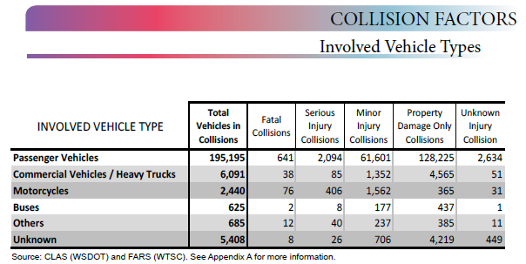
2015 Annual Collision Summary Data – Washington State
Notes:
(Talking Points) Over the past two decades, the number of truck accidents has increased by 20%. According to the Federal Motor Carrier Safety Administration (FMCSA), in 2002, 4,897 individuals died and 130,000 people were injured in crashes that involved a large truck. And even though we recognize that the advancement in AI will greatly reduce the number of accidents in the future. We also know that AI systems from time to time will fail to operate as designed and due to the large size and heavy weight of most trucks, an accident involving a truck often results in greater harm than an ordinary accident involving a private passenger cars.
(Talking Points) In the event of a vehicle accident resulting in litigation, many third-parties associated with the operation of the truck and trailer will be involved (manufactures’, motor carrier, third-party maintenance and compliance providers’ and shippers’. All, will be looking to the other to place blame. Therefore, as part of 49 CFR, Parts 365 & 387, and as part of our legislation, we are recommending that the U.S. Department of Transportation, Washington Department of Transportation, Washington Commercial Enforcement and the Federal Highway Safety Administration work together to further enhance the current mandatory compliance guidelines for all parties involved.
(Talking Points) Most contractual agreements contain strong defense and indemnity language. These agreements also require proper coverage and notice of cancelation. However, the procedural elements that apply to these contracts ensure proper coverage, are bilateral in nature and are rarely applied properly. The result, can often be devastating to the injury party and their family members. In addition, sophisticated shippers’, are often left paying losses that they would not otherwise have been responsible for to include punitive damages, when its proven that the motor carries policy was not sufficient or had lapsed at the time the loss occurred. Therefore, we are suggesting that risk management experts in the motor carrier

Slide 13
The Importance of Safety
Driverless Cars Could Reduce Traffic Fatalities by to 90%, says Report.
A new report has analyzed the impact of driverless cars on the incidence of fatal traffic accidents, and say that simply by taking human emotions and errors out of the equation, we could reduce deaths on the road by 90 percent. October 1, 2015, Science Alert

Slide 14
How It Would Work?
Example: Otto applies for ACV motor carrier operation authority in Washington State.
Step One: Applicant to complete and submit application for common carrier of property
status.
Step Two: Submitted information to include: UBI number; legal name; USDOT number; safety and compliance fitness survey; proof of primary commercial auto liability insurance, all risk apparel, and $5 million (mandated amount).
Step Three: Go through required testing; meet or surpass ACV testing standards.
Step Four: Issuance of permission to test or deploy.

