Slide 1
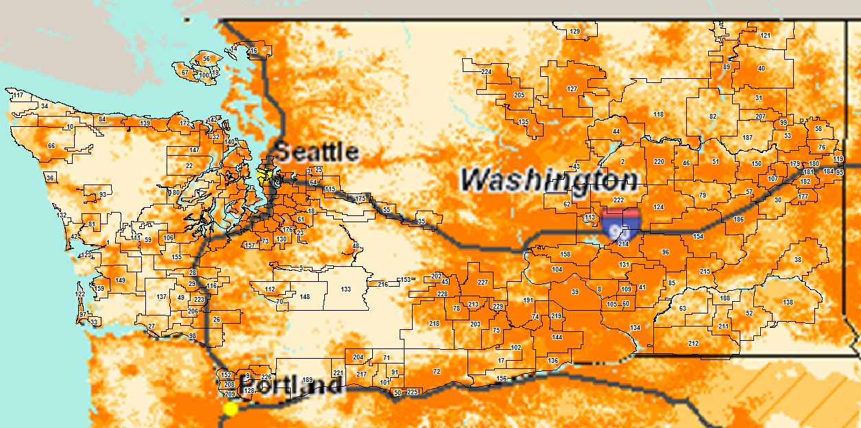
AT&T Wireless Coverage and CenturyLink Washington Wire Centers
Source: AT&T Coverage website on 03/18/13
Exhibit JMF-7
Page 1 of 6

Slide 2
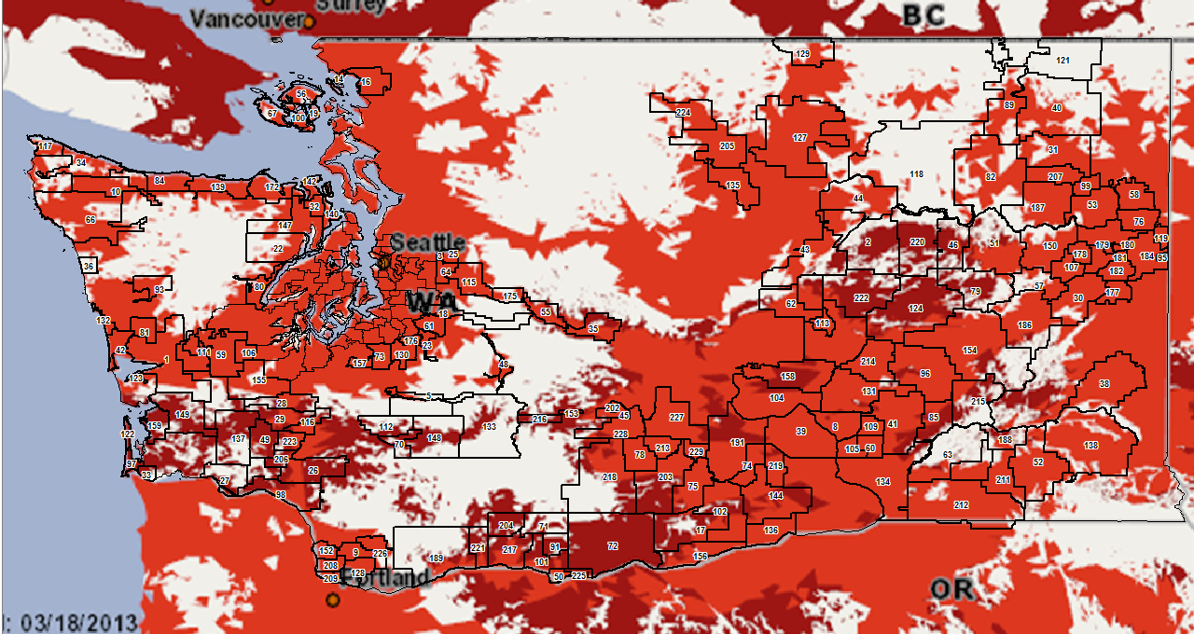
Verizon Wireless Coverage and CenturyLink Washington Wire Centers
Source: Verizon Coverage website on 03/18/13
Exhibit JMF-7
Page 2 of 6

Slide 3
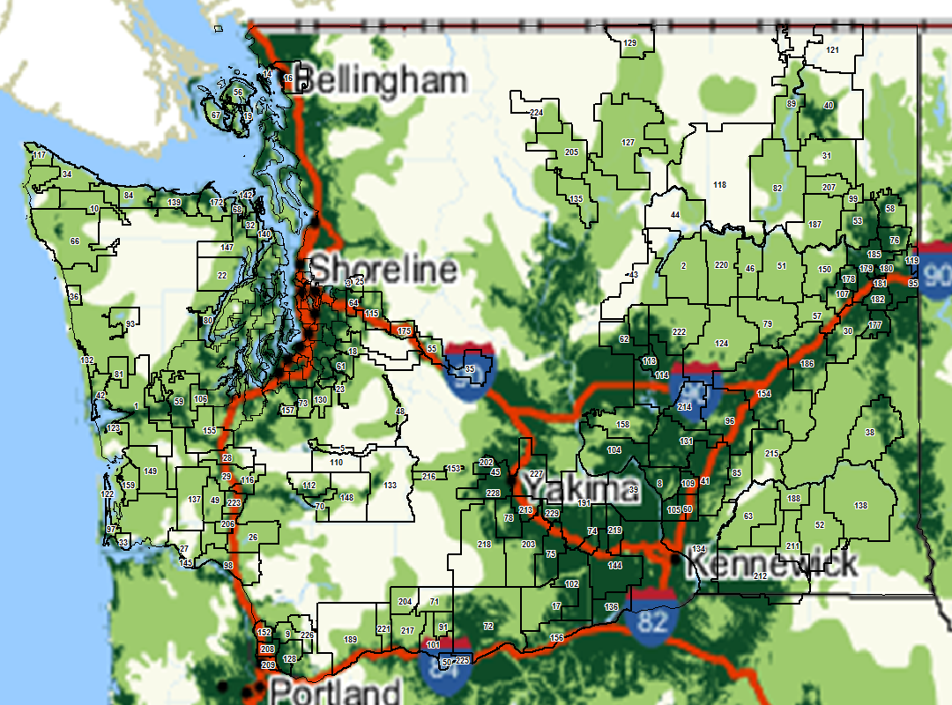
Sprint Wireless Coverage and CenturyLink Washington Wire Centers
Source: Sprint Coverage website on 03/18/13
Exhibit JMF-7
Page 3 of 6

Slide 4
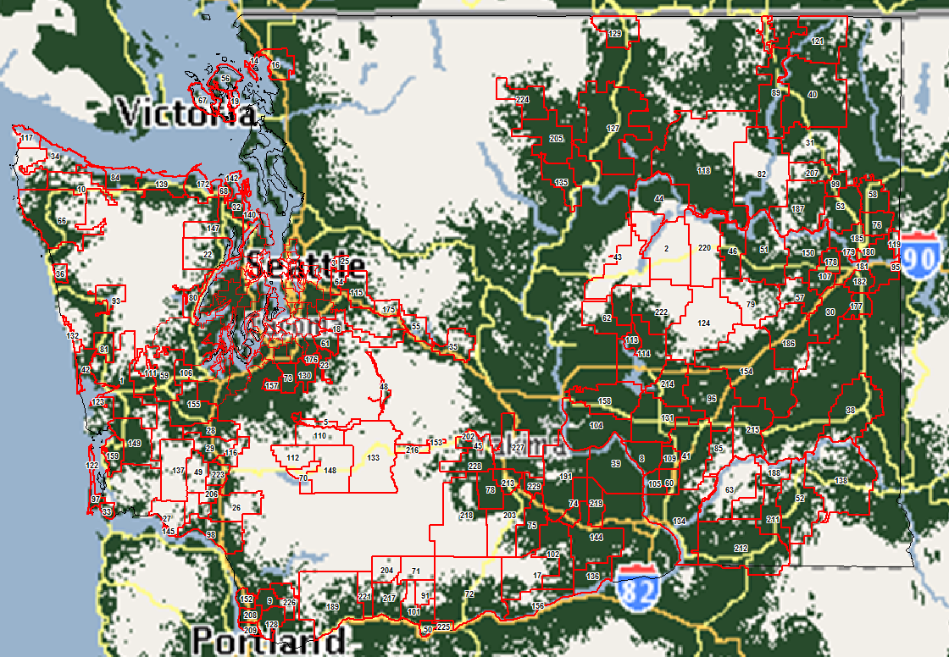
T-MobileWireless Coverage and CenturyLink Washington Wire Centers
Source: T-Mobile Coverage website on 03/18/13
Exhibit JMF-7
Page 4 of 6

Slide 5
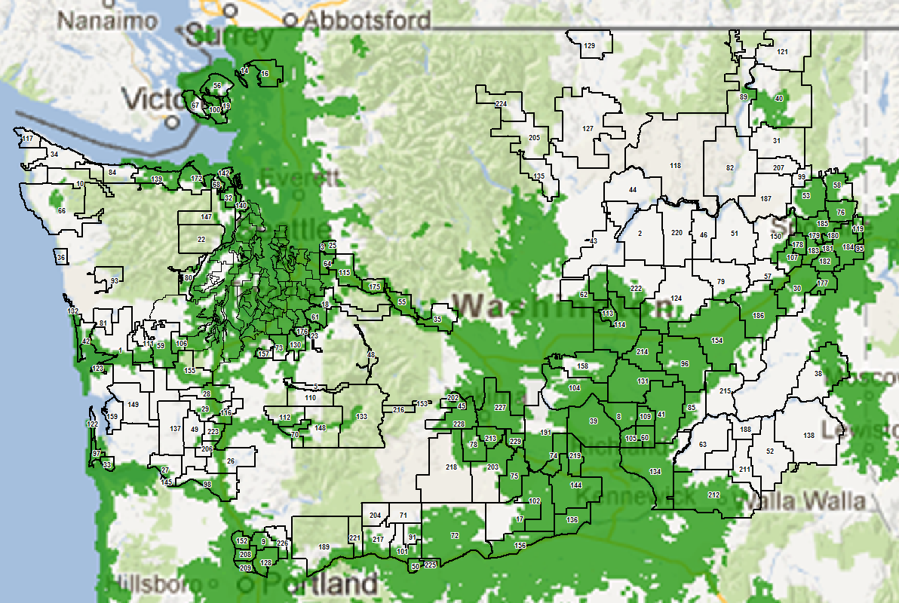
Cricket Wireless Coverage and CenturyLink Washington Wire Centers
Source: Cricket Coverage website on 03/18/13
Exhibit JMF-7
Page 5 of 6

Slide 6
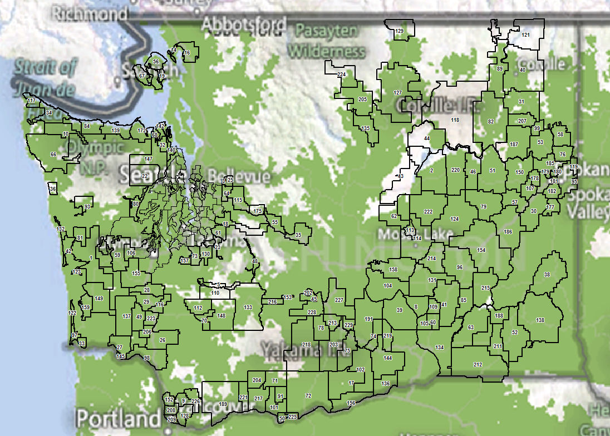
US Cellular Wireless Coverage and CenturyLink Washington Wire Centers
Source: US Cellular Coverage website on 03/18/13
Exhibit JMF-7
Page 6 of 6

