Slide 1
Smart Grid Investment Grant Update
September 23, 2011 Washington Utilities and Transportation Commission Update – Josh DiLuciano
Smart Circuit Project – Spokane, WA

Slide 2
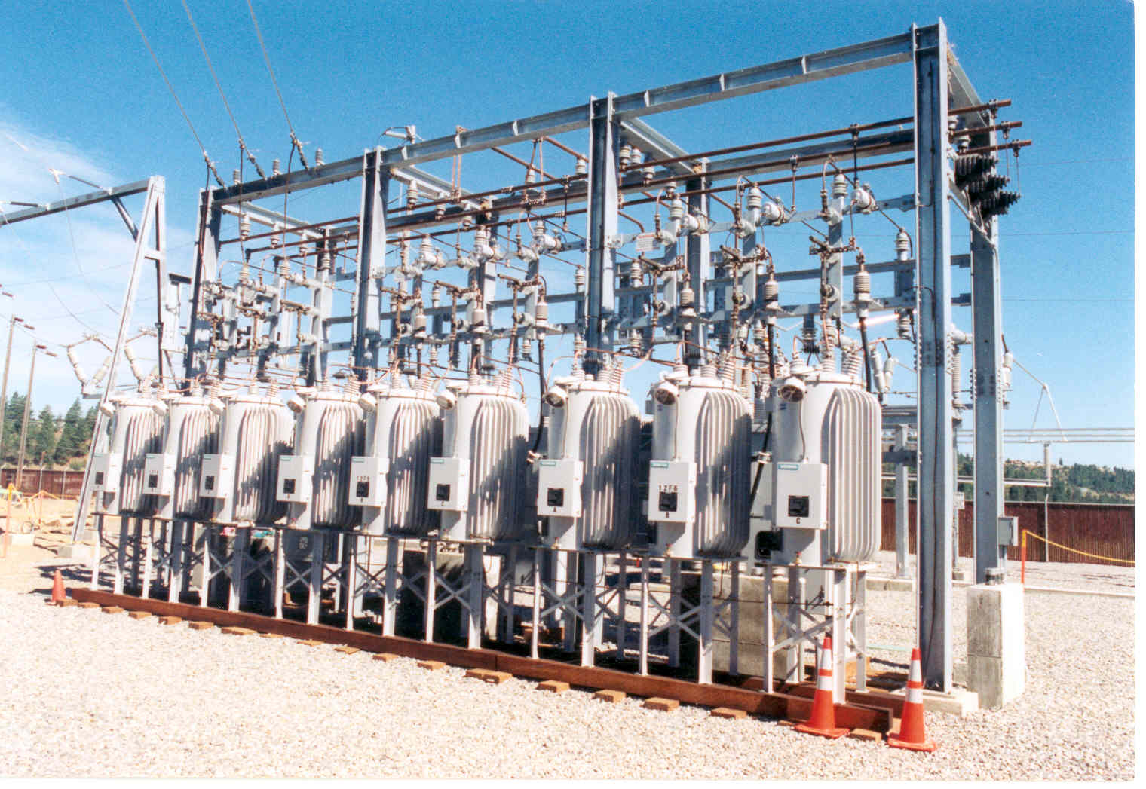
Overview
Substation Construction
9of 14 Substations Complete
Distribution Construction
Smart Switches & Capacitors being Installed
Reporting
Project Performance
Build Metrics
Impact Metrics
6 Stations 100% Complete with Overhead Construction
2
Notes:
To date we have completed 24 miles of reconductor with 6.5 left. (Numbers are rough as I have not updated from completions last week.)
We have installed 219 devices with 159 left to install.
33 Vipers installed with 54 left to install
124 ScadaMates installed with 46 left to install
62 Switched banks installed with 59 left to install
4 stations are 100% complete with OH construction. North East, Lyons and Standard, Francis and Cedar, and Fort Wright.

Slide 3
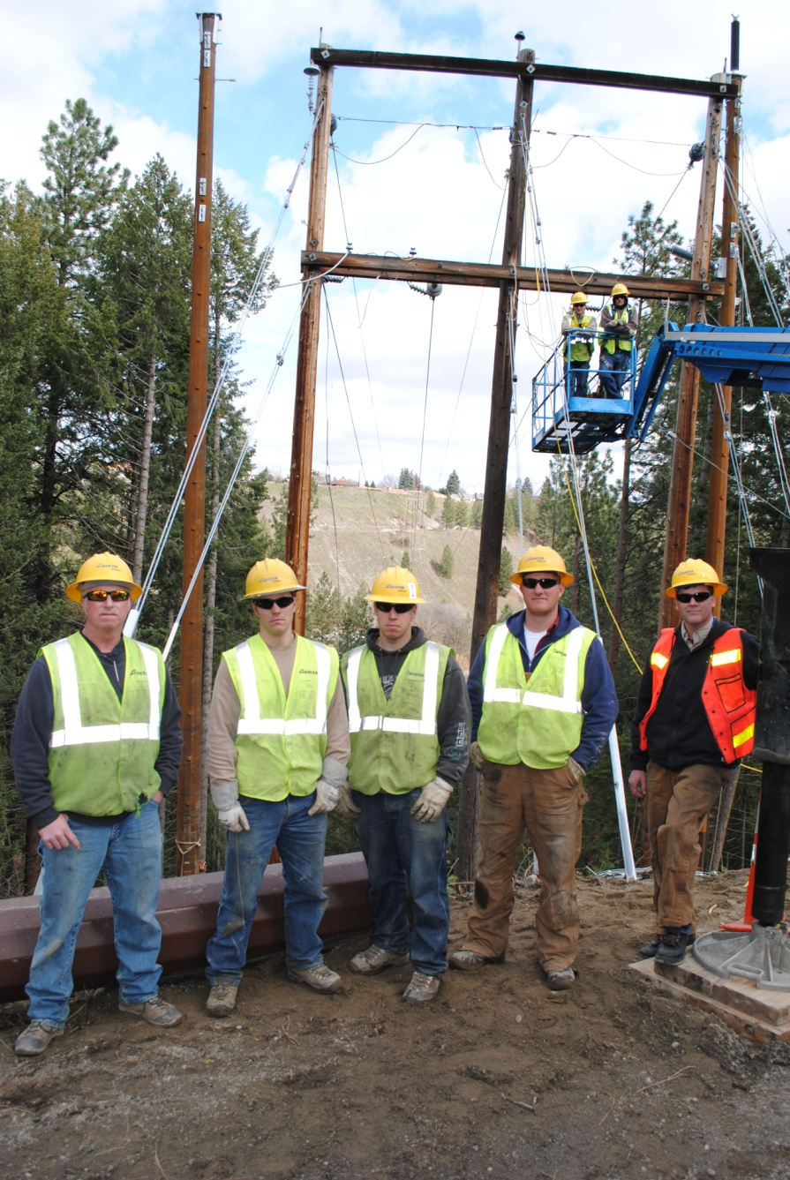
Distribution Construction
3
Notes:
4 stations are 100% complete with OH construction. North East, Lyons and Standard, Francis and Cedar, and Fort Wright.
-initially planned on installing 59 vipers and scadamates on the rest, but decided to install 87 vipers and reduce scadamates because we learned they were less expensive to install and provided more functionality

Slide 4
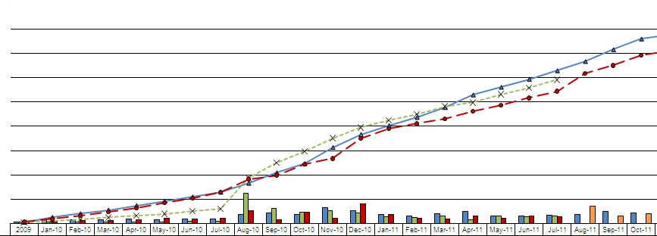
Project Performance
Cost Performance Index (CPI) 1.09
Schedule Performance Index (SPI): 0.94
4

Slide 5
Smart Grid Update
September 23, 2011 Washington Utilities and Transportation Commission Update – Dan Johnson
Smart Grid Demonstration Project – Pullman, WA
5

Slide 6
Smart Grid Demonstration Project Overview
Communications
Radio Network Complete
Port of Whitman Fiber Construction underway
Distribution Management System
Integration into Outage Management Tool
Substation Construction
Smart Switches & Capacitors installed
Smart Transformer Prototypes being tested
1.6Mile Reconductor Complete
Advanced Metering System
Meter Installation 100% Complete
Distribution Construction
Turner Substation construction on schedule
6

Slide 7
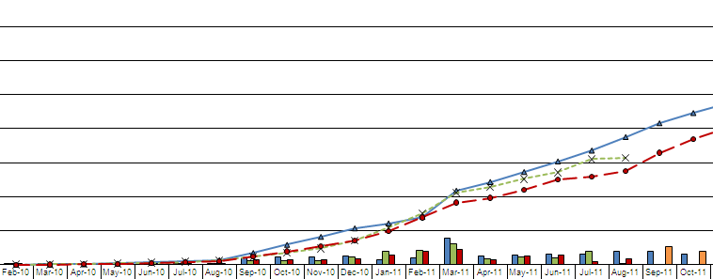
Project Performance
Cost Performance Index (CPI) 1.14
Schedule Performance Index (SPI): 0.84
7

Slide 8
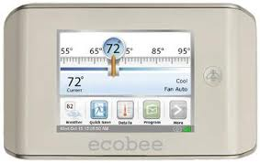
The Customer Experience
Advanced Metering System
Energy Management Web Tools
Customer Pilot
8

Slide 9
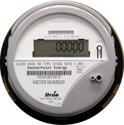
Smart Grid Demonstration –
Meter Installation
Advanced Metering System
Scope Services provided the contract installation
Albion/Pullman installation complete of 12,692 Electric and 5,264 Gas
Communication reading meters is 99.5%
9

Slide 10
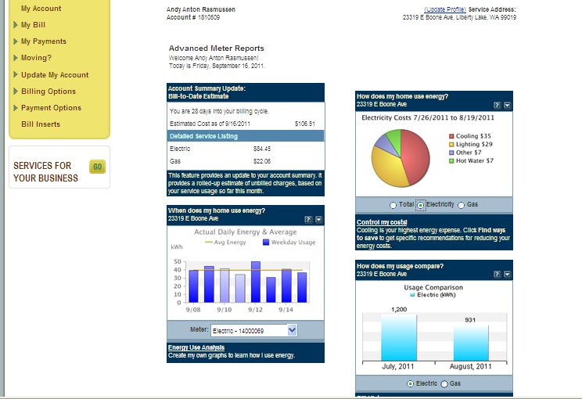
Energy Management Web Tool
10

Slide 11
Customer Experience Design
 | Measure Change in Consumption | Measure Change in Satisfaction & Usefulness
24-48 Hour Delayed Data | X | X
Real Time Info |  | X
11

Slide 12
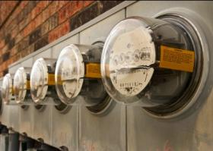
The Customer Experience
Customer Pilot
Improve energy consumption data
Establish and test regional signals
Understand customer experience, satisfaction, and program participation
Target of 1,500 customers in Pullman
Testing, Understanding, Learning
12

Slide 13
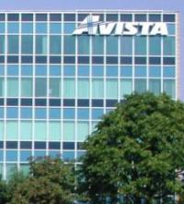
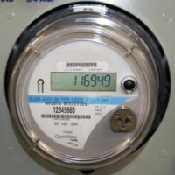
Web Portal + Real Time Consumption using a Programmable Communicating Thermostat
Encryption
Secure VPN
13

Slide 14
Customer Communications Update
September 23, 2011 Washington Utilities and Transportation Commission Update
Smart Grid Demonstration Project – Pullman, WA
Smart Circuit Project – Spokane, WA
14

Slide 15
Communications Objectives
Educate customers about the project and expected benefits
Educate customers about activities that directly impact them such as replacing existing meters with new advanced meters
Provide resources for customers to address their questions and concerns
Educate and empower customers to more actively manage their energy usage with enhanced technology and tools
15

Slide 16
Customer Advisory Group
Assembled customer advisory group
Currently consists of three Avista residential customers in Pullman
Group provides input and feedback on communication materials
16

Slide 17
Community Meetings
Conducted a variety of community meetings and presentations which resulted in local news coverage, another channel to help educate and inform customers about the Demonstration Project
17

Slide 18
Survey
Issued post-advanced meter installation survey to assess awareness of meter exchange communication and level of satisfaction with advanced meter installation process
18

Slide 19
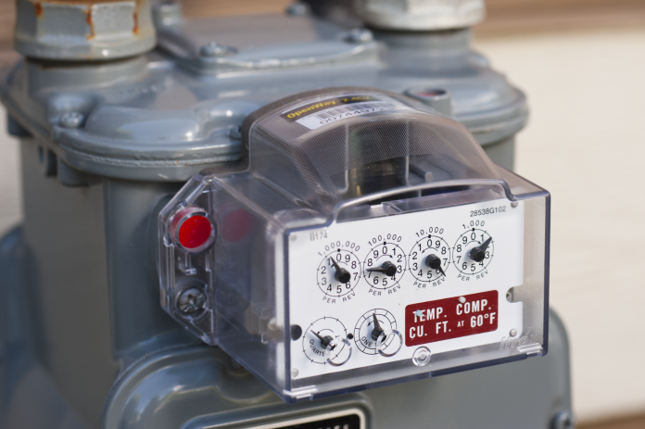
Post Meter Installation Survey Findings
282 total responses, resulting in a 6% response rate
Recall of communication prior to meter installation is high:
Seventy-one percent (71%) of the customers surveyed recall receiving a
letter in the mail prior to the installation
11% recall reading a news article
5% recall hearing a presentation from Avista
14% recall “other” forms of communication: door hanger, neighbor, installer,
internet, WSU, Avista employees (friends)
Nearly three-quarters of the customers are
‘very satisfied’ with the installation process
19

Slide 20
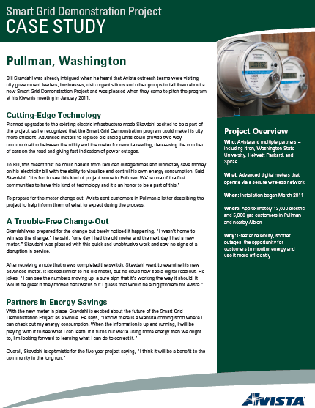
Case Studies
Developed case studies about advanced meter installation for use on the web, events and community meetings
20

Slide 21
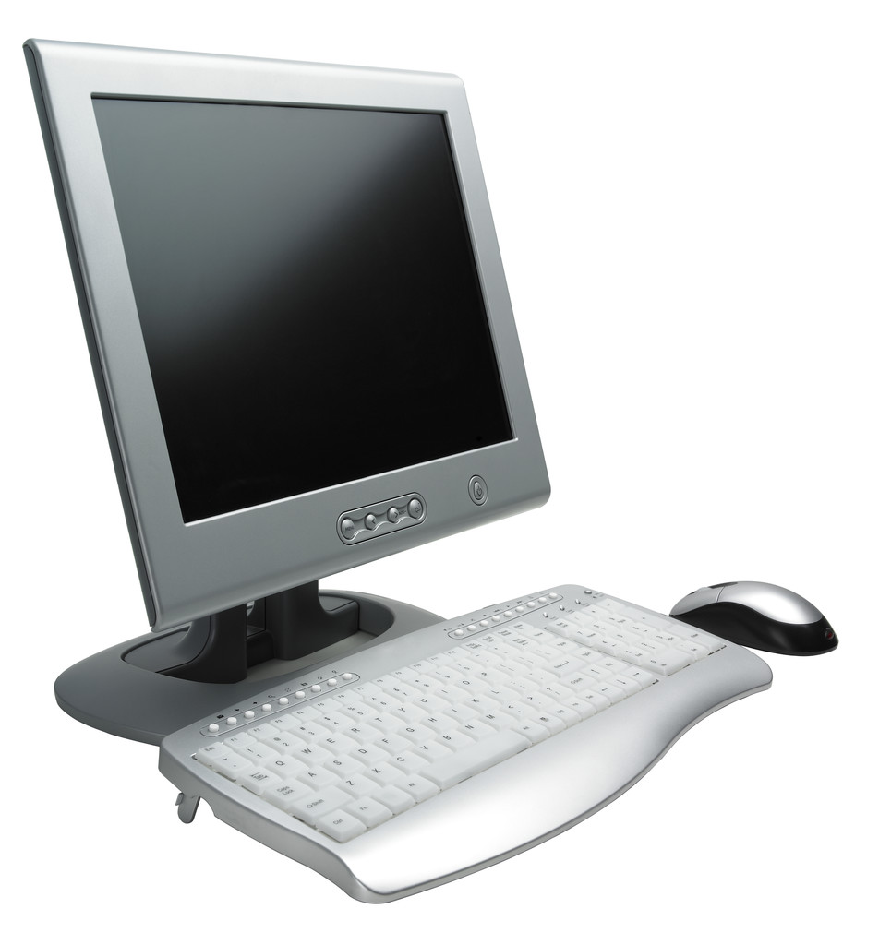
Advanced Meter Web Portal
Finalizing Web Portal Communications Plan
Tactics likely to include:
Letter to customers in the treatment group with an overview of the new portal features and benefits as well as instructions on how to access
Online tutorial for how to access and use new energy usage portal
Web portal FAQ
Conducting baseline survey mid-October to measure awareness and attitudes toward current online energy saving tools
21

Slide 22
Cyber Security Overview
September 23, 2011 Washington Utilities and Transportation Commission Update – Clay Storey
Smart Grid Demonstration Project – Pullman, WA
Smart Circuit Project – Spokane, WA
22

Slide 23
Security Update - Goals
Goals
Identify risk from new investments and capabilities
Measure risk for impact and probability
Manage risk to the organization and its customers
Apply best practice controls per industry baselines
What Success Looks Like
The NIST Security Lifecycle is operational
Documented risk response and controls implementation
Senior leadership understands and accepts the residual risk profile
23

Slide 24
Security Update - Strategy
Enterprise Security
Physical Security
Cyber Security
Smart Grid
Generation and Production
Transmission and Distribution
Facilities
Enterprise Technology
24

Slide 25
Security Update - Pullman
Categorize
Systems
Select
Controls
Implement
Controls
Assess
Controls
Authorize
Systems
Continuous Monitoring
25

Slide 26
Security Update - Spokane
Categorize
Systems
Select
Controls
Implement
Controls
Assess
Controls
Authorize
Systems
Continuous Monitoring
26

Slide 27
Questions………..
27

