Slide 1
PSE’s Equity Advisory Group and CEIP Public Participation efforts
UTC CETA Implementation Workshop – April 6, 2021
Ben Farrow, Director Clean Energy Strategy, PSE
Diann Strom, Strategic Engagement Lead, PSE

Slide 2
Examples of categories, customer benefit indicators, and measurement of customer benefit indicators
These are provided as examples of how categories, customer benefit indicators, and customer benefit indicator metrics could be identified. Actual customer benefit indicators will be proposed based on public and advisory group feedback.
Customer Benefit Indicator Category | Customer Benefit Indicators (outcomes) | Customer Benefit Indicator Metrics (how we measure the outcomes)
Rulemaking language | Public Participation + EAG input | Public Participation + EAG input
Energy and Non-energy Benefits
 | Decrease in income spent on electricity | Share of household income spent on electricity
 | More efficient homes | Household energy use
 | Dollars saved in customer costs | Customer cost savings
 | Home comfort
 | Improved airflow
 | More attractive homes/business
Long-term and Short-term Public Health, Environmental and Reduction of Costs and Risks
 | Reduced air pollution | NOx, CO2 emissions
 | Reduced climate change impacts | Levelized cost of greenhouse gas
 | Increased energy employment | Number energy jobs
 | Decreased poverty | % living in poverty
Energy Security and Resiliency
 | Availability for options for customers | Demand Response
 | Less reliance on market | Market Purchases
 | Access to storage | Distributed Storage

Slide 3
CEIP and public participation: goals
For the 2021 CEIP, we will:
Engage with the new Equity Advisory Group
Inform and consult PSE’s existing advisory groups
Inform and consult our customers, specifically highly impacted communities and vulnerable populations
Outcomes we’re seeking for 2021:
Durable CEIP
Diverse, meaningful, and equitable engagement
Accountable, repeatable process
Create a foundation of community relationships and approaches for future engagement

Slide 4
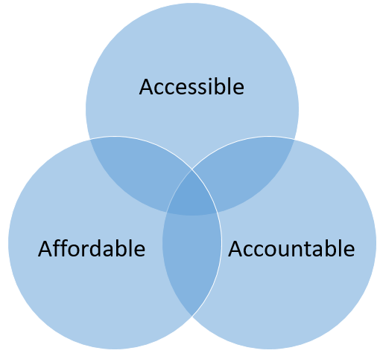
EAG mission and framework
Mission: Provide advice to PSE on equity issues and broaden our engagement with frontline customers as we work to deliver a just and equitable clean energy future
2021 inaugural EAG will:
Engage in developing metrics that help us measure equity in electric energy planning and decision-making for PSE’s Clean Energy Implementation Plan
Focus on paths to expanding equity, so our efforts are accessible, affordable and accountable
Highlight and mitigate barriers to customer participation
Provide advice on PSE’s public participation plan
Shape process for future EAG membership

Slide 5
Engagement objectives – draft
Engagement includes: EAG; existing advisory groups; and customers
Apr-Jul 2021 |  | Aug-Oct 2021 |  | 2022-2025
Develop CEIP with engagement focused on equity and customer benefits |  | Solicit comments on draft CEIP |  | Implement CEIP Continue public participation
Objectives
Collect input on: Clean energy values Customer benefit interests and priorities Ideas to advance equity |  | Compile and respond to feedback on CEIP, including: Draft actions and targets Proposed approach to clean energy implementation |  | Keep the conversation going and continue to refine elements for next CEIP
Aug. 15: Draft CEIP
Oct. 1: Final CEIP

