Slide 1
WECC Resource Adequacy Work
Jordan White
Vice President of Strategic Engagement & Deputy General Counsel
Victoria Ravenscroft
Sr. Policy and External Affairs Manager

Slide 3
WECC’s Resource Adequacy Work
NERC Long-Term Reliability Assessment (LTRA)
Continent-wide assessment of the adequacy of the Bulk Electric System over the next 10 years
NERC Summer & Winter Assessments
Continent-wide assessment of the adequacy of electricity supplies in the coming summer/winter season
WECC Resource Adequacy Forum
WECC Western Assessment of Resource Adequacy

Slide 4
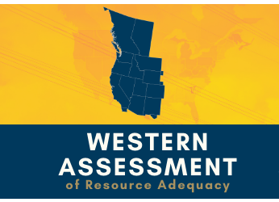
Western Assessment of Resource Adequacy
Assessment of resource adequacy in the Western Interconnection
Developed to address WECC stakeholder requests in response to NERC’s LTRA
More granular analysis
Different assumptions
Analysis of more constrained scenarios

Slide 5
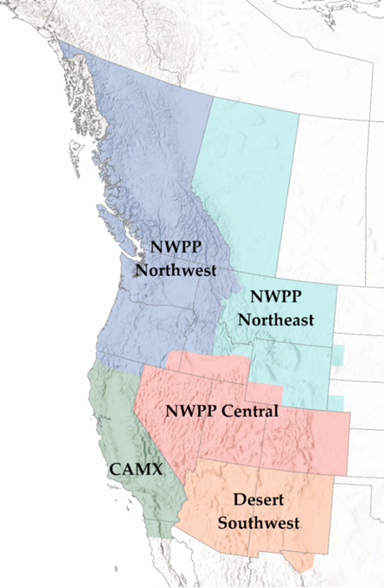
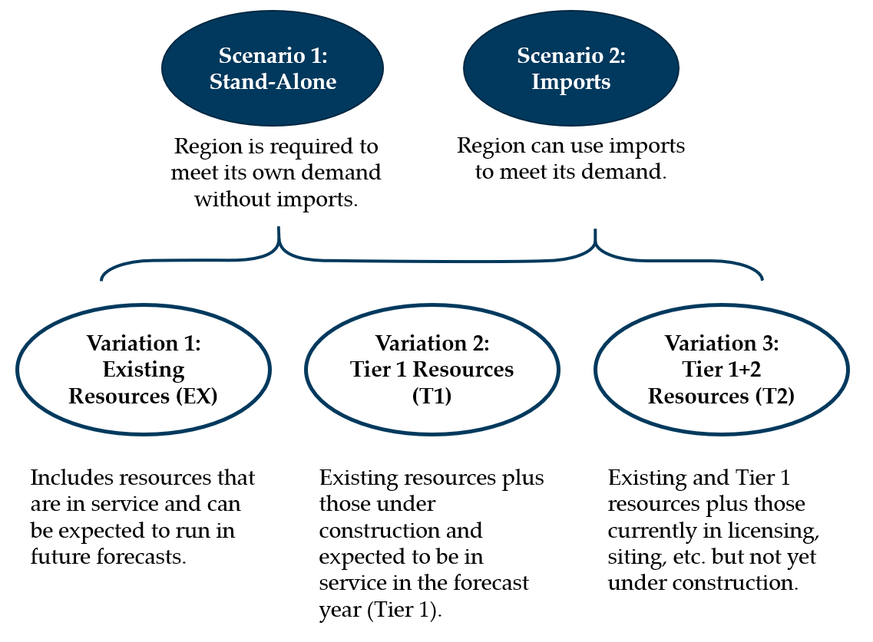
Western Assessment of Resource Adequacy
Assessment Regions
Scenarios
NWPP Northwest (NWPP-NW)
NWPP Northeast (NWPP-NE)
NWPP Central (NWPP-C)
California-Mexico (CAMX)
Desert Southwest (DSW)

Slide 6
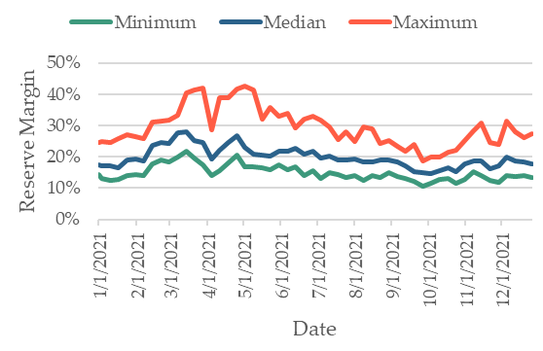
Takeaways and Recommendations
2021 NWPP-NW Planning Reserve Margin
Weekly Max, Min, and Median

Slide 7
Takeaways and Recommendations: Variability
Variability
Increasing variability on the system is driving a need for change in the way we analyze and plan for resource adequacy.
Recommendation
Consider methods to account for variability at different times of the year in determining planning reserve margins.
Consider the availability and variability characteristics of capacity additions.
2021 NWPP-NW Planning Reserve Margin
Weekly Max, Min, and Median

Slide 8
2021 Planning Reserve Margin Weekly Max, Min, and Median
NWPP-C
NWPP-NE
CAMX
DSW

Slide 9
Takeaways and Recommendations: Imports
Peak Day Expected Import Availability - 2021
Peak Day Low Import Availability - 2021

Slide 10
2021 Peak Day Low Import Availability
NWPP-C
NWPP-NE
NWPP-NW
NWPP-NE
NWPP-C
CAMX-N
CAMX-S
DSW
Total Expected Import Availability
CAMX-So
DSW

Slide 11
Takeaways & Recommendations: Imports
Imports
The level of imports historically relied upon by entities has changed. Under some conditions, import capability is reduced.
Under highly stressed conditions, entities in each of the five subregions could be impacted by the reduction in imports.
Without coordination, entities could be relying on the same resource during a time of great need.
Recommendation
Planning entities should coordinate their resource planning efforts on an interconnection-wide basis each year to help ensure they are not all relying on the same imports (especially during times of high variability).

Slide 12
Summer 2021
Resource adequacy issues remain
Reliance on imports
System variability
August 2020 heatwave is a great learning opportunity for entities
Expect entities are working to address possible resource needs
Monitoring coordination efforts
Extreme weather is becoming part of “normal” life
Expect entities are preparing for the “new normal”
Coordination is key

Slide 13
Western Assessment of Resource Adequacy
The Western Assessment does…
Use existing IRP information aggregated to the Balancing Authority (BA) level
Look at imports based on forecast data supplied by BAs
Provide a check on variability in and across subregions
Provide a snapshot of our reliance on imports
Provide information useful in the operational planning horizon
The Western Assessment does not…
Look at pending IRP information
Look at contract data for import and transmission assumptions
Provide information for an apples-to-apples review of utility IRPs

Slide 14
Jordan White
jwhite@wecc.org
Victoria Ravenscroft
vravenscroft@wecc.org

