Slide 1
San Juan Islands Fiber Inspection plans and results as of 11/30/16
November 30, 2015

Slide 2
Inspection Plan
By November 30 of each year, CenturyLink will submit annual inspection plans to the Commission for the subsequent calendar year for the San Juan Submarine Facilities. The plans should, at a minimum, specify the location of the facility to be inspected and the frequency and manner in which inspections will be conducted.
Annually, a qualified central office technician will retrieve the overall optical loss results from the Coriant 7100 nodes located on Lopez Island and La Conner. The results will be captured and compared to the equipment manufacturer’s optical specifications.

Slide 3
Inspection Plan (continued)
Annually, a qualified central office technician will retrieve the overall optical loss results from the Fujitsu 7420 nodes located on Friday Harbor, Lopez Island, and Orcas Island. Results will be compared to the equipment manufacturer’s optical specifications.
Annually, field operations will conduct a site survey at the first location where submarine cable appears on land and is accessible. The survey will involve visual examination of the fiber optic cable, condition of the vault or pedestal, and changes in the surrounding environment.

Slide 4
Lopez to La Conner
This document describes signal loss measurement between the Coriant 7100 optical electronics located in Lopez Island and in La Conner Washington
Loss is the difference between the Transmit (Tx) signal level and the Received (Rx) signal level.
Levels will be measured on the optical service channels (OSC) of the 7100N Reconfigurable Optical Add Drop Multiplexer (ROADM) High-speed cards.

Slide 5
Coriant 7100 Optical Specifications
Lopez 7100N is equipped with OADM-LR High-speed cards
The OADM88-LR supports span loss of 14 dB to 26 dB
La Conner 7100N’s are equipped with LRAM-88 cards in both Optical Line Amplifier (OLA) shelves
The LRAM-88 can support spans of 14 dB to 26 dB
OADM: Optical Add-Drop Multiplexer
LRAM : Long Range Amplifier Module

Slide 6
Lopez to Friday Harbor
We will conduct signal loss measurement between the Fujitsu FW7420 optical electronics located at Lopez Island and at Friday Harbor
Loss is calculated as the difference between the Transmit (Tx) signal level and the Received (Rx) signal level.
Levels will be observed on the working channels of the FW7420 High-speed cards.

Slide 7
Radio
In each report for each microwave system, CenturyLink will state whether it followed its current Antenna and Tower Routine Inspection (Appendix A to the Settlement Agreement). If CenturyLink changes its Antenna and Tower Routine Inspection, CenturyLink will provide the Commission with the revised routine inspection document on or before March 31 of each year.
A site survey will be completed by the CenturyLink Antenna/Tower Team, utilizing the Antenna and Tower Inspection Form (Settlement Agreement Appendix A). This form captures: Tower/Structure, Antenna & Waveguide, Air Pressure, Environmental(surrounding environment/security concerns). Deviations, exceptions and recommendations for correction will be captured and acted upon.

Slide 8
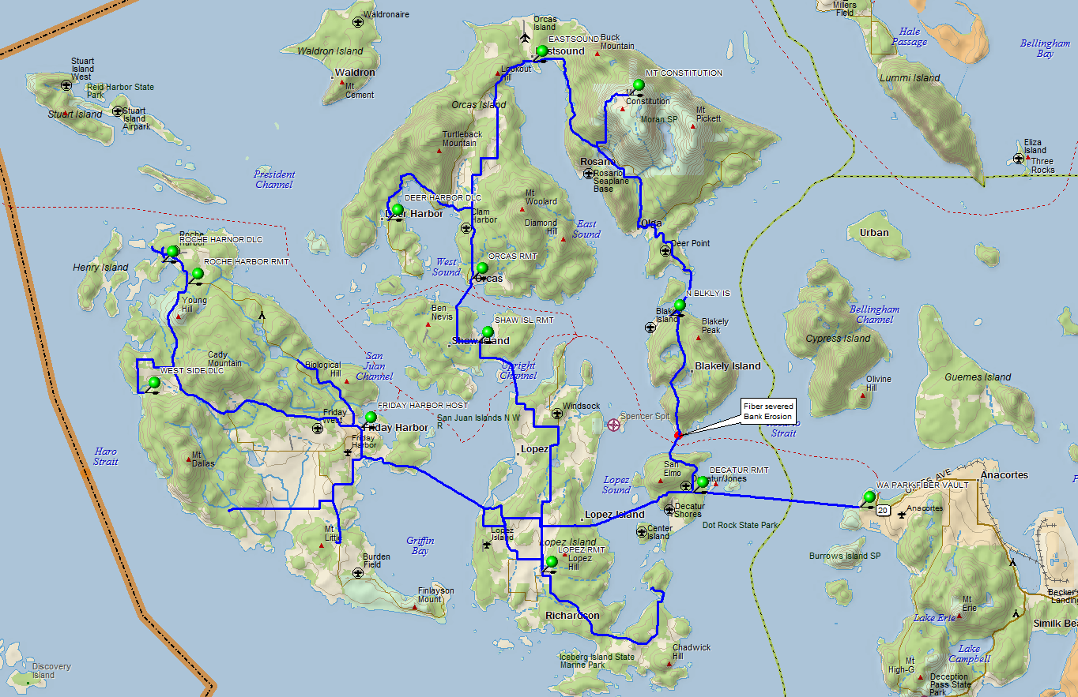
San Juan Island Fiber
Customer: CENTURYLINK
Location: LOPEZ, WA
Product:
TO
BLHMWA01
C
E
D
F
A
B
G
H
MICROWAVE RADIO ROUTE
FIBER ROUTE
FIBER SEGMENT DETAIL
A
Requestor:
Originator: SCOTT DALLASTA
Date: 12-11-13

