Slide 1
Fatal Flaws in PSE attempt to justify Energize Eastside
Supplementing my written narrative on this subject
Submitted by Richard Lauckhart on behalf of CENSE
Public Hearing on PSE CUP Application, January 2022

Slide 2
What I will be telling you…
PSE fails in its legal burden to prove EE project need
The solid verifiable facts demonstrating project need have not been provided (i.e. “show us your homework”)
It is clear that PSE relies on load flow studies that contain fatal flaws
PSE is attempting to meets its stated goal of increasing it rates to retail customers in order to grow its profits
PSE makes no legitimate effort to study appropriate alternatives to EE
MaxETA/Synapse provide an interesting but flawed review of project need

Slide 3
Where is PSEs homework?
For eight years PSE has stubbornly refused to make available the standard vital underlying information that power planners use and expect from others to justify system upgrades.
In simple terms, PSE has been hiding the ball since 2013.
Without full disclosure and transparency regarding this key information, following execution of nondisclosure agreements by the parties and their experts, PSE fails to even enter the arena of a preponderance of evidence, if it withholds its evidence.
This project cannot proceed on a “just trust me” basis.

Slide 4
Solid, verifiable facts are required
The basic facts needed to support accurate, verifiable conclusions for a system upgrade are generated by computer simulations of a utility’s entire system known as “load flow studies,” or “power studies.”
These studies also include adding and analyzing other utilities’ resources outside the utility’s service area (but part of the interconnected grid) that can be called upon in an emergency.
In fact, these simulations are indeed conducted in both “normal” and “emergency” scenarios, as we will see later. For four scenarios, in fact:
winter peak load with no elements of the grid forced out of service,
winter peak load with certain elements of the grid out of service on forced outages,
summer peak load with no elements of the grid forced out of service,
and summer peak load with certain elements of the grid out of service on forced outages.

Slide 5
What are load flow studies?
Load flow studies are the mechanism that utilities use to test the reliability of the transmission grid
Load flow studies are designed to predict the behavior of the entire interconnected power grid in a future time period
Puget is embedded in and an integral part of the entire Western Interconnect (aka WECC) area
Load flow modeling involves complicated mathematical algorithms to address a nonlinear system with a massive amount of input data
Solving the power flow Jacobian Matrix
use of the Newton–Raphson solution method to address the non-linearity

Slide 6
Problems with PSE/Quanta studies
PSE’s load flow studies addressing the possible need for EE make no sense in the eyes of a qualified expert like myself
Input data is flawed, which results in flawed output
At least seven (7) major flaws in the input data (detailed in a later slide)
“Garbage In – Garbage Out” The studies are very much out of date
Studies were run in 2013 to forecast what would happen in the year 2018
PSE’s Public Relations approach to telling the public about this problem oversimplified the important outputs of the load flow study

Slide 7
PSE oversimplified and erroneous depiction of load flow output
The eastside is embedded in the WECC grid…No indication of what the boundaries of the eastside are
No indication of how the eastside “Current System Capacity” is determined
Customer Demand growth is now demonstrably way too high
This graphic is intended to tell someone that there will be outages on the eastside if EE is not built. But no legitimate basis for that conclusion.
Show us your homework!!!

Slide 8
Eight NERC/FERC subregions WECC is one of the eight PSE is embedded in and a part of WECC

Slide 9
Five WECC subregional planning regions These subregions of WECC perform transmission reliability studies annually. Both load flow and transient stability analysis taking into account possible contingency outages of generators and transmission lines (N-2) PSE is embedded in and a part of Northern Grid

Slide 10
Takeaways from the last two slides…
PSE is embedded and an integral part of the Western Interconnect
Any analysis of the reliability of PSE power system and the eastside needs to be studied in a WECC wide load flow study
Transmission reliability studies involved both (a) steady state Load Flow studies and (b) transient stability studies
PSE/Quanta studies done in 2013 (forecasting what would occur in the year 2018) attempted to study state state load flow studies only!
But these PSE/Quant load flow studies contained at least seven flaws.
PSE has never provided the input and output files for these load flow studies

Slide 11
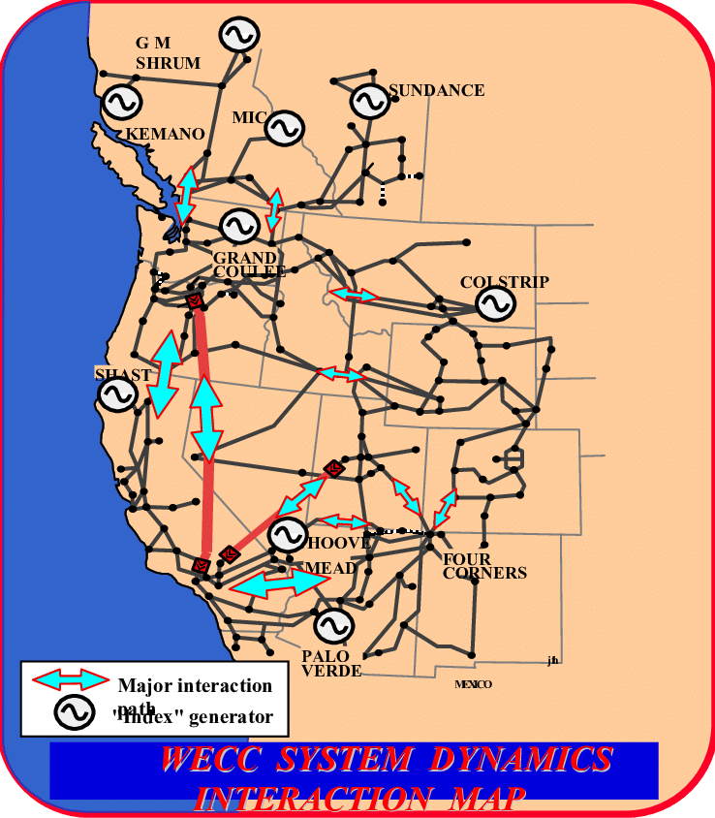
WECC
Western Electricity Coordinating Council
The major transmission lines and generating stations
Notes:
What is WECC? WECC is the regional entity that monitors and enforces reliability standards in the Western Interconnection subject to oversight by NERC and FERC.

Slide 12
Load flow study
Inputs
Physical layout of grid
How much electricity is needed
How much electricity can be generated
Resistance in each wire
Outputs
How much electricity passes through each part
Warning if any part overloads
Warning if voltage drops too much

Slide 13
Truth about load flow studies…
Garbage in, Garbage out
It is not possible to show the output of the load flow study in a graphic like PSE has used in its PR campaign (as shown in the graphic on slice 7 of this PPT deck)
Failure of the model to “solve”, (aka Failure to Converge), and (aka Voltage Collapse) is a key concern in load flow modeling of how the system will actually behave under stress conditions of concern

Slide 14
Garbage in – Garbage out
PSE/Quanta load flow studies had at least 7 major flaws in its input data
Roger Schiffman and I ran load flow studies that did not include these major flaws.
Our finding is that if these flaws are corrected, then there is no reliability problem in the future.
Load increases forecast in the Lauckhart-Schiffman study have now proven to be too high. Making our finding of no problem even more legitimate.

Slide 15
Load Flow databases available to experts like myself…FERC Form 715 https://www.ferc.gov/industries-data/electric/electric-industry-forms/form-no-715-annual-transmission-planning-and-evaluation-report-instructions
The Federal Energy Regulatory Commission (FERC) requires PSE to make load flow data bases available to experts like myself.
I am able to get this data by signing a CEII Non-Disclosure Agreement
These data bases are called “Base Cases.” There are a large number of such Base Cases that I can get from FERC or WECC for the Western Interconnect.
Schiffman and I ran our load flow studies off of these Base Cases and found no reliability problem on the eastside
We found at least 7 fatal flaws in the PSE/Quanta input data

Slide 16
A power system expert needs to see these five files
If I or anyone with my power planning expertise had just these five files from the PSE/Quanta studies, I would, probably within less than a week, be able to pinpoint with precision where the specific flaws in those studies lie.
It would be analogous to finding a computer bug’s source by looking deep into the source code.
PSE has succeeded so far in refusing me and others access to these easily available five text files, because PSE claims my federal security (CEII) clearance is not good enough for PSE.
PSE by law does not have the right to set its own CEII qualifications.
In my case, their refusal was explained by my not having armed guards posted at my house to prevent terrorists from getting in and finding PSE grid information. That requirement goes far beyond what anyone else requires.
PSE is inappropriately using this excuse to avoid having to provide embarrassing details of its load flow studies.

Slide 17
Where is the homework?
PSE offers as sole proof of project need to improve Eastside reliability its obsolete 2013 and 2015 load flow studies.
PSE has never SHOWN ITS HOMEWORK to show its conclusions are supported by the underlying facts.
PSE and its consultants relying on PSE/Quanta flow studies produce impressive spreadsheets and reports, but they never show where the data is supported in the key five text files.
What is needed is the equivalent of a “DATA AUTOPSY.”

Slide 18
Why would PSE/Quanta utilize load flow studies with fatal flaws to justify EE?
Macquarie, an Australian based Company, purchased all the common stock of PSE in 2009.
Macquarie stated: “We don’t have employees. We’re not the neighboring utility. Combining work forces and eliminating redundancies is not the story. Our interest is to grow the business.”
Macquarie had a plan to invest $1 Billion each year into new PSE utility infrastructure so they could get the WUTC to increase the electric rates for PSE retail customers and increase their profit.

Slide 19
What if there was no need for $5 billion of new PSE utility infrastructure?
By the year 2013, Macquarie was 4 years into the five year period and had been able to justify only a small amount of new investment
Macquarie came up with the idea of justifying Energize Eastside in order to greatly increase their investment. Macquarie hired Quanta to run load flow studies to attempt to justify the need for EE.
Macquarie was using Quanta to build any new PSE infrastructure. Macquarie apparently advised Quanta that they would become the Engineer, Procure, Construct (EPC) contractor on Energize Eastside if Macquarie could get it permitted.
It would appear that Quanta adopted a fatally flawed load flow analysis in order to get the lucrative EPC contract.

Slide 20
The Seven Fatal Flaws found so far… First fatal flaw
The first fatal flaw is the shutting down of 6 natural gas fired generators.
Puget acquired these resources in order to assure sufficient supply to meet their winter peak demand.
These resources were also acquired to solve an identified “voltage collapse” problem in the Puget Sound Region
Shutting down these resources in a load flow study of a winter peak load event is non-sensical.

Slide 21
List of Puget Sound Area resources in Quanta load flow studies: Quanta shut down Sumas, Ferndale, Whitehorn, Fredonia, Freddy 1, and Fredonia in their very high Winter load scenario. By contrast, WECC ran these six PSE resources in their very high Winter load scenario.

Slide 22
PSE’s latest Supply and Demand balance Shows 545 MW of new capacity need in Winter by the year 2026. That is with all PSE gas fired generation running. Removing the 1,600 MW of PSE gas fired generation as done by Quanta make the shortfall grow to over 2,100 MW. That is not a legitimate scenario for the future. The gas fired generation needs to run during the winter peak and can be available for use in the Summer is needed.

Slide 23
Observations from the PSE Supply and Demand table
PSE is short on power today. Their plan is to rely on the uncertain and risky spot market for power. Who knows if that power will be available, and if so, what it will cost. Relying on such a short-term market is what drove Pacific Gas & Electric into bankruptcy several years ago.
But the problem in the PSE/Quanta modeling is that they remove a large part of the PSE natural gas fired generation that is included on this chart.
That not only makes no sense, but it causes “voltage collapse” in the Puget Sound region.

Slide 24
Puget Sound Area gas fired generation
The location of these 6 PSE gas fired generators and their operation is critical to providing reliable power to PSE customers (and all customers in the Puget Sound Region including Seattle City Light customers).
Shutting down these 6 PSD gas fired generators in a period of high demand for power in the Puget Sound Area would not be allowed by the reliability coordinator RC West.

Slide 25
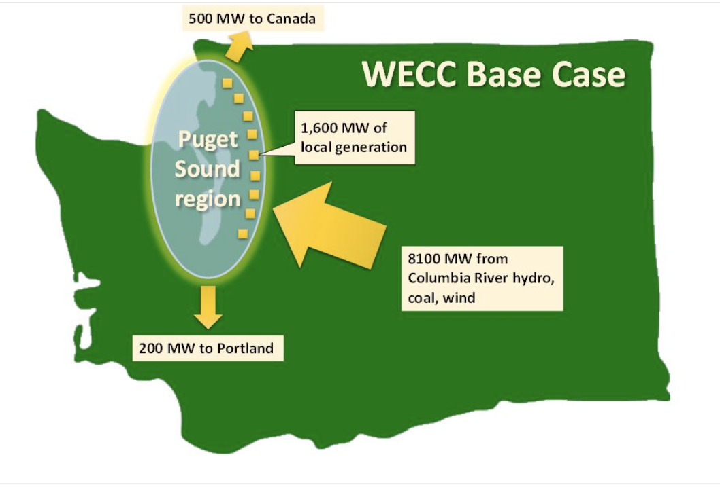
WECC
Western Electricity Coordinating Council
Base Cases
2013 WECC PSE Base Case for 2018 Peak Winter Day
Notes:
WECC Base Cases: Each year WECC develops a series of Base Cases for different seasons (e.g. summer and winter) for several years into the future in order to assure there are appropriate plans to meet future electricity demands in a reliable fashion. In Western Washington, biggest peaks are on a “heavy” winter day. Base Cases are used to make projections for planning purposes. Here is one created by WECC in 2013 that projected into 2018. This represents a reliable system based on data WECC used as given to it by PSE.

Slide 26
Generation Resource Technologies and total MW in WECC When Quanta runs a load flow study in which PSE is very short on generation capacity, then Quanta needs to run resources very far from the Puget Sound Area to meet PSE loads. During Winter peak situations many of the generators in California and Arizona are not needed to meet their load. They are summer peaking states. Quanta assumed these surplus resources in the south would be used to meet PSE loads rather than PSE’s own resources. When this is done without the cancelled BPA I-5 Corridor reinforcement project, “voltage collapse” occurs in the Puget Sound Area. The fix to this problem requires turning on the 6 PSE Puget Sound Area generators and shutting down an equivalent amount of generation that that were located far from Puget Sound Area loads. List of resource supplies in WECC with their technology and MW capacity
 | capacity MW
natural Gas | 97,000
hydro | 68,000
coal | 30,000
wind | 25,000
solar | 20,000
nuclear | 8,000
geothermal | 4,000
other | 5,000
 | 257,000

Slide 27
Challenge Number 6 placed to PSE on March 28, 2016
We challenge PSE to cite standards that require them to turn off 6 local generation plants at the same time they are serving peak demand with an N-1-1 contingency.
[PSE never answered this challenge]

Slide 28
Key input and output files from load flow modeling runs (e. g. Base Cases)
1. areatie.lst. It shows the lines between utilities. It contains input data (how much power these lines can move), and output data (how much power flows over these lines in the “solved case,” i.e., a result the system can produce under simulated conditions. There are 22 different areas in WECC. PSE is in the Northwest area. PSE is one of 489 zones in WECC.
2. buslist.lst. This file consists of a long list of substations and line connections across all of WECC including the PSE substations on line connections. There are 22,195 Busses in WECC. There are 3,500 different generation plants in WECC totaling 257,000 MW.
3. flows.lst. It shows every segment of the transmission and substation grid in WECC, including the PSE service area. Input data here is the capacity of the segments. This file’s output data shows how much power flows through each segment in the solved case. There are 17,454 different branch segments in the WECC. There are 8,769 high voltage transformers in WECC. There are 11,257 load serving substations in WECC.
4. owner.lst. A listing of 489 utilities that own what facilities in WECC.
5. summary.lst A general overview of what generation is available in that particular solved case.

Slide 29
And how will PSE meet its future resource need?
An earlier graphic shows a large PSE need for additional supply side or demand side projects growing, particularly in the year 2026 when the Colstrip coal plant goes away
Pursuant to Washington Administrative Code WAC 480-107-009. When PSE has a need to fill a gap between supply and demand, PSE is required to develop all-source RFPs and conditions for targeted RFPs.
All source means either new supply or new Demand Side Management (DSM) programs.
Puget has surprisingly chosen to cancel recent DSM and all-source RFP’s. I suspect they fear someone will propose to build a 50 MW peaker at Lakeside or provide them new DSM programs…which bids will negate the need for EE if there ever was one.

Slide 30
The Seven Fatal Flaws found so far… Second fatal flaw
The Second fatal flaw was in assuming the BPA proposed “I-5 Corridor Reinforcement Project” would be built. But that project was cancelled in 2017.
The BPA proposed project was a 500-kilovolt (kV) lattice-steel-tower transmission line that would have run from a new 500-kV substation near Castle Rock, Wash., to a new 500-kV substation near Troutdale, Ore.
This high capacity 500 KV line, if built, would have increased the grid’s ability to move significantly more power into the Puget Sound Area.
That is how PSE/Quanta managed to avoid “voltage collapse“ in their modeling. But the BPA project has been canceled and the PSE/Quanta load flow modeling is therefore fatally flawed.

Slide 31
BPA’s stated reason for cancelling that project
“BPA proposed the I-5 Corridor Reinforcement project in 2009 as a solution to preserve reliability, meet existing contract requirements, reduce curtailments, and serve demand on the transmission system – which at the time was growing. More recently, BPA considered the size, local impacts and increasing costs of the proposed project, which prompted us to take a hard look at all of our transmission practices and analytics, including a fresh look at load (electrical demand) forecasts, generation changes and market dynamics. As a result of this comprehensive review and the inherent difficulties associated with building this line, we are taking a new approach to managing congestion on our transmission grid. My decision today reflects a shift for BPA – from the traditional approach of primarily relying on new construction to meet changing transmission needs, to embracing a more flexible, scalable, and economically and operationally efficient approach to managing our transmission system. We will also increase our reliance on advanced technology, robust regional planning, industry standard commercial practices and coordinated system operations.”

Slide 32
The Seven Fatal Flaws found so far… Third fatal flaw
Not allowing nearby 230/115 KV transformers to serve Eastside load in the modeling when in the real world they in fact do serve Eastside load.
Excluding these obvious resources available to PSE in peak load times to sustain reliability is either due to gross incompetence or willful deceit.
Again, common sense would dictate an honest and accurate picture of the real-world power when planning “what if” simulated solutions

Slide 33
PSE neglects to recognize that there exist many more 230/115 KV transformers that can provide power to the eastside 115KV grid if a transformer at Sammamish fails followed by the failure of a transformer at Talbot Hill

Slide 34
The Seven Fatal Flaws found so far… Fourth fatal flaw
There is the false assumption that PSE ratepayers are responsible to build EE for developing the capability to allow 1,500 MW of power to flow to Canada under winter peak load conditions and two elements of the grid out on forced outage.
That amount of Firm Delivery of power was never required.
BPA seems to think it has the obligation to deliver 1,500 MW of power to flow to Canada under winter peak load conditions and two elements of the grid out on forced outage.
If that is true, then BPA needs to pay the cost of transmission infrastructure improvements that allow that to happen.
PSE and its customers have no obligation to pay the cost of transmission infrastructure improvements that allow that to happen.

Slide 35
The Seven Fatal Flaws found so far… Fifth fatal flaw
The fifth fatal flaw is in using the wrong “rating” of transformers and transmission line segments on the grid in the load flow studies
“Ratings” are how much power the equipment can accommodate without causing the equipment to fail.
Ratings are higher in the winter because the cold temperatures help avoid the equipment to over-heat.
Ratings are higher when an outage is of short duration because the short term of the outage keeps the equipment from overheating.
PSE/Quanta used summer “normal” transformer “ratings” when the studies should have used winter “emergency” transformer ratings (winter emergency ratings are 30% higher than summer normal ratings)

Slide 36
The Seven Fatal Flaws found so far… Sixth fatal flaw
The PSE/Quanta studies assume customer demand on the Eastside will rapidly grow over the next 10 years when in reality the Eastside load is actually decreasing.
Again, reality and common sense are not taken into account to adjust for real-world facts, in order to allow “garbage in” inputs to continue to skew in favor PSE’s desired result (and prevent writing off $89 million in sunk costs so far).
By analogy, no sane person would rely on a weather prediction for tomorrow’s weather made eight years ago over an untainted weather forecast made today. But that is precisely what PSE is trying to get away with here.

Slide 37
The Seven Fatal Flaws found so far… Seventh fatal flaw
The seventh fatal flaw found so far is in not simulating reasonable alternatives to EE by running load flow studies with prominently proposed alternatives.
PSE failed to consider any of the following alternatives:
- the available, cheaper, safer, and overall better Seattle City Lines on the Eastside;
- the cheaper and safer Lake Tradition alternative;
- a single small gas-fired peaker plant placed right where the load is in Bellevue, with no need for 18 miles of transmission lines;
and known effective non-wire solutions such as Demand Side Maintenance (DSM) MaxETS/Synapse prefer

Slide 38
What other fatal flaws did PSE/Quanta have in their load flow modeling?
We can only know with final absolute certainty what mistakes the PSE/Quanta made by looking at the detailed input/output files in the load flow modeling they conducted
Or, conversely, we can only know with final absolute certainty the project is valid if PSE proves with the essential five data files that they are right. What are they hiding?
PSE needs to SHOW ITS HOMEWORK! You would think they would want to do that to the hearing examiner’s satisfaction to make sure there is no doubt who is right
I have done such a data autopsy using the five key input and output files that come from a load flow study. In a recent case in Montana as Consolidated Energy of New York’s consultant, I suspected, as here, flaws in the flow studies done for a major wind energy project. After searching for the data from the flow studies where I suspected to find flaws, in the span of just a few days, using the simple “find” feature that comes with every text file application like Notebook in Windows, I discovered these nine fatal flaws.
It is not important for our purposes in this hearing to explain in detail what those incorrect data entries were. Suffice it to say the project proponent admitted these were all mistakes, and that it indeed about two of them but did not make corrections. The result being that a project initially projected to cost $260 million became one of $60 million.

Slide 39
What if PSE still refuses to show its homework?
An autopsy like those I have done in recent consulting assignments needs to be done here.
Such an autopsy is needed here if the hearing examiner is going to see all the important facts.
If PSE fails to come forward with that information, then my strong circumstantial proof of the flaws in PSE’s one defective piece of evidence offered for project need is refuted and its permit application should be dismissed.

Slide 40
There are alternatives to EE that are lower cost, have lower cost, lower environmental impact and are much safer (explained in detail in my report)
Seattle City Light Eastside Lines
Lake Tradition Transformer
50 MW Peaker Plant
Demand Side Management

Slide 41
The Synapse work…my findings (explained in detail in my report)
Winter findings…No winter need. Matches Lauckhart/Schiffman work
Summer Findings…bogus Bulk Electric System Vulnerability problem

Slide 42
Responsible Power Planning Details in my report
I worked for Puget for 21 years, including 5 years as Vice President of Power Planning. We performed our Power Planning duties in a responsible cost effective, and environmentally conscious manner. Examples of Responsible Power Planning are:
John Ellis on using BPA lines instead of building our own
BPA I-5 Corridor Reinforcement Planning…cancelled
Responsible Power Planning = using one of the safer alternatives instead of building Energize Eastside

Slide 43
Findings and Conclusion
As is well documented in this report, PSE fails in its legal burden to prove project need.
The PSE CUP for Energize Eastside should be denied.
If PSE thinks the denial was improper, PSE has the option of taking the matter to EFSEC. That is where they should have gone in the first place and they have that option if Newcastle denies their CUP application.

