Slide 1
COVID-19 Equity, Customer Communications, and Outreach Workshop
Docket U-200281
Tuesday, August 3, 2021, at 1 p.m.

Slide 2
Welcome

Slide 3
Ground Rules for a Virtual Meeting
This meeting is being recorded in Microsoft Teams
MUTE your microphone when you’re not speaking
Speak up when you are presenting or asking questions
Use chat or raise hand to ask questions
Don’t put your phone on HOLD
Stay engaged and present!
If you have slides you would like us to run or have tech issues, email emilie.brown@utc.wa.gov

Slide 4
Agenda
Welcome
Guest Speakers
Break
COVID Data Overview
Utility Outreach Overview
Disconnections Review
Break
Debt Relief
Next Steps
Adjourn

Slide 5
Guest Speakers
Carol Weltz (SNAP), Shaylee Stokes (Hopelink), Shawn Collins (Energy Project), Michael Furze (Commerce) and Amy Wheeless (NWEC)

Slide 6
CAP Agencies
Overview of CAP agency outreach and availability
What’s working/what’s not in customer outreach and communications
How are CAP agencies using new eligibility guidelines for IOU low-income programs
Obstacles to receiving LIHEAP and ideas to overcome

Slide 7
Small Business Resiliency Network
Outreach to low-income and underserved populations

Slide 9
Data Overview
Status of arrearages through June
Low-income assistance distribution
Available COVID low-income assistance funding

Slide 10
Status of Arrearages Through June

Slide 11
Low-Income Assistance Distribution

Slide 12
Available COVID Low-Income Assistance Funding

Slide 13
Utility Outreach Overview
Update on outreach efforts
BIPOC, Tribal, low-income outreach
Language access
Response to customer notices sent in June
Other wins/losses?

Slide 14
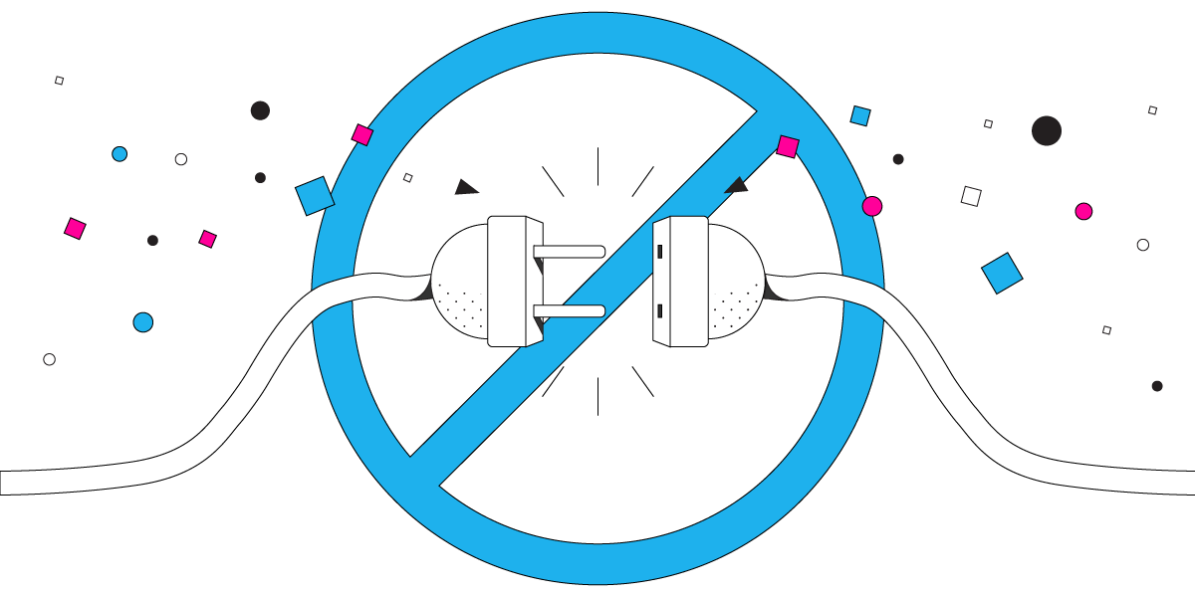
Disconnections
What steps are utilities taking to avoid disconnections?
Customer notices/contact points
The practice of reporting to credit agencies

Slide 15
Consumer Protection’s Role in Disconnections
Utilities must email customer information to disconnections@utc.wa.gov
Required information:
Account Holder(s) name(s)
All Customer contact information
Account number
History of:
Disconnect notifications
Customer’s assistance qualification status
Payment plan discussions

Slide 16
Consumer Protection’s Role in Disconnections
Inquiry will be opened on behalf of customer
Disconnection process halted until UTC CP staff close inquiry
UTC Complaint Specialist will review: ​
Was proper notice provided?​
Was customer informed of assistance programs?​
Was customer engaged in payment plan discussion?​

Slide 18
Debt Relief with Amy Wheeless (NWEC)
Presentation on debt relief idea proposed in Oregon
Expanding Debt Relief - Discussion

Slide 19
What’s Next?
Sept. 30 – Statewide Disconnection Moratorium Expires
Fall 2021 - CR-101 – Fees and Deposits
Nov. 15 – March 15 – Winter Moratorium (WAC 365-100-010)
April 2022 – Fees and deposits resume

