Slide 1
Predictive Services
Climate and Significant Fire Potential Outlook
Wednesday May 26th 2021

Slide 2
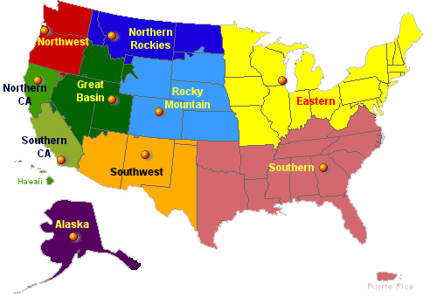
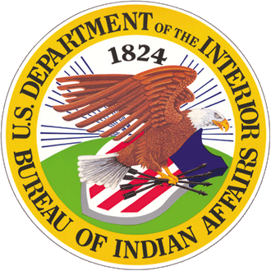
Fire Activity
Fire Mobilization
Prioritization

Slide 3
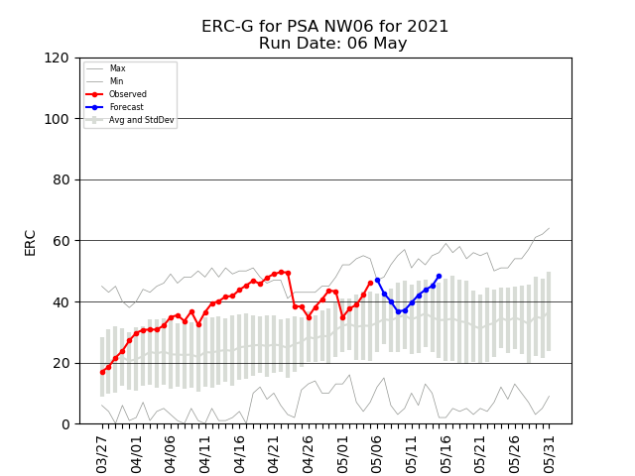
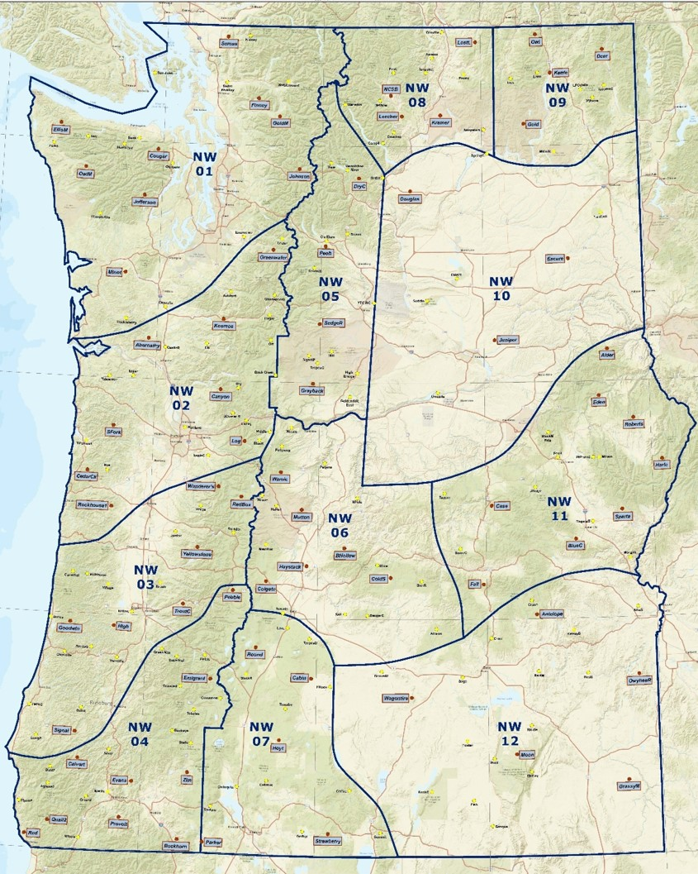
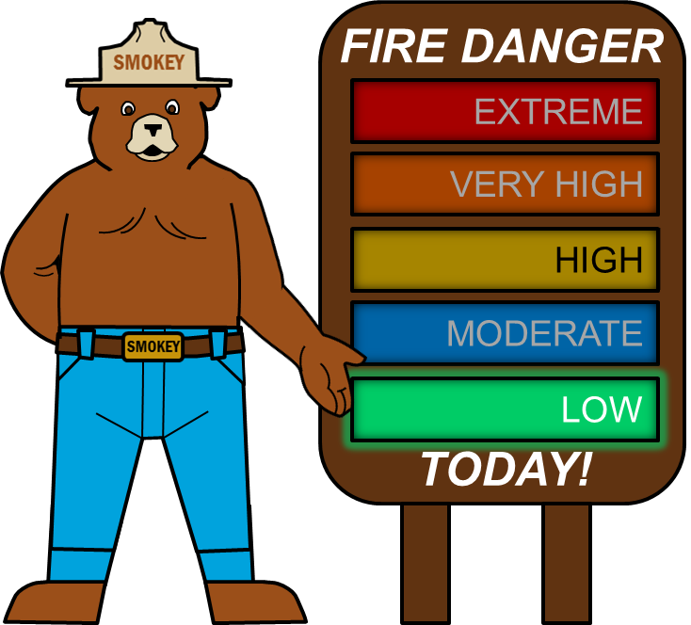
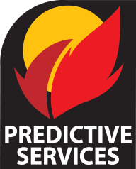
Daily Fire Activity
Daily Fire Danger
Daily Fire Weather

Slide 4
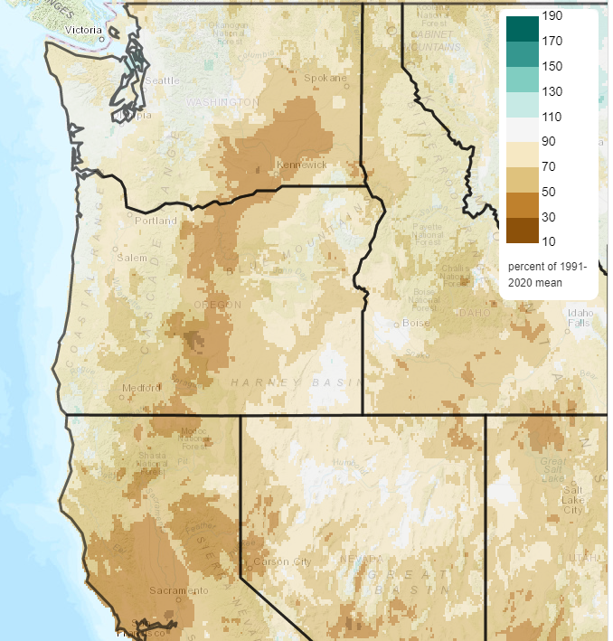
Precipitation:
Percent of normal
Since Jan 1st
17 Year Average:
4,039 fires

Slide 5
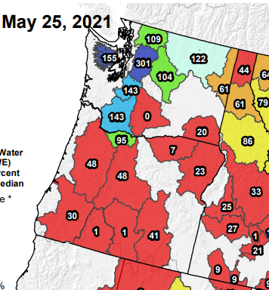
Current Snow Water Equivalent

Slide 6
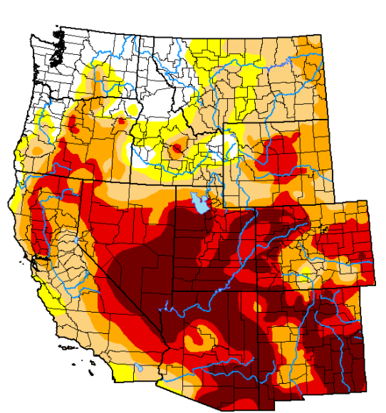
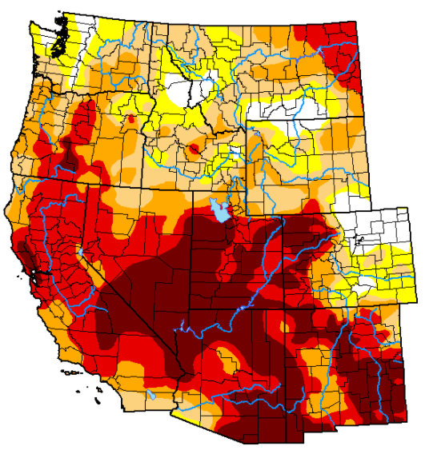
U.S. Drought Monitor
Mar 2nd 2021
May 20th 2021

Slide 7
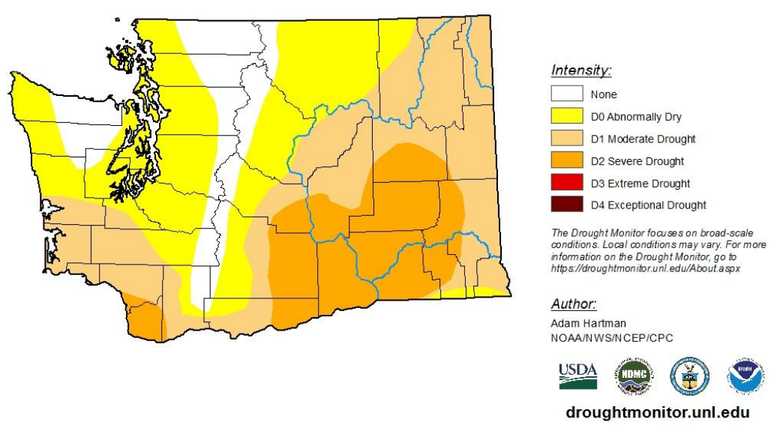
17 Year Average:
4,039 fires

Slide 8
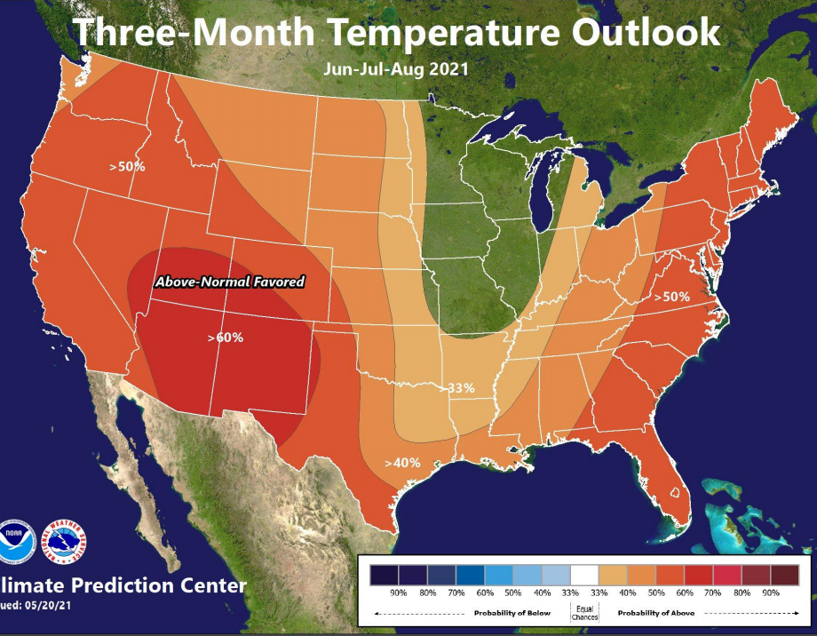
17 Year Average:
4,039 fires

Slide 9
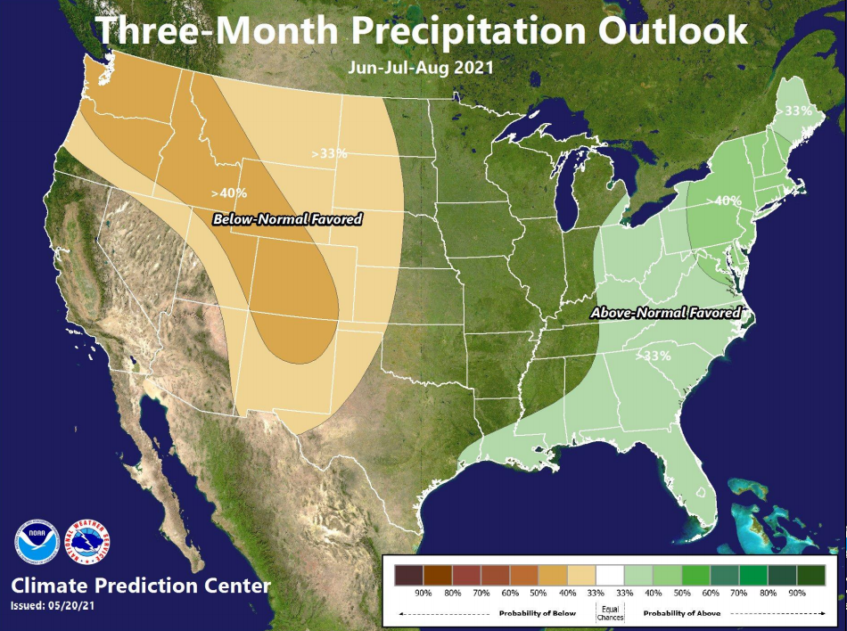
17 Year Average:
4,039 fires

Slide 10
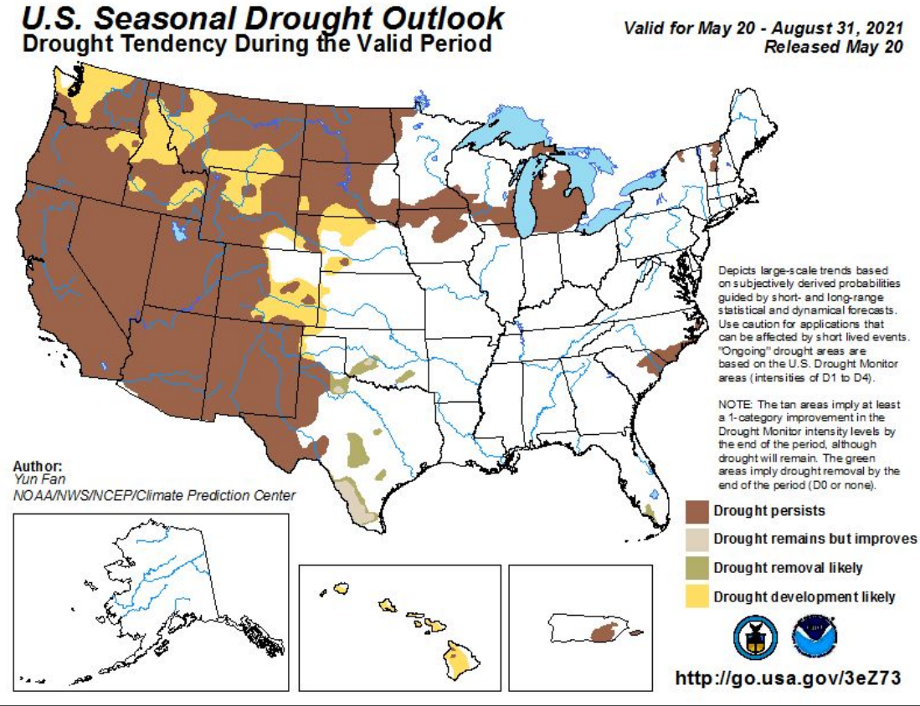
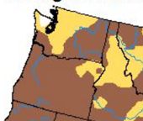
17 Year Average:
4,039 fires

Slide 11
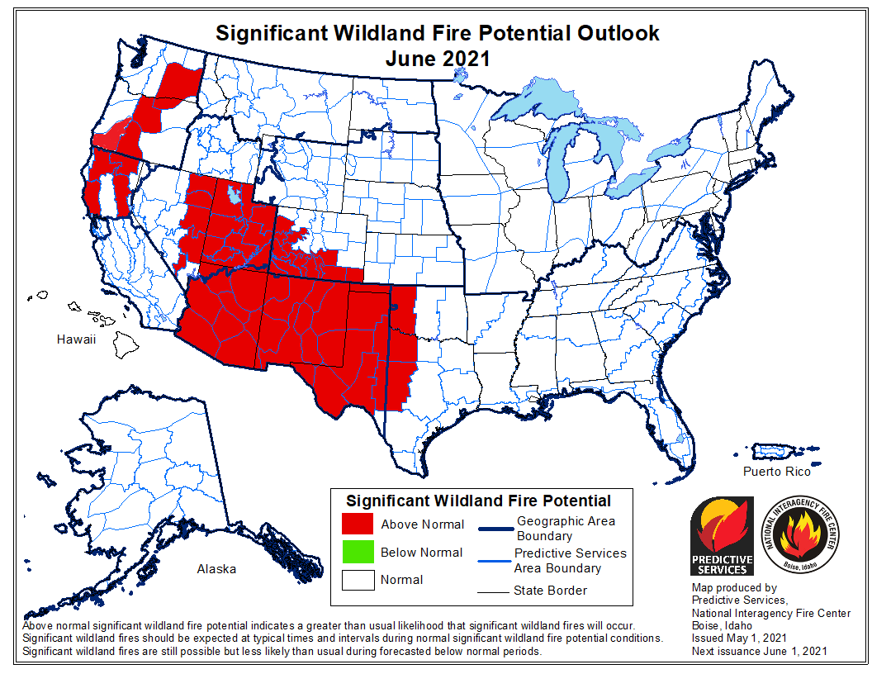
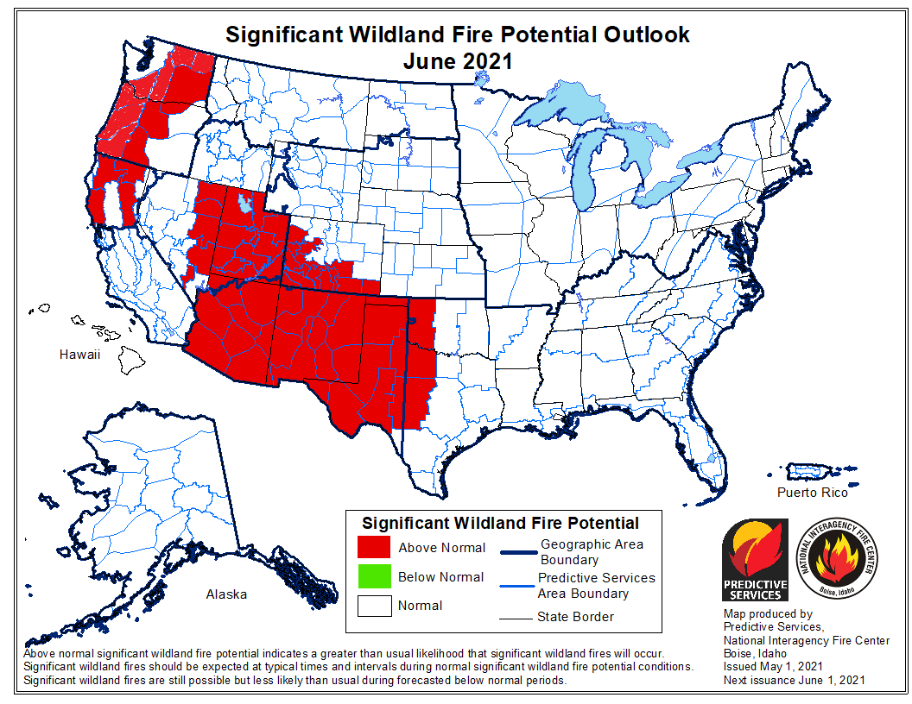
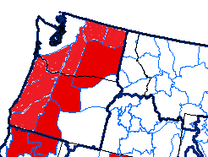
June Large Fire Outlook
Risk of large, costly fires requiring mobilization of extra resources is expected to rise above typical in June in central Oregon and central Washington during windy conditions or widespread lightning events.
July-Aug-Sep
Large Fire Outlook
High fire danger from lengthy drought is expected to create conditions more conducive than usual for large, costly fires in mid to late summer over almost all the Pacific Northwest

Slide 12
http://gacc.nifc.gov/nwcc

