Slide 1
WUTC Workshop Docket U-161024
Pacific Power Distribution Planning
March 10, 2017

Slide 2
Pacific Power
Kevin Putnam, Director-Field Engineering and Area Planning
Scott Beyer, Director-Transmission Planning
Heide Caswell, Director-T&D Asset Performance

Slide 3
Agenda
Electric T&D Planning
Define
Tools
Process
Solution Selection
Examples/Experiences
DER Screening Tool
Energy Storage
Simplified California DRP
Challenges
Moving Forward

Slide 4
Electric T&D Planning-Define
Distribution Planning Study (5 year)
Less than 35kV
Distribution Substation Getaway to End of Feeder
Area Planning Study (10 year)
Distribution Substations
Sub-Transmission
Transmission
Transmission Studies

Slide 5
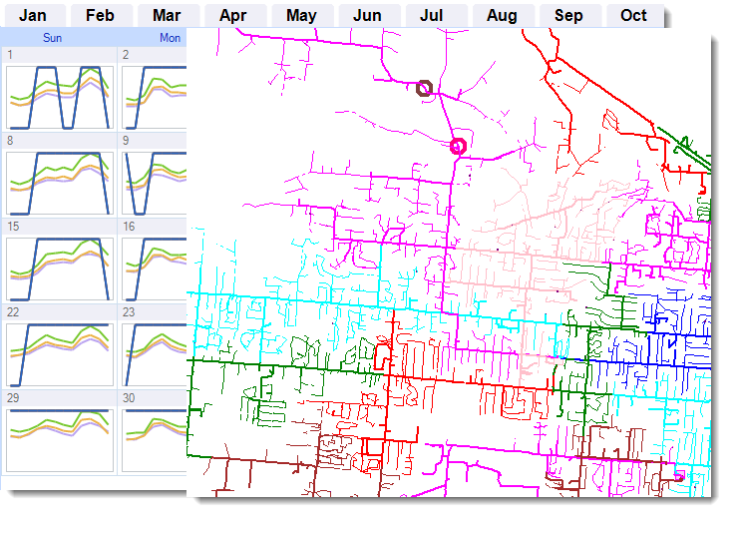
Electric T&D Planning-Tools
Transmission
Production cost model (GRIDVIEW)
Power flow model (PSS/E)
SCADA
PI Historian
Distribution
Power flow model (CYME)
CYME Gateway (Data)
Reliability model (GREATER, FIRE)
SCADA
PI Historian
DER Screening tool
Customer
Production/load resource meters
AMI meters (in certain jurisdictions)

Slide 6
Electric T&D Planning
What drives the need?
New Customer Uses
Enhance system capacity
Improve system reliability
Perform work required by mandates
Replace equipment/modernize grid

Slide 7
Electric T&D Planning-Process

Slide 8
Electric T&D Planning-Solutions
Improve Planning Information
Improve System Operation
Modernize the Energy Grid
Enhance System Capacity
Customer Solutions
Utilize Advanced Technology

Slide 9
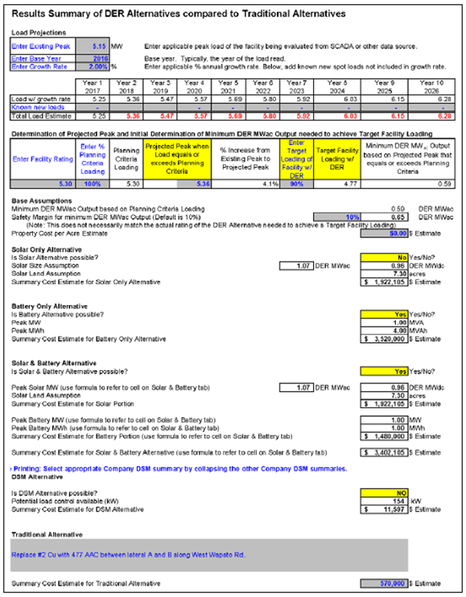
Electric T&D Planning-Screening
Pacific Power Smart Grid Report 9/1/2016
DER Template Discussion (pages 14,15)
Appendix E DER Template (pages 46-63)
Solar
Solar and Energy Storage
DSM Alternative

Slide 10
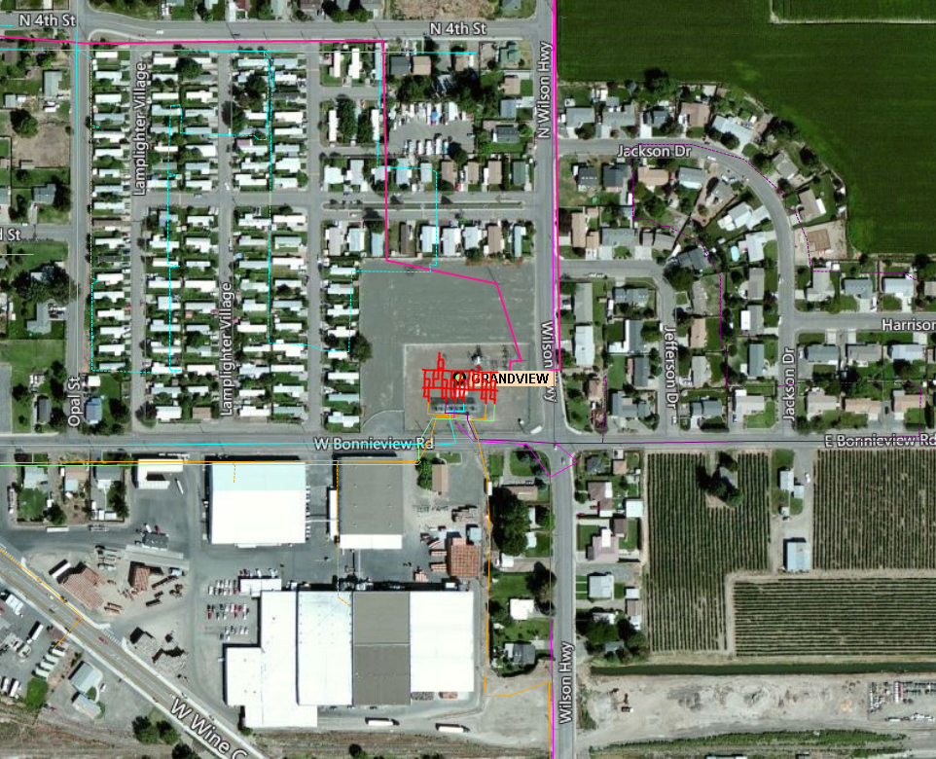
Electric T&D Planning-Storage
Washington Clean Energy Fund 2 Discussion (page 17)
Appendix G Washington Clean Energy Fund 2 Grant Application (pages 65-69)

Slide 11
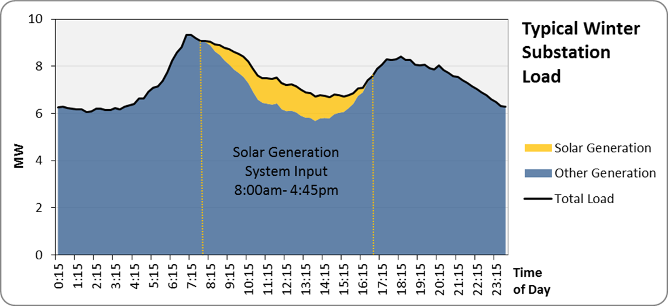
DRP Experience
California Simplified Distribution Resource Plan

Slide 12
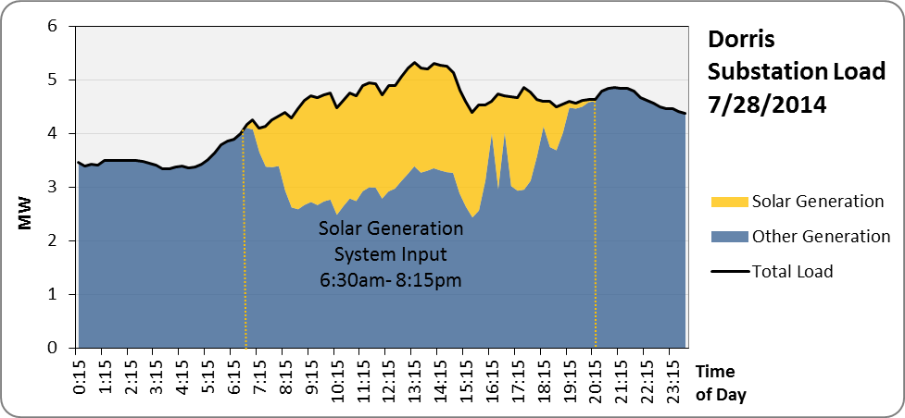
DRP Experience

Slide 13
DRP Experience

Slide 14
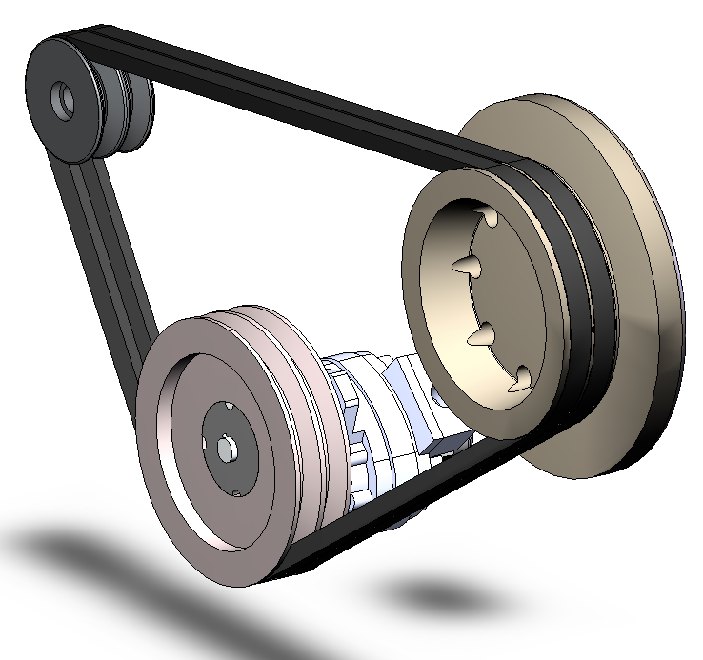
Planning Challenges in the Future
Traditional Planning Approach: required loose integration of scenarios against which plans are developed
Future Planning Approach: requires tight integration of scenarios against which plans are developed

Slide 15
Challenges
Preserve the quality of service to our customers
Load Modeling
Variability in our customers’ needs
Changes in forecasting methods and data sources
Interrelationship between energy sources and distribution planning decisions
Distribution Power Flow software is in its formative state
Process and Policy
Distribution models become more critical
Technology rapidly evolving
Addressing emerging issues
Translating distribution into transmission planning
Pricing structures drive certain technologies

Slide 16
Moving Forward
Develop margins for distribution planning
Identification of relevant costs, risks, benefits
Maintain focus on industry developments
Modeling tool developments in power flow software
Greater data needs now and in the future
Integration and interfaces between data sources and data uses is critical to ensure proper answers are developed
Distribution models and application become more critical
T&D Planning and the IRP
Distinct and Separate Requirements

