Slide 1
Pacific Power Equity Advisory Group Plan April 6, 2021
Notes:
Choose from three different title slide designs by Selecting “New Slide.” These slides are suitable for residential customer presentations.

Slide 2
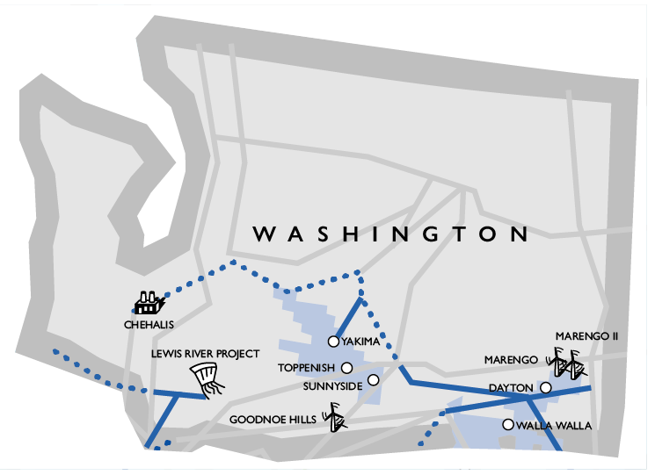
Proudly Serving Washington
PacifiCorp is a multi-jurisdictional, electric utility serving customers in six states.
In Washington, PacifiCorp serves approximately 137,000 customers throughout Benton, Columbia, Garfield, Kittitas, Yakima, and Walla Walla counties.
Largely non-urban areas with some of the lowest median income levels in the state.

Slide 3
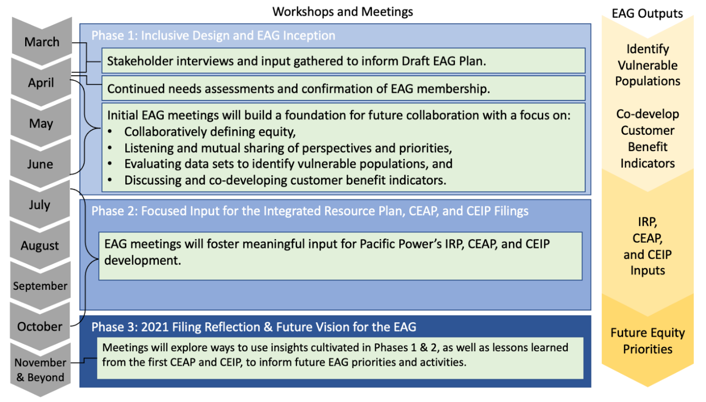
Pacific Power Equity Advisory Group Planning Process
Advisory Group created no later than May 1, 2021
First Advisory Group meetings held Q2 2021, with meetings continuing throughout 2021
Advisory Group feedback will be used primarily to inform the CEIP (particularly Customer Benefit Indicators) and may inform the CEAP and resource planning process generally.

