Slide 1
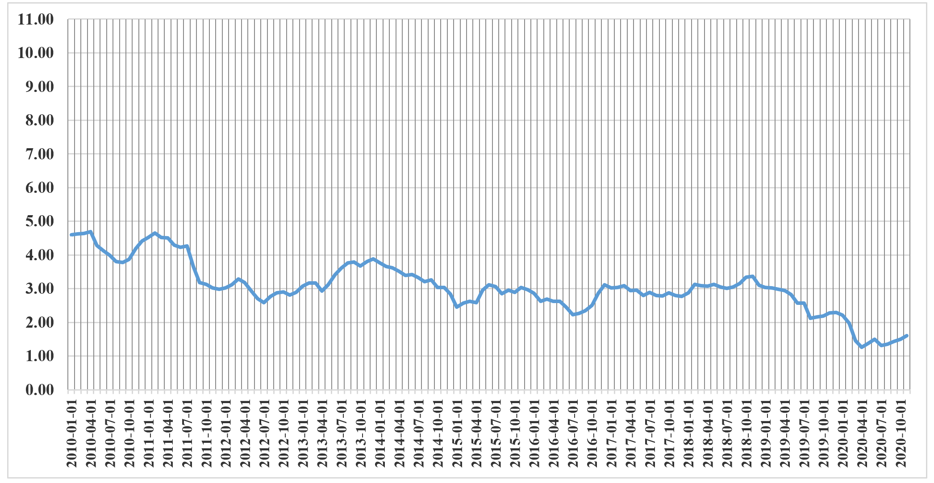
Washington Authorized ROEs for Electric Utility and Gas Distribution Companies
10.1
10.2
9.8
9.8
9.8
9.8
9.5
9.5
9.5
9.5
9.5
9.5
9.4
9.4
9.4
9.4
Between 2013 and 2018, the authorized ROEs for WA utilities were 9.5%/9.4%, while the yield on 30-year Treasuries averaged 3.0%.
Since the beginning of 2019, the authorized ROEs for WA utilities have remained at 9.40%, while the yields on 30-year Treasury bonds have declined from 3.0% to 1.50%.

