Slide 1
Attachment A to PSE’s Response to Informal Bench Request No. 001 Docket Nos. UE-121697 & UG-121705
November 21, 2012

Slide 2
Summary of 2007-2011 Results
If the proposed decoupling mechanisms had been in place for the period 2007-2011:
Customers would have seen both surcharges and credits to their bills (i.e., the mechanism is “two-sided”)
The K-Factor would have worked both ways for gas and electric customers
The average rate impacts associated with the surcharges and credits would have generally been +/- 1% range

Slide 3
Natural Gas Decoupling Backcast Summary

Slide 4
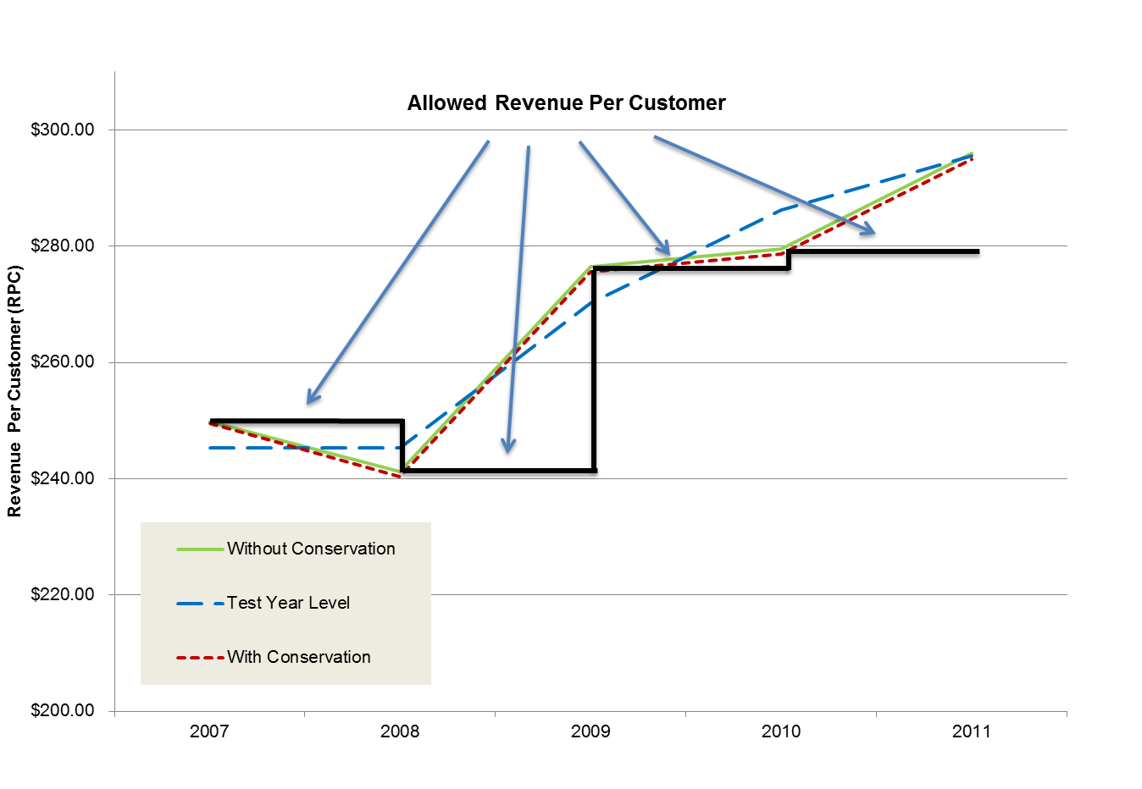
Allowed Revenue Per Gas Residential Customer

Slide 5
Allowed Revenue Per Gas Non-Residential Customer

Slide 6
Electric Decoupling Backcast Summary

Slide 7
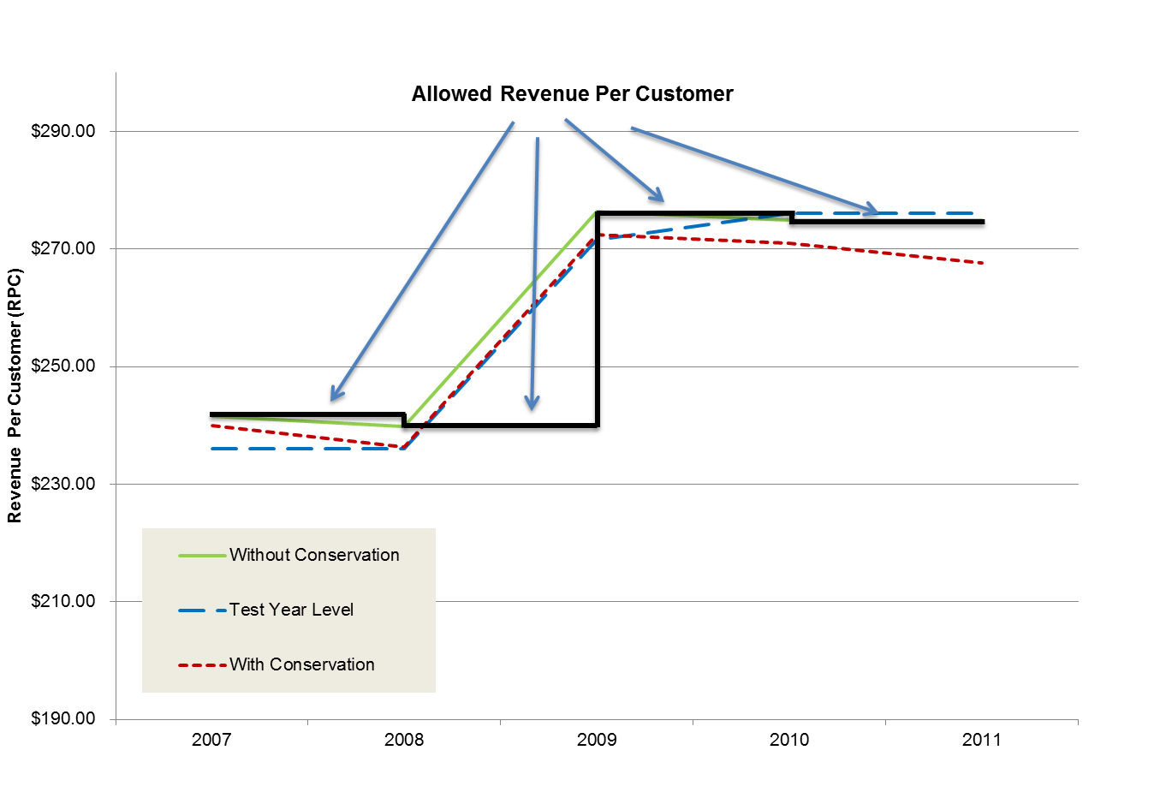
Allowed Revenue Per Electric Residential Customer

Slide 8
Allowed Revenue Per Electric Non-Residential Customer

Slide 9
Gas Decoupling Backcast Summary – No K-Factor

Slide 10
Allowed Revenue Per Gas Residential Customer – No K Factor

Slide 11
Allowed Revenue Per Gas Non-Residential Customer – No K Factor

Slide 12
Electric Decoupling Backcast Summary – No K-Factor

Slide 13
Allowed Revenue Per Electric Residential Customer – No K Factor

Slide 14
Allowed Revenue Per Electric Non-Residential Customer – No K Factor

Slide 15
Appendix

Slide 16
Natural Gas Decoupling Backcast Summary – Residential Calculations with K-Factor (2007)

Slide 17
Natural Gas Decoupling Backcast Summary – Residential Calculations with K-Factor (2008)

Slide 18
Natural Gas Decoupling Backcast Summary – Residential Calculations with K-Factor (2009)

Slide 19
Natural Gas Decoupling Backcast Summary – Residential Calculations with K-Factor (2010)

Slide 20
Natural Gas Decoupling Backcast Summary – Residential Calculations with K-Factor (2011)

Slide 21
Natural Gas Decoupling Backcast Summary – Non-Residential Calculations with K-Factor (2007)

Slide 22
Natural Gas Decoupling Backcast Summary – Non-Residential Calculations with K-Factor (2008)

Slide 23
Natural Gas Decoupling Backcast Summary – Non-Residential Calculations with K-Factor (2009)

Slide 24
Natural Gas Decoupling Backcast Summary – Non-Residential Calculations with K-Factor (2010)

Slide 25
Natural Gas Decoupling Backcast Summary – Non-Residential Calculations with K-Factor (2011)

Slide 26
Electric Decoupling Backcast Summary – Residential Calculations with K-Factor (2007)

Slide 27
Electric Decoupling Backcast Summary – Residential Calculations with K-Factor (2008)

Slide 28
Electric Decoupling Backcast Summary – Residential Calculations with K-Factor (2009)

Slide 29
Electric Decoupling Backcast Summary – Residential Calculations with K-Factor (2010)

Slide 30
Electric Decoupling Backcast Summary – Residential Calculations with K-Factor (2011)

Slide 31
Electric Decoupling Backcast Summary – Non-Residential Calculations with K-Factor (2007)

Slide 32
Electric Decoupling Backcast Summary – Non-Residential Calculations with K-Factor (2008)

Slide 33
Electric Decoupling Backcast Summary – Non-Residential Calculations with K-Factor (2009)

Slide 34
Electric Decoupling Backcast Summary – Non-Residential Calculations with K-Factor (2010)

Slide 35
Electric Decoupling Backcast Summary – Non-Residential Calculations with K-Factor (2011)

