Slide 1
Procedural Rules and Ethics January 8, 2018
Legal Ethics in
UTC Practice
Greg Kopta
Director,
Administrative
Law Division

Slide 3
WAC 480-07-345(3) Appearance and Practice Before the Commission
Unethical conduct is not permitted. Persons appearing in proceedings before the commission in a representative capacity must conform to the standards of ethical conduct required of attorneys before the courts of Washington. . . . If any representative fails to conform to those standards, the commission may exclude the person from the proceeding, may report the ethical violation to any appropriate licensing authority, and may refuse to permit the person to appear before the commission in a representative capacity in any future proceeding.

Slide 4
RPC 3.3 Candor Toward the Tribunal
(a) A lawyer shall not knowingly:
make a false statement of fact or
law to a tribunal or fail to correct
a false statement of material fact
or law previously made to the
made to the tribunal by the lawyer;
(2) fail to disclose a material fact to a tribunal when disclosure is
necessary to avoid assisting a criminal or fraudulent act by the
client unless such disclosure is prohibited by Rule 1.6;
(3) fail to disclose to the tribunal legal authority in the controlling
jurisdiction known to the lawyer to be directly adverse to the
position of the client and not disclosed by the opposing party; or
(4) offer evidence that the lawyer knows to be false.

Slide 5
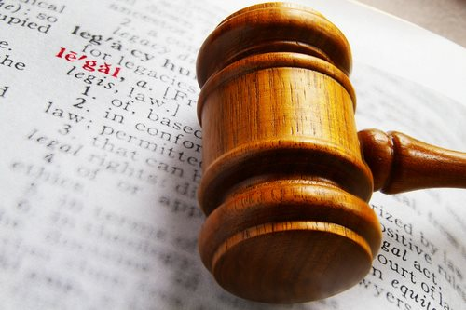
RPC 3.3 Comment
[2] This Rule sets forth the special duties of lawyers as officers of the court to avoid conduct that undermines the integrity of the adjudicative process. A lawyer acting as an advocate in an adjudicative proceeding has an obligation to present the client's case with persuasive force. Performance of that duty while maintaining confidences of the client, however, is qualified by the advocate's duty of candor to the tribunal. Consequently, although a lawyer in an adversary proceeding is not required to present an impartial
exposition of the law or to vouch for the evidence submitted in a cause, the lawyer must not allow the tribunal to be misled by false statements of law or fact or evidence that the lawyer knows to be false.

Slide 6
RPC 3.4 Fairness to Opposing Party
A lawyer shall not:
(a) unlawfully obstruct another party's access to evidence or unlawfully alter, destroy or conceal a document or other material having potential evidentiary value. A lawyer shall not counsel or assist another person to do any such act;
(b) falsify evidence, counsel or assist a witness to testify falsely, or offer an inducement to a witness that is prohibited by law;
(c) knowingly disobey an obligation under the rules of a tribunal except for an open refusal based on an assertion that no valid obligation exists;
(d) in pretrial procedure, make a frivolous discovery request or fail to make reasonably diligent effort to comply with a legally proper discovery request by an opposing party; or
(e) in trial, allude to any matter that the lawyer does not reasonably believe is relevant or that will not be supported by admissible evidence, assert personal
knowledge of facts in issue except when
testifying as a witness, or state personal
opinion as to the justness of a cause, the
credibility of a witness, the culpability of
a civil litigant or the guilt or innocence of
an accused.

Slide 7
RPC 3.5 Impartiality and Decorum of the Tribunal
A lawyer shall not:
(a) seek to influence a judge . . . or other official by means prohibited by law;
(b) communicate ex parte with such a person during the proceeding unless authorized to do so by law or court order; . . . or
(d) engage in conduct intended to disrupt a tribunal.

Slide 8
RPC 3.5 Comment
[4] The advocate's function is to present evidence and argument so that the cause may be decided according to law. Refraining from abusive or obstreperous conduct is a corollary of the advocate's right to speak on behalf of litigants.

Slide 9
Sample
“The implications here are troubling, to say the least of [Company] management practices which include an open declaration of resistance against a nonprofit tribal electric utility . . . . Although the WUTC may not be the ultimate forum to address the historical pattern of mistreatment of Native Americans in this state, the Commission should also not perpetuate such practices by tacit sanction. Sufficient for present purposes, the apparent indignation and scrutiny levied upon [Intervenor], which the Company has not been remiss to play up on brief, should also be applied equally to a utility whose practices are unquestionably the charge of the Commission to monitor and address, if wayward or wanting in some respect . . . .”

Slide 10
Sample
“Where the evidence adduced by [the Company] was so overwhelming as to be completely unassailable, the Initial Order simply “moved the goalposts” – revising prior Commission orders to make the unassailable facts no longer relevant. Oftentimes the goal posts were moved without any notice to [the Company], based on inconsequential or ambiguous evidence. And to add insult to injury, whenever evidence could be found – or in some cases invented – that would support the Petitioner’s or Staff’s cases, the case was freely and liberally expanded to allow fines and retroactively find that [the Company] will not provide its service to the satisfaction of the Commission.”

Slide 11
Discussion

