Slide 1
PacifiCorp’s Responses to UE-240537
Mike Wilding
Vice President, Energy Supply Management
Kerstin Rock
Managing Director, Western Market Policy & Analytics

Slide 2
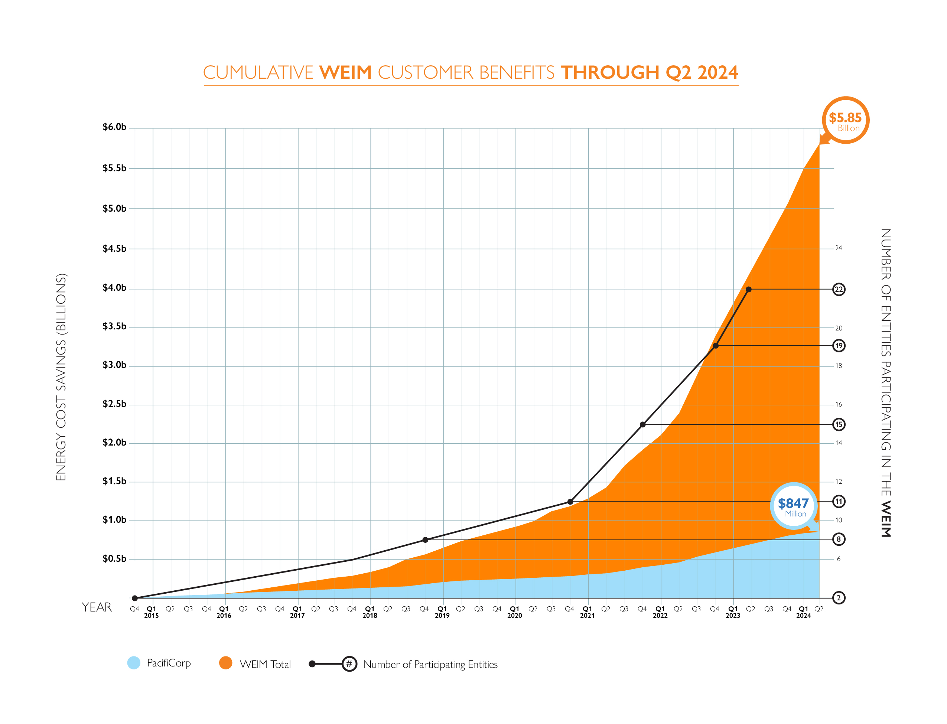
EDAM Builds on the Success of the WEIM
Economic Benefits for Customers
WEIM has produced more than $5.8 billion of customer benefits since inception in 2014
PacifiCorp customer benefits total nearly $850 million during that same time
Reliability Benefits
Automated dispatch and efficient use of the transmission system have increased reliability
September 2022, record heat across the West
January 2024, ice storms and record cold in the Northwest
EDAM is the only day-ahead market in the West that can accommodate all WEIM entities and maintain the realized success of the current market
Individual balancing authority areas (BAAs) maintain balancing and reliability responsibilities, but WEIM allows BAAs to carry less reserves
Environmental Benefits
WEIM has reduced curtailments of renewable generation by 2.4 million MWh and more than 1 million metric tons of associated reductions in CO₂
Automated dispatch has facilitated energy transformation in the West through the integration of renewable generation and storage

Slide 3
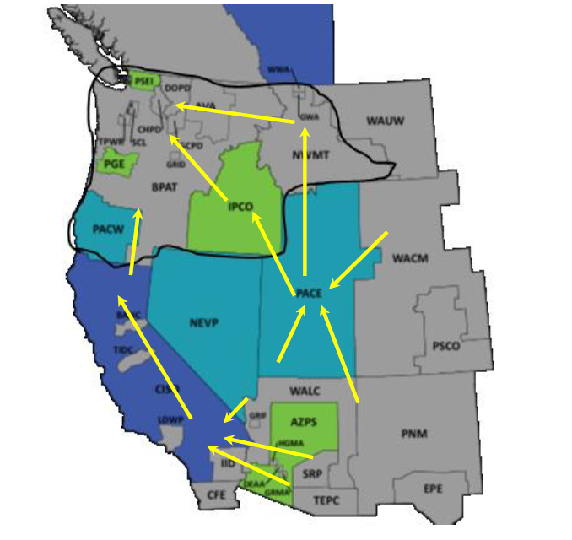
Efficient Use of Transmission Enhances Reliability
During the January 2024 ice storms energy from outside the region moved into the northwest
Imports into the Northwest averaged approximately 5,000 MW during ice storm and reached to more than 6,000 MW at the peak
Source: Energy GPS LLC, Analysis of January Cold Snap in the Pacific Northwest, PNUCC Board Meeting, February 9, 2024
https://www.pnucc.org/wp-content/uploads/2024-02-BPA-Storm-Response_Prep-.pdf

Slide 4
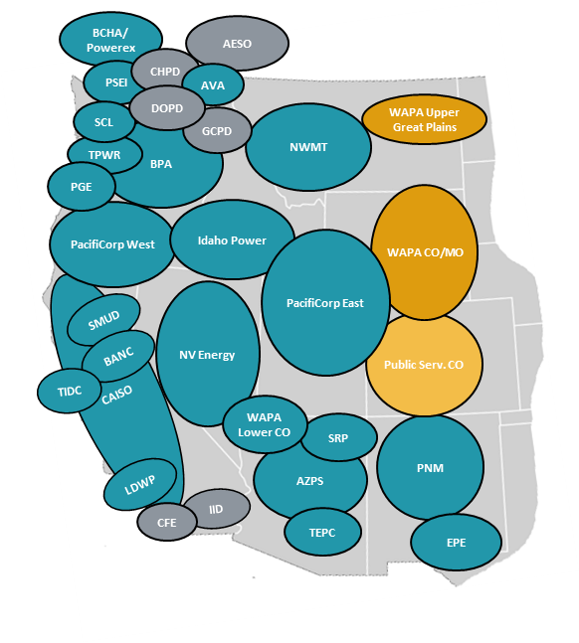
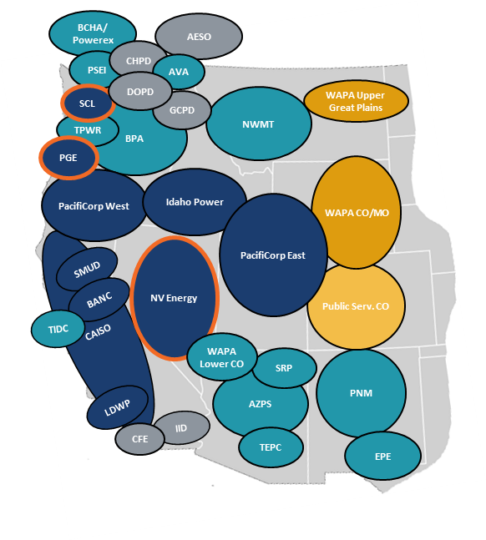
2024 Updated Brattle Study
Changes in update include:
Portland General Electric, Nevada Energy and Seattle City Light have been added to EDAM footprint
Resources updated using PacifiCorp 2024 IRP
New transmission projects have been added to model
Removal of ozone transport rule
Includes SPP RTO West footprints which are expected to be operational before 2032
BAU Case
EDAM Case
The Brattle Group

Slide 5
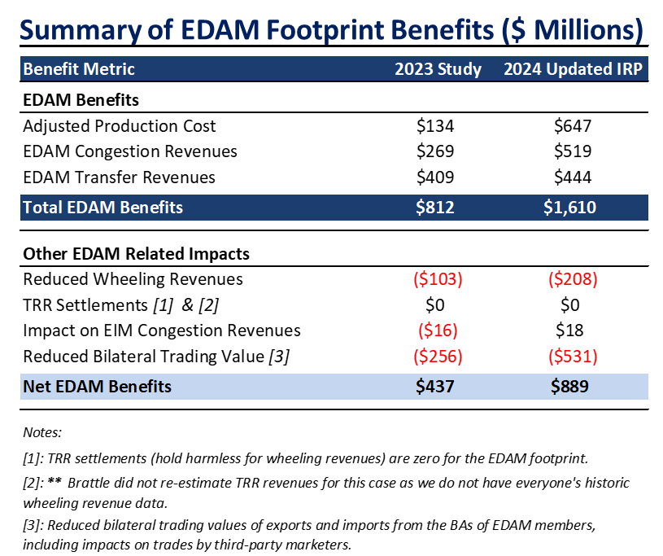
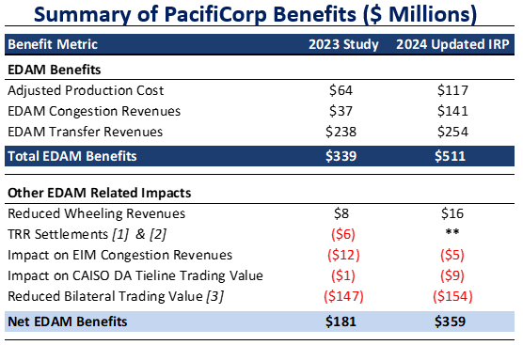
EDAM Provides Greater Economic Benefits for Customers
The Brattle Group

Slide 6
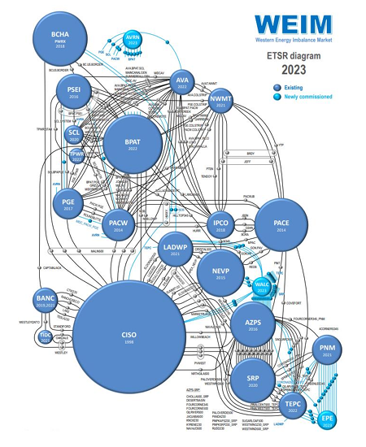
EDAM Enhances Reliability
EDAM increases the transfer capability in the region on a day-ahead basis removing transmission hurdles
Moving to a seven day-operations enhances planning and results in better day-ahead set-ups over weekends and holidays
EDAM creates a new imbalance reserve product to address day-ahead uncertainty and compensates generators to hold capacity for that uncertainty
EDAM reduces each participants uncertainty requirement through a diversity benefit
WRAP creates a forward procurement standards for resource adequacy and the operations program can be relied for the EDAM resource sufficiency evaluation (RSE)
CAISO

Slide 7
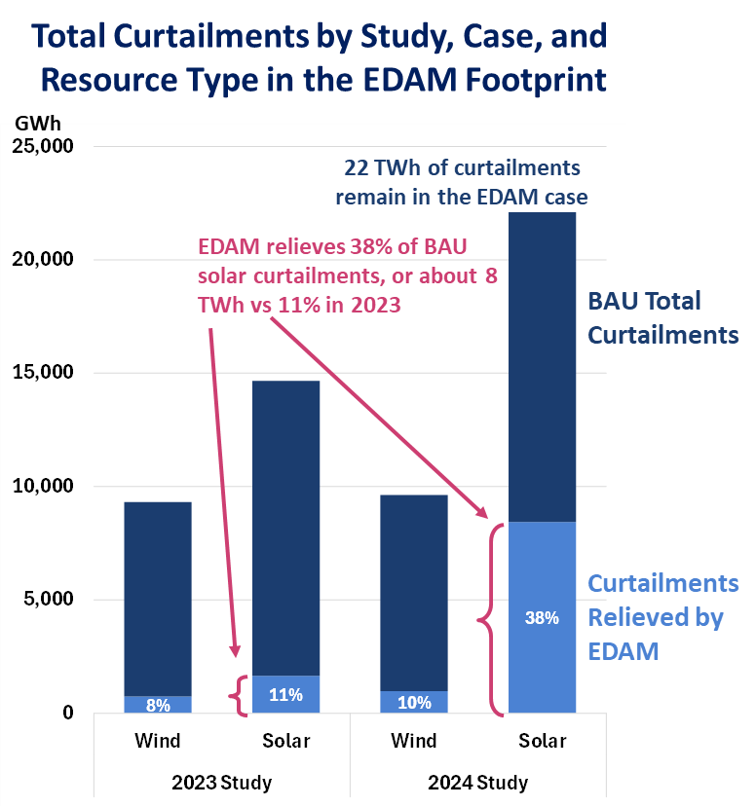
EDAM Further Unlocks Renewable Energy
EDAM reduces renewable curtailments within the market footprint by more than 9 million MWh
This is more than three times the 2023 study reduction of approximately 2 million MWh
2024 study shows 38% reduction in curtailment compared to base case, while 2023 study showed 10% reduction
In 2024 study, 22 million MWh of curtailments occur in EDAM, which could be reduced with a larger EDAM footprint
Most of the curtailment reductions are in CAISO, especially solar
The Brattle Group

Slide 8
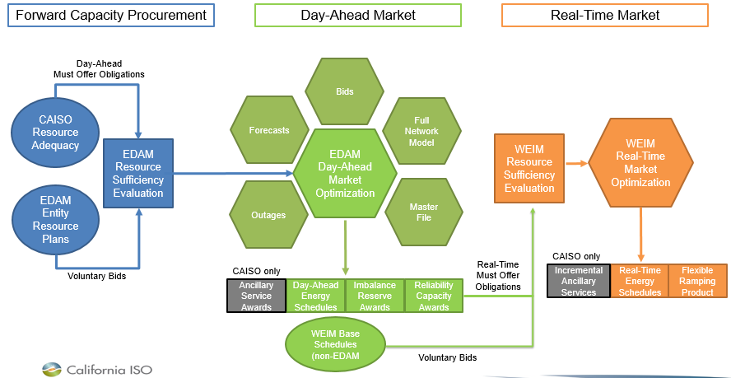
EDAM Operations
WRAP
WRAP

Slide 9
Operational Changes
Transmission
Energy Supply Management
7-day transmission scheduling
Unscheduled, released and unsold firm ATC is made available to EDAM
Additional requirements for registering firm transmission at EDAM interfaces
7-day trading
EDAM RSE and WRAP management
Transmission rights management
All generation participating
Grid Operations
Finance
Changes to real-time RSE test
New e-tag shortfall and resupply test
More staff needed to support complex market environment
Moving to weekly settlements from monthly settlements
More charge codes to accommodate day-ahead transactions in market

Slide 10
EDAM Does Not Change PacifiCorp’s Reliability and Resource Adequacy Obligations
Resource Adequacy
Reliability
WRAP
PacifiCorp maintains responsibility of reliability.
PacifiCorp is still the BAA in charge of balancing.
No change from operations practices today.
Decision to join WRAP was not contingent on joining EDAM.
Resource adequacy planning outside of EDAM processes.
WRAP

Slide 11
PacifiCorp Supports the Pathways Initiative
Step 1
What it is
Purpose
Why we support it
Elevates the authority of the WEM Governing Body to primary authority
Dual filing mechanism for disputes
Trigger mechanism for implementation based on EDAM commitments
Promote broader participation in the WEIM/EDAM
Increase independence without California legislation
Low-cost and easily implementable
Significant step towards more independence
Led to more entities committing to EDAM
Shows that California entities are willing to compromise

Slide 12
PacifiCorp Supports the Pathways Initiative
Step 2
What it is
Purpose
Why we support it
Creation of a regional organization that can function as independent governing body
California legislation to transfer oversight of market operations to regional organization
Balances need for independent governance while minimizing costs
Incremental approach to governance reform
Leverages CAISO’s infrastructure and experience
Intended to support expansion of EDAM footprint

Slide 13
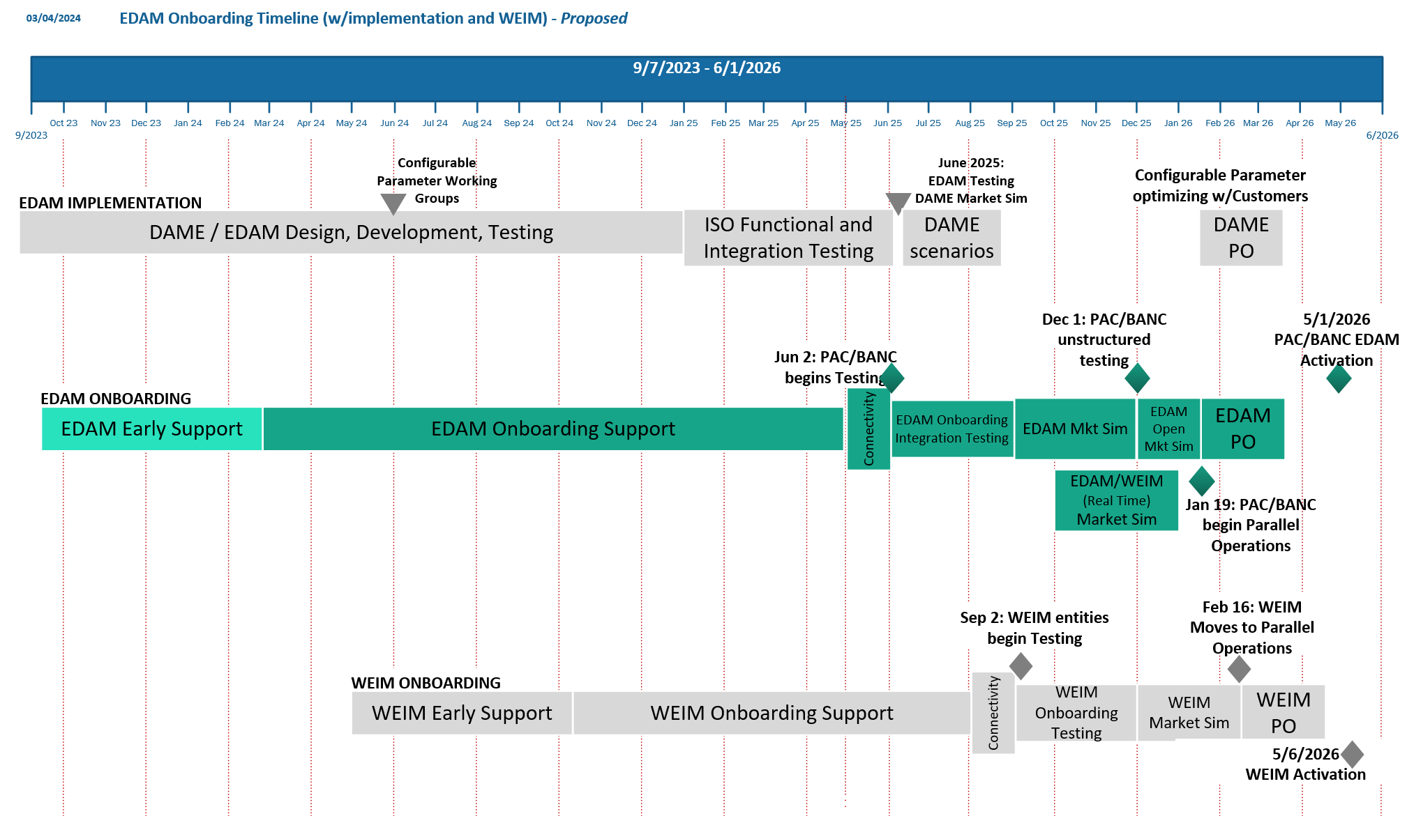
EDAM Timeline
TODAY

Slide 14
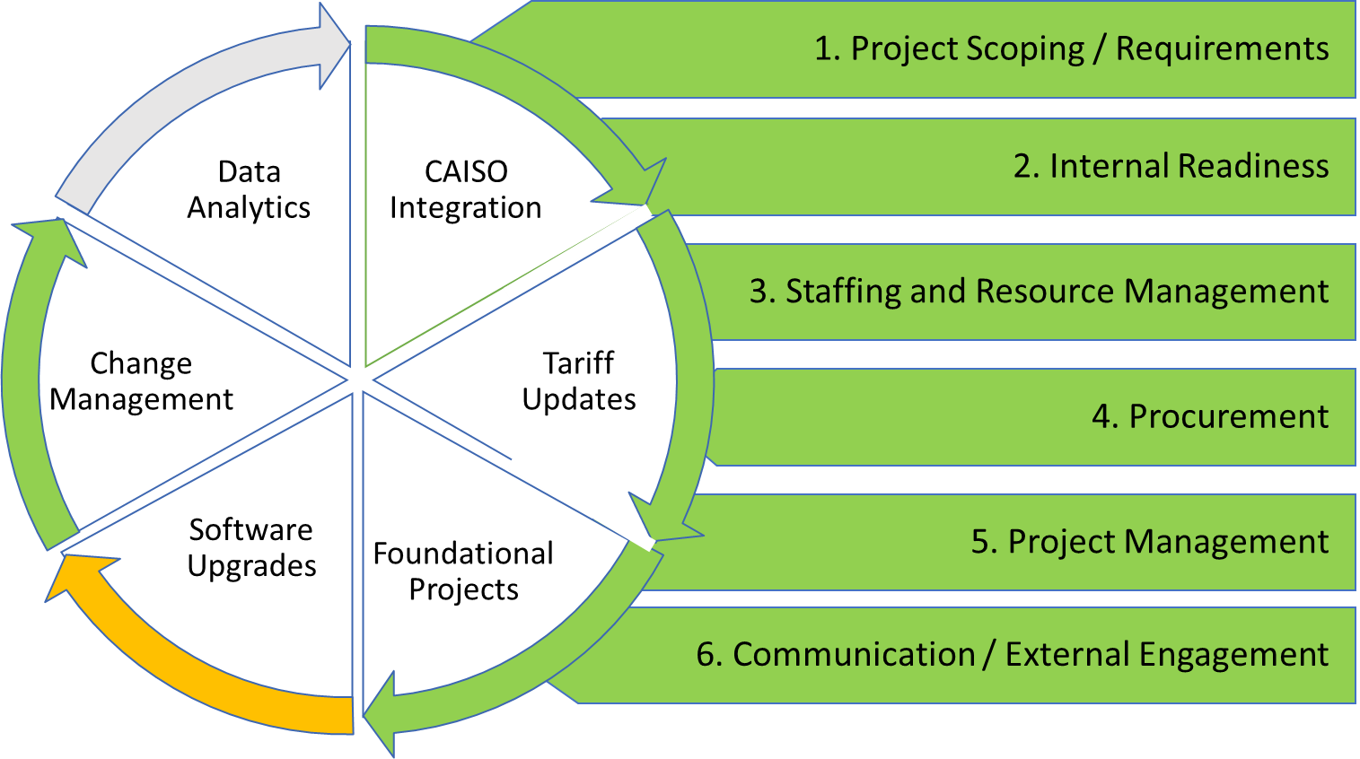
Implementation Progress and Focus Areas
OATT Process Launched
Kicked off process with stakeholders on April 16th
Software Upgrades
Vendor budgets received
Next: Development of scope of works (SOWs) and contracting
Foundational Projects
Requests for Proposals (RFPs) for VER forecasting and back-office solutions
Metering
Moving forward with converting non-participating units to participating, expected to be complete by November 2025
CAISO Integration
Executed Implementation Agreement

Slide 15
Questions?
Mike Wilding
Vice President, Energy Supply Management
Michael.Wilding@pacificorp.com
Kerstin Rock
Managing Director, Western Markets Policy & Analytics
Kerstin.Rock@pacificorp.com

