Slide 1
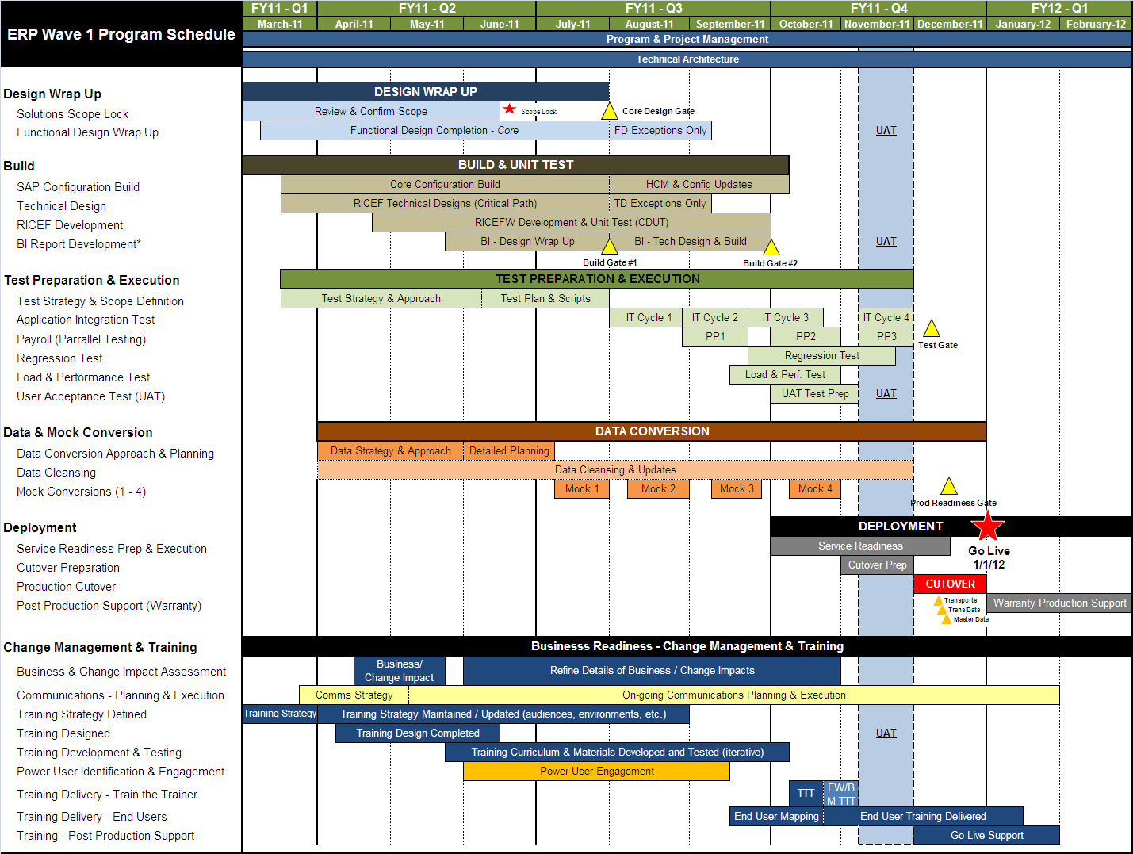
SAP Integration Program Revised Schedule -- January 2012 Go-Live
Attachment 2
Upcoming Milestone(s)
Critical Program Dates
SAP Config Build → HCM Configuration – 10/7)
Integration Test Cycle 1 & Mock 2 → 8/26/11
Payroll Parallel Test →8/29 – 9/23
Core Tech Design→ 9/02/11*
*Exception approved work thru mid-October 11
Core RICEF Build → 9/30/11*
*Exception approved work thru Nov 11 for on hold items
Training Curriculum → August 2011
Project Start Date: Feb 21, 2011
Project End Date: Jan 31, 2012
Tech Design: Mar – Sept‘11
Config Build: Mar – Oct ’11
RICEF Build: Mar – Sept ’11
BI Build: July – Sept ’11
Bus Readiness/Training Design.: Feb –July ’11
Training Dev and Delivery: Aug ‘11 – Jan ‘12
Test Preparation & Execution: Jul – Nov ’11
Int. Test Cycle 1: 8/1 – 8/26
Int. Test Cycle 2: 8/29 – 9/23
Int. Test Cycle 3: 9/26 – 10/21
User Acceptance: 11/7 – 12/2
Production Cut Over: Dec ‘11
Post-Production Support: Jan -Mar ‘12

