Slide 1
Transient Stability Analysis
Transient stability studies analyze the system response to disturbances such as the loss of generation, line-switching operations, faults, and sudden load changes in the first several seconds following the disturbance. Following a disturbance, synchronous machine frequencies undergo transient deviations from synchronous frequency. The objective of a transient stability study is to determine whether or not machines will return to synchronous frequency following a disturbance.
The attached slides describe the phenomena and when the Transient that happens after a fault on the grid become problematic (e.g. voltage collapse)

Slide 2
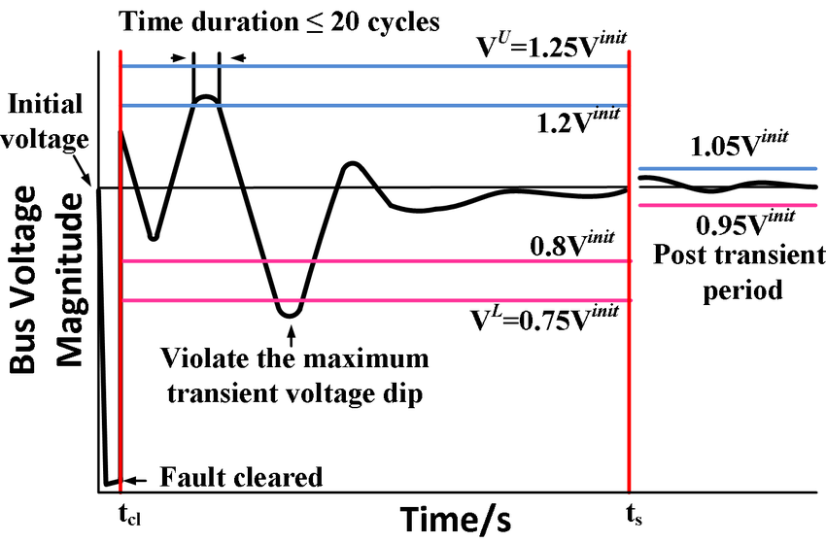

Slide 3
Flexible AC Transmission System (FACTS)
The power system has become the main driver of the world economy. Nowadays, power systems operate near to
their constraints due to the continuous demand increase. The voltage instability is the main cause of constraint
violations and voltage collapse. The voltage stability is related to the control of the reactive power. The Flexible AC
Transmission System (FACTS) is a power electronic based system and other static equipment that provide control of one or more AC transmission system parameters to enhance controllability and increase power transfer capability. The optimum location of FACTS devices is a very important issue in
power systems, since the weakest busbar and/or transmission lines need to be identified

Slide 4
