Slide 1
2022 Wildfire Season Preparedness
April 27, 2022

Slide 2
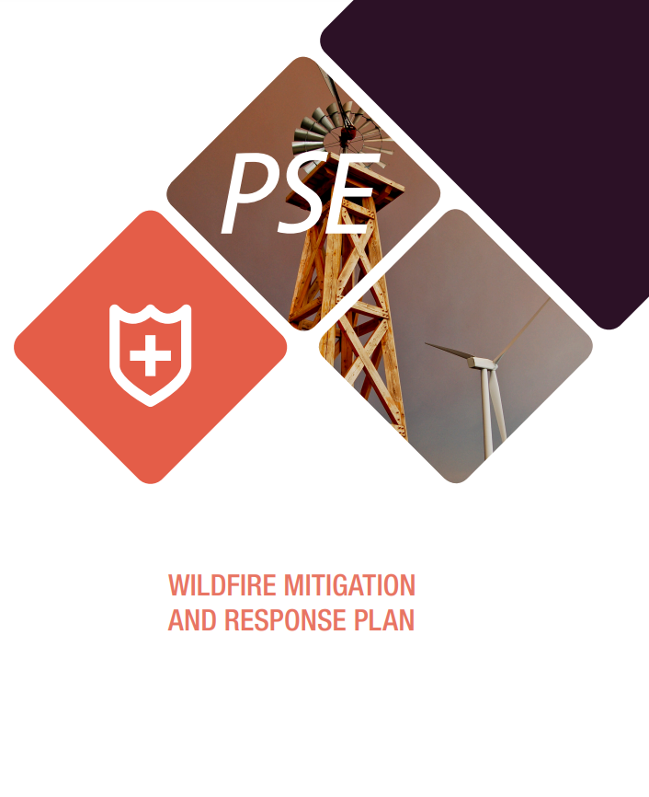
Responding to Evolving Wildfire Risks
Situational Awareness
Fault Reduction
Fault Protection
Communication and Outreach
Operational Procedures & Emergency Response

Slide 3
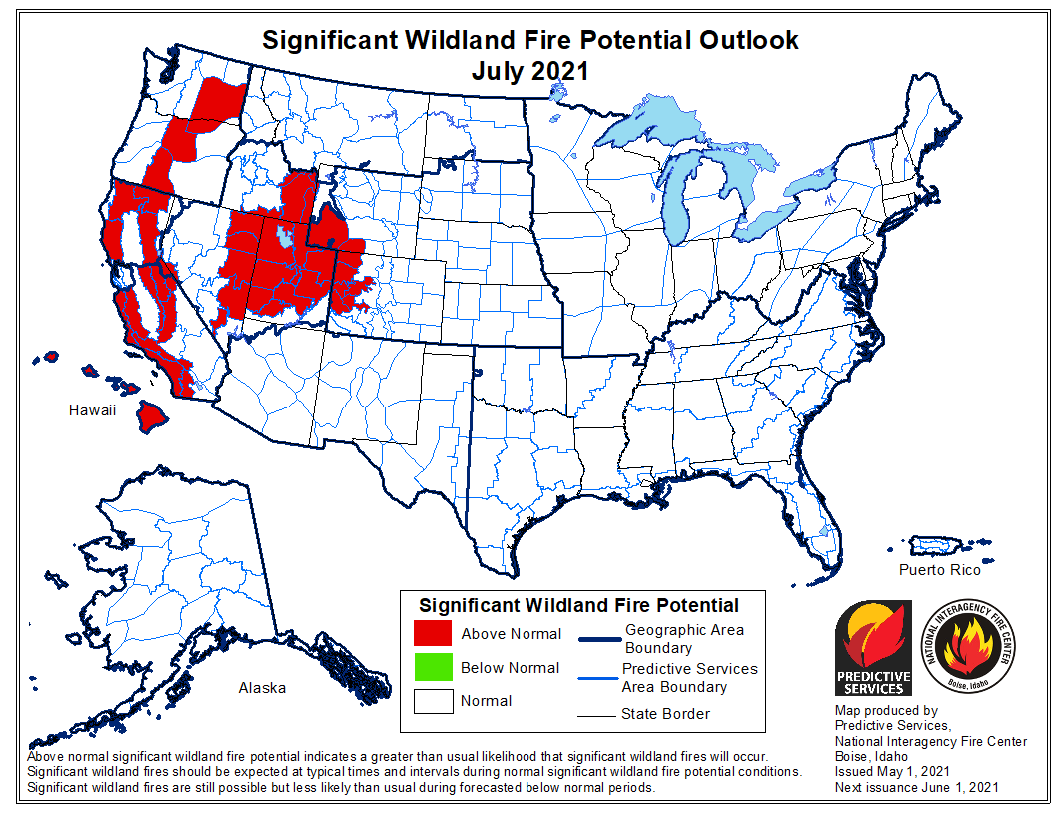
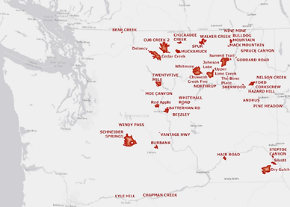
2021 Predicted Outlook
2021 Wildfire Season Review
(Actual conditions largely followed predictions)
2021 NWCC Large Wildfire Events

Slide 4
2021 Wildfire Season Review
Number of wildfires in PSE territory and whether they affected PSE infrastructure
Year | Number of wildfires within or near PSE’s territory | Number of wildfires that affected PSE infrastructure
2017 | 3 | 0
2018 | 5 | 0
2019 | 0 | 0
2020 | 3 | 2
2021 | 5 | 0
* Sourced from NICC Annual Fire Reports

Slide 5
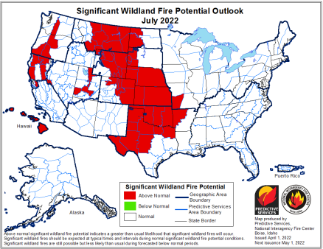
2022 Wildfire Season Outlook
The outlook for significant wildfires prior to July 2022 is normal in PSE’s service territory
The outlook for significant wildfires in July of 2022 is above normal in portions of PSE’s service territory
PSE prepares for an active fire season regardless of forecasts

Slide 6
2022 Pre-Wildfire Season Actions
Incorporated 2022 risk modeling into Daily Risk Dashboard and Operational Procedures
Conducting pre-season inspections and remediation for vegetation
System hardening projects completed that reduce wildfire risks and improve reliability
Participating in hazards workshops hosted by county emergency management departments
Hosting first community meeting
Formalizing and improving daily ignition/fire event logging practices

Slide 7
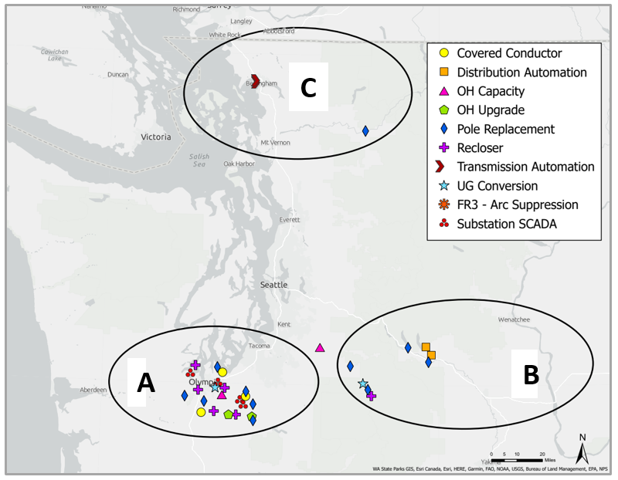
2020-2021 Fault Reduction and Protection Projects
2022 Pre-Wildfire Season Actions

Slide 8
2022 Plan Updates
Progress in developing and implementing a public safety power shutoff (PSPS) plan
Advancements in wildfire risk assessment model and incident capture capabilities
Investment plan for fault reduction and protection through 2025 to execute our strategies
Roadmap for the next planned improvements across each plan element
Increased staffing dedicated to wildfire planning, administration, and mitigation efforts

Slide 9
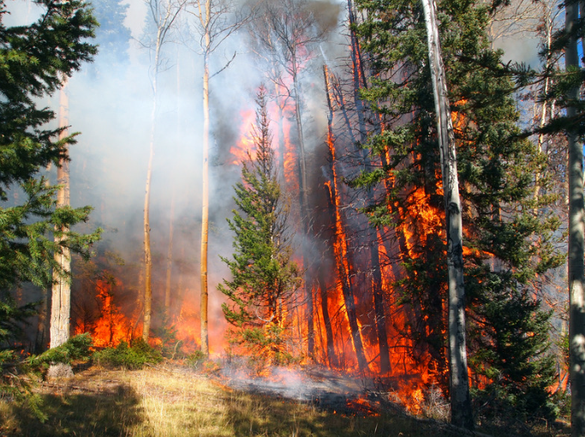
Public Safety Power Shutoffs
PSE’s approach and objective is community specific and informed wildfire ignition risk reduction and safety plans that recognize the potential negative consequences of a power shut-off. Key elements in implementation include:
Risk modeling
Situational awareness to forecasted and real-time weather conditions
Customer education and communication strategies
Documented operations procedures

Slide 10
We will hold our first community engagement meeting in Cle Elum, WA on June 8, 2022
To ensure broad and inclusive outreach, PSE will be using a variety of outreach methods to invite customers to attend
Additional community meetings will follow this summer in other higher wildfire risk areas in our service territory
Community Engagement
Community feedback
Initial communications and outreach planning
Ongoing planning and implementation
Community feedback used to inform planning and future outreach efforts
Continuous improvement
Scope/develop systems, tools and processes; identify additional resources

Slide 11
Continuous Improvement
Advance specific grid modernization investments for a resilient community.
Enhance decision criteria that prioritizes investments and actions that reduce wildfire risk.
Deploy situational awareness technologies.
Refresh operational procedures and performance metrics with wildfire risk in mind.
Engage and collaborate with communities, customers, and emergency response personnel to inform our
tools, actions, and plans.

Slide 12
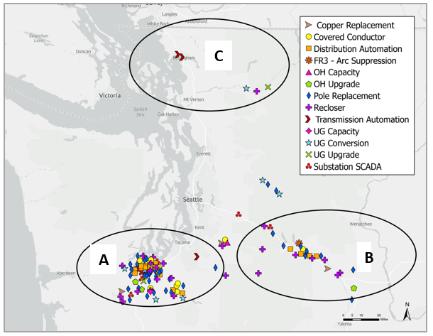
2022-2025 Fault Reduction and Protection Projects
2022-2025 System Hardening Projects
* Sourced from NICC Annual Fire Reports

Slide 13
Thank You

Slide 14
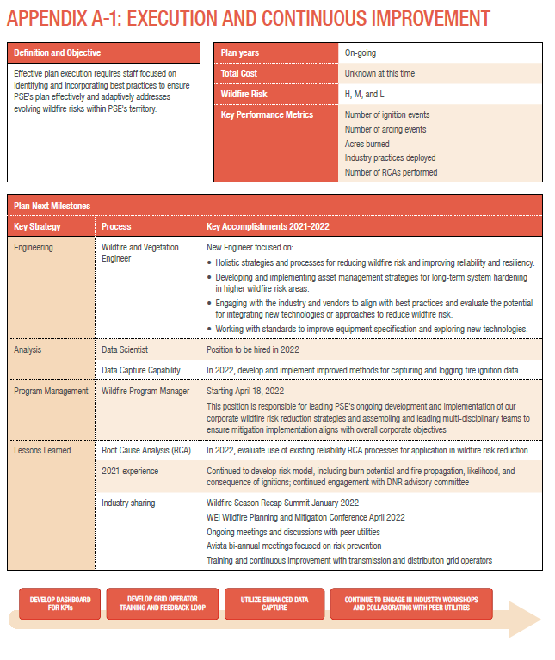

Slide 15
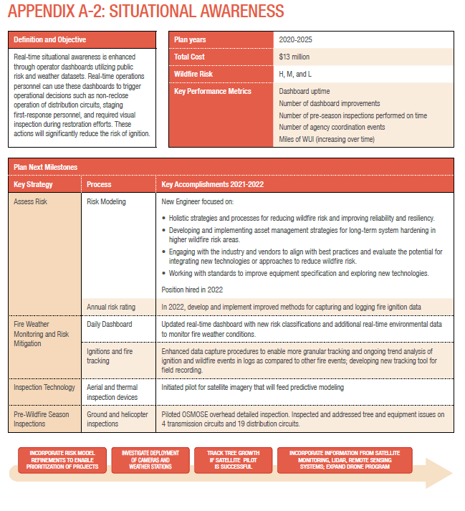

Slide 16
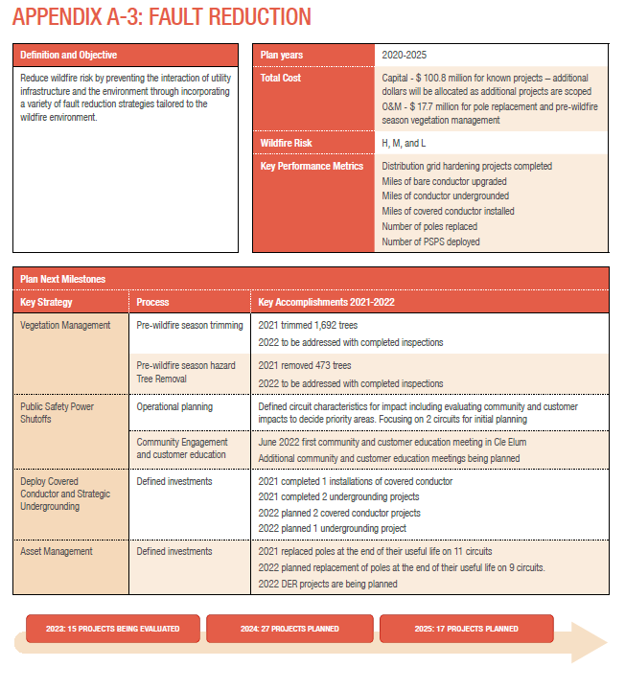

Slide 17
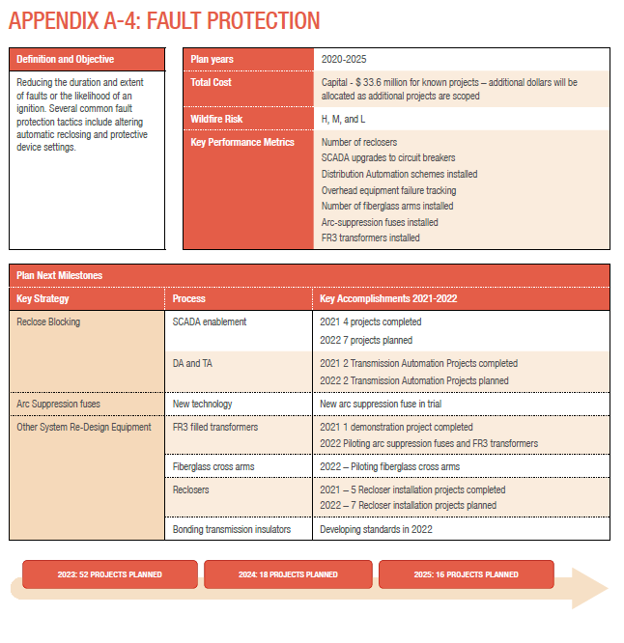

Slide 18
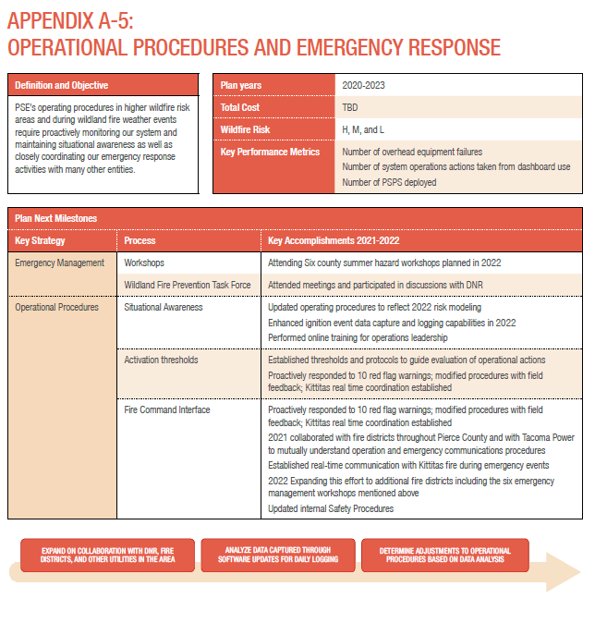

Slide 19
