Slide 1
July 24, 2023
Washington Department of Commerce & Utilities and Transportation Commission Meeting
Saad Malik (Director, Reliability Assessments)
Victoria Ravenscroft (Sr. External Affairs & Policy Manager)

Slide 2
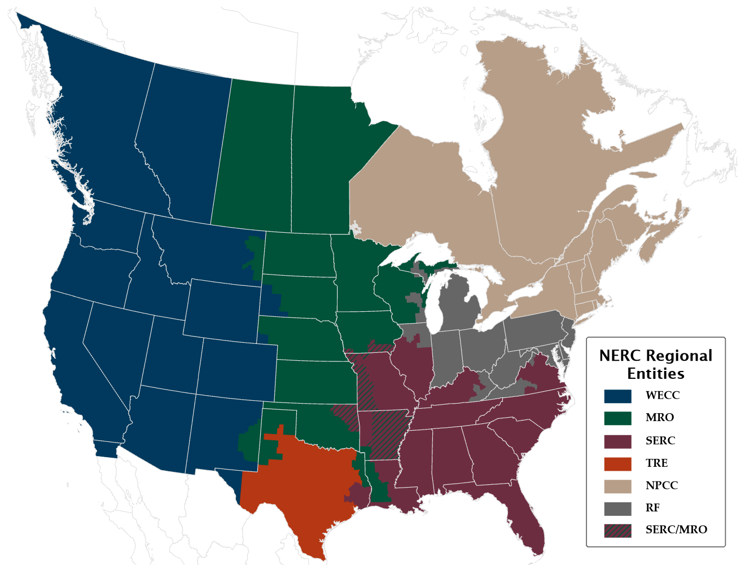
Responsibility for Reliability
§215 Federal Power Act—
FERC certifies an Electric Reliability Organization (ERO)
The ERO may delegate authority to Regional Entities
The Regional Entity carries out delegated responsibilities

Slide 3
WECC’s Work
WECC has a responsibility to help create, monitor, and enforce reliability standards and promote activities that ensure the reliability of the Bulk Power System in the Western Interconnection.
Develop, monitor, and enforce mandatory reliability standards
Analyze and evaluate system performance
Identify and assess emerging risks
Educate and share information

Slide 4
WECC’s Reliability Risk Priorities

Slide 5
Summer 2023 Assessment Highlights
All areas are resource adequate at the peak hour
Demand is at risk outside of the peak hours
Supply chain issues
Heat waves
Wildfires

Slide 6
Trajectories of New Renewable Resources

Slide 7
2022 Resources (Planned minus Actual)

Slide 8
Energy Emergency Alerts (EEA)

Slide 9
Demand at Risk
Demand at Risk

Slide 10
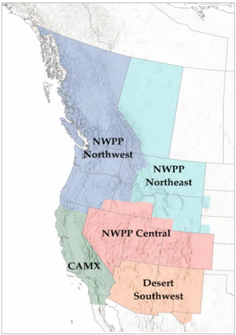
Western Assessment of Resource Adequacy
Assessment footprint
Western Interconnection
Five subregions
10-year, hourly analysis (2023-2032)
Probabilistic approach
Data comes from WECC Balancing Authorities
Includes expected demand and resource information

Slide 11
Demand-at-Risk Hours Results
Subregional Demand-at-Risk Hours
2023-2032
(with New Resources and Imports)
2021 Assessment 2022 Assessment

Slide 12
Western Assessment of Resource Adequacy
While there has been some improvement in near-term (2–3 years) resource adequacy risk, it has not been eliminated
Actions like retirement delays and expedited building of resources
Likelihood and magnitude of resource adequacy risk have increased compared to previous analyses
Long-term, the risk increases over the next 10 years
Variability drives resource adequacy risk, and variability increases over the next decade

Slide 13
Year 20 Assessments
Year 20 Foundational Case Development
Extreme Heat
Extreme Cold
Impact of Changing Loads
Transmission Trends

