Slide 1
Energy Insecurity and Utility Disconnections
Presentation for State of Washington Utilities and Transportation Commission
June 23, 2023
David Konisky Lynton K. Caldwell Professor
Co-Director, Energy Justice Lab O’Neill School of Public and Environmental Affairs Indiana University

Slide 2
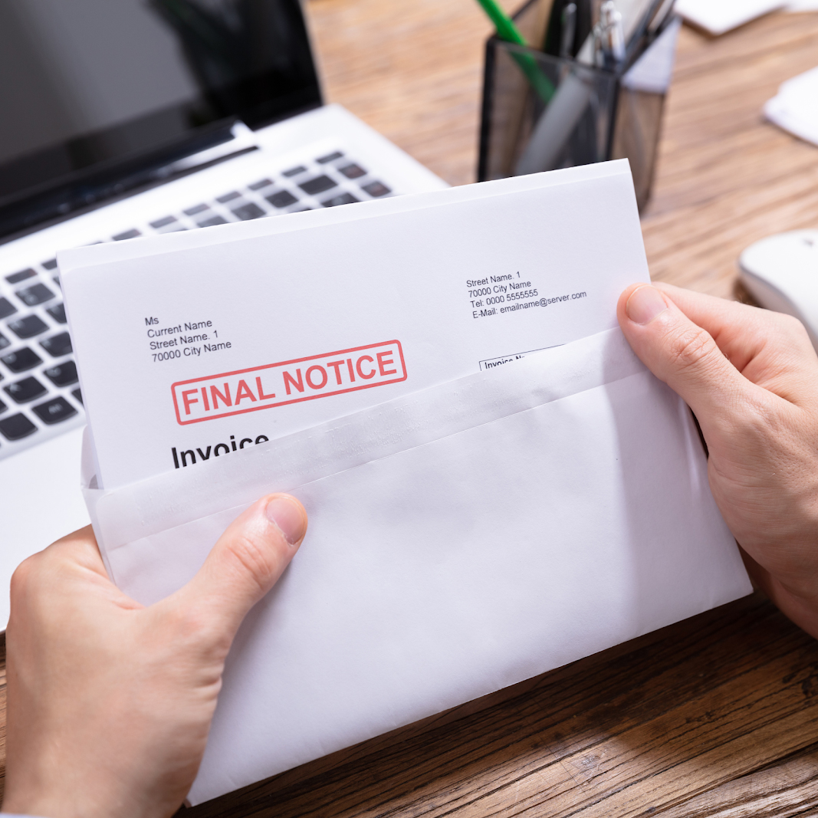
Each year in the U.S, nearly 3 million people have their electricity shut off due to nonpayment of their monthly utility bill.
- Source: Energy Justice Lab, Utility Disconnections Dashboard (https://utilitydisconnections.org)

Slide 3
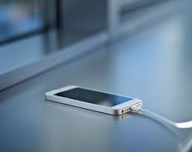
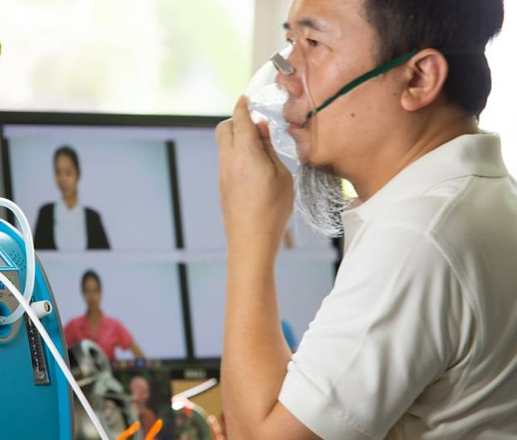
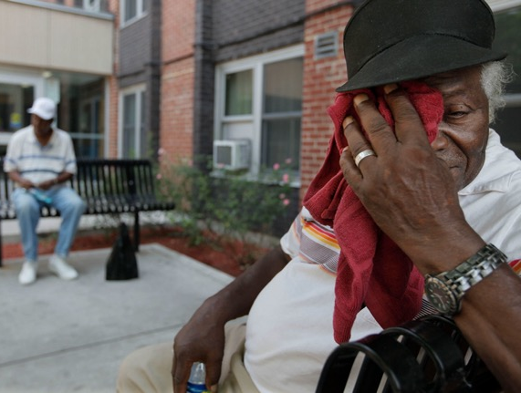
Without Power…

Slide 4
In 2020, across the United States….
Source: U.S. Energy Information Administration. 2022. Residential Energy Consumption Survey, https://www.eia.gov/consumption/residential/index.php

Slide 5
Research questions
How do households cope when they are energy insecure?
Is energy insecurity a short-term or persistent condition?
How prevalent is energy insecurity, and what are its correlates?
Understanding the dimensions of energy insecurity and the consequences for energy insecure households

Slide 6
Panel survey of household energy insecurity
Four waves tracking the same respondents, all within 200% of the federal poverty line, over the course of a year
June
July
August
Sept/Oct
Nov/Dec
Jan
Feb
March
May
2021
March
2020
April
May
April
1
2
3
4
n=2,381
n=2,247
n=1,672
n=1,378
Pandemic
shut downs
begin

Slide 7
Could not pay an energy bill
Received notice for disconnection
Utility disconnected service
Measured energy insecurity on a household basis
Monthly: May 2020-May 2021, and during past year
For each type of energy service: electricity, natural gas, heating oil, etc.
Also asked questions about COVID, household composition, and housing conditions.
Conducted subsequent interviews with households that experienced disconnection.

Slide 8
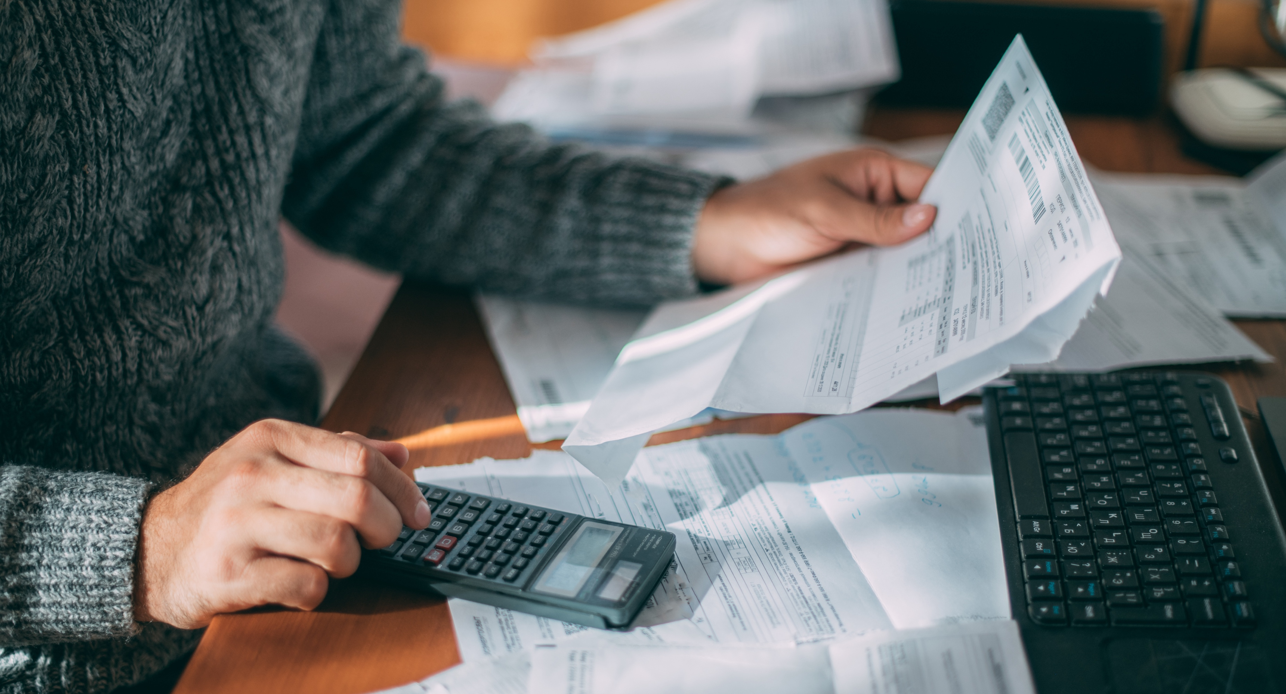
How prevalent is energy insecurity, and what are its correlates?

Slide 9
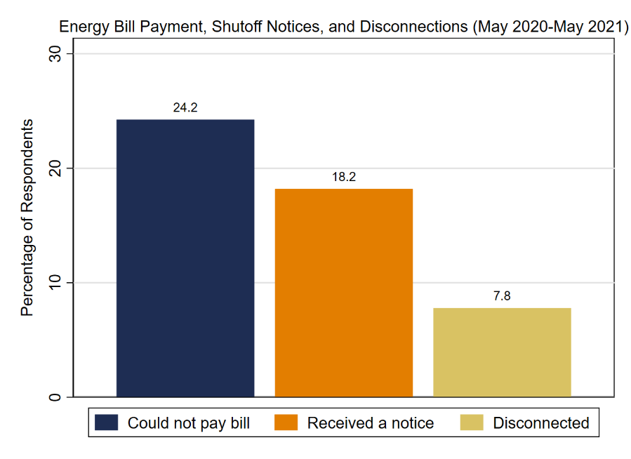
Rates of Energy Insecurity, May 2020-21
Estimates of Full Population
Bill: 23.5M people (4.6M households)
Notice: 17.7M people (3.5M households)
Disconnect: 7.5M people (1.5M households)
Source: Carley and Konisky. 2021. Survey of Household Energy Insecurity in Time of COVID. Wave 4 Report.

Slide 10
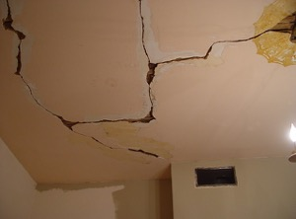
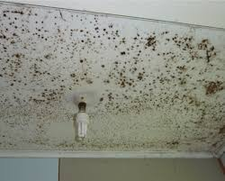
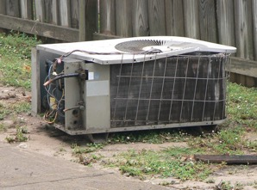
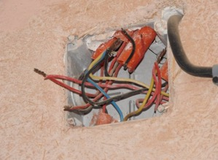
What Factors Correlate With Energy Insecurity?
Deficient/inefficient housing conditions
Higher energy burden
Use of at-home electronic medical device
Demographics and household composition
Low-income
Young children
Race and ethnicity
Sources: Memmott, Carley, Graff, Konisky. 2021. Socioeconomic disparities in energy insecurity among low-income households before and during the COVID-19 pandemic. Nature Energy 6, 186-193; Konisky, Carley, Graff, Konisky. 2022. The persistence of household energy insecurity during the COVID-19 pandemic. Environmental Research Letters; Michelle Graff, Sanya Carley, David M. Konisky, and Trevor Memmott, 2021, “Which Households are Energy Insecure? An Empirical Analysis of Race, Housing Conditions, and Energy Burdens in the United States,” Energy Research & Social Science 79, 102144.

Slide 11
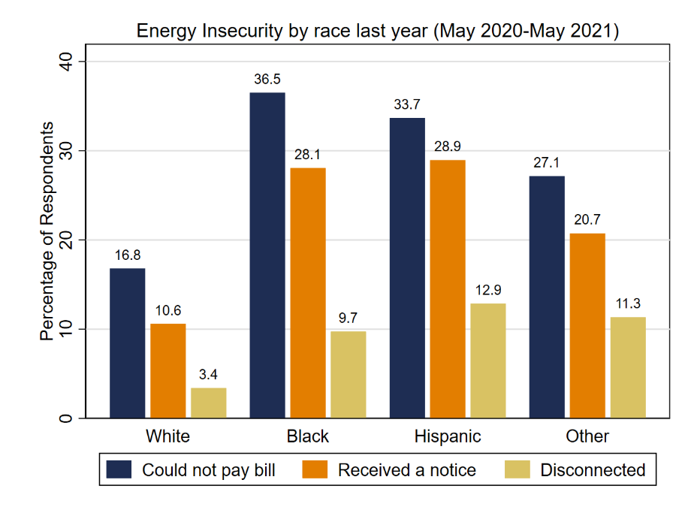
Energy Insecurity: Disparities by Race
Source: Carley and Konisky. 2021. Survey of Household Energy Insecurity in Time of COVID. Wave 4 Report.

Slide 12
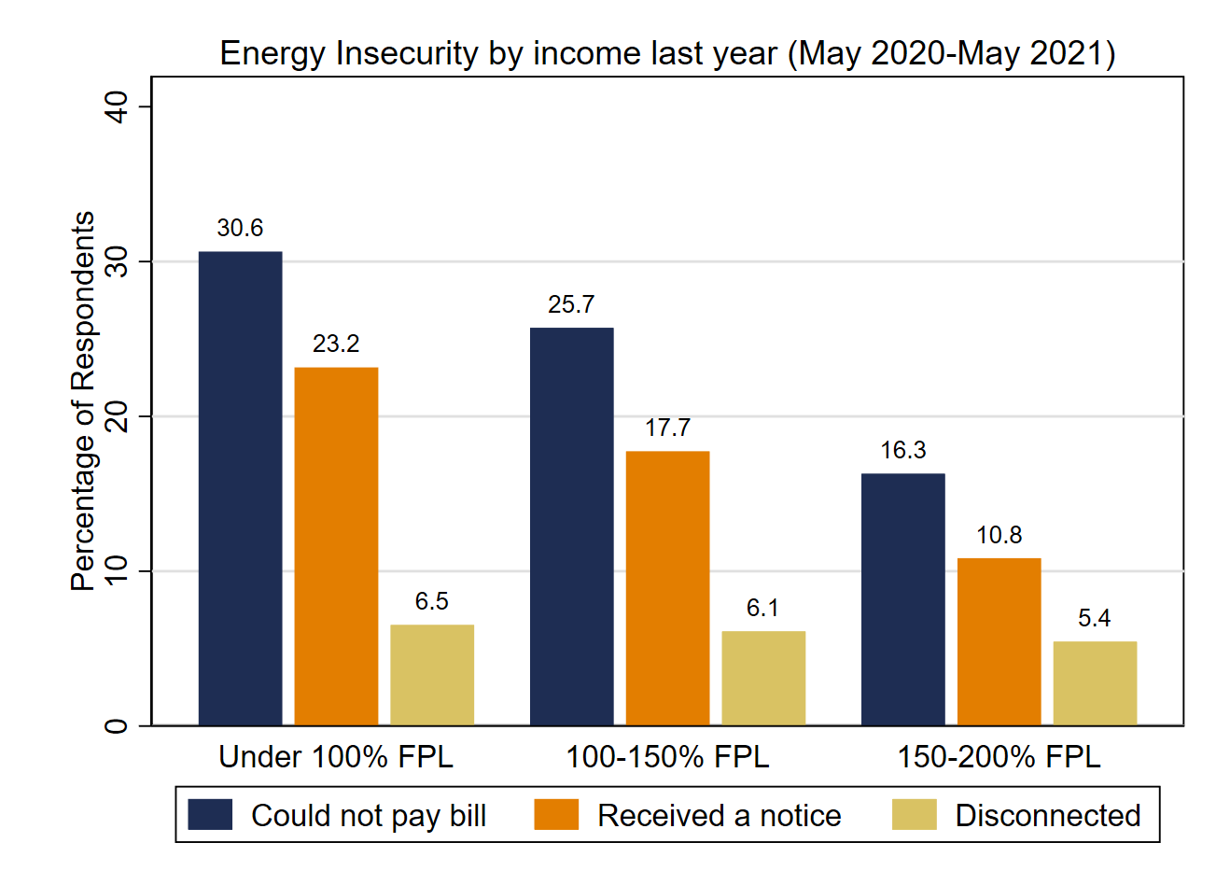
Energy Insecurity: Disparities by Income
Source: Carley and Konisky. 2021. Survey of Household Energy Insecurity in Time of COVID. Wave 4 Report.

Slide 13
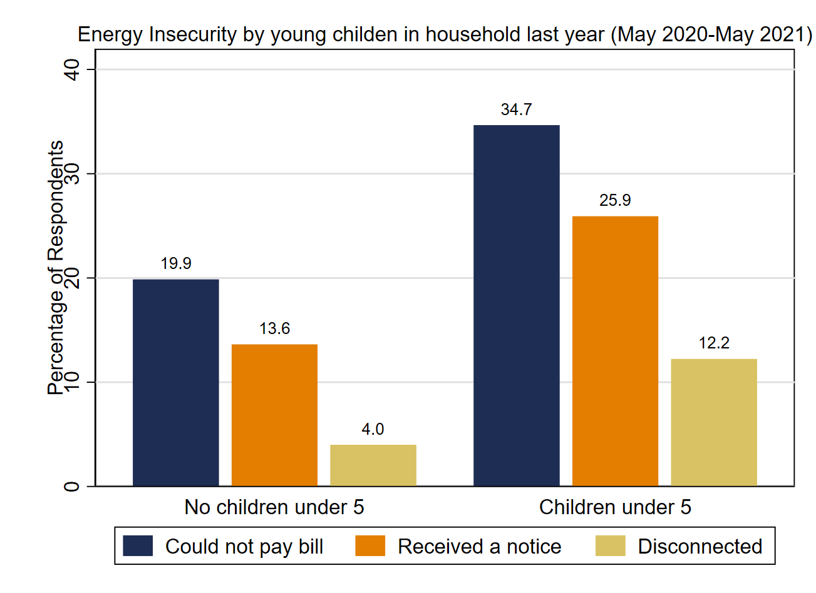
Energy Insecurity: Disparities by Children
Source: Carley and Konisky. 2021. Survey of Household Energy Insecurity in Time of COVID. Wave 4 Report.

Slide 14
Is energy insecurity a short-term or persistent condition?

Slide 15
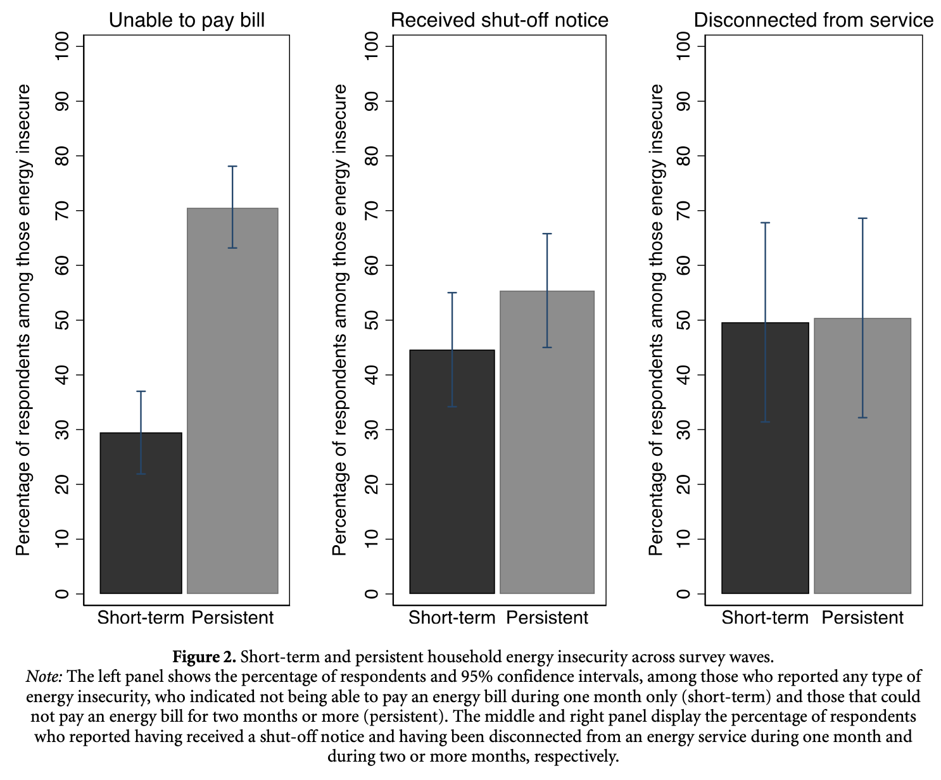
We should think about energy insecurity not just as an acute situation, but a chronic problem.
Struggle to pay bills
Shutoff
Disconnection + other fees, on list for risk of shutoff
Struggle to pay bills
Shutoff
Source: Konisky, Carley, Graff, Memmott, 2022. The persistence of household energy insecurity during the COVID-19 pandemic, Environmental Research Letters, 17, 104017.

Slide 16
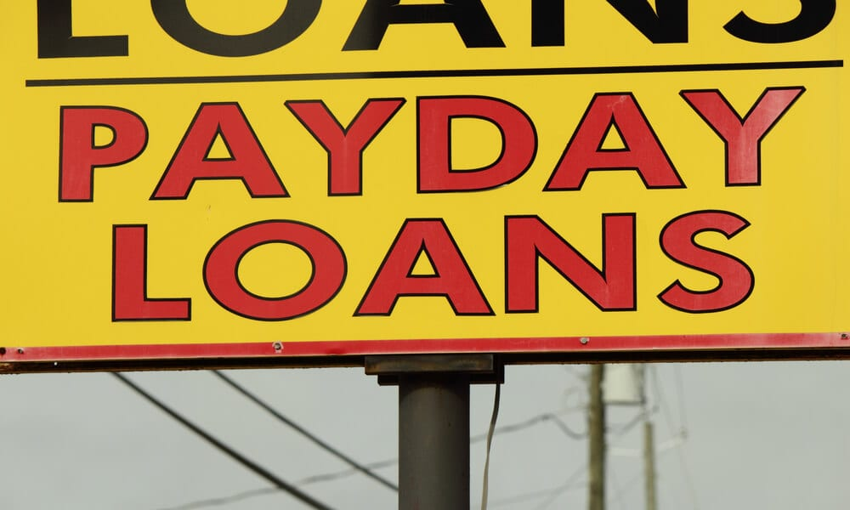
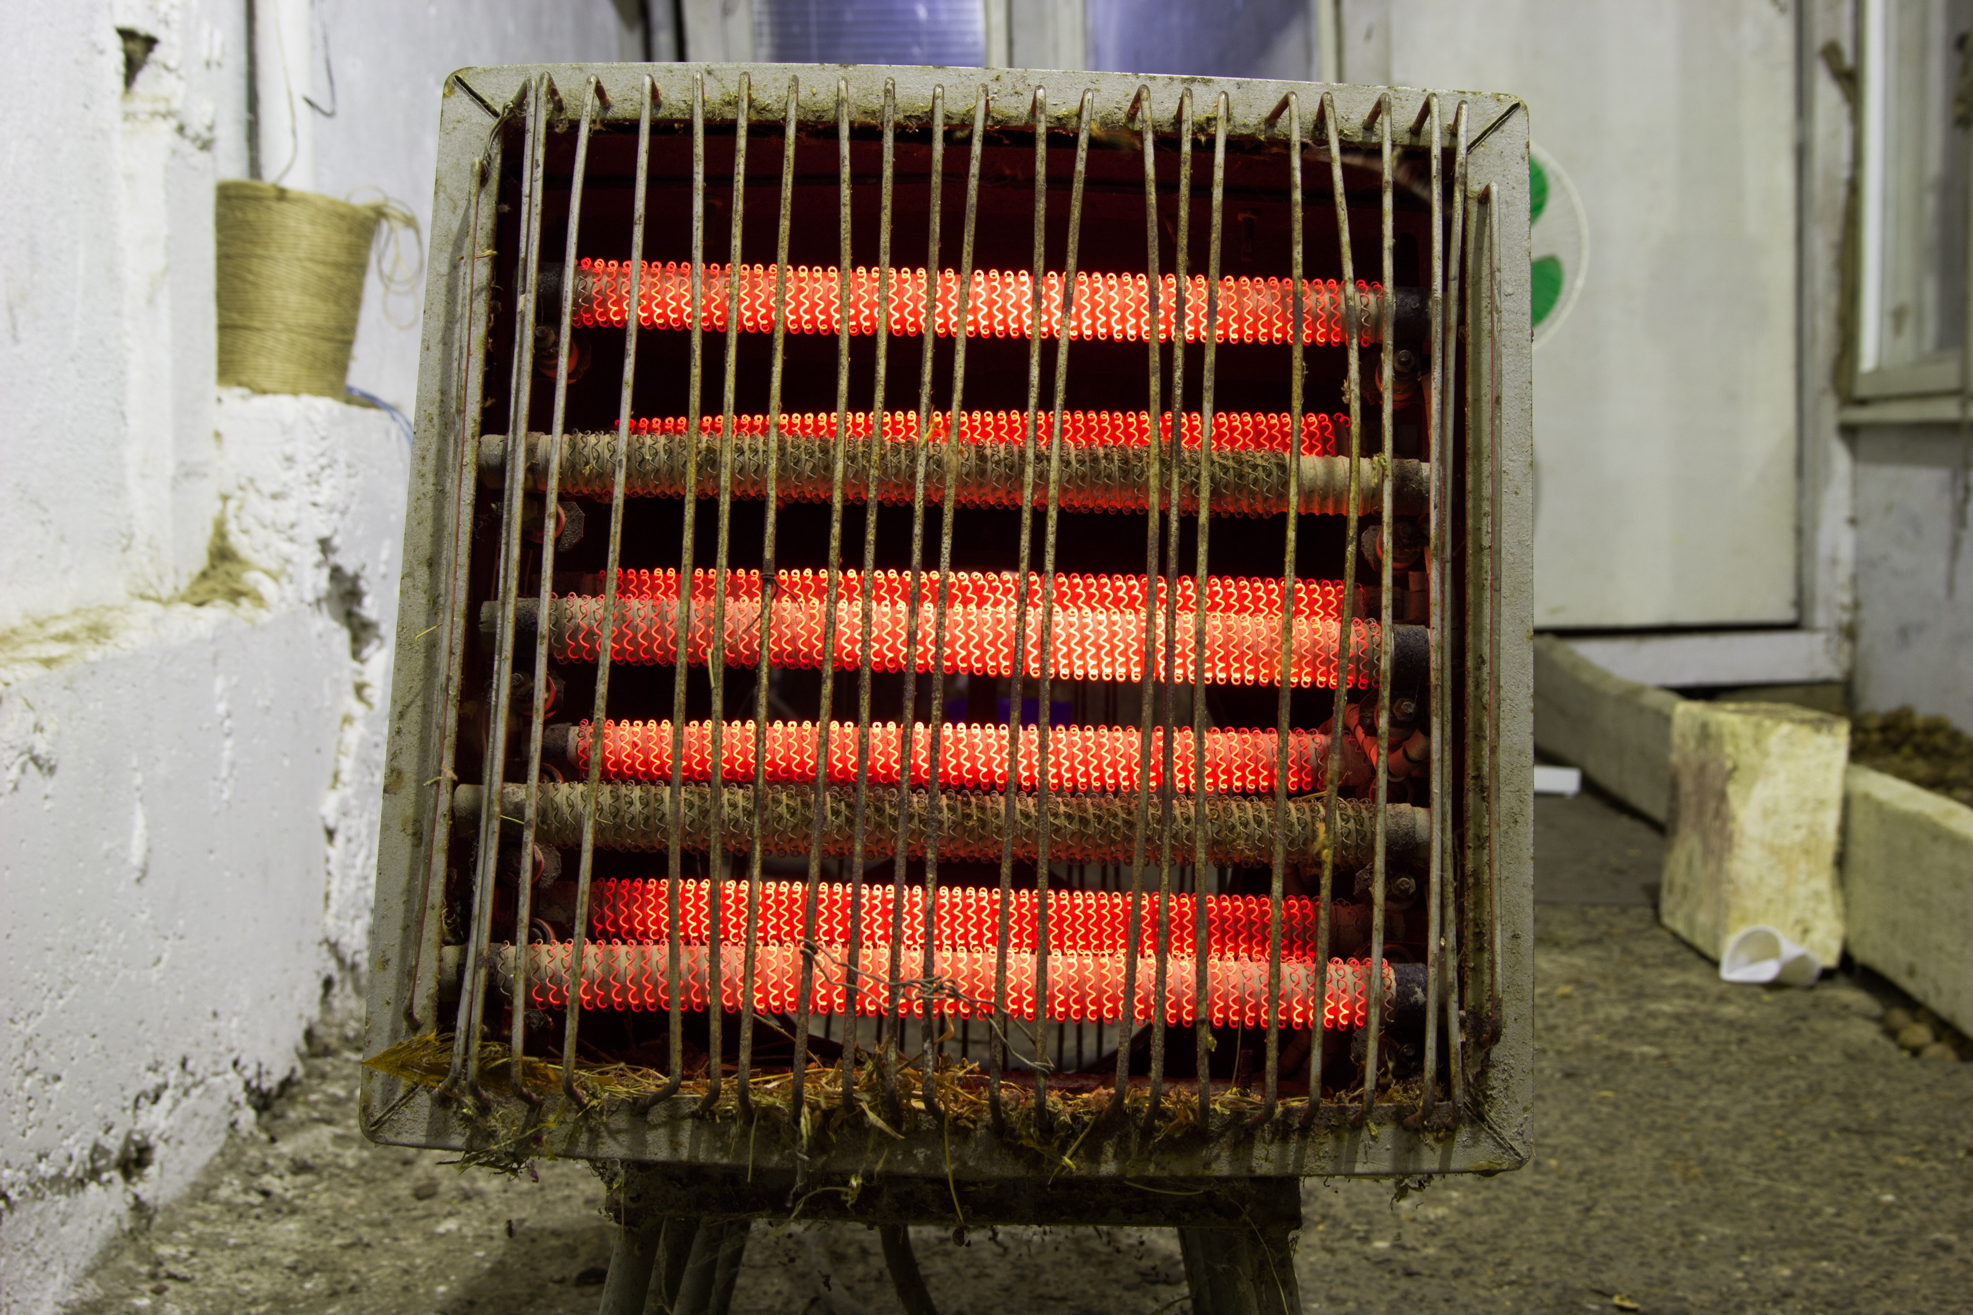
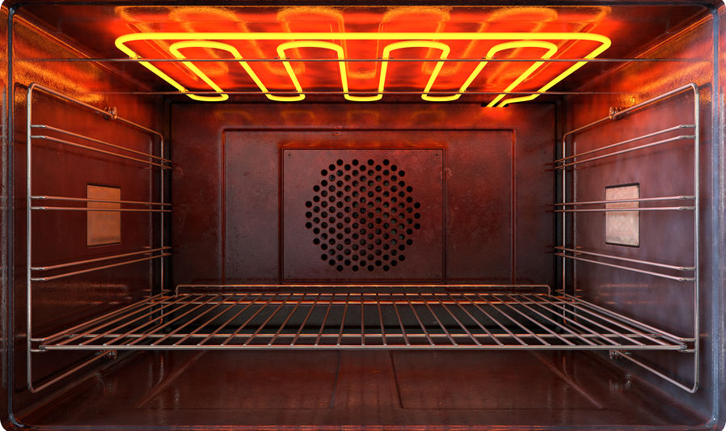
How do households cope when they are energy insecure?

Slide 17
Coping Strategies
(55%)
Risky Temperature Behavior
(26%)
Forgo other Expenditures (medical, food)
(17%)
Payment Assistance
(23%)
Bill Strategies
(32%)
Formal Assistance Networks
(16%)
Government Assistance (WAP, LIHEAP, Local Government Assistance)
(11%)
Informal Assistance Networks
(10%)
Personal Networks (Friends, Family, Neighbors, Religious or Other Group)
(10%)
Bill Balancing
(18%)
Utility Debt
(27%)
Banks and Payday or Other Lenders (2%)
Utility Assistance and Payment Plans (6%)
Source: Carley, Graff, Konisky, Memmott. 2022. Behavioral and financial coping strategies among energy insecure households. Proceedings of the National Academy of Sciences.

Slide 18
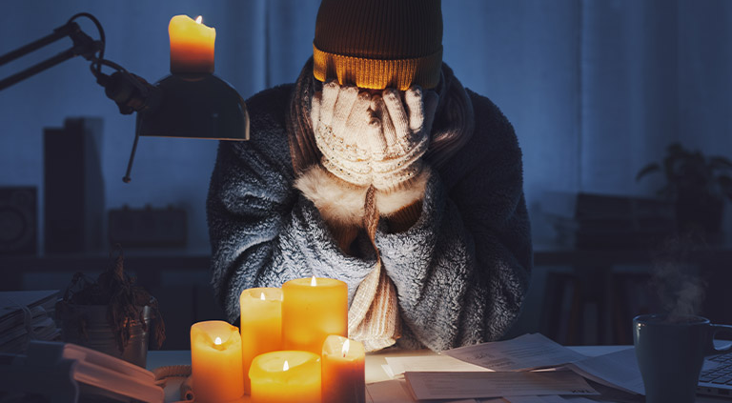
Notes:
Stories from interviews

Slide 19
Relevant research from the Energy Justice Lab
Trevor Memmott, Sanya Carley, Michelle Graff, and David M. Konisky, 2023, “Utility Disconnection Protections and the Incidence of Energy Insecurity in the United States,” iScience 26(3), 106244.
David M. Konisky, Sanya Carley, Michelle Graff, and Trevor Memmott, 2022, “The Persistence of Household Energy Insecurity during the COVID-19 Pandemic,” Environmental Research Letters, 17(10: 104017.
Sanya Carley, Michelle Graff, David M. Konisky, and Trevor Memmott, 2022, “Behavioral and Financial Coping Strategies among Energy Insecure Households,” Proceedings of the National Academy of Sciences, 119(36): e2205356119.
Shalanda Baker, Sanya Carley, and David M. Konisky, 2021, “Energy Insecurity and the Urgent Need for Utility Disconnection Protections,” Energy Policy 159, 112663.
Michelle Graff, Sanya Carley, David M. Konisky, and Trevor Memmott, 2021, “Which Households are Energy Insecure? An Empirical Analysis of Race, Housing Conditions, and Energy Burdens in the United States,” Energy Research & Social Science 79, 102144.
Trevor Memmott, Sanya Carley, Michelle Graff, and David M. Konisky, 2021, “Sociodemographic Disparities in Energy Insecurity among Low-income Households Before and During the COVID-19 Pandemic,” Nature Energy 6: 186-193.
Matt Flaherty, Sanya Carley, and David M. Konisky, 2020, “Electric Utility Disconnection Policy and Vulnerable Populations,” The Electricity Journal 33(10): 106859.

Slide 20
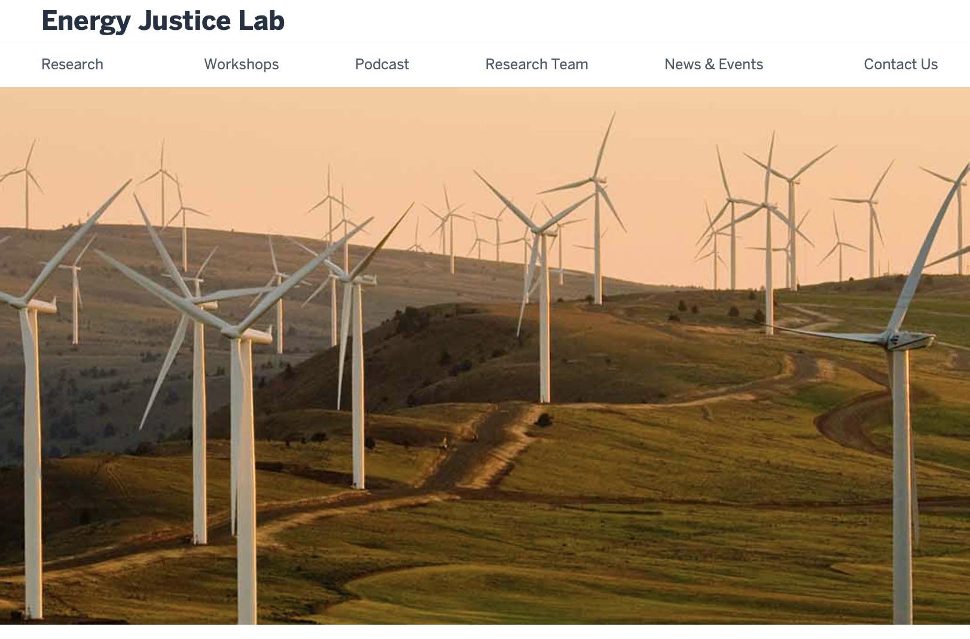
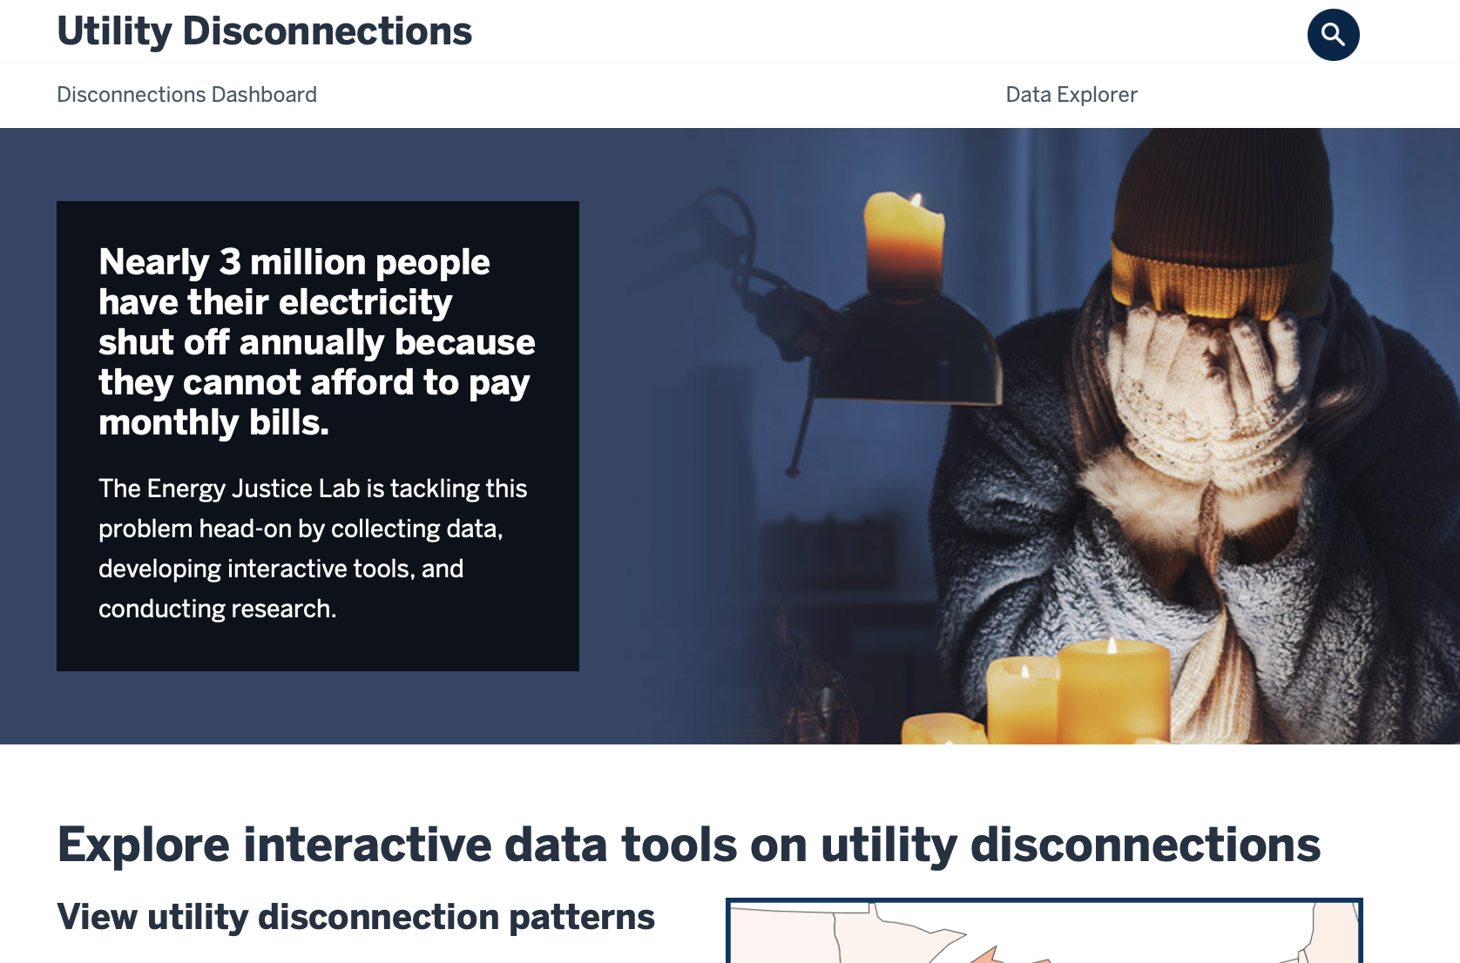
Contact:
David Konisky
dkonisky@indiana.edu
812-855-6990
https://energyjustice.indiana.edu/
https://utilitydisconnections.org/

