Slide 1
National Perspective
Jan. 15, 2025

Slide 2
EVGrid Assist
Enhance learnings through informational webinars and peer-to-peer sharing, drawing from emerging research and real-world demonstrations and experience
Provide pathways for stronger vehicle grid integration (VGI) coordination between electric utilities, regulators, manufacturers, technology providers, and other stakeholders
Collaboratively identify solutions to emerging VGI challenges
Develop resources and provide data, tools, and analyses that support decision making
Build capacity and provide technical assistance to support stakeholders as they develop and implement solutions.

Slide 3
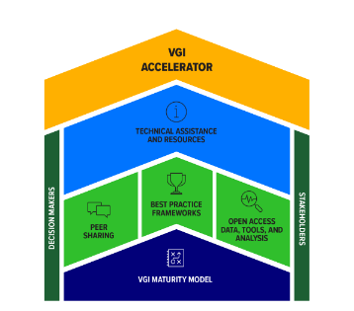
Best Practice Frameworks
Best Practices Guide EV Load Forecasting
Energy Systems Integration Group (ESIG)
Best Practices Guide for Benefit-Cost Analysis of Managed EV Charging
Lawrence Berkeley National Laboratory and Synapse Energy
(https://emp.lbl.gov/publications/best-practices-guide-benefit-cost)

Slide 4
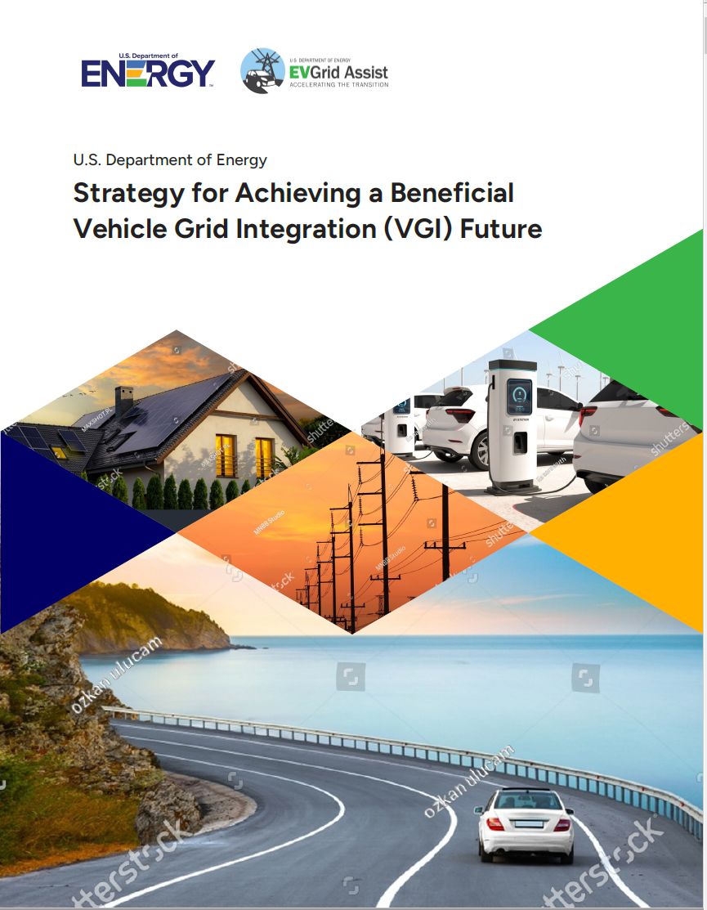
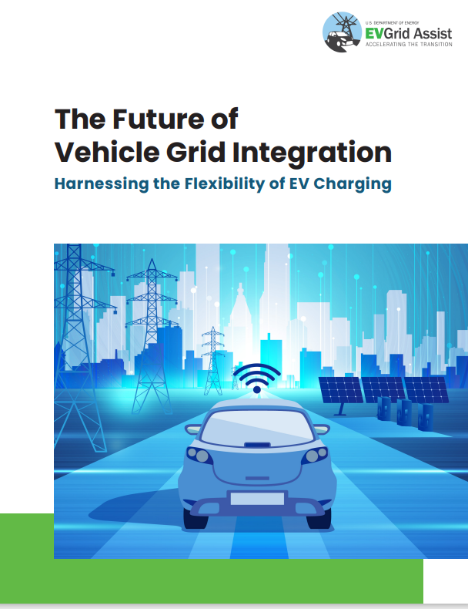
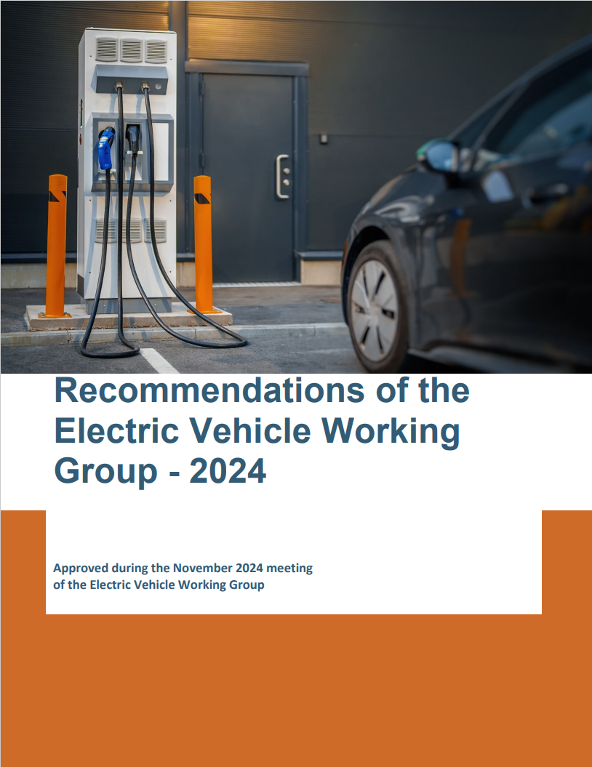
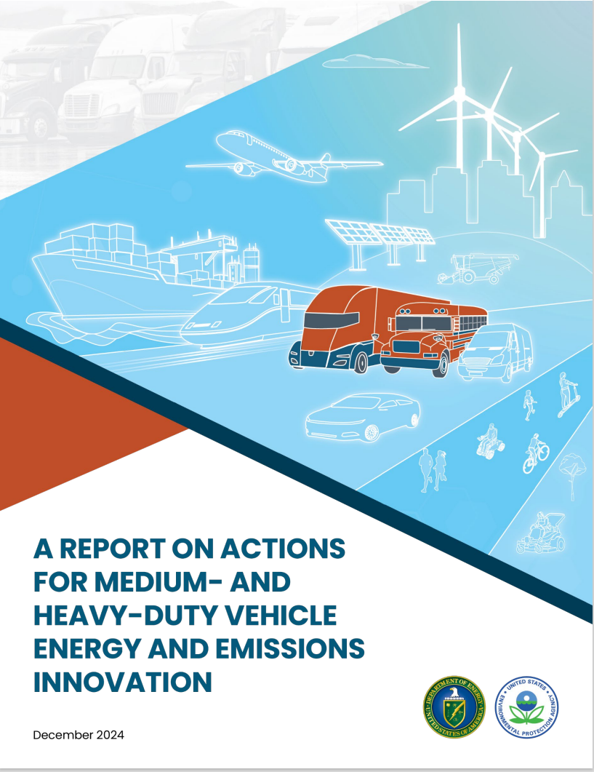
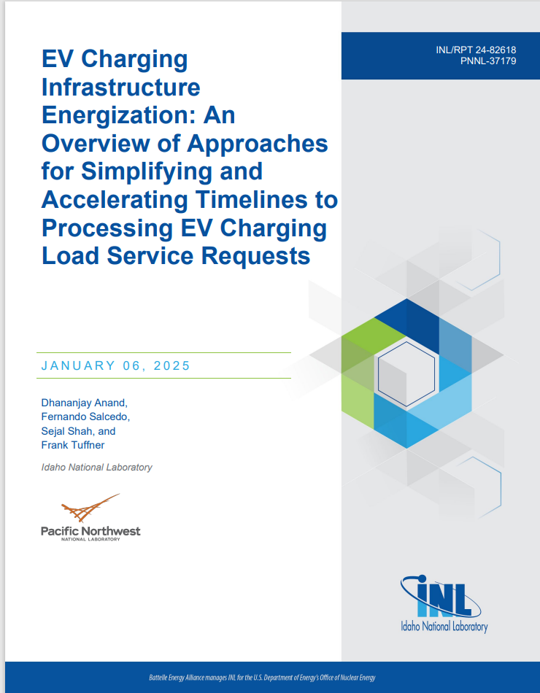
Recent Publications
Coming Soon!

Slide 5
Notes:
Kara

