Slide 1
Real Reliability The Value of Virtual Power
Prepared by
Ryan Hledik
Kate Peters
Washington UTC Resource Adequacy Meeting
July 24, 2023

Slide 2
What Is a VPP?
A VPP is portfolio of distributed energy resources (DERs) that are actively controlled to provide benefits to the power system, consumers, and the environment.
Virtual Power Plant
Examples of potential elements
Utility or aggregator
Power system
Smart thermostats
Rooftop solar PV
DERs are controlled by utility
1
Utility manages DERs to provide grid benefits
2
Electric vehicles (EVs)
Distributed batteries
4
Shared cost savings
3
Power system costs & emissions are reduced
Smart water heaters
Commercial building automation systems

Slide 3
VPPs are at a deployment inflection point
Drivers
Declining DER costs
Technological advancement
Inflation Reduction Act
FERC Order 2222
Growing model availability
The decarbonization imperative
Homes with Smart Thermostats
Homes with Electric Water Heating
PRESENT | 2030
10% | 34%
PRESENT | 2030
49% | 50%
Residential Rooftop Solar
Behind-the-Meter (BTM) Batteries
PRESENT | 2030
27 GW | 83 GW
PRESENT | 2030
2 GW | 27 GW
Light-Duty Electric Vehicles
PRESENT | 2030
3 mil. | 26 mil.

Slide 4
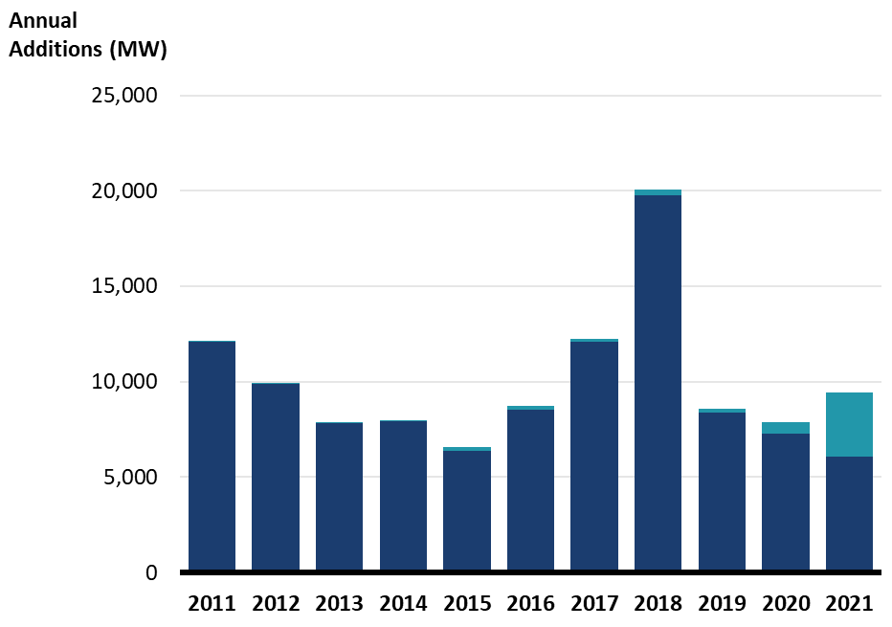
Resource adequacy needs persist in the US
$120 billion of investment in past decade
Driven by electrification, coal retirements, and growing renewables dependence
Our study:
Can VPPs reliably serve this resource adequacy need?
And can they compete economically with gas peakers and batteries?
Historical U.S. Capacity Additions for Resource Adequacy
~110 GW, 2012-2021
 | Battery
 | Gas

Slide 5
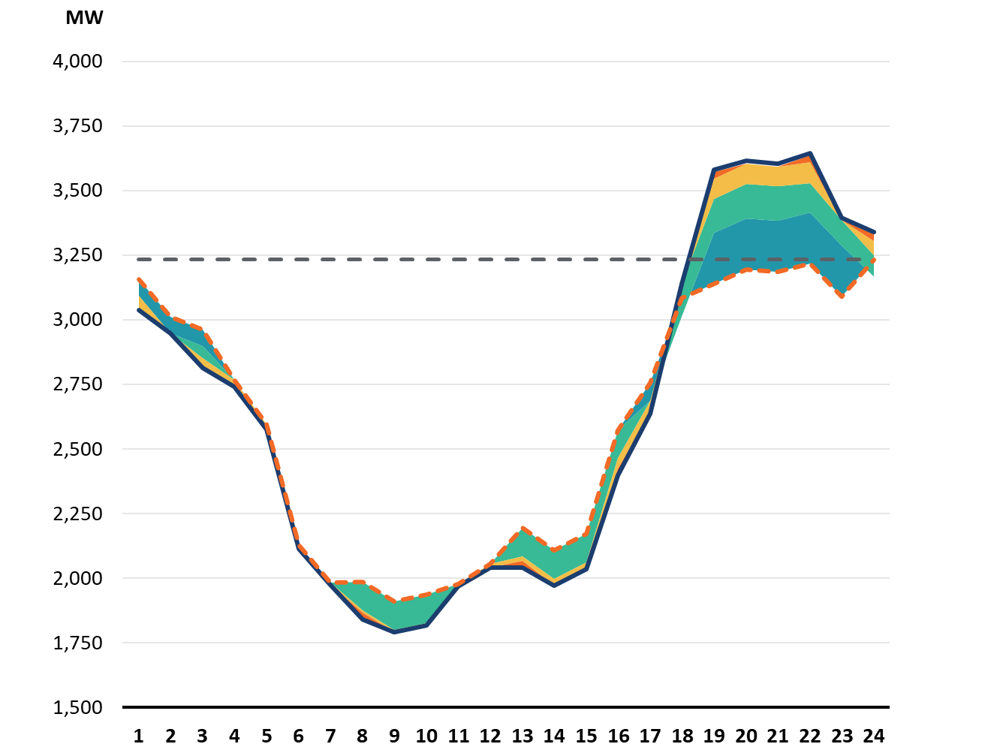
The modeled VPP can fully provide 400 MW of resource adequacy for a moderately-sized utility
We modeled four commercially available residential demand flexibility technologies for an illustrative utility composed of 1.7 million customers
Peak Net Load Day
400 MW Reduced Load
The VPP reduces load in:
Summer and winter
7 months
63 hours of the year
7 consecutive hours
BTM Battery
Home Managed EV Charging
Smart Water Heating
Smart Thermostat
VPP shifts customer usage to low cost hours
 | Net Load
 | Net Load
 | After Dispatch
Hour of Day

Slide 6
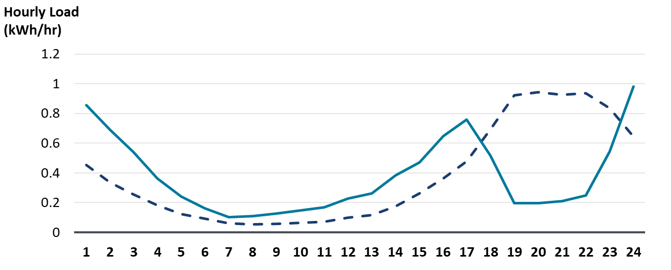
Simulated VPP dispatch is based on observed performance in actual deployments
EV Home Charging Load Profile Relative to Hourly System Costs
(Average across days and EV portfolio)
1
Max 1 event per day
2
4
 | Before Dispatch
 | After Dispatch
3
5
 | Emissions
 | Energy

Slide 7
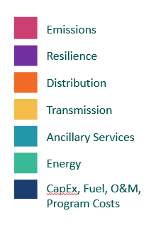
Resource Adequacy… For Cheap
Annualized Net Cost of Providing 400 MW of Resource Adequacy
RMI estimated that 60 GW of VPPs could be deployed nationally by 2030. At that scale, VPPs would save $15 to $35 billion in resource costs relative to the alternatives over 10 years … plus $20 billion in societal benefits

Slide 8
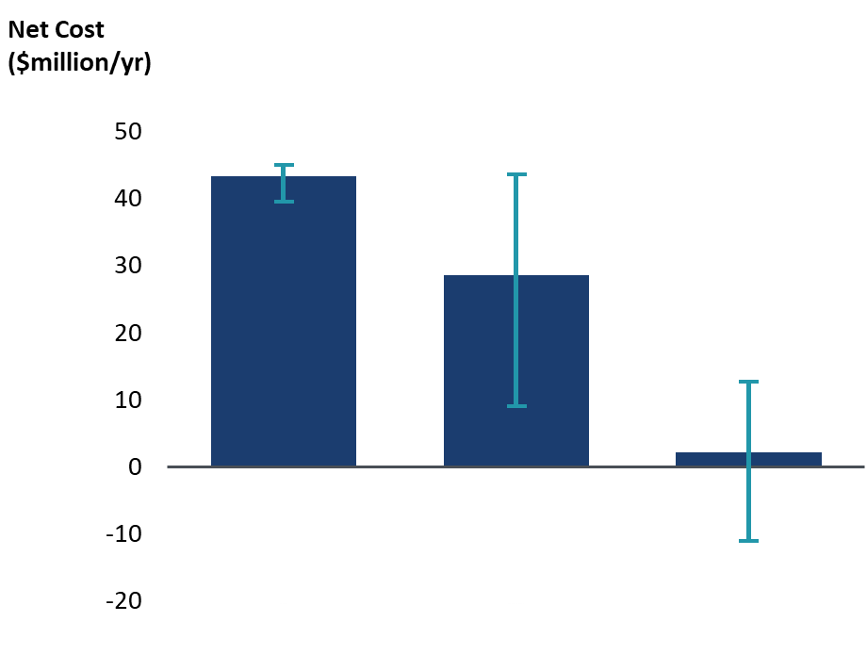
The VPP could provide resource adequacy at a negative net cost to society
Net Cost of Providing 400 MW of Resource Adequacy
(Range observed across all sensitivity cases)
Gas
Battery
VPP
High
Low
Base
Economic competitiveness of battery storage and VPPs varies across markets, depends trajectory of future cost declines.
In markets with higher T&D costs or higher GHG emissions costs, the additional (i.e., non-resource adequacy) value of a VPP can outweigh its costs

Slide 9
The ideal conditions for VPP deployment
MARKET DESIGN
Wholesale markets provide a level playing field for demand-side resources.
Retail rates and programs incentivize participation in innovative, customer-centric ways.
POLICY SUPPORT
Codes and standards promote deployment of flexible end-uses.
R&D funding supports removal of key technical barriers.
MARKET
DESIGN
POLICY
SUPPORT
Maximized
VPP Value
TECHNOLOGY INNOVATION
DERs are widely available and affordable. DERs can communicate with each other and the system operator.
Algorithms effectively optimize DER use while maintaining customer comfort and convenience.
REGULATORY FRAMEWORK
Utility business model incentivizes deployment of VPPs wherever cost-effective.
Utility resource planning and evaluation accounts for the full value of VPPs.
TECH
INNOVATION
REGULATORY
FRAMEWORK

Slide 10
Three low-risk actions utilities and regulators can take now
For more information:
Conduct a jurisdiction-specific VPP market potential study. Then establish VPP procurement targets.
Establish a VPP pilot. Test innovative utility financial incentive mechanisms.
Review and update existing policies to comprehensively account for VPP value.
https://www.brattle.com/real-reliability/

Slide 11
Appendix

Slide 12
VPPs can provide several additional major benefits not modeled in this study
Increased renewables deployment
Flexible scaling
Better power system integration of electrification
Enhanced customer satisfaction
Improved behind-the-meter grid intelligence
Faster grid connection

Slide 13
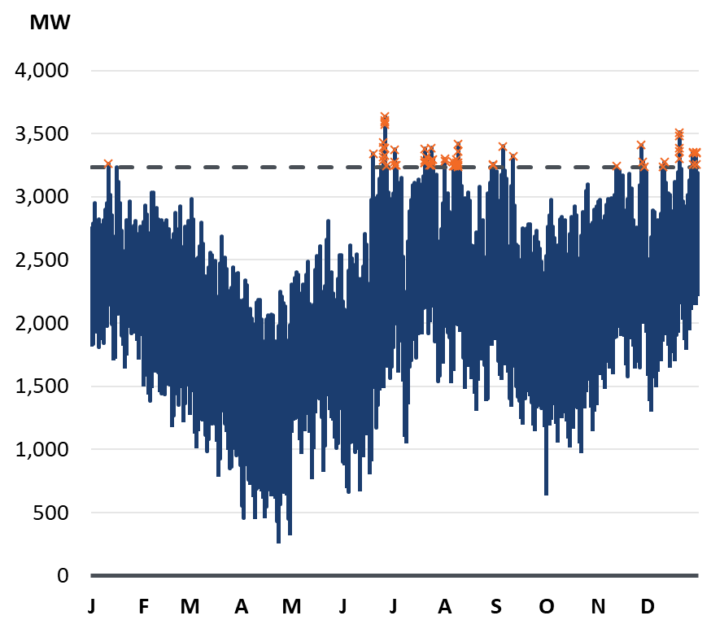
We conducted hourly reliability analysis for a VPP, a gas peaker, and a utility-scale battery
The illustrative utility
Mid-sized (1.7 million customers)
50% renewables by 2030
Winter and summer resource adequacy needs
Defining resource adequacy
Serve all load contributing to top 400 MW of net peak demand
Requires performance during 63 hours of the year
7 consecutive hours in one day
Utility Hourly Net Load Profile
400 MW Reduced Load
63 hrs must be addressed to serve top 400 MW of load
Net Load (gross system load minus renewable generation)

Slide 14
We modeled a VPP composed of four commercially available residential load flexibility technologies
 | Smart Thermostat DR | Smart Water Heating | Home Managed EV Charging | BTM Battery DR
Eligibility (% of residential customer base) | 67% summer; 35% winter | 50% | 15% | 1%
Participation (% of eligible customers) | 30% | 30% | 40% | 20%
Total Controllable Demand at Peak (MW) | 204 MW | 114 MW | 79 MW | 26 MW
VPP Operational Constraints | 15 five-hour events per season, plus 100 hrs of minor setpoint adjustments per year and energy savings | Daily load shifting of water heating load, ancillary services | Daily load shifting of vehicle charging load | 15 demand response events per year
We model all utility-incurred costs (incentives, implementation including marketing and per-unit DERMS costs)

