Slide 1
Decoupling and Rate Plan Efficiencies
Commission Update
August 28, 2014

Slide 2
Today’s Objectives
Begin an ongoing dialogue on the effects of the Commission’s 2013 Order
Update the Commission on PSE’s continuing efforts to manage cost
Update on Safety & Service metrics in light of cost management
Address questions and solicit feedback

Slide 3
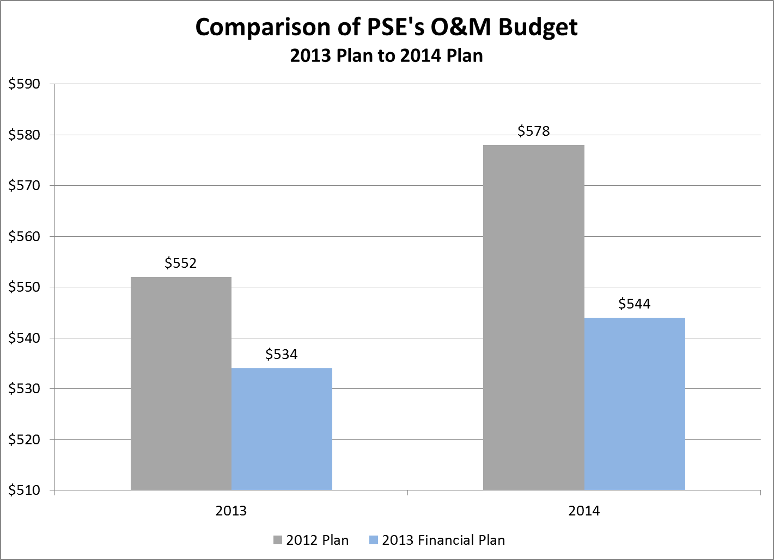
PSE Has and Continues to Control Cost
PSE has and continues to control cost
With decoupling, the Company has reviewed and developed plans to achieve additional operating efficiencies
Plans continue to be vetted and refined

Slide 4
Recent/Ongoing Cost Reduction Efforts
PSE has recently implemented specific reductions; for example:
Fleet overhead evaluation
IT equipment deployment policies
Materials overhead management
Strategic sourcing
Workforce and related infrastructure review
Labor benefits recalibration to market
Vacancy and talent redeployment review and assessment
Corporate campus consolidation
Other factors affecting PSE’s cost structure include
Puget Energy credit rating upgrade and revolver debt refinancing
Hydro Treasury Grants and rate base offset

Slide 5
Longer-term Process & Technology Efficiencies
The Company’s analysis identified areas of opportunity for repeatable and sustainable business process efficiency improvements
SAP core financials
Procurement
Service Partner interface processes
Energy Operations maintenance program improvements
Electric and Gas Operations mobile dispatch improvements
Energy Imbalance Market

Slide 6
Safety Statistics
Measure | Industry Avg.* | Goal | Actual YTD
Total incident rate | 2.80 | 1.40 | 1.14
Lost workday case rate | 0.80 | 0.29 | 0.13
* Source: Bureau of Labor Statistics, 2012 Report, Combined Utility Statistic (Incl. Electric, Gas, and Water)
Safety Statistics

Slide 7
SQIs – PSE’s 2014 performance (to-date) compared to WUTC benchmark
Description | Benchmark | Year to Date
WUTC Complaint Ratio | ≤ 0.40 complaints/1,000 customers | 0.13
SAIDI (System Average Interruption Duration Index) | ≤ 320 minutes/customer/year | 108
SAIFI (System Average Interruption Frequency Index) | ≤ 1.30 interruptions/customer/year | 0.58
Telephone Center Answering Performance | ≥ 75% of calls answered within 30 seconds | 76%
Telephone Center Transactions Satisfaction | ≥ 90% satisfied | 93%
Gas Safety Response Time | ≤ 55 minutes | 31
Gas Field Service Ops Customer Satisfaction | ≥ 90% satisfied | 95%
Percent of Appointments Kept | ≥ 92% | 98%
Electric Safety Response Time | ≤ 55 minutes | 52.5
SQIs – PSE’s 2014 performance

Slide 8
Additional PSE Metrics
Measure | Target | Performance
% of Billing Exceptions resolved within target timeframe | 95% resolved within 60 days | 99.5%
First call resolution | 90% | 93.99%
Gas system leak reduced/eliminated | 188 leak reduction by YE | YE leak reduction forecast = 577
PSE Corporate Score Card

Slide 9
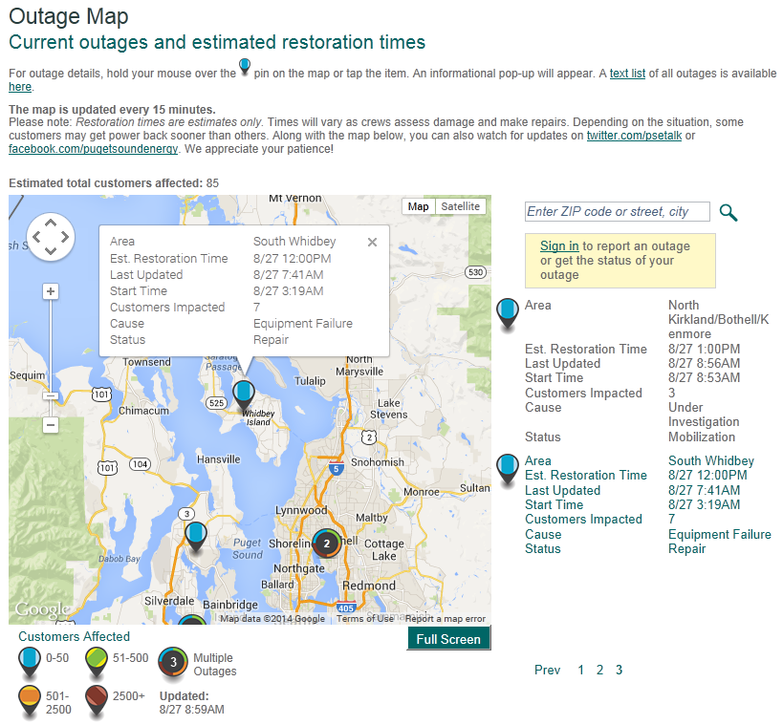
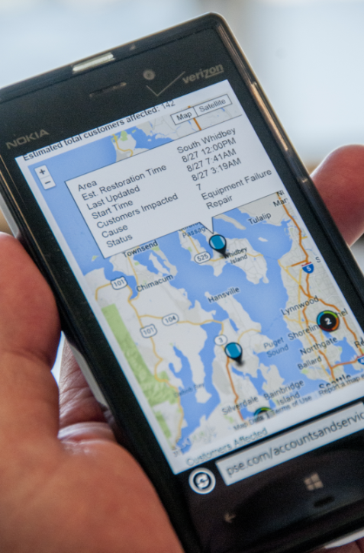
Outage Map
Outage Map

Slide 10
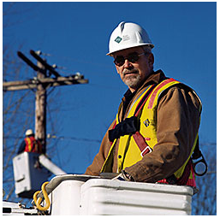
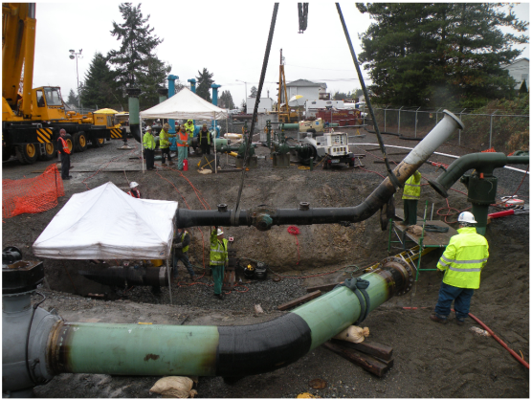
Summary
The Company is implementing its near- and mid-term efficiency improvements, and vetting and refining its longer-term plan to deliver sustainable efficiencies and cost reduction measures in support of its Mission: Safe, Dependable, Efficient
Thank you for the opportunity to present this status update

