Slide 1
Climate Commitment Act Workshop Series
Washington Utilities & Transportation Commission
November 8, 2023

Slide 2
Agenda
Welcome, Opening Remarks, and Introduction
Summary of previous workshops
Overview of risk sharing mechanisms at the Commission
Discussion 1: CCA Risk Sharing Discussion
10 Minute Break
Discussion 2: CCA Dispatch Cost Modeling Discussion
10 Minute Break
Wrapping up the CCA Workshop Series
Questions
Closing Remarks & Adjourn

Slide 3
CCA Workshop Series Work Plan
Event | Date
Notice of first workshop: CCA 101 | March 15, 2023
Notice of opportunity to file written comments on draft CCA work plan, action timeline, and future workshops | April 10, 2023
First CCA workshop: CCA 101 | April 10, 2023
Written comments due – Proposed topics for discussion | May 10, 2023
Notice of second workshop – Second CCA workshop topics (Auction revenues to benefit ratepayers, “low-income” definition, CCA cost recovery); issue final CCA work plan and action timeline. | June 15, 2023
Second CCA workshop: Second CCA workshop topics (Auction revenues to benefit ratepayers, defining “low-income,” cost recovery). | July 26, 2023
Third CCA Workshop: – Continuation of cost recovery and planning issues (Long-term utility planning forecasts and forecast adjustments). | September 15, 2023
Fourth CCA workshop: Risk sharing and dispatch modeling | November 8, 2023
Rulemaking | Timeline TBD

Slide 4
Workshop #1 Summary
Commission Jurisdiction
Climate Commitment Act is primarily regulated by the Department of Ecology
UTC is directly involved under two WACs:
WAC 173-446-230
Approval of supply/demand forecasts for estimates of retail electric load and forecasted resource fuel types to deliver load (Only applicable for electric IOUs, not natural gas)
UTC retains “oversight and jurisdiction over the use of revenues collected from an investor-owned utility through the consignment and auction of no cost allowances for the benefit of ratepayers.”
WAC 173-446-240
The UTC “retains jurisdiction over the use of the revenues collected by investor-owned utilities from allowances consigned for the benefit of ratepayers.”

Slide 5
Workshop #1 Summary
Ecology Jurisdiction (highlights – non-exhaustive list)
RCW 70A.65- Cap and Invest Program Creation, Administration, and Enforcement
Monitoring/oversight of sale/transfer of allowances
Establishing and administering auctions
RCW 70A.65.020 - Environmental Justice Review
RCW 70A.65.120 - Allocation of no-cost allocations to electric utilities
WAC 173-446-230 - Distribution of allowances to electric utilities.
RCW 70A.65.130 - Allocation of no-cost allocations to gas utilities
WAC 173-446-240 – Distribution of allowances to gas utilities.

Slide 6
Workshop #1 Summary
Docket Scope
Solicit feedback and facilitate discussion on Commission scope, process, and content in development of Commission guidance on CCA matters
Provide guidance on interested party and Commission identified CCA issues
Develop a Policy Statement or rule to issue Commission guidance on identified CCA issues

Slide 7
Workshop #2 Summary
No Cost Allowances
Once utilities satisfy their statutory obligation to eliminate impacts to low-income customers, how should utilities use the revenue from CCA allowances?
Statute provides some specific examples for gas but is vague for electric
Can this revenue be used to purchase offsets?
Can the revenue be used to purchase RNG or other alternative decarb strategies?
Utilities need clear but flexible guidance to make significant decarb investments
Support for prioritization of low-income focused programs and decarb efforts and guidance on reducing long-term compliance costs
How should the UTC, utilities, or Advisory Groups determine how CCA revenue is used to benefit customers?
Support for annual report detailing number of allowances received, consigned, use of revenue, etc. – however there are legal restrictions in ECY rules

Slide 8
Workshop #2 Summary
Defining Low-Income
CETA provides a clear definition of low-income. Should continue using it for consistency
Challenges arise around how to identify low-income customers (i.e. known low-income (KLI), what data is collected)
KLI provides a good baseline for identification
Beyond baseline, cannot have uniform approach right now as all utilities are not in same place regarding data on their customers, rely on low-income advisory groups
Helpful to have Commission guidance stating KLI is baseline and directing IOUs to go beyond
Is identification for the purpose of outreach or automatic enrollment for this credit?
Guidance to utilities on automatic enrollment regarding equity and privacy concerns
Potential Metrics:
1) KLI over estimated amount of low-income, based on low-income needs assessment,
2) Percent of KLI that are above a certain energy burden threshold,
3) Metric related to CCA credit amount and how that relates to bill amount

Slide 9
Workshop #2 Summary
CCA Cost Recovery
Separate tariff mechanism aligned with timing of PGA and using deferral as true-up mechanism for following year most appropriate. Concern about accuracy of forecasts due to market uncertainties
What is the prudency of buying allowances vs decarbonizing?
Traditional cost-effective analysis pushes to a more allowance focused pathway
GRC may be a good place to determine prudency for CCA compliance costs
Minimizing the number of dockets in which prudency is determined gives non-companies party more of a chance to weigh in in-depth without being spread as thin
Discussion of a Cost-Sharing or Risk-sharing mechanism
Debate over appropriateness of NWEC proposed risk-sharing mechanism
Debate over Commission authority with cost-sharing
Concern about creating a mechanism that incentivizes non-cost-effective decisions

Slide 10
Workshop #3 Summary
CCA Forecasting, Long-Term Planning
Modeling should reflect dispatch logic and seek to minimize costs to customers, still focused on least reasonable cost
There are still significant questions that need to be answered regarding how Ecology will allocate no-cost allowances to electric utilities
No-cost allowances distort the behavior of market participants
Clarity is needed in order to implement no-cost allowances into dispatch and modeling logic
Questions remain on what guidance should be for modeling GHG costs in dispatch – to be covered today

Slide 11
Workshop #3 Summary
CCA Tariffs and Cost Recovery
Base Rates vs. Separate Tariff
Depends on what will be included under “CCA Costs”, such as fuel contracts, capital expenditures, etc.
A separate tariff would be a cleaner option, but the GRC may allow for general investments to help comply with CCA
Need to holistically understand CCA cases
Confidentiality concerns
Utility concern about confidentiality of bidding strategies
Rules prevent public disclosure but does not prevent UTC from receiving information confidentially
CCA Risk Sharing Mechanism
Short on time, more discussion during 4th workshop

Slide 12
Examples of Risk Sharing Mechanisms
Power Cost Adjustment Mechanism (PCAM)
Incentivizes companies to manage power costs effectively and shares risks between utilities and consumers
All three electric IOUs in WA have a PCAM, with varying components for deadbands, sharing bands, and thresholds for deferrals of refunds/surcharges
Net Power Costs (NPC) are forecasted to set rates for customers, and then compared to Actual NPC to determine refunds/surcharges
NWEC proposal for CCA from UG-230470 (PSE CCA Tariff)
Baseline example, no-cost allocation schedule for NG utilities provided by Ecology
Customers pay for 100% of costs until the total allowances purchased equal the utility’s no-cost allowance allocation, cost sharing occurs above the baseline
If allowance purchases are below the no-cost allocation baseline, savings sharing occurs

Slide 13
Discussion 1: CCA Risk Sharing Discussion
Themes from Public Comments
Risks and utility control over them
Under utility control: CCA compliance and bidding strategies, alternative compliance methods
Not under utility control: Weather, allowance availability, conservation, linkage
Question of whether risks need to be under utility control to be shared
CCA risk sharing mechanism structure
Should be based on evidentiary record without adding additional compliance burdens
Potentially be included in the annual Purchased Gas Adjustment Mechanism
Balance of upside and downside to both utilities and consumers
Potential performance based regulatory concepts
Assessing for prudency
General UTC standard for prudency; demonstrate reasonable action based on available information at the time
IRPs as evidence when determining rate treatment
Demonstrate quick response time to new and evolving CCA conditions
Frequency of prudency reviews
Every 4 years
Aligns with compliance periods for CCA, additional reviews will add compliance burden
Annually
Delayed recovery increases costs
Prudency standard should not depend on what the final outcome is throughout the compliance period

Slide 14
Discussion 1: CCA Risk Sharing Discussion
For a potential CCA risk sharing mechanism, what risks associated with the CCA are under utility control? Examples may include market risk, energy procurement, conservation levels, etc.
How should a potential CCA risk sharing mechanism be structured?
What should the Commission consider when assessing utility actions for prudency as they relate to the CCA?
When should the risk sharing mechanism allow for prudency determination? Every auction, yearly, every four-year compliance period, or another frequency?

Slide 15
10 Minute Break

Slide 16
Discussion 2: CCA Tariffs and Cost Recovery
Themes from Public Comments
Requiring GHG costs in dispatch modeling
No
May lower surplus sales revenues and accelerate depreciation
Harm to consumers in other jurisdictions
Yes
Without CCA costs in dispatch, no-cost allowances may result in more emissions
Appropriate inclusion minimizes costs to customers
Information needed to add GHG costs to dispatch
Generator emission rates
CCA allowance prices, potentially with a formula or proxy price to project into the future
Relies on volatile forecasts of load, variable resource generation, market prices, allowance prices
Effect on customers
WA customer rates would be higher due to reduced dispatch and market sales
Because IOUs receive no-cost allowances, inclusion of GHG costs should have no negative impact
Failing to include GHG costs will prevent true economic dispatch
If GHG costs are accurately included, avoided cost from reduced emissions will more than offset net cost increase. Depends on accuracy of GHG cost assumptions.

Slide 17
Discussion 2: CCA Tariffs and Cost Recovery
Should the Commission require utilities to include GHG costs in their dispatch modeling?
What information is needed/readily available to effectively model GHG costs in dispatch, and what assumptions can be made to navigate any potential data limitations?
What effect would the inclusion of GHG costs in dispatch modeling have on customers?

Slide 18
10 Minute Break

Slide 19
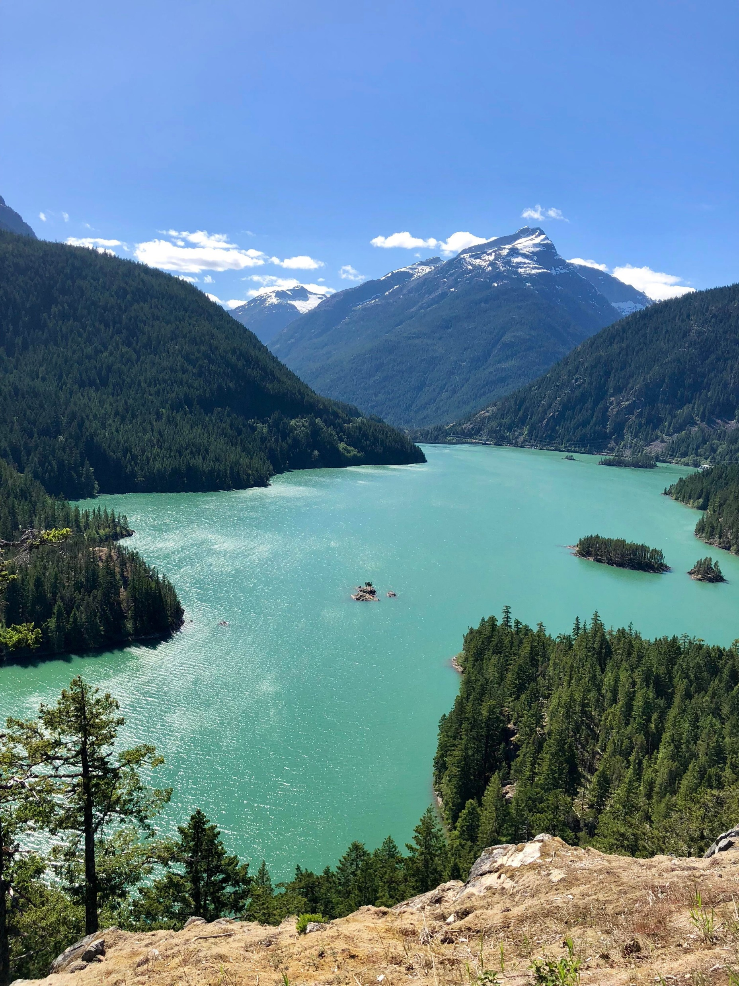
Time for additional comments, discussion
Now that we are at the end of the CCA workshop series, we have included some additional time for parties to address any outstanding topics from the past workshops
As a participant in this workshop series, do you have any other points or concerns you would like to share?

Slide 20
Upcoming Rulemaking
Considering release of either Policy Statement or change of rules to provide guidance on CCA related issues
Issues being identified through workshop series and future discussions
Allows Commissioners to have substantive discussions with each other regarding guidance to be issued through this rulemaking
Future process or schedule for rulemaking have not been determined yet, waiting on receipt of public comments

Slide 21
Thank you for joining!

