Slide 1
Outreach, Assistance, and Disconnect Overview

Slide 2
Agenda
Outreach Efforts
Assistance Provided
Disconnect Process

Slide 3
Outreach Update: April – July
Calls
17,597Automated Calls placed
Emails
18,973 sent
Letters
56,001 mailed
Website
Other
Social Media
24% (answered)
44% (voicemail)
49% open rate
Door Tags (over 1400 placed)
10,100 views of CNG Energy Assistance Page (approx. 8,300 directly to EA page)
CBOs
33,037 Manual calls placed since 4/1/20 (14,510 customers called)
6,706 Manual calls since 4/1/21
Radio
Bill Onserts

Slide 4
Outreach to Low-Income and Under Served Communities
Big Heart Automatic Grants totaling over $598k provided to over 2k customers who previously received Energy Assistance
CNG partners with 6 Tribal Communities – Big Heart information provided to 3 who responded
Big Heart information provided to the following Community Based Organizations
Work Source
Adonai
Refugee & Immigrant Service NW
People for People
Department of Youth, Children, and Families
CNG Consumer Specialist continuing to attempt to develop partnerships with additional CBOs

Slide 5
Outreach Response
Response for BHG #2 (non-auto) by outreach type based on those willing to share.
Top 3 outreach types are:
Letter
Agent
Bill Insert/Onsert
This information is a manual process.

Slide 6
Big Heart Program Overview
Self-Certify
$2,500 Limit up to Total Amount Due
<200% FPL
Auto-Apply
$2,473,250
Multiple Grants Available
Minimum burden and barriers to participate.
Doesn’t disqualify customers from other assistance, nor ask for payment upfront.
Two types of grants: Automatic Hardship and Financial Hardship (Customers who verbally express hardship receive assistance based on benefit curve to determine grant amount).
Time Payment Arrangements (TPAs) for outstanding balances (18-months for Residential; 12-months for Commercial).

Slide 7
Assistance Provided
BHG #1 (auto) funds spent - $598,105; grants issued - 2,132; average payout - $280.54.
BHG #2 (non-auto) funds spent - $1,228,532; grants issued – 3,393; average payout - $362.08.
Total funds spent $1,826,638; total grants issued – 5,525; average payout - $330.61; 75% of total assistance funds spent.

Slide 8
Arrears by the Numbers
Residential
Commercial/Industrial
 | May 2021 | June 2021 | July 2021
# of Accts | 16,353 | 16,051 | 15,742
Total Arrears | $2,993,433 | $2,576,711 | $2,233,306
31-60 Days | $931,204 | $486,054 | $413,185
61-90 Days | $546,388 | $522,134 | $251,273
> 90 Days | $1,515,842 | $1,568,524 | $1,568,847
June 2021 | July 2021
1,859 | 1,919
$1,241,735 | $1,236,148
$210,855 | $211,679
$206,856 | $115,597
$824,022 | $908,872

Slide 9
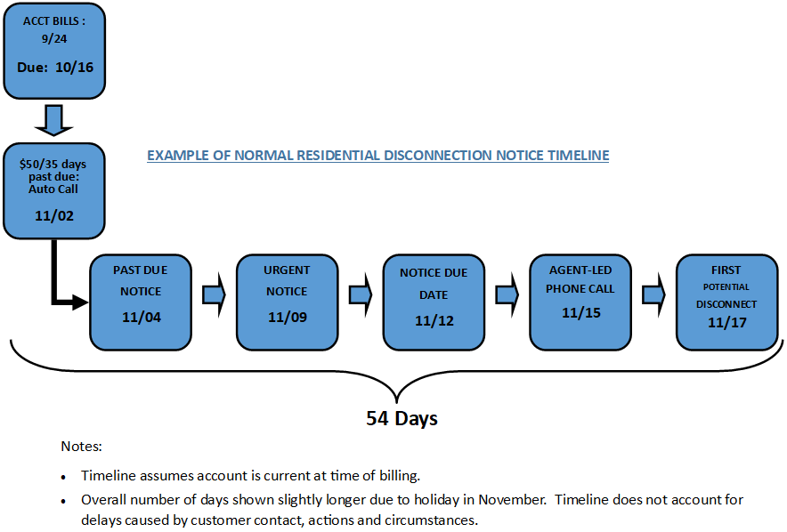
CNG Normal Collections Process

Slide 10
Steps Taken to Avoid Disconnects
When a residential account meets the debt criteria of $50.00 and 35 days past due, the account enters into a collections process and the following events occur:
1. Automated call.
With verification the customer can receive account balance information to avoid interruption of service or a message is left asking the customer to contact CNG Customer Service.
2. Disconnection of Service notice
Written notice that serves as an initial past due notice.
3. Urgent Notice
If no payment is received or payment arrangement (TPA) established, a second notice is mailed.
4. Start Severance Process
If none of the above listed measures result in payment or TPA, CNG Credit agents manually review the accounts flagged for disconnection.
Accounts are filtered based on a calculation that includes risk factors such as: how long the account has been in service, how long it’s been since the account last received payment, and the % of account balance covered by the last payment.
Only those accounts most at risk for write off based on these and other risk factors are considered for disconnection.
Payment Plans can be initiated by our customers at any time through many self-service channels. Customers can create pay plans online, through our telephone IVR or by talking with a Credit or Customer Service Representative.
A manual call from a Credit agent is made each time the terms of an arrangement are not kept.
allows the customer the opportunity for renegotiation
provides the utility opportunity to discuss energy assistance options that may be available to the customer.
A manual call from a Credit agent is made on all accounts considered for disconnection which provides a level of thoroughness that is not achieved solely through unattended, automated calls.
This manual attempt is made at least a full business day before disconnection and our agents continue to work with customers to discuss assistance options, give them time to pay or make reasonable payment arrangements to avoid disconnection.
CNGC does not utilize third-party collection services on active accounts.

Slide 11
COVID Variations to Collection & Communication Processes
All automated collection processes were stopped. No disconnect notices were sent to past due customers and no services have been disconnected for non-payment.
CNG Credit agents continued to make manual outbound call attempts to past due customers with the sole purpose of educating on assistance options that might be available to discuss extended payment arrangement options.
33,037 manual outbound call attempts since 4/1/20 (14,510 Customers)
All CNG Customer Experience Team employees were trained on new Federal and State assistance options and extended Payment Arrangement processes and directed to proactively offer these options to customers.
CNG established a special task force, known as the CARES Team, to make outbound calls in response to emails from customers expressing concern about paying their bills due to COVID impacts.
Heart Grant in place 4/28/20 – 3/31/21 and Big Heart established effective 4/1/21

