Slide 1
WUTC IRP Rulemaking Workshop
on Transmission and Distribution Planning
March 10, 2017

Slide 2
Levels of System Planning
Facility | Interstate Pipeline (Transmission) | High Pressure Feeders (Distribution) | Low Pressure Feeders (Distribution) | Low Pressure Services (Distribution)
Owner | Interstate Pipeline Company | Local Distribution Company | Local Distribution Company | Local Distribution Company
Delivery Area | Utility Service Territory | Multiple Neighborhoods | One Neighborhood/ Street | Single Building
Planning and Construction Time | 3-10 years | 1-5 years | 6 months - 2 years | weeks to months
Cost | $$$$ (>$100 million) | $$$ (<$50 million) | $$ (<$5 million) | $ (<$10 thousand)
Demand Driver | Large Planned Loads (Customer Contracts) | New and Existing Neighborhood Growth | Existing Neighborhood Growth | New Residential or Commercial Customer

Slide 3
Forward-Looking Distribution System Planning
Supply: Model distribution system based on actual pipe placement and specifications
Demand: Forecast peak hour usage for the area in question
Simulate system under peak conditions and/or use field measurements during cold periods
Apply system planning criteria to identify areas of concern
Ongoing field monitoring of pressures and customer growth informs which areas to investigate
Develop alternatives to address issue
Determine the lowest-cost/risk alternative to meet customer needs

Slide 4
1. Supply: Model Distribution System

Slide 5
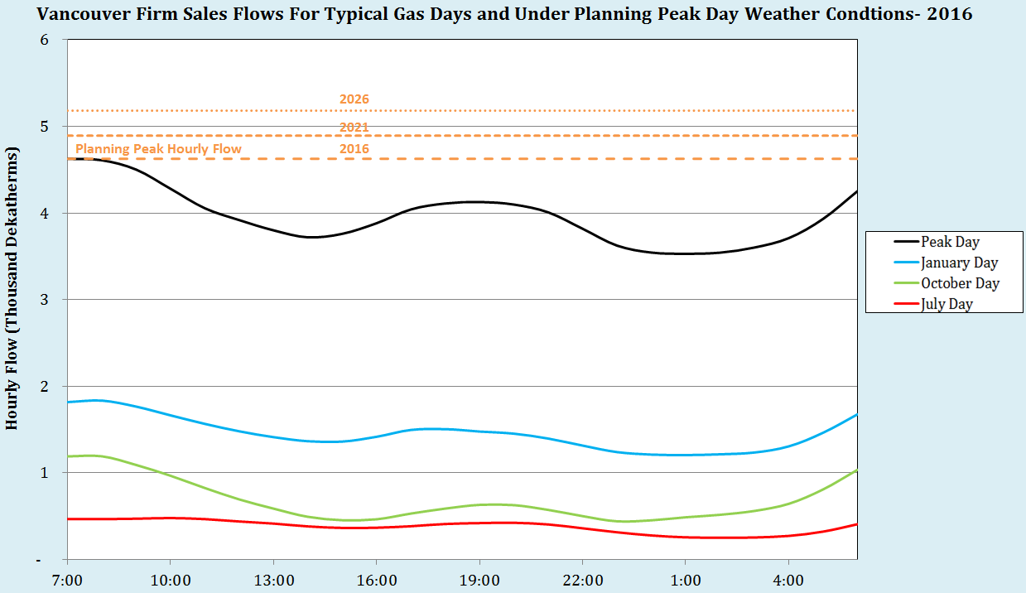
2. Demand: Forecasting Peak Hour Load for the local area
Load forecast incorporates all expected savings from energy efficiency

Slide 6
3. Simulate Distribution System Under Peak Hour Usage

Slide 7
4. Apply System Reinforcement Criteria
Transmission and High Pressure Distribution Systems:
Design parameters set to Peak Hour load requirements.
Experience at least a 30% pressure drop: investigation to be initiated.
Experience or model indicates a 40% pressure drop: reinforcement critical (40% pressure drop = 80% decline in capacity).
For pipelines feeding other high pressure systems: consider minimum inlet pressure requirements for proper regulator function in addition to total pressure drop.
Reinforce systems where near-term growth is anticipated or identified by leading indicators (e.g. new road construction, subdivision or planned industrial development).
Meet pressure requirements of firm service customers.
IRP identifies supply requirements or needs.
Distribution Systems:
Design parameters set to Peak Hour load requirements.
Experience minimum distribution pressures of 15 psig: initiate investigation.
Experience or model minimum distribution pressures of 10 psig: reinforcement is critical.
Reinforce systems where near-term growth is anticipated or identified by leading indicators (e.g. new road construction, subdivision or planned industrial development).
Meeting pressure requirements of firm service customers.

Slide 8
5. Develop alternatives to address issue
Supply-side alternatives
Additional pipeline infrastructure
Increase capacity of existing pipeline infrastructure (uprating)
Mobile/Fixed LNG storage
Mobile/Fixed CNG storage
Other storage solutions?
RNG (if ideally located)
Demand-side alternatives
Customer-specific and geographically-focused interruptibility agreements
Targeted Energy Efficiency (more on this later)
Direct load control?
Time of use pricing?

Slide 9
5. Example Supply-side solution
Camas Loop Reinforcement

Slide 10
What is “Targeted” DSM and how is it different than typical Energy Efficiency?
Doing something different in a specific location compared to what is done in the state as a whole to acquire more DSM/EE (or at least acquire DSM/EE faster) than would take place in the location with state-wide programs.
This can be achieved by either “Accelerating” or “Enhancing,” or Accelerating and Enhancing, DSM program offerings for the location in question.

Slide 11
What are “Accelerated” and “Enhanced” DSM/EE?
“Accelerated” DSM/EE is speeding up the timeline to acquire savings which meet current cost-effectiveness requirements (based on state-wide avoided costs) in a local area with location specific targeted marketing and/or increased incentives.
Acquiring DSM/EE savings that would be acquired eventually through state-wide operations faster in the locality in question.
“Enhanced” DSM/EE savings are savings that do not meet current cost-effectiveness requirements (based on state-wide avoided costs) but are cost-effective if location-specific avoided costs are used to represent the value of achieving peak hour savings from DSM/EE in the local area that is experiencing a distribution system weakness.
Acquiring DSM/EE savings in the local area that are cost-effective using local avoided costs that are not cost-effective under current state level planning using state-wide avoided costs.

Slide 12
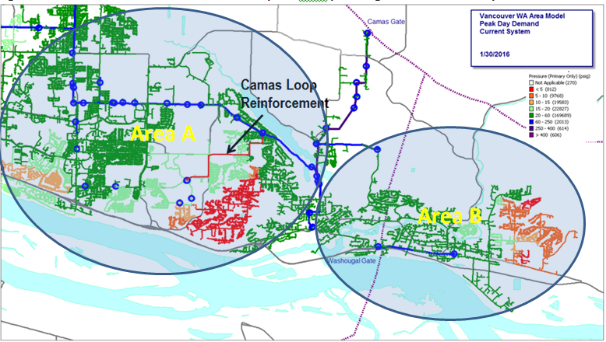
How is Area for Targeted DSM Program Determined?

Slide 13
Targeted DSM Pilot Research Questions:
What amount of peak day hour savings do different measures provide?
What DSM measures should be considered for targeted DSM initiatives?
How firm/reliable and long lasting are Targeted DSM peak hour savings?
How fast can Targeted DSM savings be achieved?
What cost-effectiveness framework is appropriate for evaluating Targeted DSM initiatives?
How much do Targeted DSM peak hour savings cost?
How viable is it to run location specific DSM programs?
How do customers respond to offerings available to some customers but not others?
What is the likelihood changes in load ultimately render Targeted DSM expenditures unnecessary or inadequate to delay/avoid a supply-side project?
What are the appropriate funding mechanisms for Targeted DSM programs?

Slide 14
Current Limitations in Distribution System Planning:
High frequency metering throughout our distribution system is limited
Peak hour load is forecasted from gate stations (Northwest Pipeline interconnection points) and large industrial customer flows as opposed to individual customer usages
Lack of appropriate metering capability for residential customers
Smallest increment meter in service today measures usage in 1 therm increments but average residential customers use far less than 1 therm per hour under normal conditions
Forecasting changes in distribution system requirements is difficult and uncertain
Identifying specific locations where customer growth will occur is challenging
Uncertainty regarding peak hour load forecasting generally increases as the size of the area being forecast decreases
Demand-side capacity options for natural gas distribution systems are not well studied
Costs and risks not fully developed

Slide 15
Questions?

