Slide 1
Cascade Natural Gas Corporation Revised Hedging Program UG-132019 Gelber & Associates Corp. December 14, 2018
Notes:
Thank you for giving us the chance to talk to you today. This is an important topic. I am Arthur Gelber. I am president of Gelber & Associates. We have been retained by Cascade Natural Gas to assist in the evolution of their hedging program and to be compliant with the policy put forth in UG-132019

Slide 2
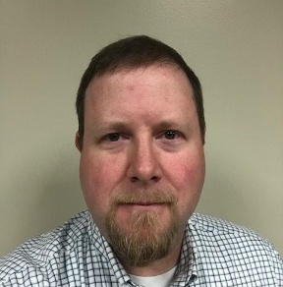
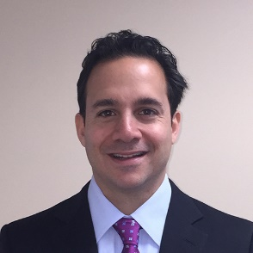
Cascade’s Hedging Project Leadership Team
Chris Robbins,
Manager of Gas Control & Supply for the Western Region
Arthur Gelber,
Consultant
Mark Sellers-Vaughn, Manager of Supply Resource Planning
Kent Bayazitoglu, Consultant
Eric Wood, Supervisor of Gas Supply
Notes:
The Cascade Hedging Project team is led by Chris Robbins (Manager of Gas Control and Supply Western Region) with additional key leadership from Mark Sellers-Vaughn, Eric Wood and their respective staff members. I have been helped by Kent Bayazitoglu, who is here today (Kent shows himself) and another of my staff members named Daniel Myers. Daniel is not present today but is dialed in.

Slide 3
Gelber & Associates
Based in Houston, TX
Natural gas specialist since 1990
Working with utilities since 2000
We’ve worked in 35 states nationwide
Design, implement and manage the natural gas hedging programs for utilities and large gas consumers
First worked with Cascade on a portion of their IRP in 2014
Recognized as utility hedging “Best in Class” by the Colorado PUC in 2017
Notes:
Assuming for now that you know the Cascade people, G&A was recognized by the Colorado PUC in 2017 as “Best in Class” asking us to keynote a Commissioners Workshop to educate the other utilities in how we operated our hedging program for Atmos Energy in Colorado. As the Commissioner said when she introduced me “we did that much better”. In short, we are in Houston, we have been doing this for 30 years and with regulated utilities for 20 years where we design, implement, and operate hedging programs for utilities and other large natural gas consumers. We first worked with Cascade on one of their IRP’s in 2014 doing some heavy Excel modeling.

Slide 4
Importance of the Winter
Like most utilities Cascade, customers’ usage of natural gas is appreciably higher in the winter months
Accordingly, a high percentage of market exposure is related to the winter cost of gas
The winter costs of gas is often related to how cold the winter is…but other macro forces are also pertinent
Notes:
Transitioning now away from program features to talk for a short bit on the topic of utility hedging. Most utility hedging performance occurs in the winter months because usage is so much higher. If you can manage the winter right, that’s 80% of the ball game.

Slide 5
Winter Drives Load Profile
Notes:
Not surprisingly, Cascades volumes for the design year are winter volumes as shown by this simplified representation of their monthly load profile. It is decisively not true that because it is colder in the winter than in the summer that prices are higher in the winter than the summer.
But it is true that Cascade’s usage is much higher. It is common across the country, and will be true for Cascade, that most of their hedging for the winter months will get done in the summer. But the window is also open in the winter, especially when prices depress before the beginning of the injection season and when forward prices are as advantageous as they are today.

Slide 6
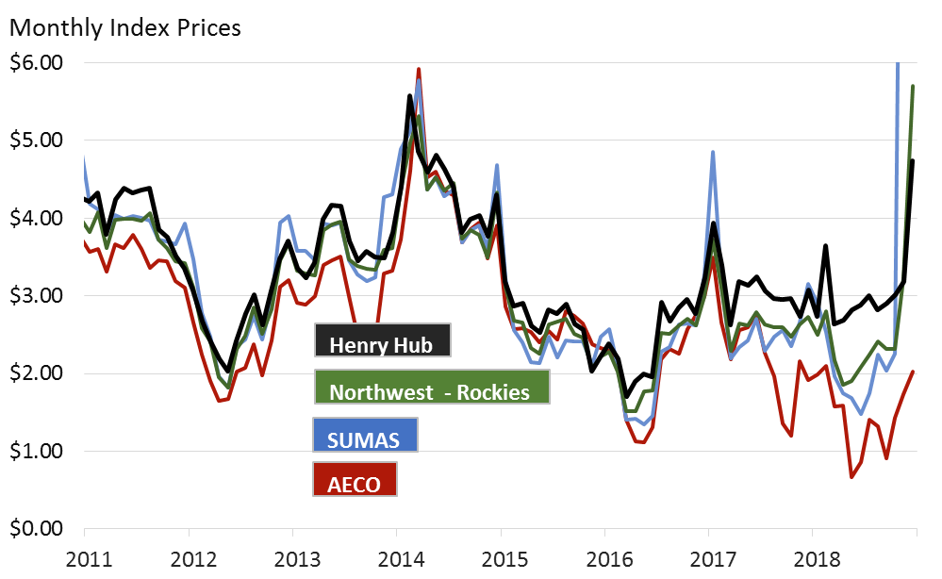
Location Matters as Northwest prices break from NYMEX (Henry Hub, Louisiana)
At this time hedging only with Henry Hub NYMEX may not give adequate price protection
Correlations have potentially distorted since the AECO supply glut and Enbridge outage
NW Rockies has good historical correlation with NYMEX
*Latest two Sumas prices are above the range of chart.
Notes:
Hedging in Washington State does not necessarily work properly simply using NYMEX Henry Hub. Effective hedging may require locational stability as well. Correlations to NW Rockies, Sumas, and AECO had been very good for a long time until recently. Since early 2017, AECO correlations began to break down which dragged down both Sumas and NW Rockies in a supply glut. This feature got especially noticeable in 2018. AECO correlations dislocation recently have been overshadowed by the Enbridge outage wrecking havoc on the supply picture. How to properly and cost-effectively manage the uniqueness of the Cascade supply basins is a feature which needs additional work.

Slide 7
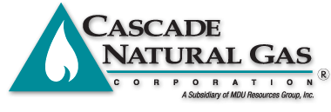
Current Cascade Hedging Plan
Buy forward up to 80%, but hedge price up to 40%
Physical supply design based on a three year ladder
Year 3 – 20% maximum
Year 2 – 25% maximum
Year 1 – 40% maximum
Fixed priced physicals are primary tool
GSOC oversight
Notes:
The current Cascade hedging plan is primarily comprise of fixed priced physical deals looking three years forward looking. 20% of the Cascade gas is reserved for daily gas, not hedged

Slide 8
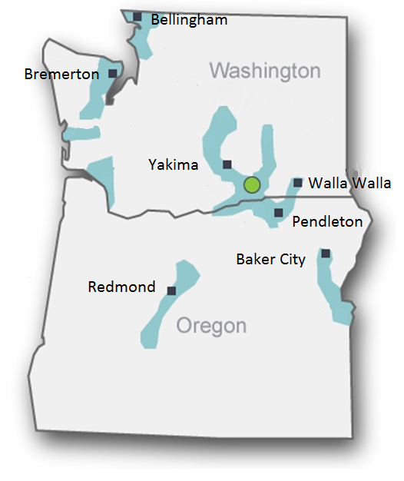
The Cascade Utility Hedging Project
Driven by UG-132019 Policy Statement
Designed to be risk responsive
Designed with constructed baseline quantitative metrics
Risk responsive features
Variable annual hedging volume between 15% minimum and 60% maximum
Flexibility between call options, fixed price swaps, or fixed price physicals
Ability to delay or accelerate purchase volumes within the structural design to take advantage of price lows and avoid price highs
VaR_{up} and VaR_{down} calculations to measure risk exposure
Notes:
The map on the right is informational. Policy Statement UG-132019 is chocked full of guidance. But there are two features I will highlight: 1. risk responsive, 2. quantitative metrics and two things that are no-nos 1. not speculative and 2. not blindly programmatic. When I first read the Policy Statement in early 2017, I told Mark that risk responsive is another way of “pay attention” and make the changes necessary to adjust to changing markets. In Colorado, we have made several major changes in our hedging program since 2008 to adjust to downward prices such adding call options to the allowed hedge mixture and greater flexibility to push adjust how and when we apply our required hedge volumes. Here are the principal features of the Cascade Proposed Hedging Program which are risk responsive: 1. variable volume between a min and a max
2. Flexibility between the choice of call options or fixed priced deals (swaps and physicals), 3. the ability to delay or accelerate anticipated purchases to adjust to price swoons and price spikes (buy the swoon, don’t buy the spike) and 4. Var up and VaR down calculations linked directly to the procurement trade log.

Slide 9
Hedging the last 20 years
Hedge Savings
Strictly Programmatic Hedging lowers volatility*
Hedging produces savings from 1998 to 2008 (hedge gains)
Hedging creates losses from 2008 to 2018
Hedge Losses
*Hedging 100% of purchases, ratably daily from 2 to 3 years away reduces monthly change volatility appreciably when compared to unhedged position
Notes:
By way of a simple price chart, this is why we are here. The price of gas has unashamedly fallen since 2008 creating major hedge losses for utilities who were late to recognize, and be willing to adjust, to the new market. This graphic, to me, has an elegant symmetry to it. There is much good which can be done in today’s market which can benefit the customers of Washington. Hedging was an absolute necessity between 1998 and 2008 when utilities were just getting their skilled in-house resources. Then between 208 and 2018, hedging was very challenging. Now with price so low and demand having grown to out-match new supplies, upward price pressures are returning.

Slide 10
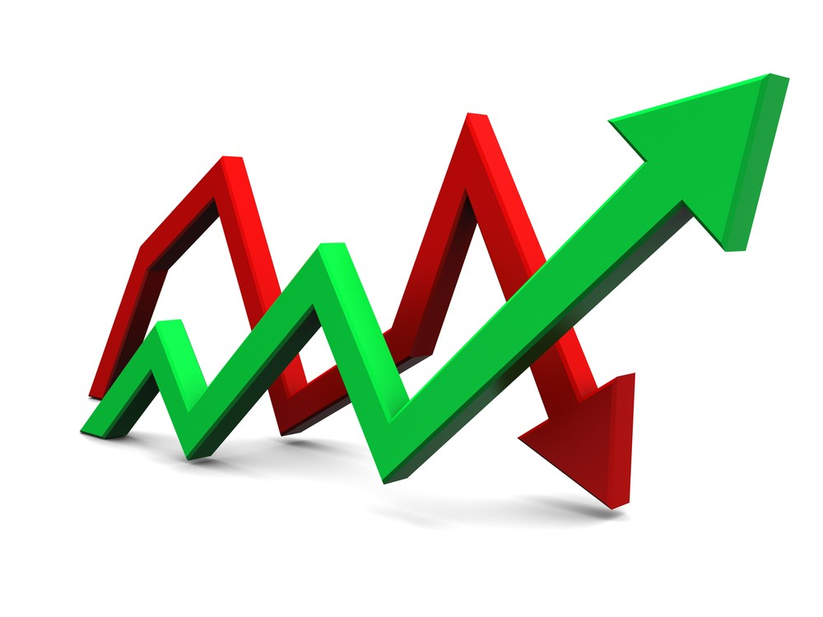
Balancing Upward and Downward Price Risk
Price Goes Up – Unhedged gas costs imperil customers
Prices Goes Down – Hedged gas purchases are higher than market
VaR (Value at Risk) is a statistical way to measure price risk exposure – gives a dollar figure for what could be lost for a given probability
VaR_{up} and a VaR_{down} can be measured and managed
This Photo by Unknown Author is licensed under CC BY-NC-ND
Notes:
The Commission was smart to hire Gettings to write his white paper. It provided a challenge to utilities to be able to manage in both upwards and downward trending market.

Slide 11
Plan Uses a Three Year Ladder
Hedging is designed for three year forward ladder
Hedge volume NOT rigid, flexibility is an element of risk responsiveness
Annual Hedge Execution Plan (HEP) meeting with GSOC to set volume guidelines
Notes:
The plan uses a three year ladder which drives Cascade to hedge more volume as the months get closer to real time. Years beyond 3 are not out of the question, but they are not currently designed into the program except as an exception. An Annual Hedge Execution Plan is convened in the late winter early spring to recommend and receive authority on the hedge volume targets, provide reporting and performance, make necessary changes…more on that in an upcoming slide.

Slide 12
Risk Responsive Tools
Structural
Annual Hedging Execution Plan (HEP)
Monthly Guidance
Approved exceptions
Flexible hedge volumes with boundaries
Analytical
CNGC Book Models – calculates hedged and unhedged volumes, mark to market, VaR_{up} and VaR_{down} Gelber Storage Model – residuals show over/under supplied market
Production models
Stochastic tools
This Photo by Unknown Author is licensed under CC BY-NC-ND

Slide 13
Why Effective
Allows the utility to use their institutional knowledge of the natural gas market
Allows professionals closest to the market to advise with key decisions
Creates a structured framework to drive expectation and constrain activities
Senior management has to authorize annual hedge percentage & strategy
Flexible hedge volumes to balance upward and downward price risk
Tactics are handled by the front-line personnel and the structure of the hedging program
Proven effective over 20 years of developing use
Notes:
This list tells you why the Cascade plan is effective. The top four is because we have the right people doing the right things. The bottom three is because we provide structure and the tools. It is what keeps us in business and has proven effective in a very difficult market for 20 years.

Slide 14
Reporting
Retrospective reporting is performed yearly at the end of the winter period
Meeting with GSOC oversight committee to review the hedging program
Benchmarks for measurement include current hedge valuation
Narrative addressing the execution of the prior year hedging plan
Hedging plan appropriateness discussion
Prospective reporting is performed yearly before the beginning of the upcoming hedging period
Identification of changes in market conditions
Targets established for hedge percentages years 1, 2, and 3
Changes to the hedging program, if necessary
Notes:
Synchronous with the annual Hedge Execution Plan is Program reporting. Reporting is envisioned to be backward facing and forward looking. Retrospectively, how are we doing. Are we adding value? Are we valuable? Prospectively-what can we do to do better, what needs to change, how has the market changed?

Slide 15
Prudence and Paper Trail
All risk responsive hedging will occur within the structure of the designed hedging program
Risk responsive activities will be communicated to oversight and management on a monthly basis in advance of hedging activity
Any exception to the Monthly Guidance will be memorialized in an Exception Document to management and file
Notes:
All risk responsive hedging will occur within the structured designed framework, activities will be communicated to file each month in advance “what did we know at the time we made our decisions”. The design allows for exceptions within the design program as long as the exception is documented in an exception document to management and to file

Slide 16
Operations, Oversight and Guidance
GSOC serves as oversight committee and authority
Gas Supply team operates as front and mid-office for transactions
Accounting operates as the back office for settlement
Resource Planning operates as research, surveillance, and compliance
Notes:
Lastly in the Cascade program, basic oversight and operations features are anticipated as elucidated in this slide. GSOC provides authority. The gas supply team executes as the front office, accounting provides verification and settlement as the back office, and Resource Planning provides research, surveillance and compliance functions. Definitely not “set-it and forget-it”.

Slide 17
Project Milestones
Project team meets
Location Basin Study Completed
Final Corporate Hedging Plan Signoff
VaR Risk Model Roll-out
Hedge Plan Written
Create 2019 HEP (Hedging Execution Plan)
Draft Process Flow Diagrams
GSOC Approves 2019 HEP
Done
2018
NOW
Implement 2019 HEP
Next Steps
2019
Notes:
We have made tremendous advances since we began in May 2018. We have accomplished so much, as this graphic shows. We are coding exclusively in Excel for pragmatic reasons. We have more to do to complete the design phase, begin the implementation phase in early 2019, an move into the operations and training phase. The program is on track. We still have some key design features to work out.

Slide 18
Summary
Revised Hedge Program avoids “set it and forget it” to be more risk responsive
The Program uses the actual Cascade procurement sheet to drive the initial quantitative metric framework
Program features and employed-resources are expected to become more sophisticated over time
Hedging Program complies with policy statement UG-132019
Notes:
In summary, the Cascade proposed hedging program is risk responsive, is not set-it and forget-it. We will use the Cascade procurement sheet to drive the VaR calculations of the quantitative framework. Plan features will continue to evolve over time as employed resources get more sophisticated. Policy Statement UG-132019 is effectively complied with and is integrated into the Hedging Program.

Slide 19
Questions and Discussion
Notes:
How does the Enbridge explosion impact the risk management program?
How are you using stochastics?
What makes the program risk responsive?
Can you describe the quantitative metrics in the Cascade program?
How do you know if the trend is up or down?
What is going on in other states where you are working?
What defines the upper limit for hedging? What defines the lower limit for hedging? How do you know how to move from the minimum to the maximum?

