Slide 1
2017 IRP Overview
Presentation to the WUTC
John Mannetti
Director, Operations Solutions
Phillip Popoff
Manager Resource Planning and Analysis
February 21, 2018

Slide 2
A rapidly changing planning landscape shapes this IRP
The 2017 Integrated Resource Plan (IRP) responds to rapid changes in carbon regulation, technology and regional markets to preserve strategic agility for PSE. The plan delays the need to acquire fossil fueled generation assets as these uncertainties take shape over the next few years.
Resource Plan Takeaways
Newer technologies, including demand response and batteries, coupled with energy efficiency push out the need for additional natural gas fired generation to 2025
In the renewables space, solar appears more cost effective than wind
Redirecting existing transmission for market purchases is a very low-cost source of capacity
Carbon regulation may adversely affect economics of Colstrip 3&4 continued operation

Slide 3
Electric IRP results find investment in solar and newer technologies to be least cost. Natural Gas IRP results point to upgrades and additional pipeline capacity in 2029.
Electric: Cumulative nameplate (MW) capacity additions¹
Gas: Cumulative Additions in MDTH/day of Capacity²
¹PSE 2017 IRP, Figure 1-4 page 1-18
²PSE 2017 IRP, Figure 1-8, page 1-25

Slide 4
PSE made improvements to the IRP process and incorporated stakeholder requests
PSE improved transparency in the IRP process
1
16
30+
Additional employee hired to manage the stakeholder process
IRP Advisory Group Meetings
Responses to detailed technical questions from stakeholders
PSE incorporated numerous stakeholder requests into the IRP
Credit Collections, Field Collections
7 of 13
1
1
Sensitivities analyzed were stakeholder driven
Additional fully integrated scenario
Additional consulting study performed to validate wind and solar costs

Slide 5
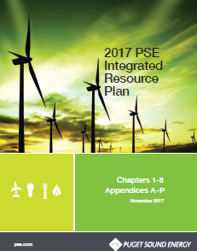
Required by the WUTC, the IRP determines “the mix of energy supply and conservation resources that will meet future and current needs at the lowest reasonable cost to the utility and its ratepayers.”¹
Compliance filing at WA Utility Commission
Filed Every Other Year: Gas and Electric
20+ year look at needs and resources
Determine least cost mix of supply and demand-side resources
Understand how uncertainty affects findings
Actual energy efficiency and supply-side resource decisions are not made in the context of the IRP.
Establish Resource Needs
Planning Assumptions & Resource Alternatives
Make Decisions
Commit to “Action”
Analyze Alternatives and Portfolios
Analyze Results
Analyze Market Risk
1
7
2
6
3
5
4
¹/WAC 480-100-238 (2) (a) Definitions, Integrated Resource Plan.

Slide 6
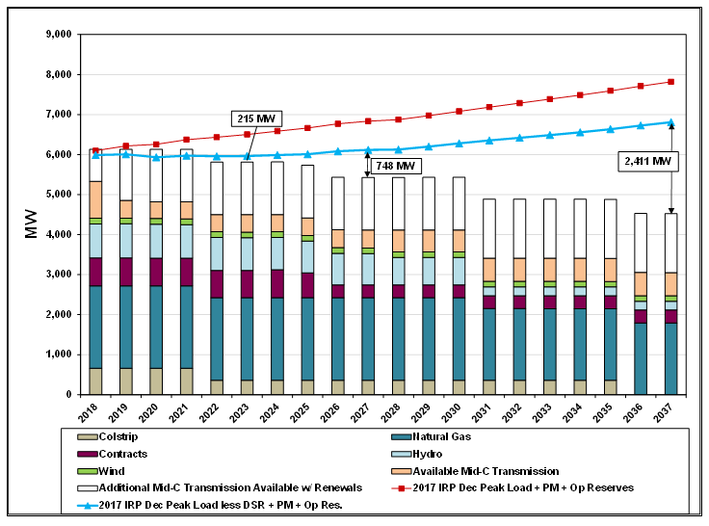
Establish Resource Needs: Electric Peak Hour Capacity Resource Need
1
Projected peak hour need and effective capacity of existing resources
PSE 2017 IRP Figure 1-1, page 1-13
February 21, 2018: 2017 IRP Overview
PSE 2017 IRP Figure 1-1, page 1-13

Slide 7
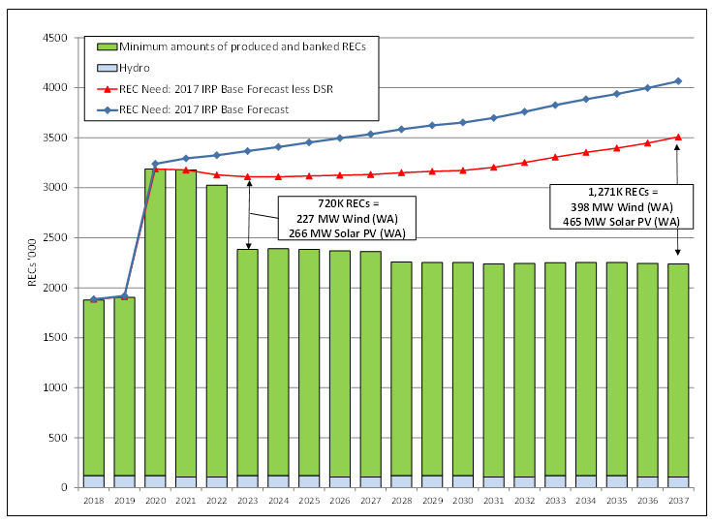
Establish Resource Needs: Electric Renewable Need
1
Renewable Resource/REC Need
PSE 2017 IRP Figure 1-3, page 1-16

Slide 8
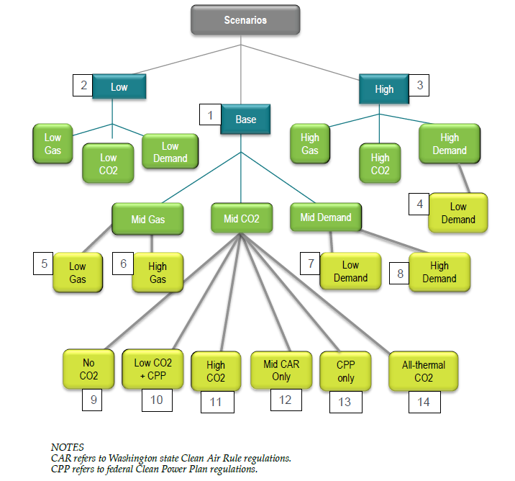
Planning Assumptions & Resource Alternatives: Integrated Scenarios
2
Fourteen fully integrated scenarios were analyzed in the 2017 IRP

Slide 9
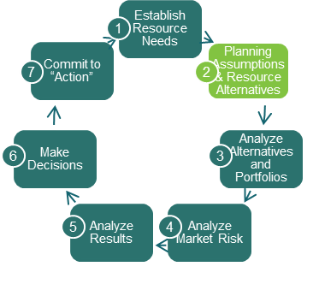
Planning Assumptions & Resource Alternatives: Carbon Regulation
2
Carbon regulation assumptions varied across 14 different scenarios
Base Case Assumptions
Forecasted carbon costs ranged from $19/ton to $51/ton in the base case
Utilized a combination of state and federal rulemakings to forecast carbon prices
Applied Clean Air Rule until 2022
Application to gas utilities and petroleum suppliers invalidated by Court after IRP filed
Applied Clean Power Plan after 2022
Not being pursued by administration
Simplified to WECC CO2 price
Findings / Outcome
Applying a carbon price to all thermal resources (Base + All-thermal CO2 scenario) may be the most aligned with current WA state emissions proposals

Slide 10
Planning Assumptions & Resource Alternatives: Resource Costs
2
Incorporated the latest resource cost and characteristic information
Demand response assumptions updated to improve capacity contribution
Solar and battery costs have declined
Resource cost studies from developers with on-the-ground experience Black and Veatch and DNVGL
PSE needs a detailed cost assumptions to calculate revenue requirements—levelized costs are insufficient
Cost decreases for natural gas-fired peakers and wind
Findings / Outcome
Solar is more cost effective than wind to meet renewable need
Batteries are present in the plan for the first time
Demand response continues to be cost effective, however policy hurdles exist

Slide 11
Planning Assumptions & Resource Alternatives
2
Transmission and Distribution Planning
Responding to stakeholder input, PSE included a large chapter on local system planning describing in detail the planning process and an upcoming transmission projects
PSE anticipates further integration between local system planning and the IRP process and looks forward to rulemakings that may provide further guidance
Findings / Outcome
Inclusion in IRP will require new processes and education to incorporate effectively.
DER technology effectiveness in meeting grid needs is maturing and PSE will continue to incorporate through least cost solution objectives

Slide 12
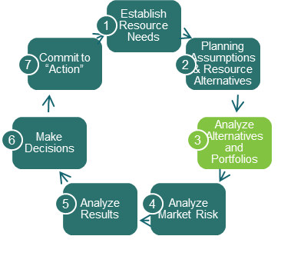
Analyze Alternatives and Portfolios
3
Portfolio optimization results by resource type
Conservation
Cost-effective conservation does not vary across scenarios. This is consistent with findings in prior IRPs.
Demand Response
All scenarios have at least 60 MW of demand response, with a few scenarios having as much as nearly 160 MW.
Transmission Redirect
Increasing market reliance by redirecting 188 MW of transmission from Hopkins Ridge and Lower Snake River is least cost across all scenarios and sensitivities.
Energy Storage
A small amount of utility-scale batteries appears cost effective at some point in the planning horizon in every scenario, given the assumed transmission and distribution benefits. By 2037, all scenarios have at least 50 MW, while a few have approximately 100 MW.

Slide 13
Analyze Alternatives and Portfolios
3
Portfolio optimization results by resource type
Eastern Washington Solar
Solar appears to be the most cost-effective renewable resource to comply with RCW 19.285. PSE is a winter peaking utility, so solar provides virtually no capacity value.
Montana Wind
Wind in eastern Montana would not be a qualifying renewable resource under RCW 19.285, unless it were delivered all the way to Washington state on a real-time basis without shaping or storage. This is a resource that could be identified as more cost effective in the upcoming RFP.
Pacific Northwest Wind
Wind in the Pacific Northwest did not appear to be a cost-effective resource in any scenario. Again, this resource may prove to be more cost effective in the upcoming RFP.
Peakers & Baseload Gas Plants
Dual fuel frame peakers were found cost effective over baseload gas plants in almost every scenario. Most scenarios show peakers as the go-to capacity resource later in the planning horizon, however this is also a result carbon regulation affecting baseload plants but not peakers. There are no baseload gas plants in the resource plan.

Slide 14
Analyze Alternatives and Portfolios: Sub-hourly Flexibility
3
PSE made significant improvements in sub-hourly flexibility modeling that will be leveraged in future IRPs
Purchased Plexos and hired E3 to perform analysis
Two Key Questions Explored:
Does the resource portfolio have Adequate Flexibility?
Results showed it is not likely that PSE needs to add resources just for flexibility
What is the value of sub-hourly flexibility benefit?
Adding different and more flexible resources such as reciprocating engines and energy storage decreased the total production cost and added more flexibility to the portfolio
Findings / Outcome
Continued focus for the future:
Resource Planning Team is currently analyzing key portfolio questions in Plexos, so we are up and running on our own
PSE will continue to refine assumptions and improve modeling capability

Slide 15
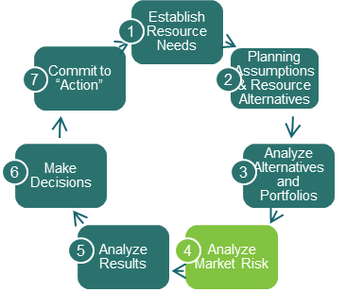
Analyze Market Risk
4
Understanding market risk is critical because PSE relies on the short-term market to meet peak capacity needs
Updated analysis of wholesale market risk leveraging NPCC and BPA regional studies
Results showed that market capacity purchases are nearly as reliable as a gas peaker, however this is dependent on regional conservation keeping pace with the NPCC 7th Power Plan
Additionally, PSE’s participation in the EIM has created opportunities to look at optimizing our transmission resources differently
Findings / Outcome
Redirect 188MW of firm transmission from LSR/Hopkins Ridge to Mid-C
Action Plan item to develop options to mitigate risk of market reliance

Slide 16
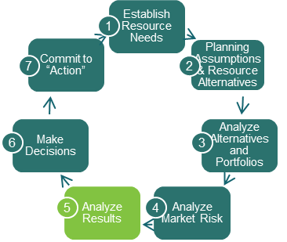
Analyze Results: Carbon Regulation
5
The form of carbon regulation affects portfolio cost and resource decisions:
There are unintended consequences created by base case carbon regulation:
Carbon price only assigned to gas CCCT, not gas peakers
Renders Colstrip uneconomic—only under CPP, not CAR
When carbon regulation is applied across all gas resources, demand response and batteries are cost effective
Findings / Outcome
IRP Results Still Valid:
Resource plan recognized this unintended consequence and took results of the unbiased application of carbon regulation, which causes an insignificant increase in cost, but pushes out need for fossil fuel plants so technology and policy can continue to work

Slide 17
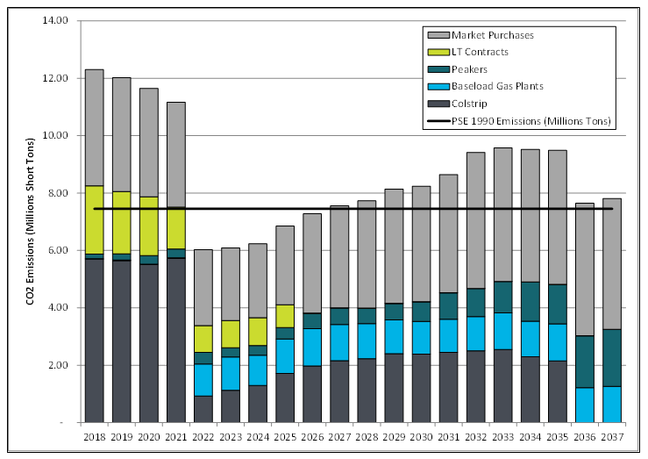
Analyze Results: Carbon Regulation
5
Portfolio CO2 Emissions From Electric Service
Projected Annual Total PSE Portfolio CO₂ Emissions and Savings from Conservation
PSE 2017 IRP Figure 2-4, page 2-7

Slide 18
Analyze Results: Colstrip
5
Replacing Colstrip 1&2 will not result in additional fossil generation being acquired
PSE examined replacement options for Colstrip units1&2 as well as the effect of a carbon price on Colstrip units 3&4
PSE also examined early retirement sensitivities for Colstrip units 3&4 as requested by stakeholders
Findings / Outcome
Colstrip units 1&2 shutdown in 2022 will not create a need for additional fossil resources. The plan shows it would be cost effective to replace units 1&2 will with a combination of conservation, demand response, redirected transmission and batteries
Continued operation of units 3&4 is highly dependent on environmental regulation. Placing a carbon price on plant dispatch for units 3&4 could adversely effect the plant economics to where it would be more cost effective to replace it with other resources

Slide 19
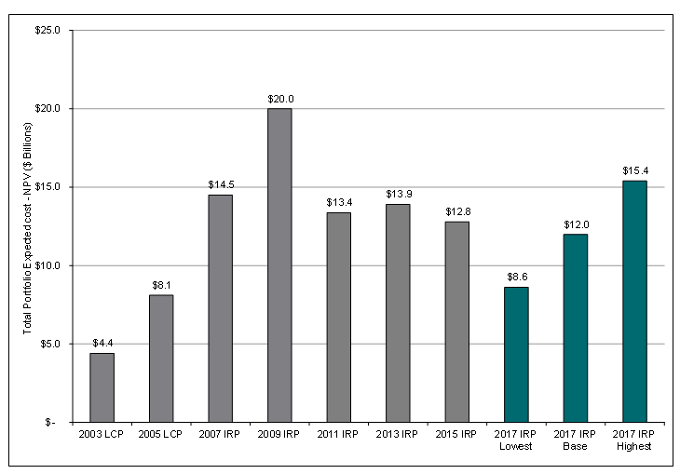
Analyze Results: Portfolio Costs
5
Incremental Portfolio Costs Over Time are consistent with recent IRPs
PSE 2017 IRP Figure 2-4, page 2-7

Slide 20
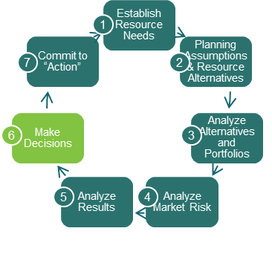
Make Decisions: Electric Resource Plan
6
The application of judgement – bringing together a resource plan
Resource Plan Compared to Base Case:
The resource plan includes more demand response and early batteries in order to delay the need for peakers until 2025.
This decision comes at a slight premium. Expected cost of the resource plan is 0.5% higher than the base case portfolio (roughly $50 million over the planning horizon).
PSE views the slight increased cost of demand response and energy storage, as an important risk mitigation decision as the state considers future carbon regulation.
Pushing out the need for additional fossil fuel plants to 2025 or beyond is a reasonable strategy. This will provide time for technology to work on reducing alternative resource costs as well as time for carbon regulations to become clearer.

Slide 21
Make Decisions: Gas Resource Plan
6
The application of judgement – bringing together a resource plan
Demand-side Resources (DSR)
Analysis applies a 10-year ramp rate for acquisition of DSR measures
Swarr Upgrade - 2024/25 heating season
This IRP finds that upgrading the Swarr LP-Air facility’s production capacity to Swarr’s original 30 MDth per day capability
PSE LNG Distribution Upgrade - 2027/28 heating season
Expansion of the distribution network’s capacity east of Tacoma that will allow more gas to flow from the LNG facility into PSE’s gas supply network
Northwest Pipeline/Westcoast Expansion - 2029/30 heating season
Additional transportation capacity from the gas producing regions in British Columbia at Station 2 south to PSE’s system on the Westcoast pipeline

Slide 22
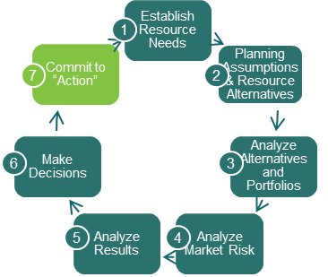
Commit to Action
7
Electric Action Plan:
1. Acquire Energy Efficiency
Develop two-year targets and implement programs that will put us on a path to achieve an additional 374 MW of energy efficiency by 2023 through program savings combined with savings from codes and standards.
2. Demand Response
Clarify the acquisition, prudence criteria and cost recovery process for demand response programs and issue a demand response RFP. Re-examine the peak capacity value of demand response programs in the 2019 IRP to include day-ahead demand response programs, and use the sub-hourly flexibility modeling capability developed in this IRP to value sub-hourly demand response programs.
3. Energy Storage
Install a small-scale flow battery to gain experience with the operation of this energy storage system in anticipation of greater reliance on flow batteries in the future.

Slide 23
Commit to Action
7
Electric Action Plan (continued):
4. Supply-side Resources: All-source RFP
Issue an all-source RFP in the first quarter of 2018 that includes updated resource needs and avoided cost information. PSE has a need for renewable and capacity resources as early as 2022, after cost-effective conservation and demand response are accounted for.
5. Develop Options to Mitigate Risk of Market Reliance
Develop strategies to mitigate the risk of redirecting transmission and increasing market reliance.
6. Energy Imbalance Market (EIM)
Continue to participate in the California Energy Imbalance Market for the benefit of our customers.
7. Regional Transmission
Examine regional transmission needs in the 2019 IRP in light of efforts to reduce the region’s carbon footprint.

Slide 24
Commit to Action
7
Natural Gas Sales Action Plan:
1. Acquire Energy Efficiency
Develop two-year targets and implement programs to acquire conservation, using the IRP as a starting point for goal-setting. This includes 14 MDth per day of capacity by 2022 through program savings and savings from codes and standards.
2. LNG Peaking Plant
Complete the PSE LNG peaking project located near Tacoma:
Construction of the facility is under way and should be completed in time for the storage project to be filled for the 2019/20 heating season. This resource is essential to delaying investment in additional interstate and international year-round pipeline capacity.
3. Option to Upgrade Swarr
Maintain the ability upgrade the Swarr propane-air injection system in Renton, which the plan forecasts will be needed by the 2024/25 heating season.

Slide 25
Next steps
Request for Proposals to be conducted in Q2 2018
WUTC acknowledgement letter
Launch of 2019 IRP process in Q2 2018 (Work Plan in July 2018)
Continuous improvement to incorporate new rule changes to the IRP process, better tools for IRP modeling, improved stakeholder education, engagement and communication, and improved collaboration with UTC.

Slide 26
Q&A

