Slide 1
WA Utilities and Transportation Commission EV Workshop
Matt Babbitts, Clean Energy Program Manager
July 2nd 2024

Slide 2
Utility EV Program Overview
Transportation Electrification (TE) Plan adopted in early 2021, allowed for the creation of our customer facing EV programs
Legislative mandate on annual TE Budget (1/4 of 1% of revenue requirement), current annual budget of $800,000
Level 2 Charger Programs
$500 rebate available to residential and business customers; more than 2,500 customers have participated, we also offer an online marketplace with Enel-X (JuiceBox chargers)
DC Fast Charger Demand Credit Program
Annual account $1,500 credit for each separately metered DC fast charger
EVSE Grant Program
50% of project cost grants available to public agency customers who install publically accessible EVSE
Low-Income Used EV Program
Income qualification at 300% of FPL, rebate is 10% of purchase price of used Battery EV (BEV)
Clean Fuel Standard Programs (new in 2024)
Designed to meet Ecology’s rules; focus on school district bus electrification and multifamily EV charging infrastructure

Slide 3
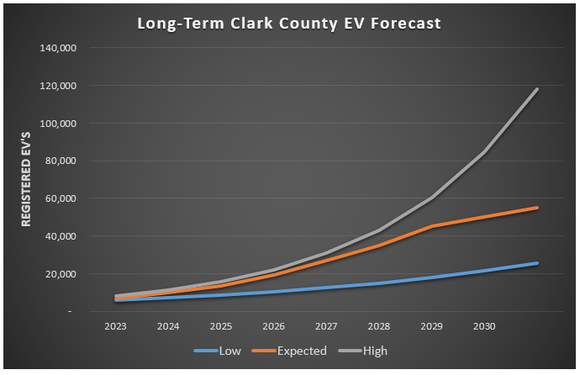
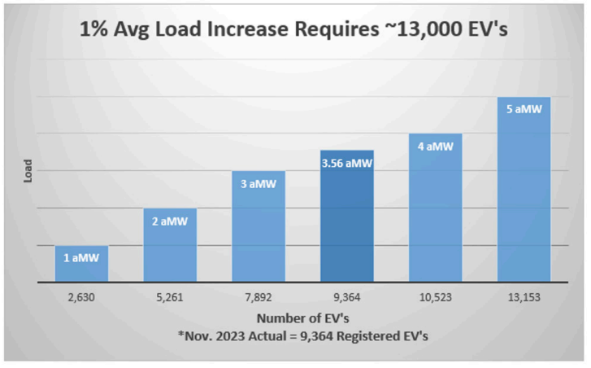
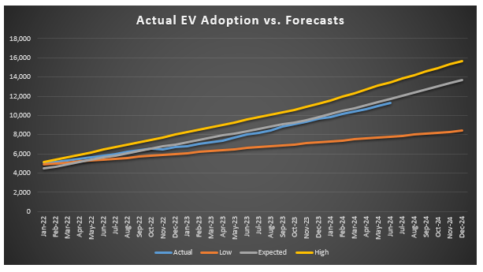
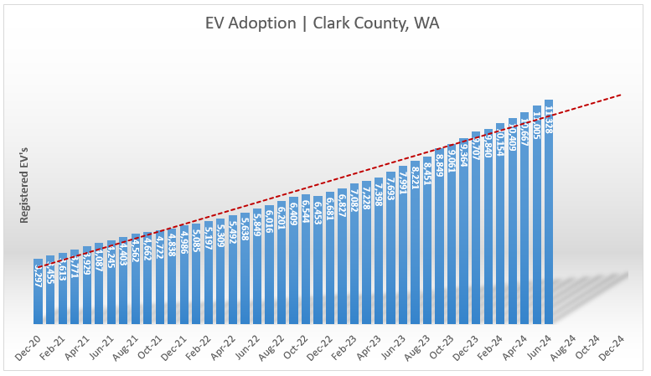
Clark County EV Adoption & Forecasts
Annual YOY growth has averaged ~45% over the last few years
Anticipate future state/federal policies to drive increased adoption
Every ~13,000 EVs results in 1% average load growth
Energy demand is manageable
Capacity and locational challenges exist

Slide 4
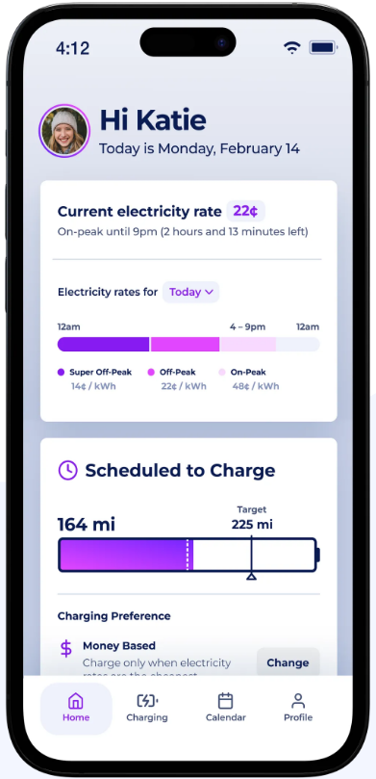
Residential EV Managed Charging
EV owner customers provide an opportunity to pilot DR programs while increasing customer satisfaction
EV owners tend to have an increased understanding of the electric sector complexities
EV owners want EV charging programs and desire to play a role in our decarbonization efforts
After several vendor demonstrations we selected Optiwatt for this small EV managed charging pilot program
Winter vs. Summer DR Events (Telematics based)
Winter Events: Weekdays only, EV charging blocked 6:00am to 10:00am
Summer Events: Weekdays only, EV charging blocked 4:00pm to 8:00pm
No events in April, May, and October
Customer Participants and Incentives
Goal of 800 EV registrations by residential customers
Participating customers earn a total of $50 in bill credit incentives ($25 up front, and $25 in Dec.)

Slide 5
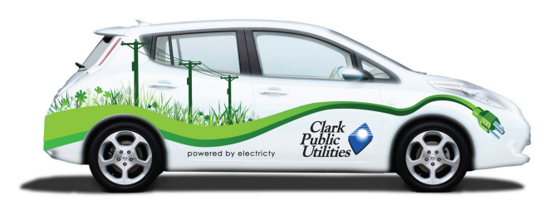
TE Barriers and Future Considerations
TE load growth while meeting decarbonization mandates
CETA and the CCA mandate steep reductions in GHG emissions, TE load growth adds additional pressures
Managed charging and other demand response programs will be a crucial piece of the solution
Equity considerations; ensuring the benefits of TE for all customers
Increasing focus on community engagement with customers and local Community Based Organizations to ensure new efforts/programs meet community needs
Clean Fuel Standard revenues will be beneficial
Distribution system upgrades
Current EV adoption has not been impactful but we are focused on future challenges created by concentrated adoption (transformer upgrades, etc.)

Slide 6
Thank you! Q&A
Matt Babbitts
mbabbitts@clarkpud.com
(360)992.3365

