Slide 1
November 2015 Windstorm Overview – Docket No. UE-160056
March 24th, 2016

Slide 2
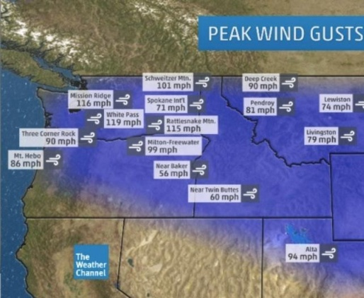
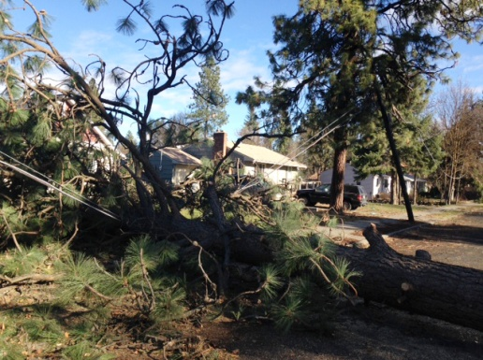
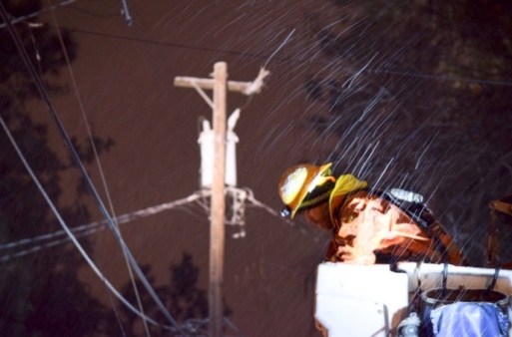
Windstorm 2015
Peak gusts in Spokane on Nov. 17, 2015 were recorded at 71 mph. Near hurricane force winds devastated our region leaving in its wake the worst outage we’ve dealt within in our 126-year history.
Nearly 180,000 customers lost power
Restoration = 10 days
Page 2

Slide 3
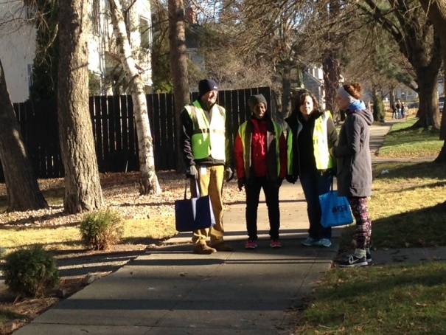
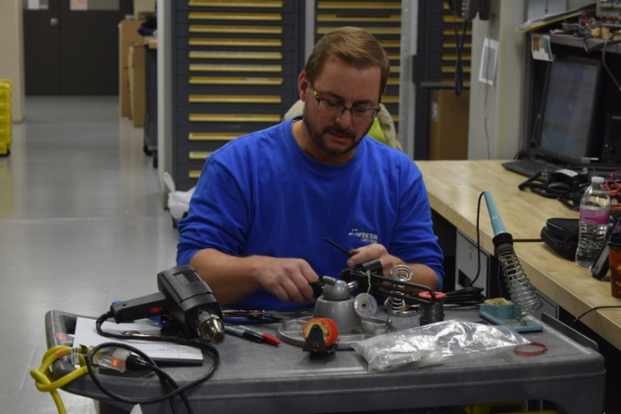
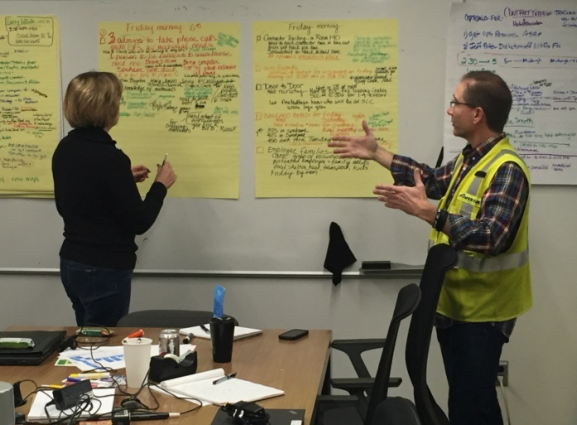
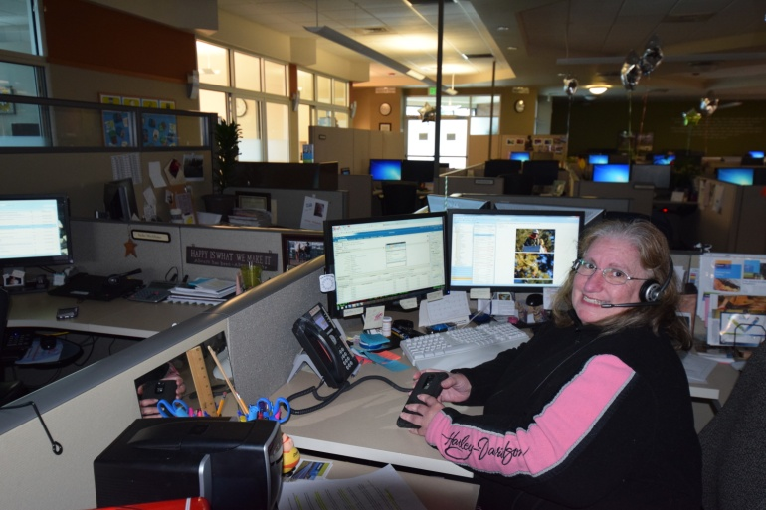
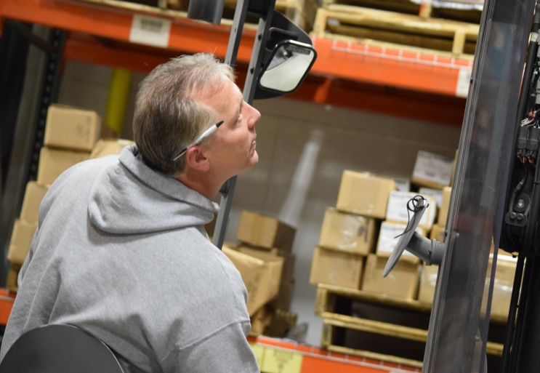
Organizational strengths and leadership during the event
Page 3

Slide 4
Prior to storm emergency operations were declared to enable rapid response
Preplanning Emergency Operations Center (EOC)
Incident Command Structure EOC Briefing
Resources
Pre storm assessment
Damage assessment
Local contractor resources
Western Regional Mutual Assistance Group
Coordination
EOC Briefings
Section Meetings
County & city Liaisons
Critical services
External
Activation
,
Page 4

Slide 5
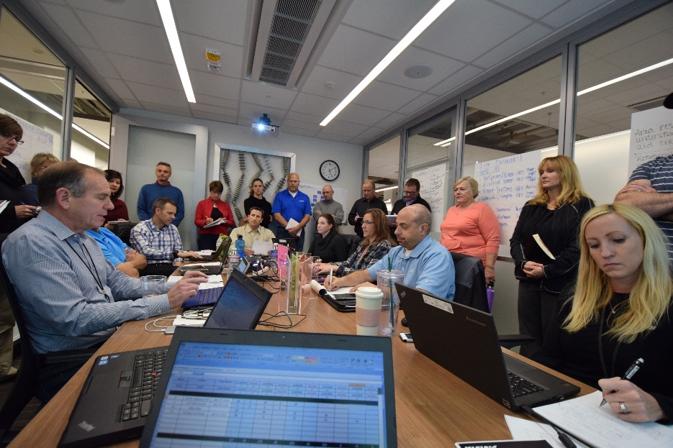
Emergency Operations Center Activation
Periodic briefing
Incident Command Structure unit activation and role assignment
Common operating picture
Problem identification
Next operating period goals
Page 5

Slide 6
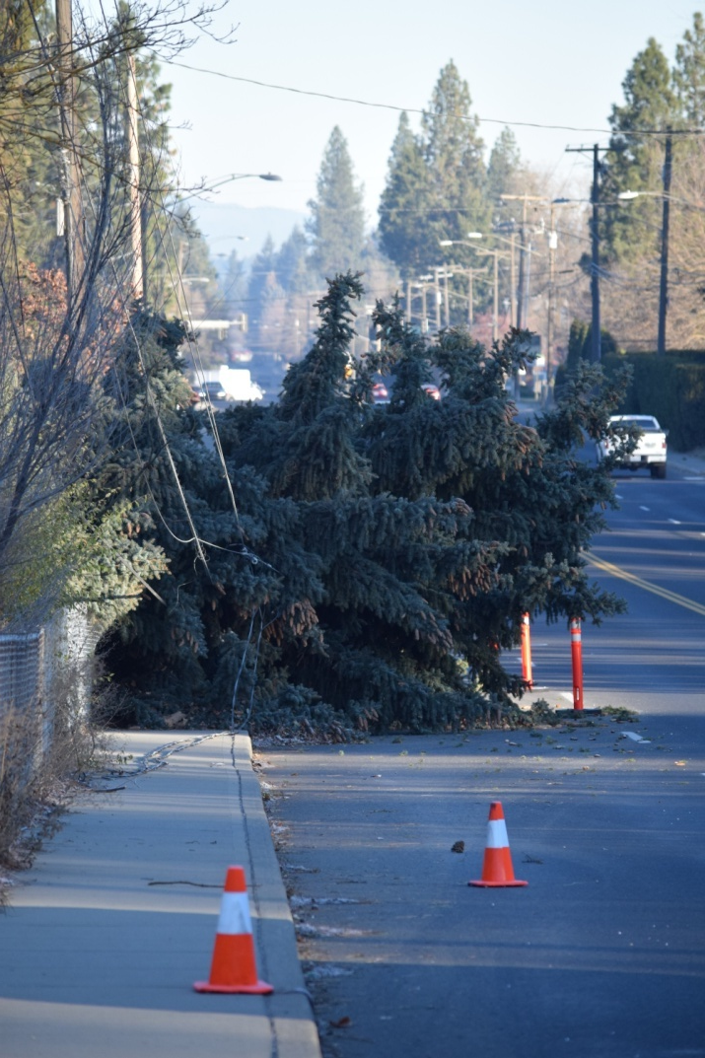
Damages from the windstorm
At the height of the storm, we lost 29 Major Transmission lines and 40 substations.
All 40 substations were restored by Nov. 19
Page 6

Slide 7
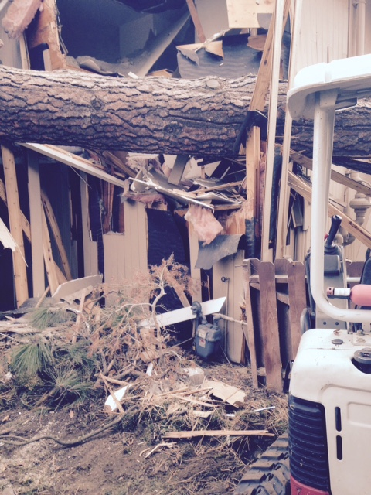
Gas operations during the height of the storm
73 | Gas operations in Coeur d’Alene and Spokane responded to 73 total trouble orders in a 12-hour period. The Spokane district responded to more blowing gas odors in Spokane in one night than the entire month of November in 2014.
30 | 30 Employees between Spokane and Coeur d’Alene responded during the storm and worked through the night to secure Avista’s system and ensure the safety of our customers and the public.
Gas meter
Page 7

Slide 8
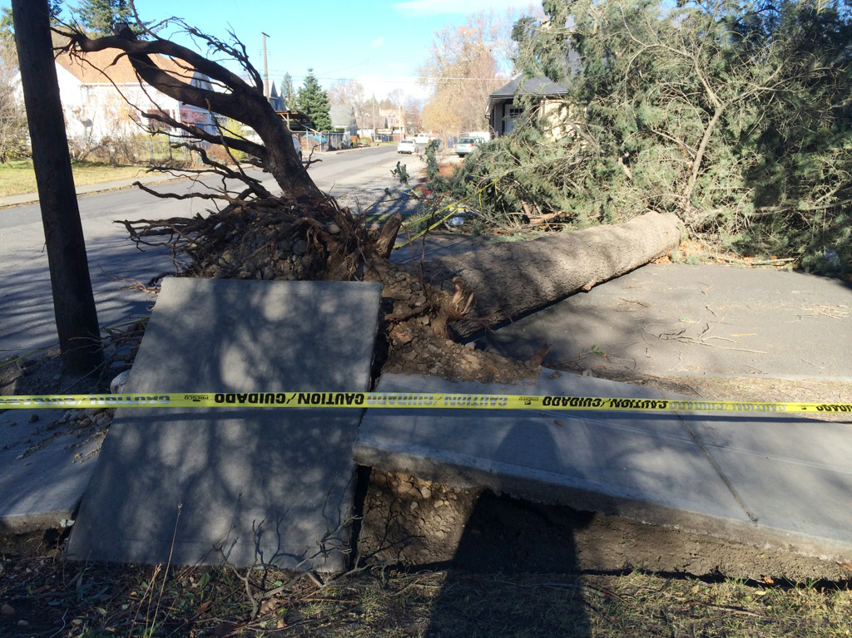
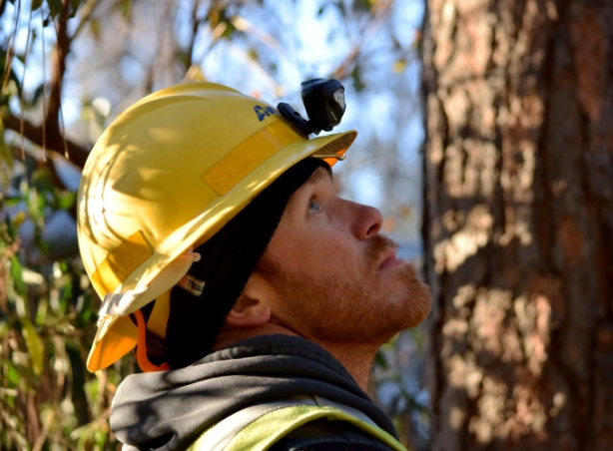
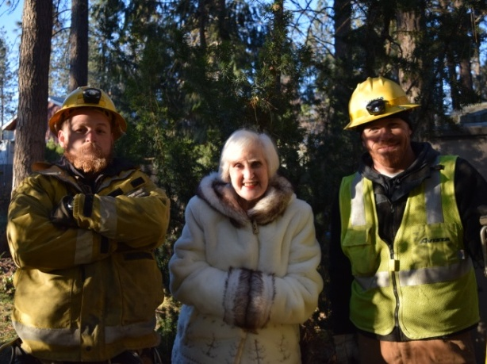
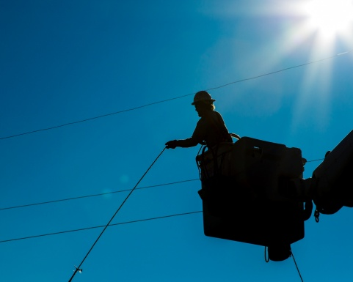
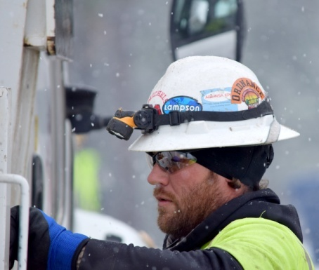
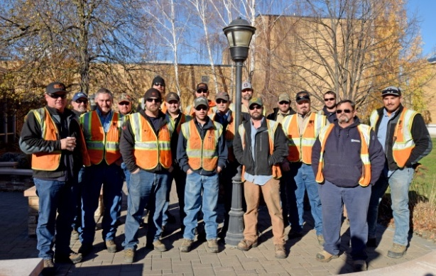
Western Regional Mutual Assistance Group activation with multiple waves
132 Avista, contract and mutual aid crews from six western states and Canada worked 16 hour rotating shifts for 10 days.
Page 8

Slide 9
Customer service highlights
Information reflects Nov. 17 through Nov. 27
55,900 | The number of calls taken. That’s 35,100 more calls than normal!
148,768 | Number of calls handled by the Interactive Voice Response system. That’s 91,000 more calls than normal!
24/7 staffing | Reps did a fantastic job!
Grade of Service
74%
Answered 74 percent of calls within 60 seconds
Page 9

Slide 10
All restoration activities were completed without injury.
Storm Safety Focus
Real time adjustments
Contractor Safety On-boarding
V-Watch
Safety led EOC briefings
Safety Field Observations
Public safety
2nd Dispatch Center
Feeder circuit restoration focus.
Page 10

Slide 11
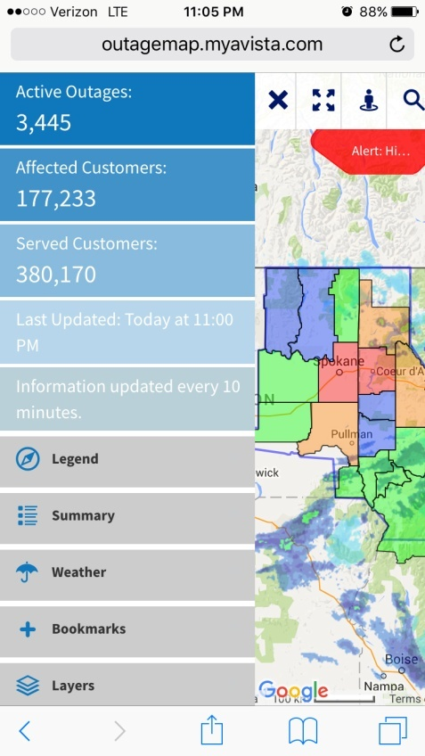
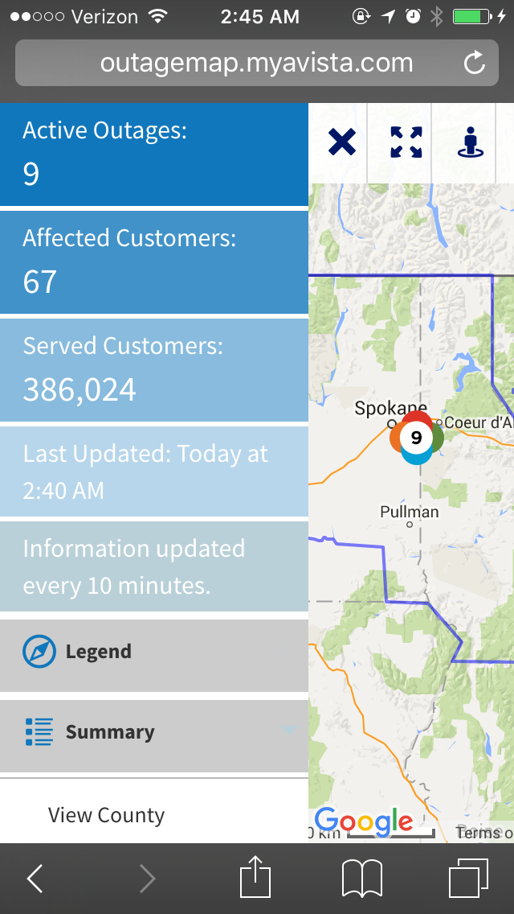
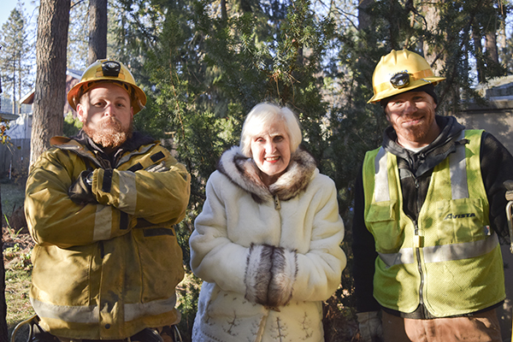
Remarkable efforts from across the community
Nov. 17 at 11:05 p.m.
Nov. 27 at 2:45 a.m.
Out of the nearly 180,000 customers without power from the Nov. 17 storm, all customers were restored by 3:45 a.m. on Nov. 27.
Page 11

Slide 12
External Communications Critical Success Factors
Community in Crisis
Entire Community Impacted
Transparent & Timely Info
Magnitude of damage
Demonstrate progress
Consistent Messages
Scott Morris
News Media
Joint News Conferences
#Inland Strong
Approach to restoring power
Social Media
Web
Call Center
Page 12

Slide 13
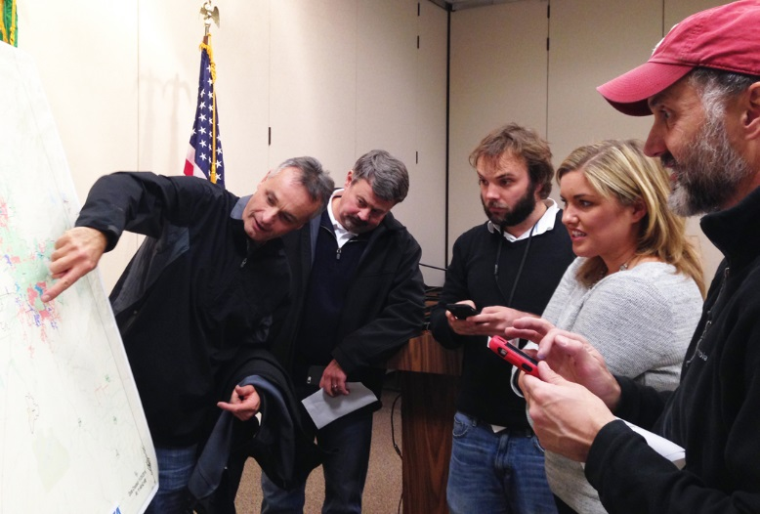
External Communications Cross-Community Focus
Anticipation, preparation and clear roles/responsibilities prior to incident
Provide a united communications front with elected officials, emergency responders and agencies
#InlandStrong
Scott Morris took the lead as Avista’s key spokesperson
Proactive dissemination of information
Scott Morris on the frontline
Page 13

Slide 14
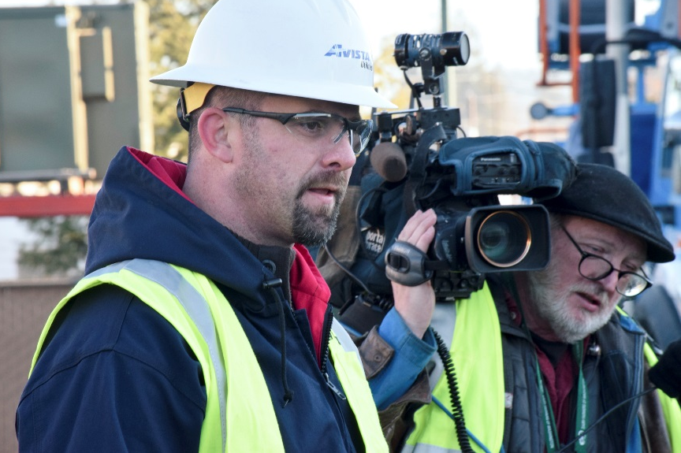
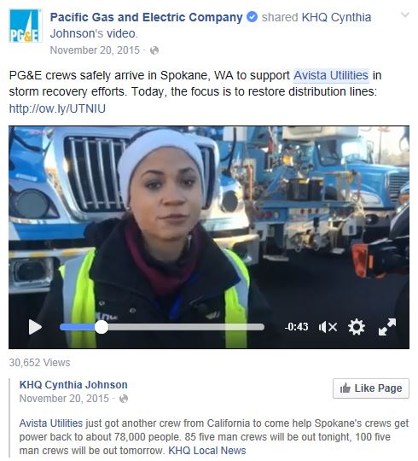
External Communications: Media Relations
Transparent & Timely Info
174 | Number of Media Inquiries Avista responded to
15 | Media Alerts issued
6 | Joint News Conferences conducted
4 | Proactive Video Opportunities
Magnitude of damage
Restoration approach
Progress being made
Page 14

Slide 15
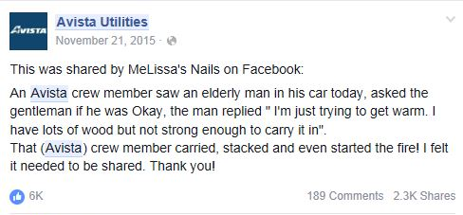
External Communications Connecting Directly with Customers
Demonstrating Progress
75 | Facebook Posts
8,100 | Direct messages with 94 percent responded to within 13 minutes or less
1 Million | Twitter accounts reached
12.7 M | Unique Twitter impressions created
837,000 | Visits to Outage Map
607,000 | Visits to avistautilities.com
Setting Expectations
Sharing Stories
Page 15

Slide 16
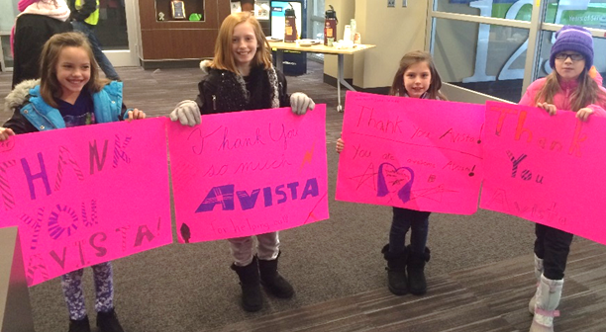
Community Outreach Highlights
More than 100 | Reached out to nursing home, assisted living and other adult care housing facilities
 | Helped secure and connect emergency generators for critical customers, including several assisted living homes
More than $94,000 | Contributed to fund shelters, warming centers, emergency food and services, extend school warming center days and food
Page 16

Slide 17
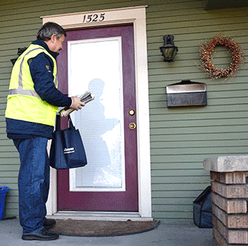
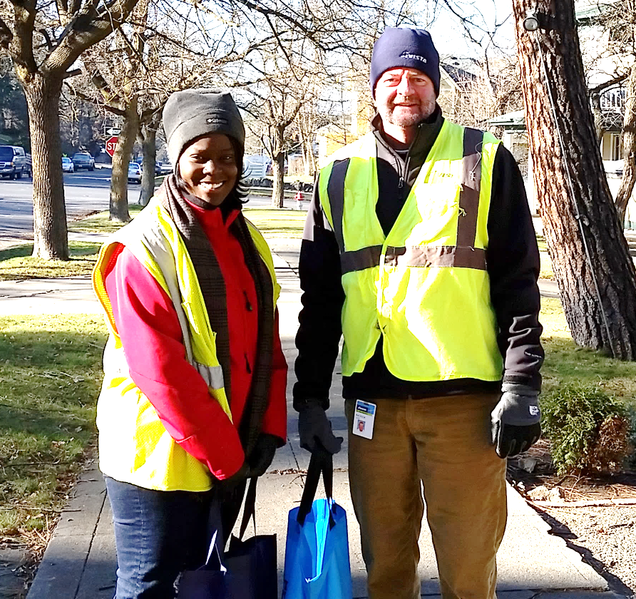
Behind the Scenes Support
At least 50 | Avista volunteers in non-critical operation positions worked with City volunteers to go door-to-door checking on vulnerable customers
More than 300 | Employees volunteered to help in any capacity during the storm
Page 17

Slide 18
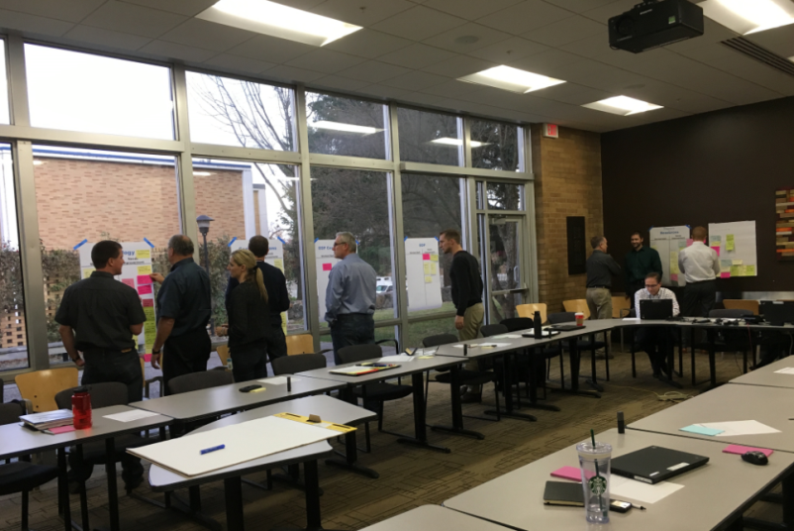
Post Storm Debriefings
Objective
Recognize successes
Identify opportunities to continually strengthen emergency response program
Conducted 17 debriefing meetings
Conducted post-storm survey with 396 respondents
Engaged 3rd party to review storm response
Page 18

Slide 19
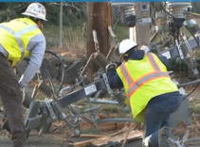
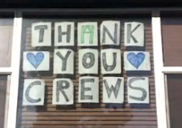
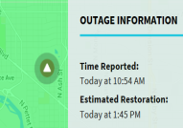
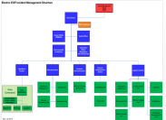
Post Storm Debriefings: Successes
No Safety Incidents
Logistics
Avista Employees
Generators
Visibility of Avista Leadership
Community Coordination and Collaboration
Communications
iFactor, Compass, IVR
EOP Incident Command Structure
Page 19

Slide 20
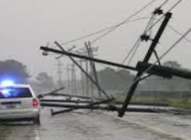
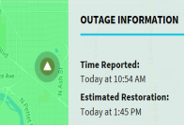
Post Storm Debriefings: Opportunities for Improvement
EOP Incident Management Structure
Training and Mock-Exercise Program
EOP Support Staff Roles
Restoration Strategy
Damage Assessment Strategy Documentation
Estimated Restoration Times (ERT)
Critical Customers and Services
Communication Processes
Page 20

Slide 21
Thank You!
Page 21

