Slide 1
Transportation Electrification at the Department of Commerce
Utilities and Transportation Commission Workshop Presentation
Andrew Rector
Interagency Electric vehicle coordinating council manager
July 2, 2024

Slide 3
Commerce’s Role in Transportation Electrification

Slide 4
What We Do – EV Council
Created via Move Ahead Washington legislation in 2022
Consists of 10 state agencies, including the UTC
Responsibilities include:
Developing and implementing the Transportation Electrification Strategy (TES)
Identifying and coordinating transportation electrification funding
Ensuring benefits flow to vulnerable and overburdened communities
8 EV Council meetings in 2024 (next meeting July 10)

Slide 5
WA EV Charging Program

Slide 6
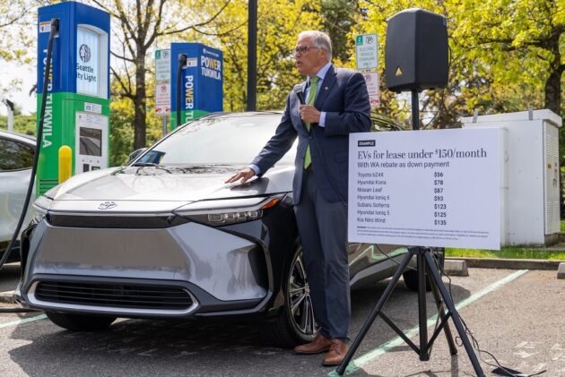
WA EV Instant Rebate Program
Eligibility:
Low-income: 300% of federal poverty level or below
Rebate amounts:
3+ year leases: $9,000
New purchases/short leases: $5,000
Used purchases/leases: $2,500
Program open:
Aug. 2024 – May 2025
Gov. Jay Inslee announcing program in April. (Governor’s Office Photo)

Slide 7
The Transportation Electrification Strategy (TES)

Slide 8
TES Development
TES serves as the roadmap to achieve maximum feasible EV adoption, aligned with state’s GHG limits
Models both the vehicle sales and charging infrastructure needed to meet EV sales requirements in Ecology rules
Developed through extensive public feedback via statewide survey, workshops, interviews, focus groups, and an EV Council Advisory Committee
Delivered to Legislature in February 2024

Slide 9
TES Recommendations
Key TES recommendations address:
Planning grid investments for future charging demand growth
Planning and building utility-side infrastructure
Addressing grid interconnection timelines
Rate-setting for EV charging

Slide 10
Current Activities
Implementing various recommendations through committees established by the EV Council
EV Charging: utility EV charging grid program, EV charging station reliability, standardize/streamline EV charging station programs
Passenger Vehicles: public information and education campaign, extension of EV sales tax exemption
Fleets: Advanced Clean Fleets adoption rates, fund/implement medium-/heavy-duty incentive and infrastructure program
Additional work streams: performance measurement, funding coordination, equity/environmental justice
Public workshop planned for July 17, noon-3 p.m.

Slide 11
Andrew Rector
EV council manager
Andrew.rector@commerce.wa.gov
360-725-3187

