Slide 1
Liquid Air Energy Storage Thomas C Dempsey, P.E., BSME, MPS Manger Thermal Operations & Maintenance
June 13, 2019

Slide 2
Key Topics in this Presentation
Seasonal Solar Generation
Lana’i 100% Renewable Energy Case Study
E3- Resource Adequacy In the Northwest
Compressed Air Energy Storage
Liquid Air Energy Storage
Potential Integration at Kettle Falls
Potential Integration at Rathdrum Combustion Turbine

Slide 3
TCD Energy Intermittency Research Facility

Slide 4
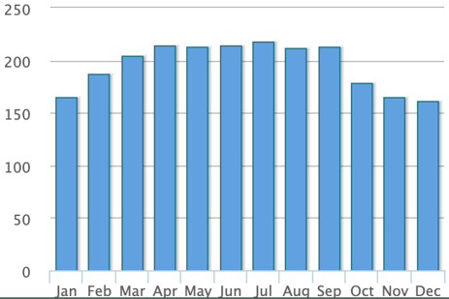
Comparison of Solar Production Curves 100% Renewable Energy for Lana’i
Lana’i, Hawaii
Spokane, WA
Key Takeaway- Spokane experiences a much wider fluctuation in solar production than Lana’i does. This makes solar firming more difficult
Notes:
Solar resource is much more consistent in Lanai. This means that energy storage is not needed to bridge seasonal solar production drops.

Slide 5
Lana’i Daily Load Pattern
Notes:
There are short periods where even with significant overbuild that biodiesel is required to be burned using conventional diesel engines.

Slide 6
Intermittent Energy Firming- Lana’i
In this example, 68% of the bus bar cost was associated with energy storage and firming.
Notes:
The cost of the energy storage and limited firming with biodiesel accounts for 68% of the total busbar cost.

Slide 7
Resource Adequacy in the Pacific Northwest March 2019

Slide 8
Resource Adequacy in the Pacific Northwest Energy + Environmental Economics (E3)
Deep decarbonization is possible without sacrificing reliable electric load service HOWEVER
100% renewable is prohibitively expensive and impractical- but 90% is not
Firm capacity is required when poor hydro, weather, and storage depletion conditions exist
A 100% GHG free system requires a 2X buildout that results in curtailment of nearly half of the solar and wind production
Ultra-long duration energy storage is a possible solution but currently impractical (this is where LAES has potential)
Notes:
Read the slide

Slide 9
E3- Annual Cost Increase vs GEG Reduction

Slide 10
E3- Generation Mix Across GEG Reduction Scenarios

Slide 11
Compressed Air Energy Storage

Slide 12
Compressor Power In / Turbine Power Out
Low Pressure & Temperature
Low Pressure
Medium Temperature
High Pressure & Temperature
Power In
Power Out
The compressor in this example consumes 100 kW, the turbine generates 72.4 kW- Total net power is -27.6 kW

Slide 13
Compressor Power In / Turbine Power Out
Low Pressure & Temperature
High Pressure Very High Temperature
Low Pressure
High Temperature
Fuel In
Power In
Power Out
The compressor in this example consumes 100 kW, the turbine generates 178.2 kW- Total net power is 78.2 kW

Slide 14
Avista’s Coyote Springs 2- GE7FA Combustion Turbine
Fuel In
Power In
Power Out

Slide 15
Compressor Power In / Turbine Power Out
Break the time connection between the compression process and the expansion process
Store the compressed air AND ITS HEAT for later use.
https://youtu.be/K4yJx5yTzO4

Slide 16
Compressed Air Energy Storage

Slide 17
Liquid Air Energy Storage

Slide 18
LAES Rendering- Expansion Energy

Slide 19
Liquid Air- Energy Inflow Model (Claude Cycle)
Notes:
The air is compressed and cooled multiple times- then expanded until the temperature drops to its condensation temperature. Liquid air is stored at very low temperature and pressure until needed for power production.

Slide 20
Liquid Air- Energy Outflow Mode

Slide 21
Liquid Air Energy Storage
The benefits of compressed air energy storage without the geographic constraints
Ability to store enormous amounts of energy in a relatively small footprint.
Technology is well understood
Liquid air is cold but is not a hazardous chemical
Highview Power
https://youtu.be/kDvlh_aG7iA

Slide 22
LAES- Why the Technology is Compelling
Potential to greatly enhance productivity and efficiency of EXISTING generation resources - thus delaying or eliminating the need for NEW fossil fueled units.
Highview claims round trip efficiency as high as 70% if waste heat is available
Long life
They provide rotating mass useful for grid stability
Massive amounts of energy can be stored without the need for geologic formations (like salt cavities) or massive disturbance of land (pumped hydro)
Zero emissions in stand alone mode. Low emissions sited with combustion turbines.
Uses very little water

Slide 23
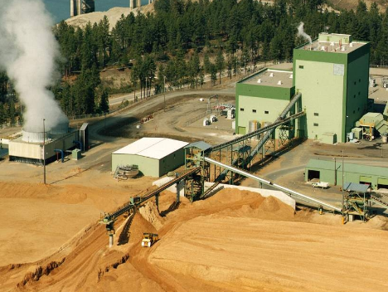
Kettle Falls Generating Station- Potential Integration of LAES
KFGS is already 100% renewable
KFGS is already a massive energy storage facility
Operation to bridge seasonal energy supply gaps
Possible potential to reduce the massive overbuild of solar and wind required to meet a zero greenhouse gas emissions future
LAES integrated with Kettle Falls would make extensive use of waste heat and cold - greatly increasing efficiency
Circulating water temperatures reduced would result in improved output and reduced water use
Some ability to use residual stack heat

Slide 24
Rathdrum Combustion Turbine
Waste heat from the exhaust of the Rathdrum combustion turbines could be used to enhance the round trip efficiency of a co-located LAES facility.
Potential for massive increase in peak capacity and output.
Use of deeply refrigerated air to cool turbine air inlets increasing output and improving efficiency
Per MWh CO2 emissions dramatically lower than when operating in simple cycle mode. (~550 lbs/MWh)

Slide 25
Rathdrum Combustion Turbine- (conceptual)

Slide 26
Questions?

