Slide 1
IRP-Related Transmission and Distribution Planning
David Nightingale, Utilities and Transportation Commission Regulatory Services Division Staff
March 10, 2017

Slide 2
IRP Rules static since 2001
Current requirements provide a very high-level framework and nothing regarding public involvement
Recent trends change the range of possible utility and customer options which can impact distribution and transmission
More transparency and public process surrounding modeling and analysis of T&D options, benefits and costs would be beneficial
It’s complicated now… much more than ever before

Slide 3
“Version 1.0” from 2001 T&D in IRP Rule for Gas Companies WAC 480-90-238(3)
Assessment of pipeline transmission capacity and reliability…
Assessment of current and new policies and programs for conservation…
Use consistent cost-effectiveness methodology to compare costs of purchasing strategies, storage options, delivery resources, and conservation

Slide 4
“Version 1.0” from 2001 T&D IN IRP Rule for Electric Companies WAC 480-100-238(3)
Assessment of transmission system capacity and reliability…
Assessment of conventional and non-conventional generation…
Compare energy supply resource (including transmission and distribution) using lowest reasonable cost criteria…

Slide 5
Technology and customer expectations have evolved since 2001
Smart Grid Initiatives and ARRA funding nationally propelled market changes
Transactive Signal and other NW pilot projects from ARRA provide examples
Advanced Metering Infrastructure (AMI) technology has matured
Cell phone and Wi-Fi communications are now ubiquitous
Distributed Energy Resources cost reductions and integration policy developing
Data collection and analytical capabilities continue to expand
Customers are increasingly concerned with privacy and energy management

Slide 6
Things we know Post-arra
Excerpts from presentation to NW Power Council’s Demand Response Advisory Committee on 3/8/2017 by Lee Hall, BPA using Navigant and PNNL analysis
2015 baseline of information, Technology and Costs continue to change (generally getting better every year)!!
PNW Smart Grid Demonstration, 2010 – 2015, US DOE funded, 11 NW utilities, BPA, PNNL, 5 product vendors, and consultants

Slide 7
Smart Grid Asset Systems
Asset System Investments:
Subprojects: ~$77M
Electricity Infrastructure Operations Center (Battelle): ~$11M
Response Ranges:
Total Load Reduction: -50 MW
Total Load Increase: +7MW
Efficiency Impact: -10MW
X – Benton PUD and Idaho Falls Storage assets eliminated due to bankruptcy of vendor.
X – City of Ellensburg small wind farm dismantled due to safety issues.

Slide 8
Smart Grid - Six Areas of Identified Benefits
T&D Optimization
Grid Reliability
Utility Operational Efficiency
Dynamic and Responsive Demand
Grid Storage, Integration and Control
End Use Energy Efficiency

Slide 9
Category | Capability Area (Function)
T&D Optimization | Automated VAR Control
 | Conservation Voltage Reduction (CVR)
 | Dynamic Capacity Rating
 | Automated Power Flow Control for Transmission
 | Automated Real Time Load Transfer for Distribution
 | Notification of Distribution Equipment Condition
 | Notification of Transmission Equipment Condition
 | Fault Current Limiting for Distribution
 | Fault Current Limiting for Transmission
 | Distributed Energy Resource Monitoring & Control
 | PMU-Based Centralized Renewable Resource Monitoring & Control
Grid Reliability | PMU-Based Wide Area Monitoring
 | Automated Islanding & Reconnection (Microgrid Capability)
 | Enhanced Fault Prevention for Distribution
 | Enhanced Fault Prevention for Transmission
 | Fault Location, Isolation & Service Restoration (FLISR)
Dynamic & Responsive Demand | Demand Response - Air Conditioning/Space Cooling
 | Demand Response - Appliances & Plug Loads
 | Demand Response - Lighting
 | Demand Response - Refrigeration, Motors & Process Equipment
 | Demand Response - Space Heating
 | Demand Response - Water Heating
End Use Energy Efficiency | End Use Conservation
 | End Use Equipment Efficiency Upgrade
 | Notification of End Use Equipment Condition - HVAC
 | Notification of End Use Equipment Condition - Refrigeration
Grid Storage Integration & Control | Transmission-Sited Grid Storage Integration & Control
 | Distribution-Sited Grid Storage Integration & Control
 | Electric Vehicle Battery Integration & Control
Utility Operational Efficiency | Automated AMI Meter Reading & Billing
 | Improved DSM Program Execution (Marketing, Implementation, M&V)
 | Improved Regional Planning & Forecasting
 | Transactive Control
Investment Categories
9

Slide 10
Six Investment Categories Showed Different Returns and Uncertainties (2015) for Smart Grid Technology
The RBC analysis focuses on the benefits and costs that can be attributed to smart grid investments, and attempts to draw a clear line between smart grid capabilities and traditional capabilities. The benefits and costs of traditional capabilities are not included as smart grid benefits and costs in the RBC. Thus, the RBC is not indicative of the benefits, costs, and B/C ratios of traditional capabilities and investments.

Slide 11
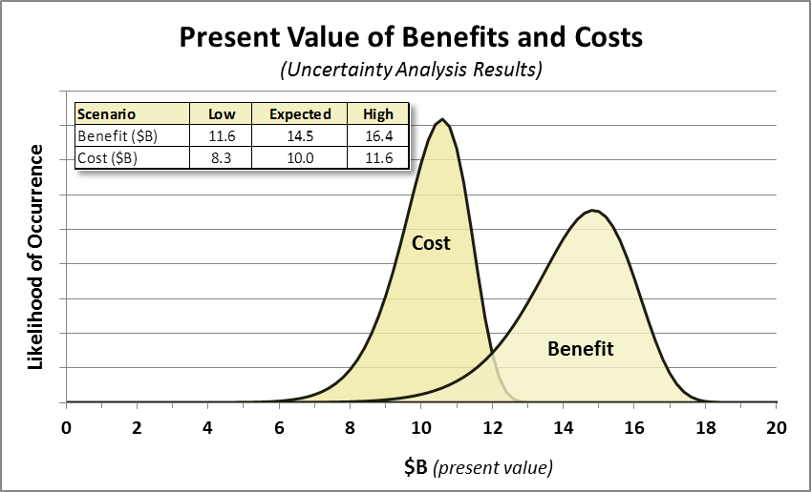
Overall Regional Benefits Very Likely to Outweigh Costs
11
See Figure 2 on page 24 of White Paper

Slide 12
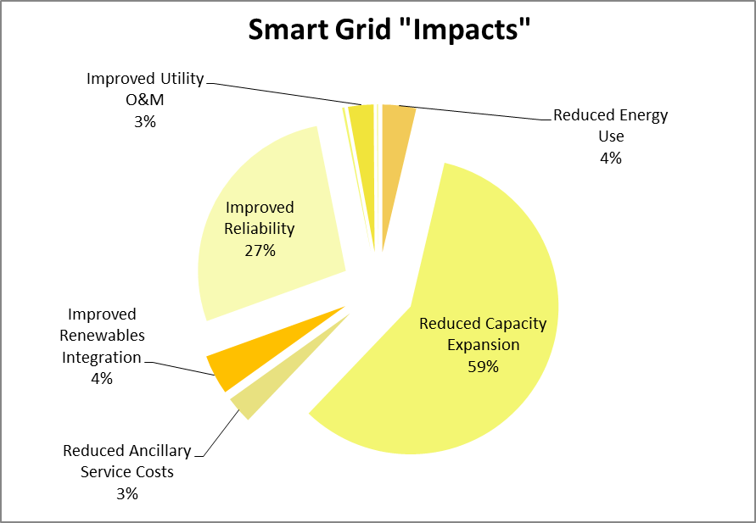
Breakout of Overall Smart Grid Impacts by Dollar (smart grid benefits)
Benefits breakout—percentage of dollars
12

Slide 13
PNW Smart Grid Demonstration
Summary Lessons Learned
Transactive Control – still maturing
Large scale smart grid projects are data intensive
Pay attention to customers!
Varying commercial readiness and cost/benefit for tested technologies (as of 2015)
Many utility specific successes and deployments
13

Slide 14
Regional Findings are especially important for Transmission Considerations
Following presentations look at:
National,
State, and
Individual utility
Experiences and perspectives of T&D planning
14

