Slide 1
Washington Natural Gas Customer R&D Needs
Presented by:
Ron Edelstein
Gas Technology Institute
September 3, 2013
Washington Utilities and Transportation Commission
Olympia, WA
Notes:
Explain what created the imperative to engage in this exercise
a very electric-centered public policy discussion
regulatory and R&D initiatives
potential long term consequences if natural gas gets left out
The energy and climate bills that were considered in the past Congress were not very good for natural gas relative to competing forms of energy.
Depending on the audience mention:
Comments submitted to DOE on Smart Grid RFI
DOE C Freitas statement regarding the ARRA – “They missed it!” by not including Gas. DOE wants to know what the industry will do and what government should fund.
NREL – “AH HA!” Gas is the 800# gorilla in the room and they need to rework their model for renewables to include gas.

Slide 2
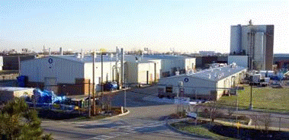
GTI Overview
Not-for-profit research, with 70-year history
Facilities
18-acre laboratory near Chicago
200,000 ft², 28 specialized labs
Other sites in DC, Oklahoma, California, Massachusetts, Texas, Alabama, Pennsylvania
Staff of 250
Market opportunities are creating substantial growth
1200 patents; 750 products
Pilot-Scale Gasification Campus–Flex-Fuel Test Facility and Advanced Gasification Test Facility
Offices & Labs
Energy & Environmental Technology Center

Slide 3
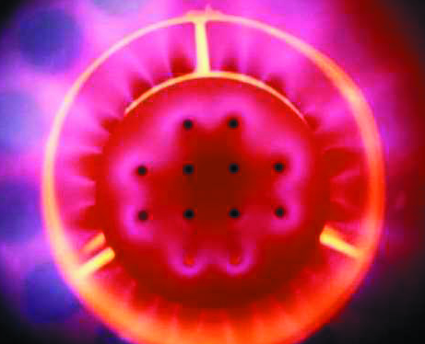
Addressing Key Energy Industry Issues Across the Value Chain
SUPPLY
DELIVERY
END USE
Expanding the supply of affordable energy
Ensuring a safe and reliable energy delivery infrastructure
Promoting the efficient use of energy resources
Reducing carbon emissions to the environment

Slide 4
RD&D Pipeline
Notes:
R&D is a complex system of interconnected activities working together to deliver an impactful solution. GTI demonstrates these “activities” through its R&D programs—the programs complement one another to ensure technology reaches its full potential and to ensure new technology flows to the marketplace.

Slide 5
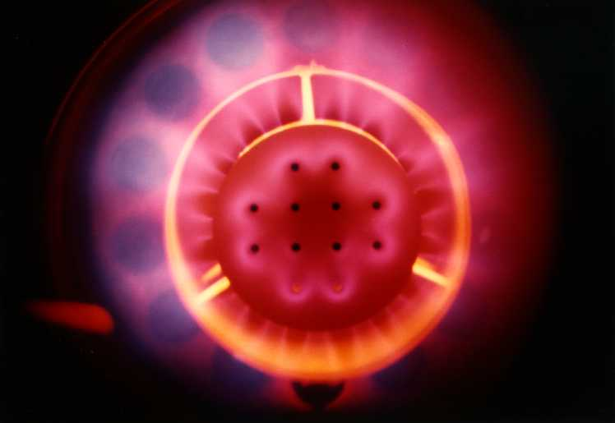
Natural Gas End Use Challenges
Affordability of Energy Use
Energy costs, efficiency
First costs
Environmental Impacts
Increased Use of Gas for Power Generation

Slide 6
Washington Natural Gas Consumption (Bcf)
Sector | 2007 | 2008 | 2009 | 2010 | 2011 | 2012
Residential | 80 | 84 | 84 | 76 | 85 | 83
Commercial | 54 | 56 | 56 | 51 | 56 | 55
Industrial | 74 | 76 | 71 | 71 | 76 | 79
Electric Power | 57 | 75 | 91 | 80 | 39 | 44
Totals | 265 | 291 | 303 | 278 | 257 | 263
Note: Numbers may not add due to rounding
Does not include Lease & Plant Fuel and T&D Consumption
Ref: EIA

Slide 7
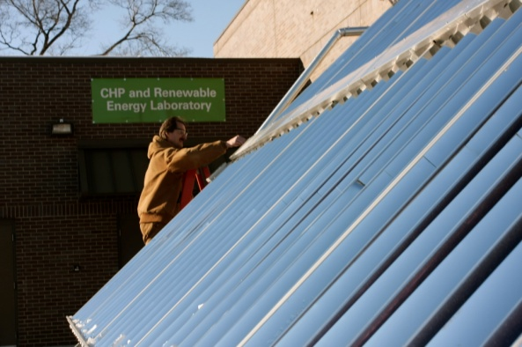
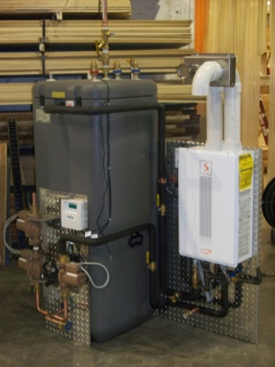
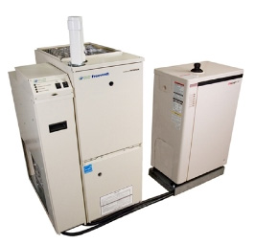
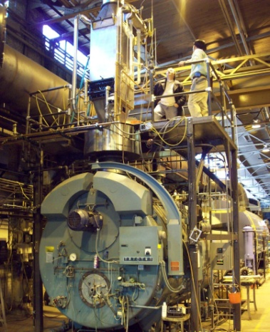
UTD Areas of Technology Focus
Residential/Commercial Water Heating
Venting Safety
Residential/Commercial Space Conditioning
Commercial Food Service
Industrial Processes
Distributed Power/CHP and Steam Generation
Transportation
Renewable Energy (biogas, solar thermal)
Carbon Management

Slide 8
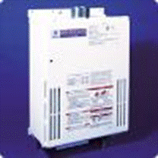
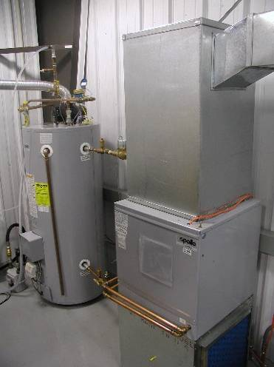
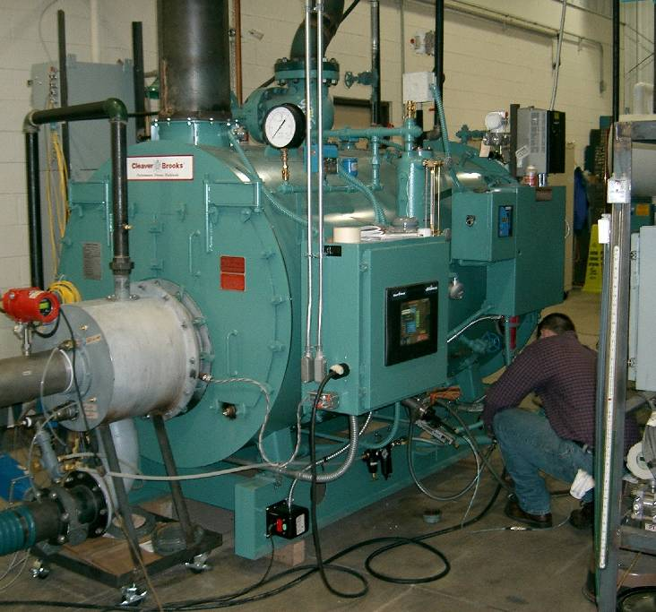
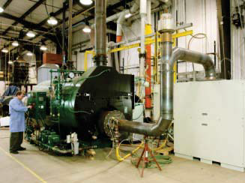
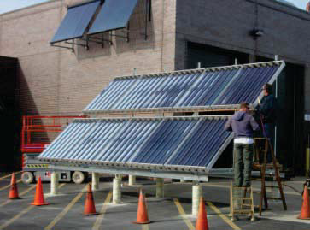
Energy Efficiency R&D
Tankless Water Heater*
Water/Space Heater Combo
Gas Heat Pump
Solar-Assisted Natural Gas Energy System
Ultamizer Super Boiler*
FlexCHP
*Commercialized

Slide 9
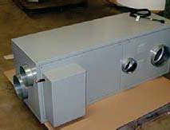
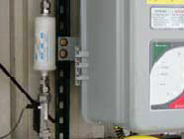
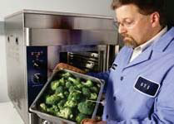
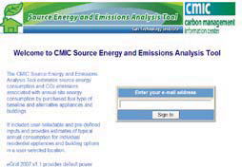
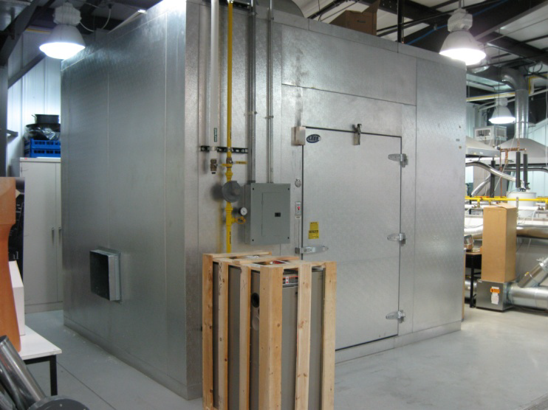
Energy Efficiency R&D
NovelAire Dehumidification*
FuelMaker’s Phill System*
Stellar Countertop Steamer*
Energy Source Analysis Tool*
Packaged Air Conditioner Furnace Condensate Freeze-up Prevention
*Commercialized

Slide 10
Real World Example of Washington Consumer Benefits: High-Efficiency Furnaces (Six years of Sales through 2002)*
39,051 high-efficiency furnaces sold in Washington
Consumer benefits (NPV) $1,300 per furnace
Total Consumer Benefits: $51 million
Benefit/Cost ratio compared to entire cost of FERC R&D program: 2.6/1
* No GAMA High-efficiency furnace sales data after 2002

Slide 11
Utah’s NGV Experience (SB275, 2013)
Provides for a cost recovery mechanism that pays for natural gas fueling stations and related facilities
Expenditures for construction, operation, and maintenance of NG fueling stations are just and reasonable if:
Expenditures are prudently incurred
Do not exceed $5 million per year
Incremental revenue exceeds revenue requirements by 50%
Stations and facilities are used and useful
Commission should assign a surcharge to each rate class on a pro rata basis
Establishes a governing body to facilitate conversion to alternative fuels and facilitate construction of facilities for such
Status: Commission hearings are underway

Slide 12
California’s NGV Experience (AB 32, AB 118, et al)
AB 32 – Greenhouse gas reduction legislation (Global warming Solutions Act of 2006)
Encourage investment and improvement in current and near-term technologies that will help meet the 2020 target
Stimulate innovation and development of new technologies that can dramatically lower GHG emissions at low costs and can start to be deployed by 2020 or soon thereafter, creating the conditions for meeting the later 2050 goal
Contribute to attainment of related objectives as much as possible, including economic growth, air quality, other environmental protection goals, affordable energy prices, environmental justice, and diverse and reliable energy sources
AB 118 – Alt Fuel Vehicle and Technology Program, which substantially increased the scope and value of NGV research and market penetration
Low Carbon Fuel Standard, adopted by the CARB and ranks vehicle fuels in order of carbon impact
NGV Roadmap, produced in conjunction with stakeholders to identify priorities for NGV R&D.

Slide 13
Sixteen States’ MOU
Memorandum of Understanding (MOU) describes a coordinated effort between the undersigned States (States) to attract automobile manufacturers in the U.S. to develop a functional and affordable original equipment manufacturer (OEM) fleet natural gas vehicle (NGV) that will also meet public demand. The States recognize the benefits and unique attributes of clean burning natural gas and understand the significant opportunity compressed natural gas (CNG) presents to save State and taxpayer dollars by encouraging an energy future that utilizes domestic energy resources to fuel our nation’s transportation needs. Through the joint solicitation of a Multi-State Request for Proposal (Joint-RFP) that aggregates annual State fleet vehicle procurements, the States will endeavor to provide a demand base sufficient to support the design, manufacture, and sale of functional and affordable OEM NGVs by automotive manufacturers in the United States.
Notes:
OK,CO, WY, PA, UT, ME, NM, WV, KY, TX, OH, MS, LA, AR, VA, TN

Slide 14
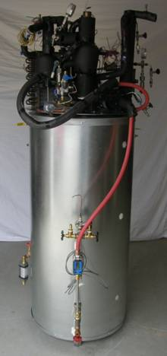
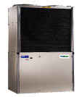
What are the Next Step-Function Opportunities in Energy Efficiency?
Gas heat pump water heater (EF = 1.3)
Gas heat pump
COP(h) = 1.3
COP(c)= 1.2
EF = Energy Factor
COP = Coefficient of Performance
Notes:
For gas-fired residential water heating, the U.S. and Canada is predominantly supplied by minimum efficiency storage water heaters with Energy Factors (EF) in the range of 0.59 to 0.62. Higher efficiency and higher cost ($700 - $2,000) options serve about 15% of the market, but still have EFs below 1.0, ranging from 0.65 to 0.95. To develop a new class of water heating products that exceeds the traditional limit of thermal efficiency, the project team designed and demonstrated a packaged water heater driven by a gas-fired ammonia-water absorption heat pump. This gas-fired heat pump water heater can achieve EFs of 1.3 or higher, at a consumer cost of $2,000 or less. Led by Stone Mountain Technologies Inc. (SMTI), with support from A.O. Smith, the Gas Technology Institute (GTI), and Georgia Tech, the cross-functional team completed research and development tasks including cycle modeling, breadboard evaluation of two cycles and two heat exchanger classes, heat pump/storage tank integration, compact solution pump development, combustion system specification, and evaluation of packaged prototype GHPWHs. The heat pump system extracts low grade heat from the ambient air and produces high grade heat suitable for heating water in a storage tank for domestic use. Product features that include conventional installation practices, standard footprint and reasonable economic payback, position the technology to gain significant market penetration, resulting in a large reduction of energy use and greenhouse gas emissions from domestic hot water production.
Capacity 1 ton 2 ton 1 ton 1 ton 2 tons Area served 1 room 3 rooms 1 room 3 rooms 2 rooms Engine 2 cycle 2 cycle 4 cycle 4 cycle 4 cycle Compressor Type Rotary Rotary Rotary Rotary Rotary Refrigerant R-22 R-22 R-22 R-22 R-22 Hot water storage 53 gal 61 gal 41 gal 69 gal 53 gal Cooling Performance Capacity 13,770 Btu/hr 19,444 Btu/hr 13,254 Btu/hr 13,651 Btu/hr 20,556 Btu/hr Coeffiecient of Performance (COP) 0.74 0.9 0.96 0.99 0.89 Supply air temperature 59 deg.F 65 deg.F 60deg.F 61 deg.F 60 deg.F Heating Performance Capacity 20,199 Btu/hr 38,929 Btu/hr 19,762 Btu/hr 20,556 Btu/hr 41,310 Btu/hrCoefficient of Performance (COP) 1.2 1.4 1.4 1.31 1.24 Supply air temperature 115deg.F 100deg.F 101deg.F 102deg.F 120deg.F Comments Hot water One room heated Hot water Refrigerant Hot water supplied supplied supplied heated to indoor unit by hot water to indoor unit by engine exhaust to indoor unit during heating; during heating; gas; 2-pipe during heating 4-pipe system 4-pipe system; system uses gas burne

Slide 15
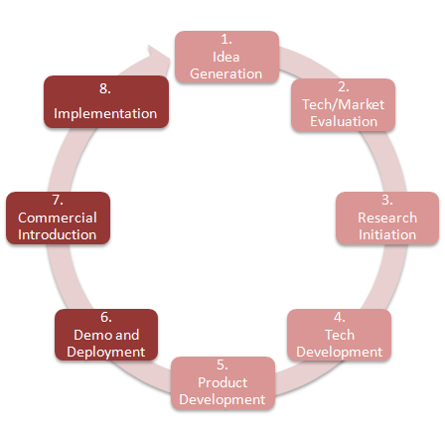
Emerging Technology Program (ETP)
Deploy and advance the next generation of end-use technologies, creating a pipeline of new products focused on increasing energy efficiency and reducing greenhouse gas emissions
Ensuring value for stakeholders by addressing implementation barriers and associated risks related to market acceptance and adoption of emerging technologies
Bridging The Valley of Death…
Product Development &
Commercialization
Process

Slide 16
Operations R&D Challenges
Aging Infrastructure
Pipeline and Distribution Safety and Integrity
Identification of high-risk sections of pipe
Prevention of third party damage
Gas/Electric Interoperability/Smart Energy Grid
Cybersecurity

Slide 17
Washington’s Natural Gas Mains (miles)
 | Miles
Bare, Unprotected Steel | 30
Coated, Protected Steel | 38
Steel, Other | 8,587
Plastic | 13,003
Cast Iron | 28
Totals | 21,686
Ref: A.G.A. Gas Facts, with 2012 Data

Slide 18
Washington’s Natural Gas Services (number of services)
 | Number
Bare, Unprotected Steel | 16,258
Coated, Protected Steel | 324,037
Steel, Other* | 2,009
Plastic | 902,821
Cast Iron | 0
Totals** | 1,245,648
*Mostly bare steel, cathodically protected
** Includes 533 other
Ref: A.G.A. Gas Facts, with 2012 Data

Slide 19
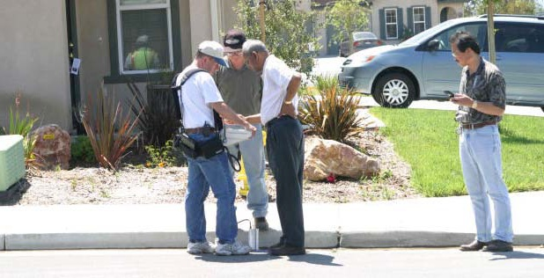
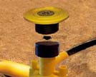
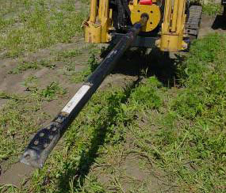
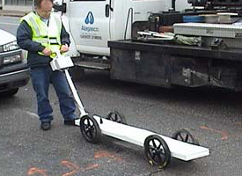
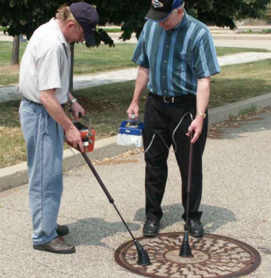
New Operations Technologies
Handheld Acoustic PE Pipe Locator*
Radio Frequency ID tags for Gas Distribution
Obstacle Detection for Horizontal Boring Tools
Metallic Joint Locator*
Portable Methane Detector*
*Commercialized

Slide 20
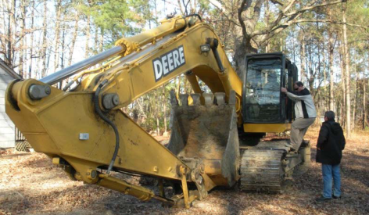
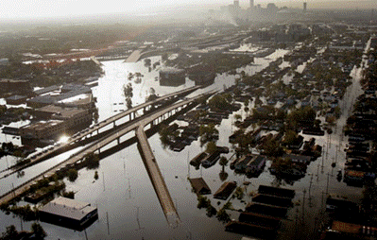
New Operations Technologies – GPS, Geospatial
GPS-Enabled Leak Surveying
GPS Cameras for Joint Inspection
GPS for New Installations
Geospatial mapping for emergency response
GPS for third party damage prevention

Slide 21
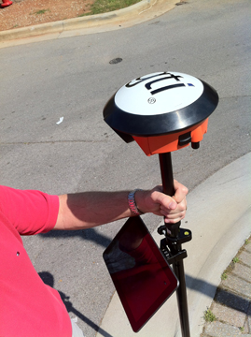
High Accuracy GPS
GTI partnered with NavCom to provide high accuracy GPS for smart phones and tablets
Sub-foot quality data in real time
No need for post processing or a base station
Field data directly inserted into the GIS (with controls)

Slide 22
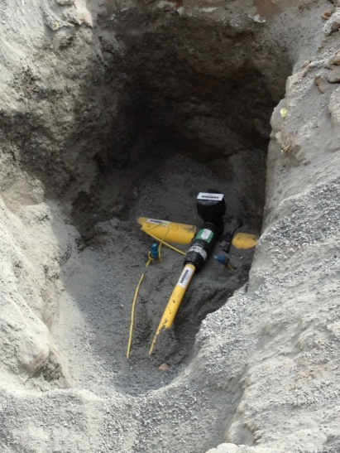
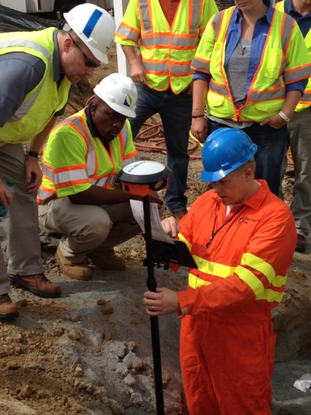
Asset Lifecycle Tracking
GTI’s technology solution to implement ASTM F2897-11a
Barcode scanner
High accuracy GPS receiver
Tablet device with GIS-based data collection software
Application to convert barcode into asset attributes to auto populate the GIS

Slide 23
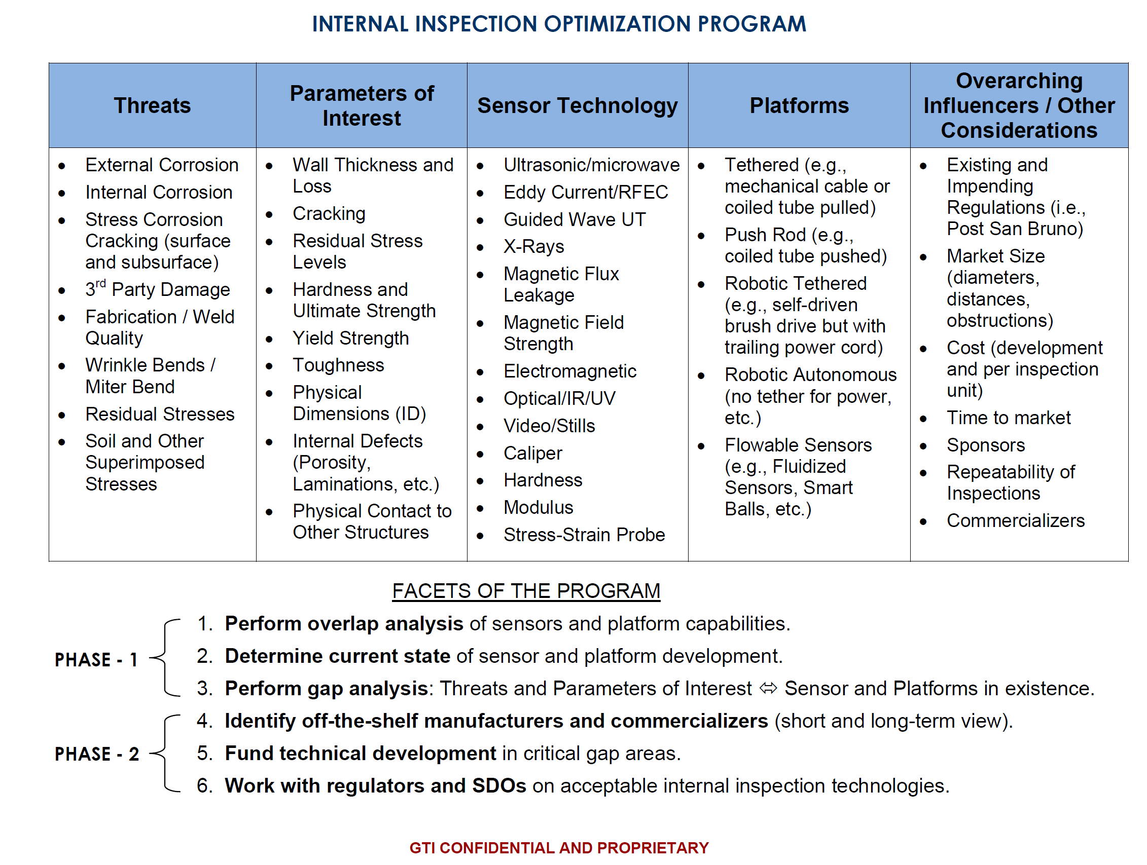
Internal Inspection – Optimization Program
EMAT

Slide 24
Project: Understanding Threat Interactions
Unknown, Hidden, and Incorrect Operations Threats
Background
Many pipeline incidents are the result of multiple, interacting causes, not a single threat.
Individual threats can each be at “acceptable” levels but when overlaid result in a significant threat to the pipeline or even a failure.
Approach
Identify threat combinations to address and control,
Develop a method to calculate threat interaction levels and severity, and
Provide a method to continuously monitor threat interactions and flag concerns at trigger points.
Benefits
Operators will be able to adequately identify combinations of threats and their associated risk.
Reduction of an operator’s risk and enhancement of compliance with Subpart O regulations.
Pipeline Failure
External Corrosion
Internal Corrosion
Stress Corrosion Cracking (surface and subsurface)
3rd Party Damage
Fabrication / Weld Quality
Wrinkle Bends / Miter Bend
Residual Stresses
Soil and Other Superimposed Stresses

Slide 25
GTI DIMP Consequence Model
Developing a model that quantifies the consequence of failure for distribution systems and DIMP based on various factors, such as:
population density, proximity of critical infrastructure and business districts, failure mode based on material properties, gas migration patterns, soil and surface conditions, pressure and potential energy
Model will assist in prioritizing replacements and the deployment of other mitigation techniques based on risk (not just probability of failure)

Slide 26
Key Challenges to Achieving the Smart Energy Grid Challenge
Key Challenges by Sector
Supply
Rapid Response Supply
Better Supply and Demand Forecasting
Integrated Communications
Overarching
Emphasis
On Safety
Delivery
Enhanced Infrastructure Flexibility
Optimized Investment
Integration of New Supply Sources and End Uses
End Use
Full Fuel Cycle Analysis
Comparable Energy Information
Energy Management Tools

Slide 27
Cyber-Security
Active participation in the Smart Grid Interoperability Panel (SGIP) Gas Technology Domain Expert Working Group (GT-DEWG)
Deliverables:
Reports of standards activity within the SGIP via quarterly newsletters
Maintenance of the on-line reference system
White paper (final report) on the automation of natural gas distribution and smart energy grid interoperability issues (will be made publicly available)
Notes:
The Smart Grid Information Clearinghouse (SGIC) is one of the organizations created via federal legislation, and provides a one-stop-shop environment where a summary of the federal legislation and regulations, as well as a state-by-state summary of smart grid activity, can be found. Throughout the course of Phase 1 the information tracked and collated by the SGIC was noted to be entirely electric focused and of minimal to moderate value to the natural gas industry. The efforts of the on-line resource created and maintained for this project, described below, highlight those regulatory and legislative proposals or changes that have the potential to impact the natural gas industry.
Together with the Smart Grid Interoperability Panel (SGIP) operating under the administration of the National Institute of Standards and Technology (NIST), GTI created the Gas Technology – Domain Expert Working Group (GT-DEWG). This platform provides a direct connection to the premier standards development organization in the U.S., and was identified as a means to provide the greatest value to the natural gas industry. The Working Group will investigate the interaction between the gas delivery and electric power delivery grids with respect to interoperability standards, common technological paradigms, and associated system implementations. A major emphasis will be an investigation of the advantages available to both industries with the development of interoperability standards that will foster the integration of gas systems into the electric-centric smart grid.

Slide 28
Delta Map
2
3
8
Approved States = 28
Total Available Funding = $34.6 MM
2
3
3
3
Company and Regulatory Approval (# of companies)
New Filings, plus approval
Pending filings (MD)

Slide 29
28 States Have Approved Voluntary Recovery
Maryland (2011): Washington Gas
South Carolina: Piedmont Gas (2011)
Texas: (2011) Atmos Energy
Tennessee (2010) AGL
Nevada (2010) Southwest Gas
Louisiana (2009) CenterPoint, Entergy, Atmos Energy
California Sempra, (3/07 and 3/13) PG&E
Arizona: Southwest Gas (2/23/06)
Oklahoma: ONG (ONEOK) (11/05)
New Mexico: PNM (10/05)
Minnesota: CenterPoint Minnegasco (07/05)
Pennsylvania: National Fuel (04/05), NiSource, PECO (2011)
Virginia: Atmos Energy (01/05)
Delaware: Conectiv (12/03)
Oregon: NW Natural (3/03), Avista
Florida: TECO Peoples Gas (1/03)
New Hampshire: NiSource (11/02)
Kentucky: Delta Natural Gas (11/04), NiSource (11/02), Atmos Energy
Utah/Wyoming: Questar Gas Co.
Alabama: Alabama Gas Corp.
Idaho: Avista, Intermountain Gas
Washington: NW Natural, Avista
Illinois: Atmos Energy, Nicor (10/05), Peoples Gas (2010)
Mississippi: Atmos Energy
North Carolina: NCNG, Piedmont (10/05)
New York: Con Ed, KeySpan Energy, NYSE&G, National Fuel, National Grid, Central Hudson E&G, Rochester G&E
New Jersey: PSE&G
Notes:
Total potential is $17 million at 1.18 cents/Mcf funding unit (or fixed dollar amount)
If half the LDC’s that can increase the R&D surcharge do so, the potential goes up about $3.5 million.

Slide 30
Why Collaborative R&D Programs?
Highly cost effective, highly leveraged dollars
Funders drive research agenda and influence product/ process
Major benefits to company customers: reduced energy usage and energy bills, reduced emissions; lower company O&M costs, increased safety, increased deliverability
Leverages collective intelligence and experience of funders to develop the best possible solutions
Provides opportunity for field demonstrations within your service territory, enabling acceptance by utility personnel, customers and regulators

Slide 31
Conclusions
End-Use Efficiency R&D will increase end-use equipment efficiency, lower first costs, enhance consumer safety
Operations R&D will lower O&M costs, increase system safety, integrity, deliverability

Slide 32
Any Questions?
Contact information:
ron.edelstein@gastechnology.org
202-661-8644
GTI:
www.gastechnology.org
OTD:
www.otd-co.org
UTD:
www.utd-co.org

