Slide 1
Recessed Open Meeting
Attachment 2
Response to COVID-19 Pandemic, Docket U-200281
Feb. 17, 2021

Slide 2
Agenda
9:30 Call to Order
9:35 Overview of Agenda and Instructions for Participation
9:40 Opening Commissioner Remarks
9:45 Public Comments (3 minutes per speaker)
10:45 Break
11:00 Commission Staff Comments
11:15 COVID-19 Utilities Workgroup Member Comments
11:30 COVID-19 Advocates Workgroup Member Comments
11:45 Commissioner Questions and Discussion
Noon Adjourn

Slide 3
Participant Instructions
Please mute your computer microphone or phone (Press *6 to mute/unmute)
Wait to be called on for comment and do not interrupt other speakers
Only use video during the time you are directly addressing the commission (video is not required for participants)
The “Chat” feature should only be used to report technical difficulties
Language Access: www.utc.wa.gov/translate
Contact information for technical difficulties (2 options)
Use the chat feature in Teams
Call Ryan Smith at (360) 915-3646

Slide 4
Commissioner Opening Remarks

Slide 5
Public Comments 3 minutes per person

Slide 6
Break

Slide 7
Commission Staff Comments

Slide 8
Economic and Public Health Outlook

Slide 9
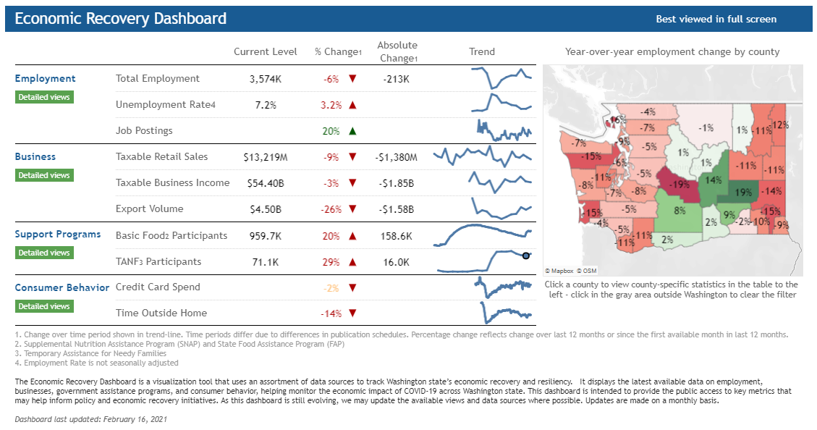
Economic Outlook
www.commerce.wa.gov/datadashboard

Slide 10
Public Health Outlook
https://www.doh.wa.gov/Emergencies/COVID19/DataDashboard

Slide 11
Gov. Inslee “Roadmap to Recovery”
Announced Jan. 11, replacing four-phase Safe Start reopening plan
New phases and metrics for reopening
Phases advance by Region
Metrics:
Trend in 14-day rate of new COVID-19 cases per 100,000 population;
Trend in 14-day rate of new COVID-19 hospital admissions per 100,000 population;
Average 7-day percent occupancy of ICU staffed beds; and
7-day percent positive of COVID-19 tests.

Slide 12
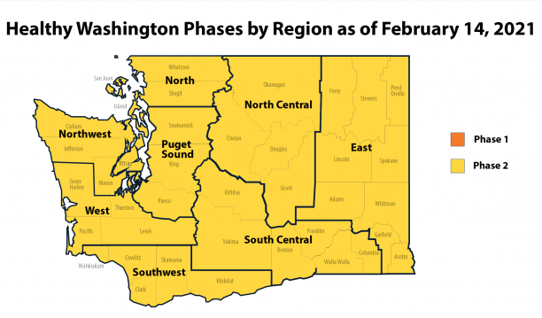
Source: WA State Dept. of Health
Notes:
Will need to update Tuesday

Slide 13
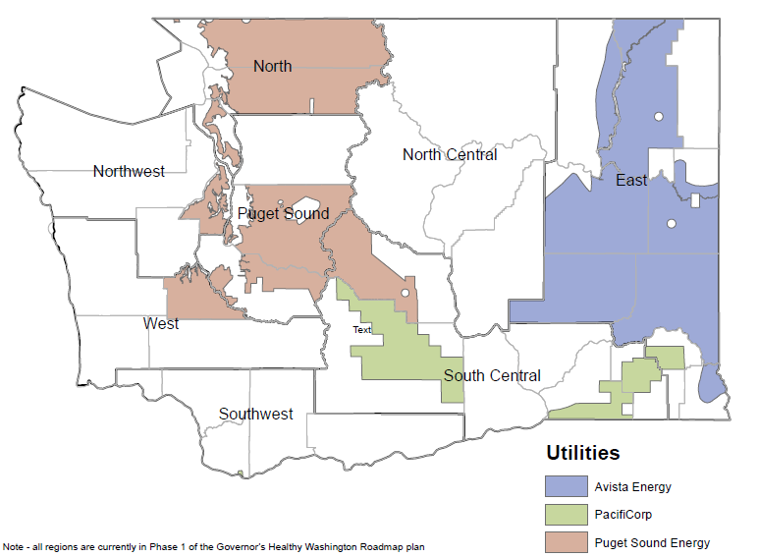
Regions vs. Service Territory - Electric

Slide 14
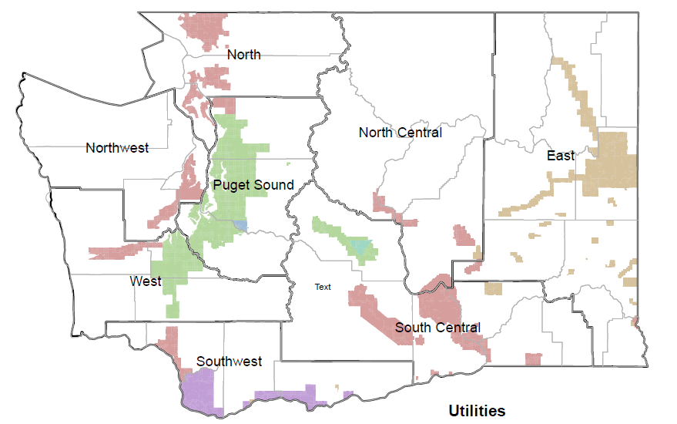
Regions vs. Service Territory - Gas

Slide 15
Customer Outlook

Slide 16
Total Electric and Gas IOU Customers with Past-Due Balances

Slide 17
Total Electric and Gas IOU Arrearages

Slide 18
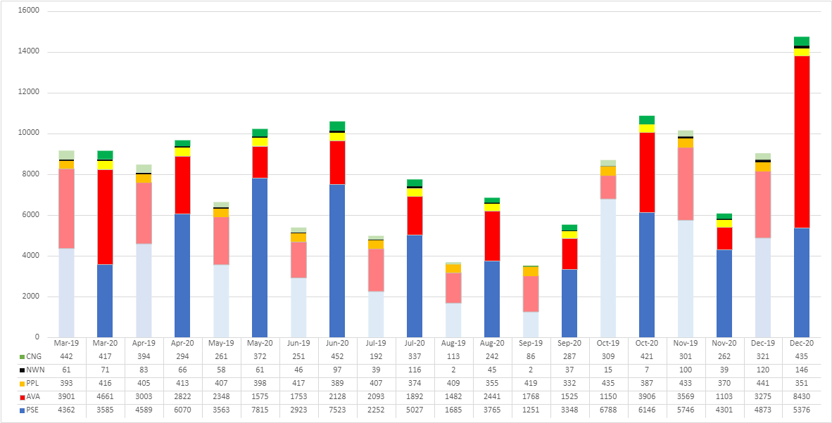
Low-Income Assistance

Slide 19
Recommendation

Slide 20
Adopt 2nd Revised Term Sheet
Extend disconnection moratorium until July 31, 2021
Hold Open Meeting in May to review Utilities' customer readiness and low-income program implementation
Utilities send notice of disconnection resumptions in June

Slide 21
Utilities Workgroup Comments

Slide 22
Advocates Workgroup Comments

Slide 23
Commissioner Discussion

Slide 24
The meeting has concluded

