Slide 1
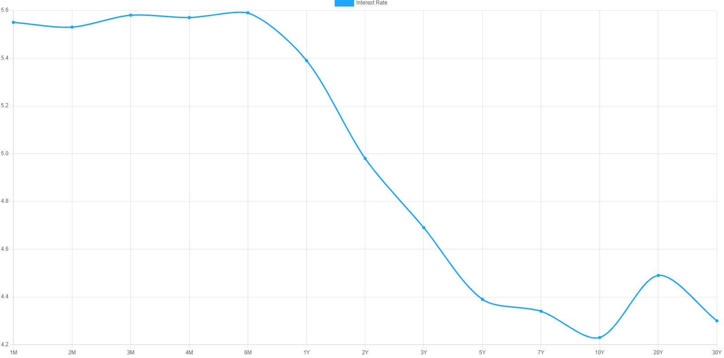
5.55%
4.50%
4.15%
4.29%

