Slide 1
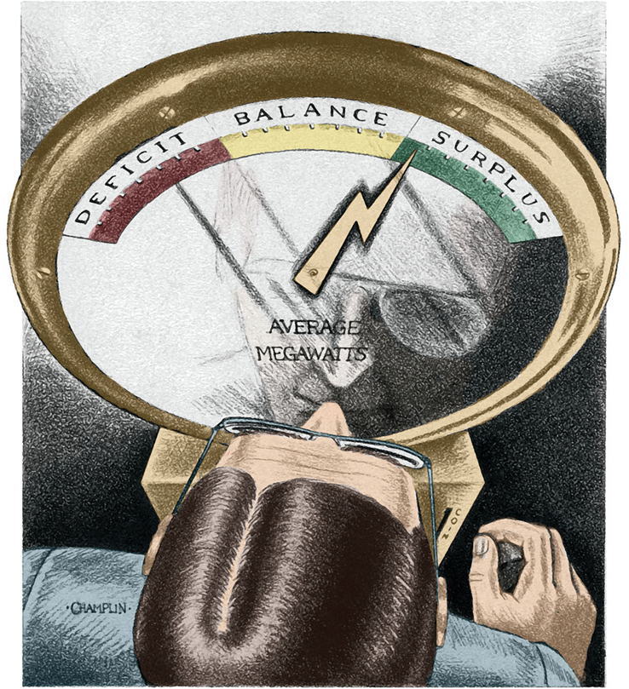
Preliminary Pacific NW Resource Adequacy Assessment
ANNUAL RESOURCE ADEQUACY MEETING
Utilities and Transportation Commission &
Department of Commerce
May 11, 2021
John Fazio
NW Power and Conservation Council

Slide 2
Adequacy Standard and the Power Plan
Adequacy assessment as an early warning The Council annually assesses the adequacy of the power supply over the next 3 to 5 years to gauge whether new resources and/or demand-side measures are needed and whether utility plans address those needs.
Incorporating adequacy into the power plan The amount of required surplus generating capability above expected load (based on the 5% LOLP standard) is used as a minimum threshold to develop the power plan’s resource strategy.

Slide 3
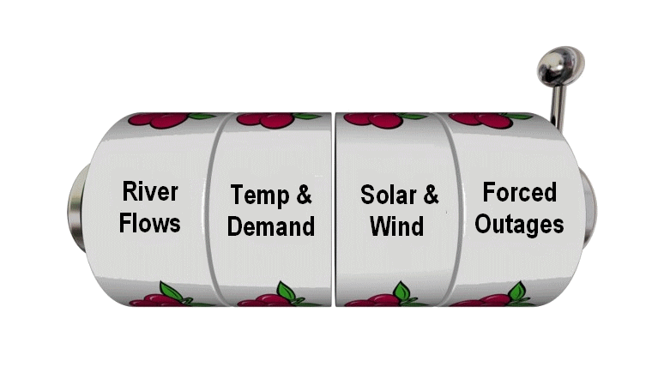
Assessing Resource Adequacy
Simulate the power supply’s operation
Chronological hourly simulation of all resources for one year
Run many simulations with different future conditions
Record all hours when load is not served
Calculate the probability of load not being served
Count number of years with at least one shortfall
Annual LOLP is the probability a future year will have at least one shortfall
LOLP = Number of years with a shortfall Number of simulations
Set a limit on the probability of not serving load
Council’s adequacy standard limits LOLP to 5 percent
Power supply is adequate if the likelihood of one or more shortfalls in a year is less than or equal to 5 percent

Slide 4
LOLP is not the probability of a blackout
Resource | Description
Generating Resources | Resources dedicated to serving PNW load, whether inside or outside the region
Conservation Programs | Cost effective energy efficiency measures, appliance and housing codes and standards
Market Supplies | In-region and out-of-region wholesale short-term market supplies
Standby Resources | Small (usually expensive) generators or demand buy-back agreements
Emergency Actions 1 | More expensive non-declared resources or demand cut-back provisions
Emergency Actions 2 | Utility or governor’s calls for energy conservation
Emergency Actions 3 | Rolling black outs or brown outs
Modeled in GENESYS
LOLP =
Likelihood of taking emergency actions, not necessarily curtailment
Not Modeled

Slide 5
Why is the adequacy assessment different now?
Climate change
Forward looking temperature and river flow projections instead of historical
Better representation of expected future conditions
Captures seasonal shifts in load and hydro generation, which affect adequacy
WECC-wide resource buildout
State clean air laws and policies are driving high acquisition of renewable resources
Increases market supply with daily periods of inexpensive energy
Affects PNW resource dispatch and can reduce future resource need for adequacy
New (and improved) adequacy model
17 BA areas, WECC resources & loads, unit commitment, fuel accounting, dynamic reserves
Individual hydro project hourly simulation, more accurate representation of flexibility
Dynamic representation market supply and price

Slide 6
Announced Coal Plant Retirements by 2025
Cumulative MW of Retired Nameplate Capacity
Coal Plant Retirement Schedule
Coal Plant | Capacity (MW) | Retire Date (EOY) | Total MW Retired
N Valmy 1 | 127 | 2021 | 127
Bridger 1 | 530 | 2023 | 657
N Valmy 2 | 134 | 2025
Centralia 2 | 670 | 2025 | 1461
Bridger 2 | 530 | 2028 | 1991
Total | 1,991 |  | 1,991

Slide 7
Preliminary Resource Adequacy Assessment
Annual LOLP (percent) | 2023 | 2025
Redeveloped GENESYS (includes no new EE in 2023 and 400 aMW of EE in 2025) | 16.1% | 1.7%
Estimated firm capacity needed for adequacy | 1600 MW
With additional reserves (but no new resources) | 9.0%
Key Findings
The existing power supply is not adequate
Utilities are aware of the imminent risk and are planning accordingly

Slide 8
Preliminary Resource Adequacy Assessment
Annual LOLP (percent) | 2023 | 2025
Redeveloped GENESYS (includes no new EE in 2023 and 400 aMW of EE in 2025) | 16.1% | 1.7%
Estimated firm capacity needed for adequacy | 1600 MW
With additional reserves (but no new resources) | 9.0%
Key Findings
The existing power supply is not adequate
Utilities are aware of the imminent risk and are planning accordingly
Region may need as much as 1,600 MW of capacity by 2023 (winter need)

Slide 9
Preliminary Resource Adequacy Assessment
Annual LOLP (percent) | 2023 | 2025
Redeveloped GENESYS (includes no new EE in 2023 and 400 aMW of EE in 2025) | 16.1% | 1.7%
Estimated firm capacity needed for adequacy | 1600 MW
With additional reserves (but no new resources) | 9.0%
Key Findings
The existing power supply is not adequate
Utilities are aware of the imminent risk and are planning accordingly
Region may need as much as 1,600 MW of capacity by 2023 (winter need)
Increasing balancing reserves in 2023 may be a cost-effective way to temporarily reduce the need for additional resources
Need drops off significantly by 2025 primarily because expected increases in market prices result in a greater number of thermal unit commitments

Slide 10
RA Advisory Committee Questions/Comments
The needed capacity for adequacy seems low relative to the capacity lost from expected coal plant retirements.
Can adequacy be maintained without conventional thermal resources?
How much can reutilization of thermal resources really help (e.g., increasing balancing reserves and unit commitment)?
Is the flexibility of the hydro system being overestimated, and are non-power hydro constraints being met?
Why are the classic and redeveloped GENESYS model LOLP results so different?

Slide 11
1. Resource need vs. Retired Capacity
Retired capacity (2019-25) is 2,276 MW yet resource need is only 1,600 MW.
Power supply was adequate in 2019 (i.e., LOLP < 5%) and thus had surplus capability that would lessen the amount of needed resource.
Expected increase in the WECC-wide market supply can help. Even though hourly imports are capped, imports can occur over more hours.
Better utilization of hydro storage (within operating constraints) can defer new resource acquisition.
Better utilization of thermal resources (e.g., unit commitment and increasing reserves) can also defer new resources.

Slide 12
2. Are conventional thermal resources needed
Concern that acquiring only renewable resources will lead to problems since they cannot be dispatched
Increasing market supply and better utilization of existing resources can lessen the amount of needed resource.
Acquiring renewable resources will increase the need for additional balancing reserves but analysis shows that (at least for now) the existing system has sufficient flexibility to cover the increased risk.
It’s unlikely that the power plan will only include renewable resources.
Retirements are scheduled over a long period (16 years), which should provide sufficient time for better storage technologies to be developed.

Slide 13
3. Thermal Resource Utilization
Can reutilization of existing thermal plants defer some of the need for new resources
Thermal plants are generally not committed for dispatch unless prices are sufficiently high. If they aren’t committed, they cannot help during shortfall events.
As market prices rise, more units are likely to be committed, which should improve adequacy (as seen in 2025).
Requiring higher balancing reserves forces more thermal resources to commit and allows them to be available during shortfall events.
However, increasing reserve requirements comes at a cost because resources may then operate “out of the money” for long periods of time.
The CAISO “flexiramp” product was proposed to address similar issues
http://www.caiso.com/Documents/MSCOpiniononMarketEnhancementsfor2021SummerReadiness-Mar8_2021.pdf

Slide 14
4. Hydroelectric System Flexibility
Is the model overestimating the flexibility of the hydro system and are non-power constraints being met?
GENESYS simulates the hourly operation of individual hydro projects and implements monthly and hourly operating constraints provided hydro owners.
Fine tuning the parameters to achieve a realistic hourly operation has been difficult and required extensive review by stakeholders. While not perfect, the current simulation has generally met with stakeholder approval.
GENESYS does its best to meet all operating constraints, but it should be noted that in real life, not all constraints can be satisfied simultaneously.
Because the redeveloped GENESYS dynamically assesses the value of water based on a forecast of future conditions, it utilizes reservoir storage more effectively than the classic GENESYS.

Slide 15
5. Redeveloped vs. Classic GENESYS
Annual LOLP (percent) | 2023 | 2025
Redeveloped GENESYS (baseline WECC buildout, 0 EE 2023, 400 aMW 2025) | 16.1% | 1.7%
Classic GENESYS (200 aMW EE 2023, 400 aMW 2025) | 15.7% | 22.6%
Comparing LOLPs directly doesn’t provide much insight due to different model complexities:
New GENESYS models 17 BA areas in the PNW Classic GENESYS models 2 areas
Simulates individual hydro plants hourly Simulates aggregate hydro hourly
Unit commitment No unit commitment
Dynamic market assessment and pricing Fixed market size and price
Dynamic allocation of all reserves Fixed hydro reserves only
Dynamic assessment of the value of water Fixed value of water in reservoirs
In 2025, the classic GENESYS shows a higher LOLP primarily due to limited hours of import and less optimal utilization of hydro storage. Increasing hours of import to match those in the new model and extended use of hydro storage reduce the classic model LOLP to 1.2%.

Slide 16
5. Redeveloped vs. Classic GENESYS
Firm Capacity Needed for Adequacy (MW) | 2023 | 2025
Redeveloped GENESYS resource need | 1,600 | 0
Classic GENESYS resource need | 1,250 | 850
Because the effect on LOLP of adding an increment of new capacity differs between models (due to differences in complexity) a comparison of resource need is better.
Resource need is firm capacity need and is not the same as nameplate capacity.
Effective load carrying capacity must be used to properly size new resource additions.

Slide 17
Preliminary Adequacy Assessment Summary
These results are preliminary and are still under review by the Council and its advisory committees.
By 2023, the PNW power supply will no longer meet the Council’s adequacy standard and will need an estimated 1,600 MW of added firm capacity (or some combination of firm capacity and increased reserves) to maintain adequacy.
After 2023, and despite additional coal plant retirements, adequacy can be maintained with minimal capacity additions because of the expected high level of WECC-wide resource buildout and the opportunity to better utilize the PNW hydro system and thermal resource fleet.
While these findings are robust across many scenarios, the inherent uncertainty in the projected WECC buildout and the likelihood of accelerated loads due to electrification programs could significantly increase the probability of shortfalls. To offset this risk, it may be appropriate to include additional resource and demand-side actions to the power plan’s resource strategy.

