Slide 1
Recessed Open Meeting
Attachment 4
Response to COVID-19 Pandemic, Docket U-200281
May 12, 2021

Slide 2
Agenda
9:30 Call to Order
9:35 Overview of Agenda and Instructions for Participation
9:40 Opening Commissioner Remarks
9:45 Public Comments (3 minutes per speaker)
10:45 Break
11:00 Commission Staff Comments
11:15 COVID-19 Utilities' Comments
11:30 COVID-19 Advocates' Comments
11:45 Commissioner Questions and Discussion
Noon Adjourn

Slide 3
Participant Instructions
Please mute your computer microphone or phone (Press *6 to mute/unmute)
Wait to be called on for comment and do not interrupt other speakers
Only use video during the time you are directly addressing the commission (video is not required for participants)
The “Chat” feature should only be used to report technical difficulties
Language Access: www.utc.wa.gov/translate
Contact information for technical difficulties (2 options)
Use the chat feature in Teams
Call Ryan Smith at (360) 915-3646

Slide 4
Commissioner Opening Remarks

Slide 5
Public Comments 3 minutes per person

Slide 6
Break

Slide 7
Commission Staff Comments

Slide 8
Economic and Public Health Outlook

Slide 9
Economic Outlook
www.commerce.wa.gov/datadashboard

Slide 10
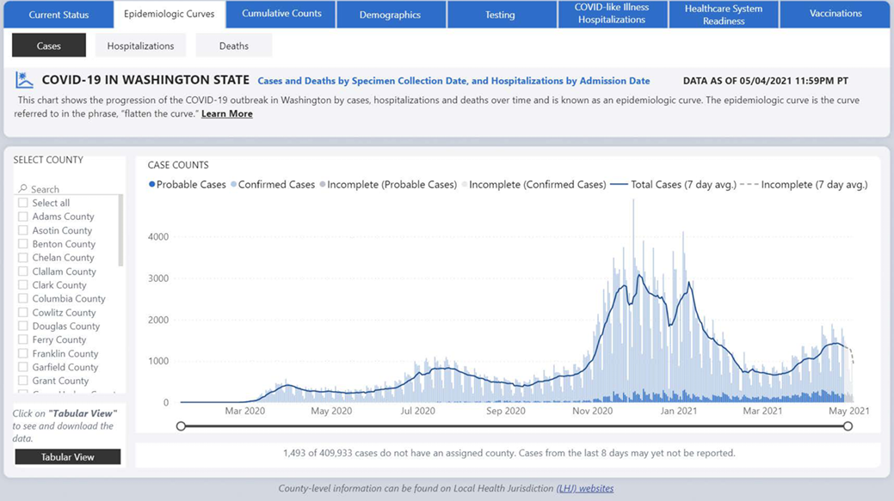
Public Health Outlook
https://www.doh.wa.gov/Emergencies/COVID19/DataDashboard

Slide 11
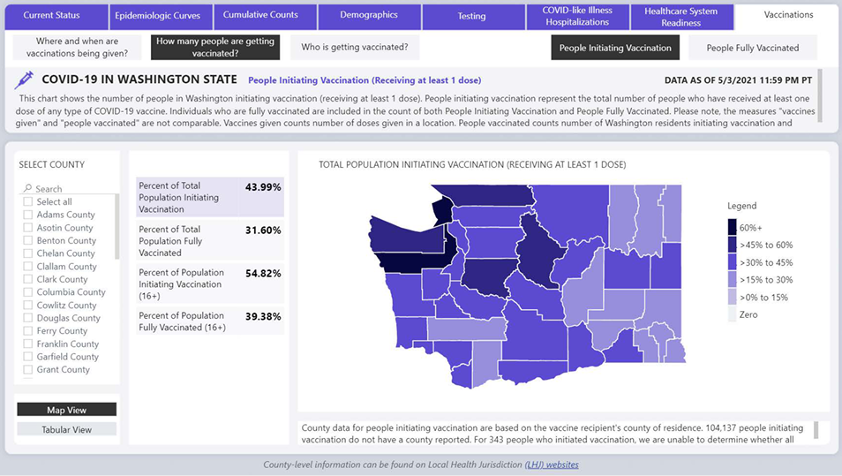
Vaccination Outlook

Slide 12
Customer Outlook

Slide 13
Customer Assistance Program Funding
Total funding:
$104 million

Slide 14
IOU Arrearage Amounts (Dollars)
March 2021 total arrearage amount: $79.3 Million

Slide 15
Total Customers with Overdue Balances

Slide 16
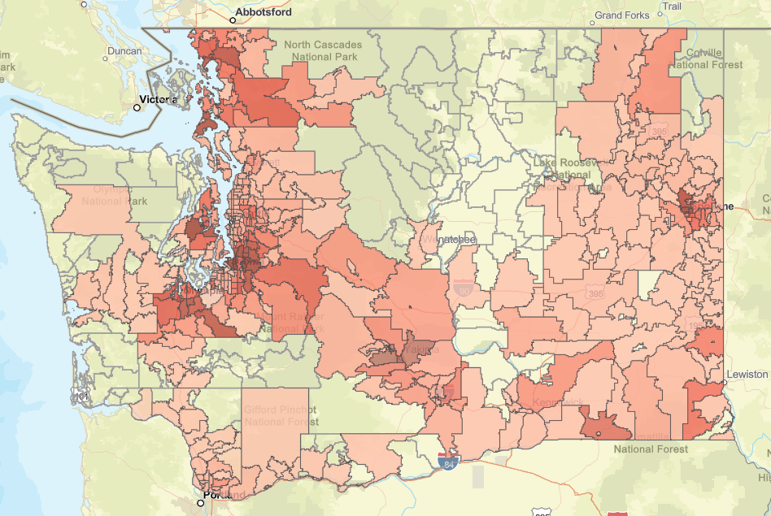
Arrearages by Zip Code
Attachment 4
Access Interactive Map
www.utc.wa.gov/COVID19

Slide 17
Equity and Communications

Slide 18
April 7 Workshop
Low-Income Bill Assistance
Equitable fund distribution
Reaching underserved and vulnerable communities
Removing barriers to customer engagement
Process improvements for financial assistance applications
Communications and Accessibility
Draft notice language – “non-confrontation and non-threatening”
Language access strategies
Inclusive and accessible communications and technology

Slide 19
Customer Engagement Best Practices
Utilize people-first, gender neutral language
Communicate in customer’s preferred language
Leverage community partnerships with local NGOs, Tribal governments, faith-based organizations
Technology should be digitally accessible

Slide 20
Recommendation

Slide 21
Adopt 3rd Revised Term Sheet
Disconnection moratorium ends July 31, 2021
Enhanced data reporting required
Send notice of resumption of disconnection in June

Slide 22
Utilities' Comments

Slide 23
Advocates' Comments

Slide 24
Commissioner Discussion

Slide 25
The meeting has concluded

